Slide 1
In a country well governed, poverty is something to be ashamed of. In a country badly governed, wealth is something to be ashamed of.
-Confucius

Slide 2
Period of Warring States (475-221 BCE)
After the collapse of the 1000-year Zhou Dynasty, several new philosophies arose in response to the need for stronger governance:
Confucianism
Daoism
Legalism

Slide 3
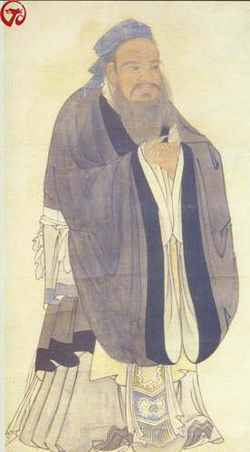
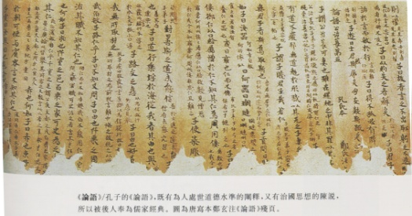
Confucius’ search for order
Confucius (551-479 B.C.E.)
A strong-willed man from an aristocratic family
Traveled for ten years searching (unsuccessfully) for an official post
Educator with numerous disciples
Sayings compiled in the Analects by disciples

Slide 4
Sayings…
I hear and I forget. I see and I remember. I do and I understand.
Everything has beauty, but not everyone sees it.
In a country well governed, poverty is something to be ashamed of. In a country badly governed, wealth is something to be ashamed of.
It does not matter how slowly you go so long as you do not stop.

Slide 5
Confucian ideas
Goal: To create moral rulers to bring order and stability to China
Kings as leaders, scholars, moral ideal for all.
Stressed ritual (predictable order!)
Formation of highly educated junzi class ("superior individuals”) to rule
Very much like Plato’s “philosopher-kings”
Acted on behalf of greater good
High ethical standards
Able to deliver wise and fair judgements

Slide 6
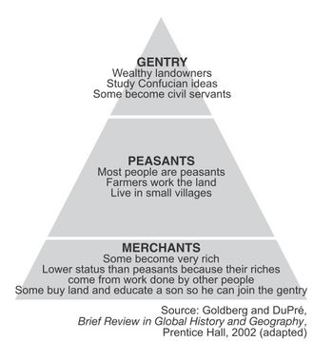
Key Confucian ideas
Ren - a sense of humanity; kind, courteous, respectful, loyal
Li - a sense of propriety
Behavior expectations change with situation
Relationships dominate: ruler to subject, father to son, husband to wife, elder to younger, and friend to friend, etc.
Xiao - filial piety
Preserves family and ancestral integrity
Confucian ideas adaptable and interpretive due to generalized ideas – no specific rules!

Slide 7
Song Dynasty (960-1279 CE)
Emphasis on administration, industry, education, the arts
Military not emphasized!
Direction of first emperor, Song Taizu (r. 960-976 CE)
Former military leader made emperor by troops
Instituted policy of imperial favor for civil servants, expanded meritocracy

Slide 8
Song Weaknesses
Civil service exam creates meritocracy, but not as difficult to pass as Tang dynasty
Increasing size of bureaucracy heavy drain on economy
Two peasant rebellions in 12th c.
Internal inertia prevents reform of bureaucracy
Civil service leadership lacked military training
Scholar-gentry sign of high social status
Unable to contain nomadic attacks
Capital moved to prevent attacks

Slide 9
India – Origins of Hinduism
Dravidians, darker-skinned sedentary inhabitants living in India
Aryans, lighter-skinned invaders from the north settle in northern India
Color bias leads to socio-economic implications (varna)
Conquered or not? No evidence of large-scale military conquest.

Slide 10
Varna: The Caste System
Origins of social order through Aryan belief in varna
Brahmin - Priest
Kshatriya - Warrior
Vaishya - Merchant
Sudra - Commoner
Harijan - “Untouchables; Pariahs” later, “Dalit”
Jati - system of sub-castes
Related to urbanization, increasing social and economic complexity

Slide 11
The Early Aryans
Sacred text: The Vedas (“wisdom/knowledge”)
Written in Sanskrit “sacred tongue”
hymns to gods
most important, Rig Veda, details conflicts between Dravidians and Aryans
Explains role of priests
Pastoral economy: sheep, goats, horses, cattle
Vegetarianism not widespread until many centuries late
Religious ideas will lead to development of Hinduism

Slide 12
Sacred texts: Upanishads
Upanishads reflect blending of Aryan and Dravidian traditions
Brahman: the Universal Soul
Samsara: reincarnation
Karma: accounting for incarnations
Dharma: duty
Moksha: mystical ecstasy

Slide 13
Early Buddhism
Siddhartha Gautama, c. 563-483 BCE
Prince born in Kshariya caste in India
Encountered age, sickness, death, then monastic life after leaving home
Abandoned comfortable life to become a monk

Slide 14
Gautama’s Search for Enlightenment
Intense meditation, extreme asceticism
49 days of meditation under bodhi tree to finally achieve enlightenment (nirvana)
Attained title Buddha: “the enlightened one”

Slide 15
The Buddha and his Followers
Begins teaching new doctrine (Buddhism) c. 528 BCE
Followers owned only robes & food bowls
Life of wandering, begging, meditation
Establishment of monastic communities

Slide 16
Buddhist Doctrine: The Dharma
The Four Noble Truths
all life is suffering
there is an end to suffering
removing desire removes suffering
this may be done through the Eight-fold Path
(right: views, intention, speech, action, livelihood, effort, mindfulness, concentration)

Slide 17
Appeal of Buddhism
Less dependence on Brahmins for ritual activities
No recognition of caste or jati status
Philosophy of moderate consumption, not extremes
Public service through lay teaching (teaching commoners)
Use of vernacular, not Sanskrit
Monasteries became important institutions in Indian society.

Slide 18
Buddhism in China
Attraction: high moral standards, intellectual sophistication, and promise of salvation
Monasteries became large landowners, helped the poor and needy
Posed a challenge to Chinese Confucian traditions!

Slide 19
Changes in Buddhist thought
Between the 3rd and 1st centuries CE…
Buddha considered divine
Institution of Boddhisatvas (“saints”) added
Charitable donations to monasteries regarded as pious activity

Slide 20
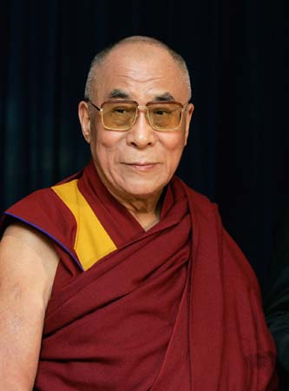
Spread of Buddhism
Theravada Buddhism (“lesser vehicle”), earlier, more conservative version
Ceylon, Burma, Thailand
Mahayana Buddhism (“greater vehicle”), newer development
India, China, Japan, Korea, central Asia
Tibetan Buddhism branches off – syncretic combination of Mahayana Buddhism and indigenous Tibetan beliefs.
Dalai Lama as leader

Slide 21
Daoism
"Rabbit's clever," said Pooh thoughtfully.
"Yes," said Piglet, "Rabbit's clever."
"And he has Brain."
"Yes," said Piglet, "Rabbit has Brain."
There was a long silence.
"I suppose," said Pooh, "that that's why he never understands anything.”
― Benjamin Hoff, The Tao of Pooh

Slide 22
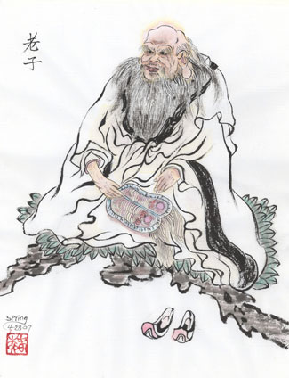
Critical reaction: Daoism
Confucian focus on social activism impossible to attain
Daoism promotes philosophical reflection and introspection
Understand natural principles, live in harmony with them
Retreat from political world
Live simply as possible.
Laozi (founder) wrote the Daodejing

Slide 23
Philosophical (original) Daoism
Dao - The way of nature, the way of the cosmos
Opposites in balance; complementary
An eternal principle governing all workings of the world: Passive, yielding, does nothing, accomplishes everything
Tailor behavior to passive, yielding nature of dao
Ambition, activism brought the world to chaos
Return to natural existence to achieve balance

Slide 24
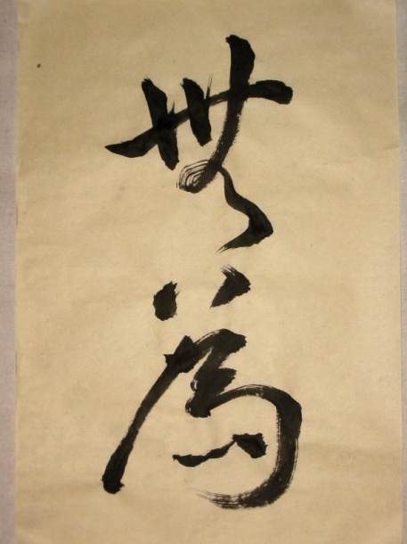
Doctrine of Wuwei
Disengagement from worldly affairs
Called for simple, unpretentious life
Live in harmony with nature
Advocated small state and self-sufficient community
Political implications:
Served as a counterbalance to Confucian activism
Flourishes when society at peace, prosperous

Slide 25
Neo-Confucianism (D+B+C)
Song dynasty refrains from persecuting Buddhists, but favors Confucians
Neo-Confucians influenced by Buddhist and Daoist thought
Reinforces relationships (expands patriarchy), search for internal meaning should positively impact society.
Zhu Xi (1130-1200), author of "the Four Books" and one of the founders of Neo-Confucianism

Slide 26
Remember “Li?” Filial piety (aka. patterns)
Neo-Confucians sought to uncover the “pattern” of all things
Believed all phenomena, including life, nature, destiny, and existence were essentially a “pattern” that could be understood if closely examined.
Human nature deeply examined
Ritual heavily stressed
Credited to the Song interest in all things “scientific,” minute, and even trivial — since even the smallest entity had the potential to reveal the underlying pattern of all things.
Daoism and Buddhism allow deeper understanding to Confucian knowledge.

Slide 27
Song Patriarchal Social Structures
Upper class women in Tang Dynasty enjoyed greater freedoms than most dynasties.
This does not extend to the Song Dynasty
Increased emphasis on ancestor worship
Elaborate grave rituals
Extended family gatherings in honor of deceased ancestors
Kowtow reinforces class and race distinction
Footbinding gains popularity
Increased control by male family members

Slide 28
