Slide 1
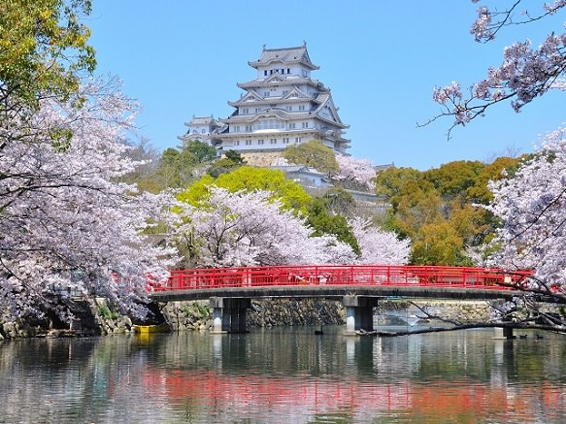
Sinification of E. Asia
Korea, Vietnam, and Japan
Himeji Castle, built in 1333

Slide 2
China and Korea
Tang Dynasty (618-907CE) armies conquered much of Korea; Silla dynasty organized resistance
Technically a vassal state, but highly independent
Tribute in gifts/rice exceeded by Chinese gifts and cultural contribution
Chinese influence pervasive!
The Silla kings built a new capital (at Kumsong) and modeled on Tang capital (Chang’an)
Korean elite turned to Neo-Confucianism; peasants turned to Chan Buddhism
Difference between Korea and China: Aristocracy and royal houses dominated Korea

Slide 3
China and Vietnam
Vietnamese adopt SOME Chinese culture, technology
However, ongoing resentment at political domination
Assert independence when Tang dynasty falls in 10th century
Differences between Vietnam and China:
Many Vietnamese retained their religious traditions
Women played more prominent roles in Vietnam than in China

Slide 4
China and Nara Japan (710–784 CE)
Chinese armies never invade Japan
Imitate Tang land and taxation policies (emperor owns all land!)
Imitate Tang administration and capital (Chang’an) at Nara.
Adoption of Confucian, Buddhist teachings
Yet retention of Shinto religion
Benevolent and malevolent spirits (kami) inhabit all things

Slide 5
Heian Japan (794-1185 CE)
Japan rejects collapsing Tang Dynasty.
Period of massive cultural awakening!
Japanese emperor moves court to Heian (modern Kyoto)
Emperor becomes figurehead, real power in hands of Fujiwara clan
Emperor is ceremonial figurehead and link to the divine – very respected!
Pattern in Japanese history: weak emperor with true power held by others “behind the throne”
Helps explain longevity of the institution (no Mandate of Heaven!)

Slide 6
Japanese Education
Zen Buddhism practiced
Classic curriculum dominated by Chinese
Formal education in Chinese
Court spoke Chinese
Government records in Chinese
Japanese script borrowed heavily from Chinese
Wealthy wrote poetry, literature.

Slide 7
Japanese Women
Wealthy lived lives of education and art
However, very regulated by ceremony.
Did not receive Chinese education – influential as preservers of Japanese culture!
Murasaki Shikibu wrote The Tale of Genji in Japanese
Heian Japan

Slide 8
Decline of Heian Japan
Nobles led elegant lives at capital
Aristocratic clans gain large landholdings due to corruption
Civil war between Taira and Minamoto clans in 12th century

Slide 9
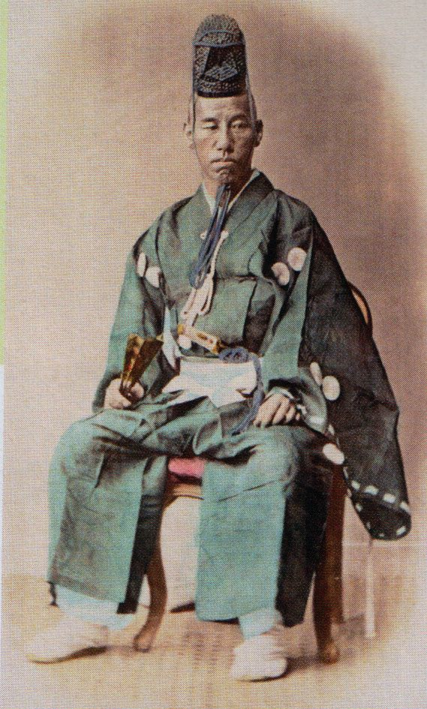
Establishment of Shogun
Minamoto leader named shogun, 1185 CE
Political leader of Japan
Emperor becomes religious figurehead only
Ruled from city of Kamakura; allowed imperial throne to continue in Kyoto

