Slide 1
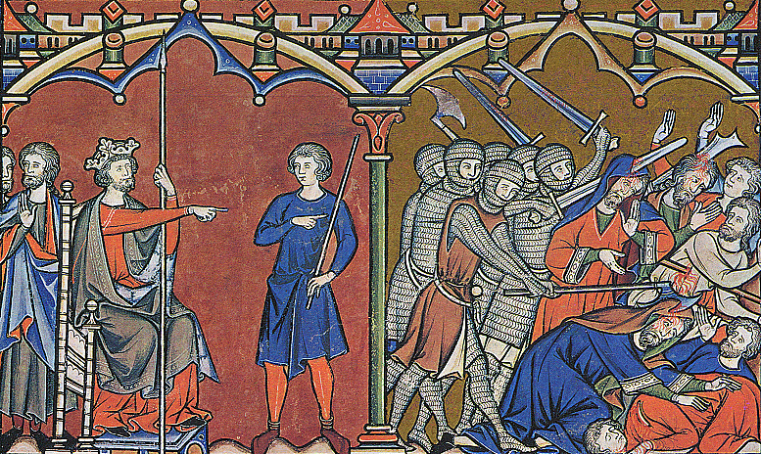
CRASH COURSE! Europe in the Middle Ages

Slide 2
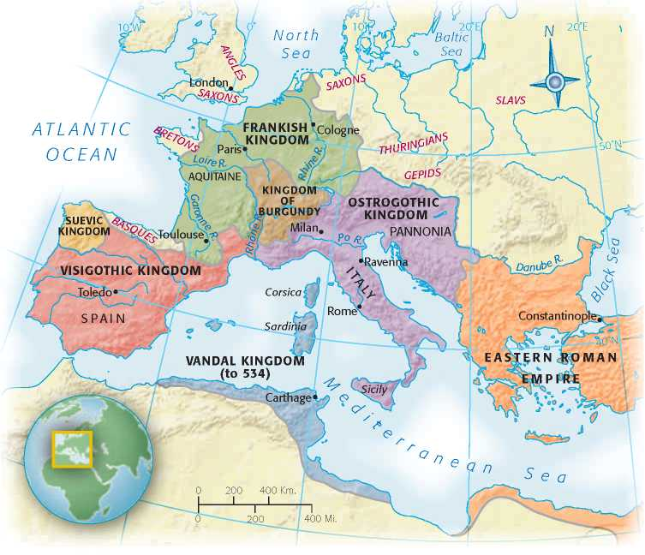
Fall of Rome, 476 CE
Last Roman emperor deposed by Germanic Odoacer, 476 CE
Administrative apparatus still in place, but cities lose population
Germanic successor states:
Spain: Visigoths
Italy: Ostrogoths
Gaul: Burgundians, Franks
Britain: Angles, Saxons

Slide 3
The Early Byzantine Empire
Byzantine Empire inherits Roman Empire after fall of Rome in 5th c. CE
Eastern territories remain major power until 13th c. CE

Slide 4
State Politics: Caesaropapism
“Caesar over Pope”
Power centralized in figure of Emperor
Byzantine leader cannot claim divinity, rather divine authority
Political rule, but involved in religious rule as well
Authority absolute

Slide 5
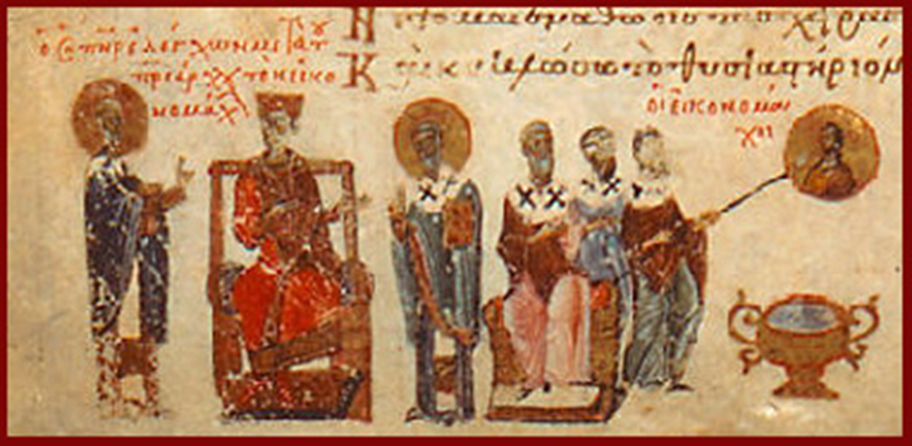
The Byzantine Church
By 6th C. Christianity is the dominant cultural community
Church and state closely aligned
Byzantine Emperors appoint Patriarchs

Slide 6
Challenges from the East
Muslim Seljuks invade Anatolia
Threatens grain supply
Defeat Byzantine army in 1071, creates civil conflict
Period of steady decline until Ottoman Turks capture Constantinople in 1453
Renamed Istanbul

Slide 7
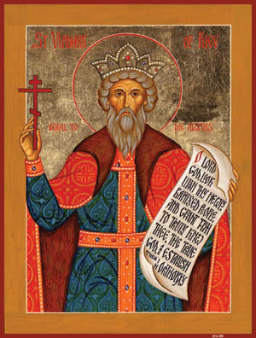
Kievan Rus’
Slavic language group
Conversion of Prince Vladimir, c. 1000CE
Byzantine culture influences development of Slavic cultures
Distinctively Slavic Orthodox church develops
Eventual heir to Byzantium

Slide 8
Kievan Rus Slave trade
Trade in fur, timber, honey, hides
Excess population = annual tribute of peasants
Exchanged for Byzantine luxury items

Slide 9
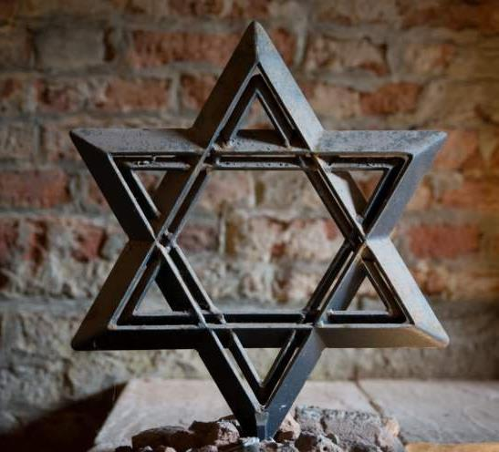
The Roots Of Christianity: Judaism
c. 1800 BCE

Slide 10
Monotheism EMERGES, Diaspora Begins
Hebrews shared polytheistic beliefs of other Mesopotamian civilizations
Abraham introduces monotheism, belief in single god, with Covenant between Hebrews and YHWH
The TaNaKh
Torah (“doctrine” or “teaching”)
Nevi'im ("Prophets")
Ketuvim ("Writings")

Slide 11
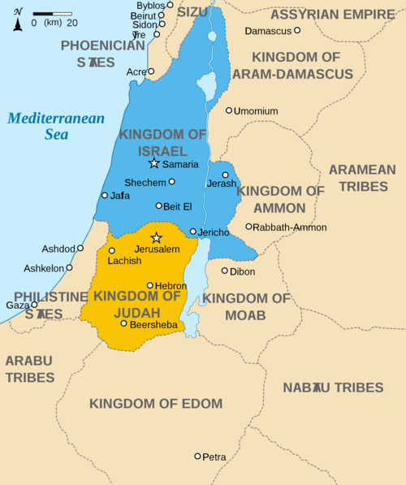
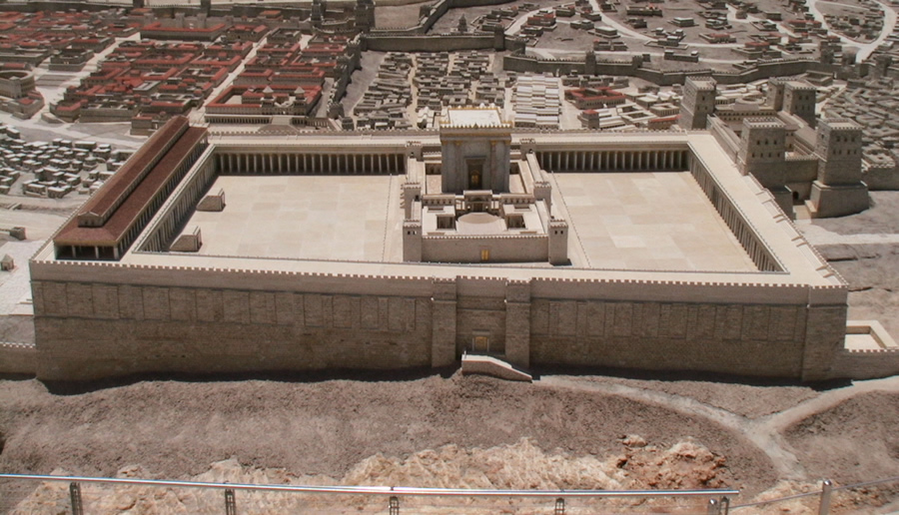
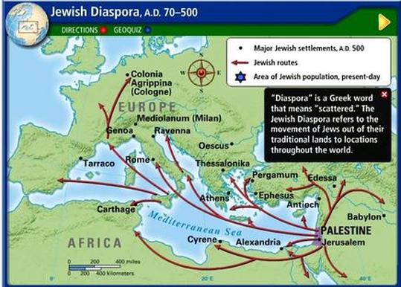
The Early Hebrews
Parallels between early biblical texts and Code of Hammurabi
Early settlement of Canaan (Israel), c. 1300 BCE
Slavery in Egypt, slavery in Babylon
Herod’s Temple constructed
Diaspora from Rome in 70 CE, temple destroyed

Slide 12
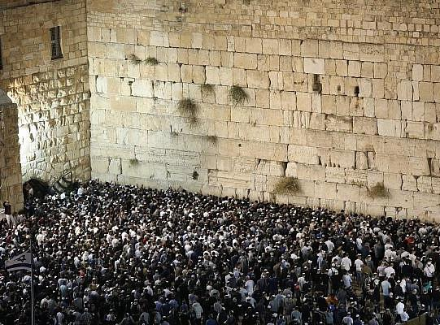
Messianic Age = Third Temple
Reconstruction of the Temple must be complete to usher in the Messianic Age
Jewish Messiah will lead followers into Kingdom of Peace

Slide 13
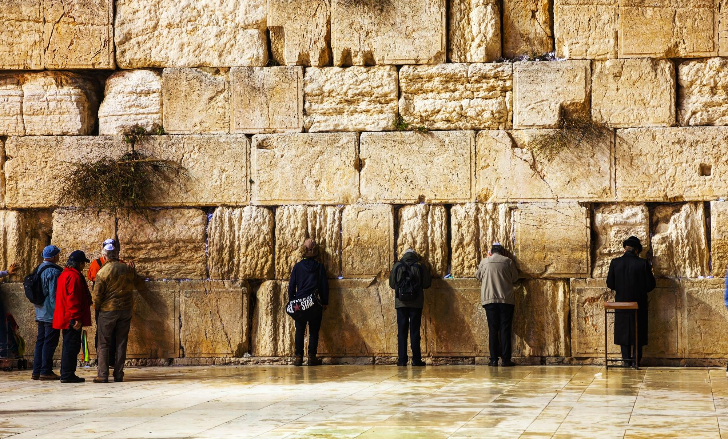

Slide 14
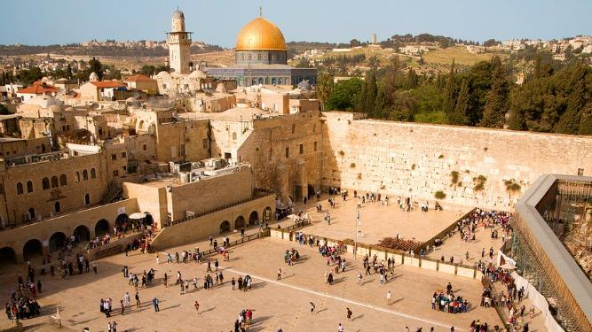

Slide 15
Other Jewish FAQ
Holy leader – rabbi
Place of worship – synagogue
Holiest day – Yom Kippur
“Day of Atonement,” 25-hour fasting
Rosh Hashana – Jewish New Year
2019 = 5780
Ceremonies - Bar mitzvah/ Bat mitzvah (“Coming of Age”)
Restrictions – Kosher foods

Slide 16
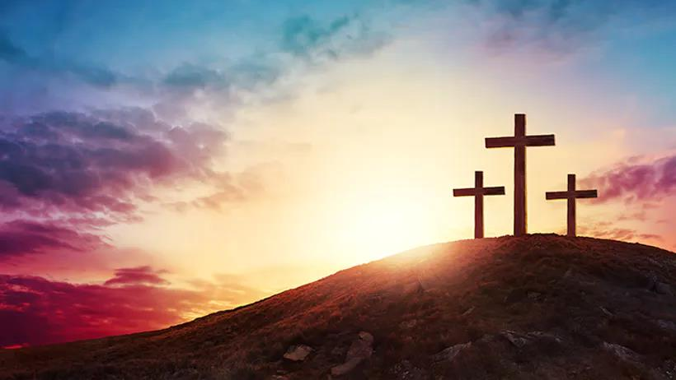
Origins of Christianity

Slide 17
Jesus of Nazareth
Jewish teacher, born c. 4 CE
Preached a moral code and a forgiving God
Reputation for miracle-working
Jews unhappy about changes in doctrine
Romans fear instigation of rebellion
Crucifixion c. 30 CE

Slide 18
Jesus’ Early Followers
Belief in Jesus’ resurrection and divine nature as son of God
Christ = “Anointed One”
Teachings recorded in New Testament
Old Testament + New Testament = Bible

Slide 19
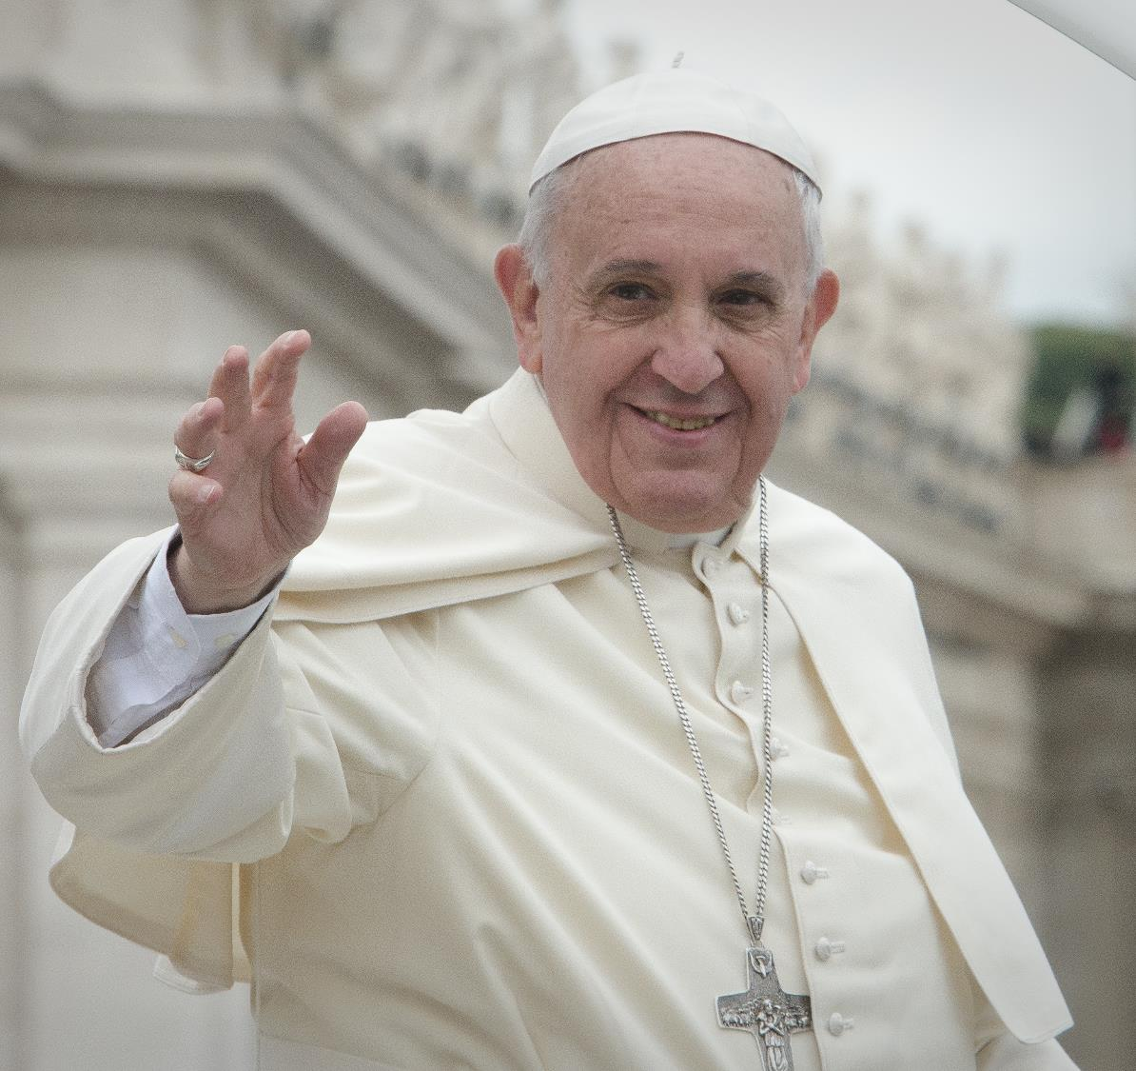
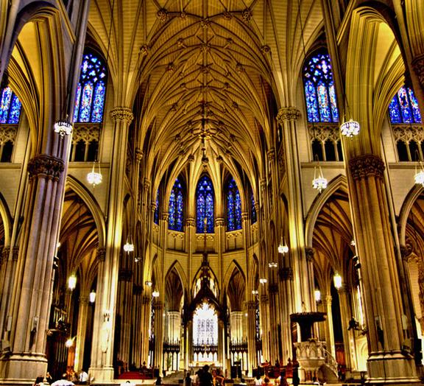
Basic Details
Head of RC Church = pope
Spiritual leader – priest
Place of worship – church / cathedral
Holiest day – Easter
Resurrection of Jesus
Christmas – birth of Jesus (moved to December by Constantine c. 336 CE)
Ceremonies – Baptism, Communion
Fear of excommunication

Slide 20
Growth of Early Christianity
Roman persecution until almost 3rd century (Constantine converts)
Yet dramatic expansion of Christianity
Especially with dispossessed, disenfranchised classes
Urban poor (“meek”)
Women
Monastic communities

Slide 21
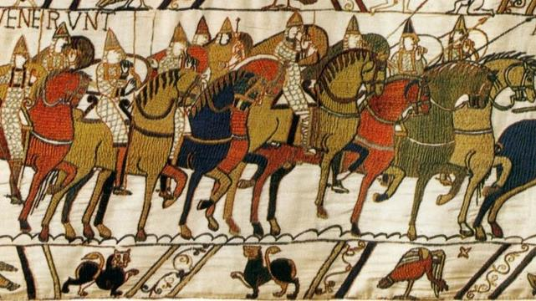
Back to Medieval Europe…

Slide 22
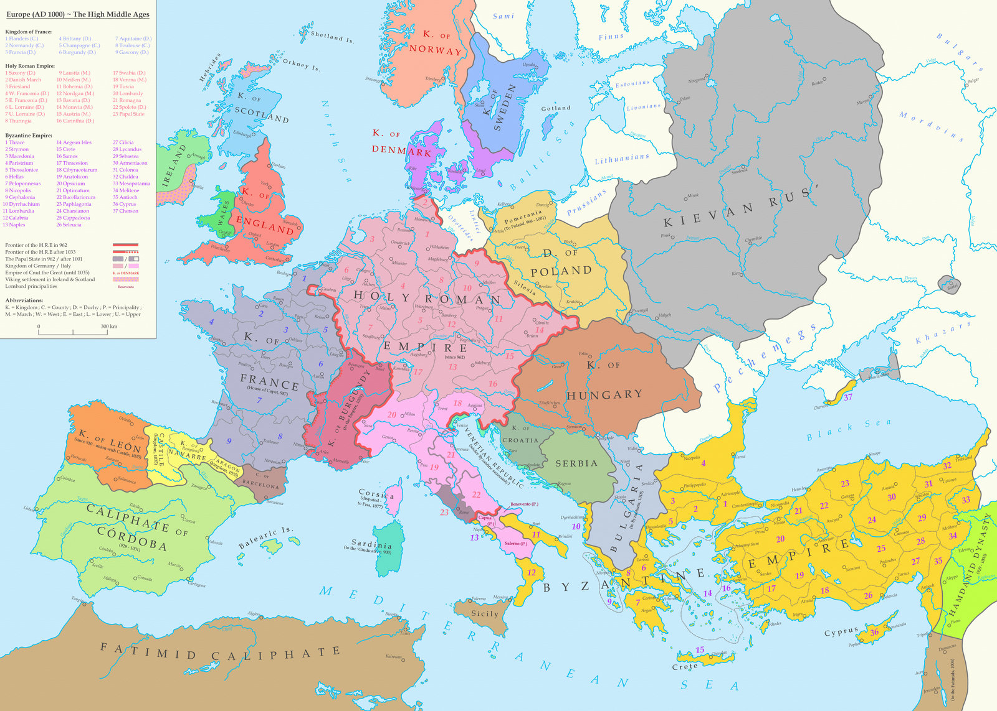

Slide 23
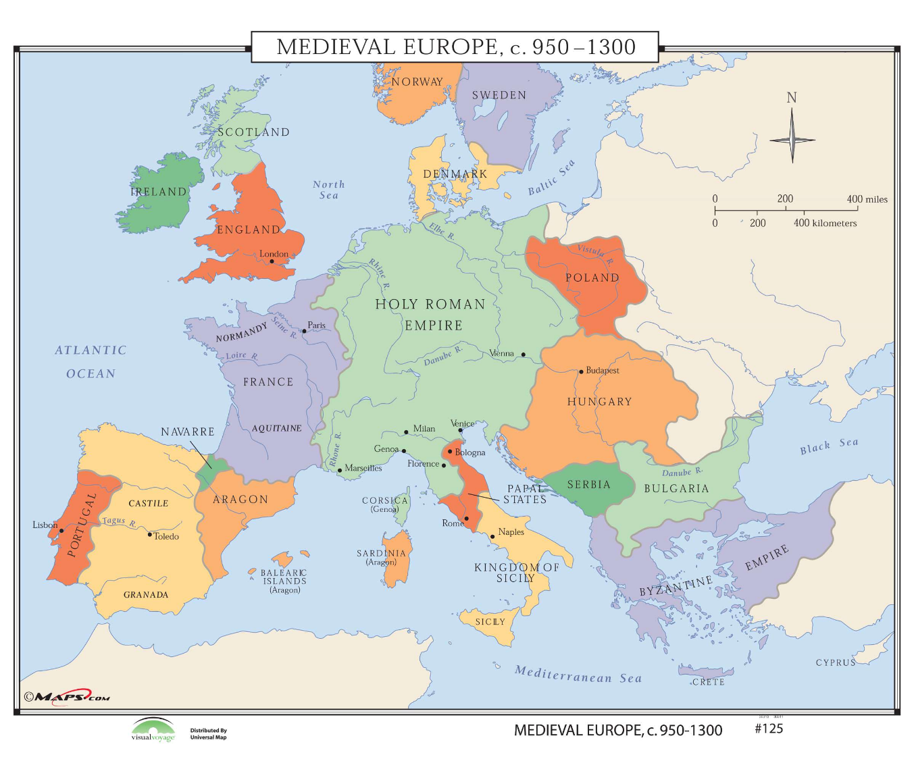

Slide 24
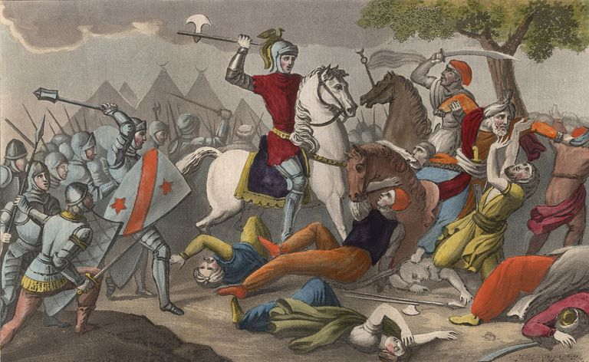
The Carolingians
Charles “The Hammer” Martel begins Carolingian dynasty
Defeats Spanish Muslims at Battle of Tours (732)
Halts Islamic advance into western Europe

Slide 25
Charlemagne (r. 768-814)
Grandson of Charles Martel
Centralized imperial rule
Functionally illiterate, but sponsored extensive scholarship
Major military achievements

Slide 26
Charlemagne as Emperor
Hesitated to challenge Byzantines by taking title “emperor”
Pope Leo III crowns him emperor in 800 anyway
Planned in advance by Church?
Definite challenge to Byzantium!

Slide 27
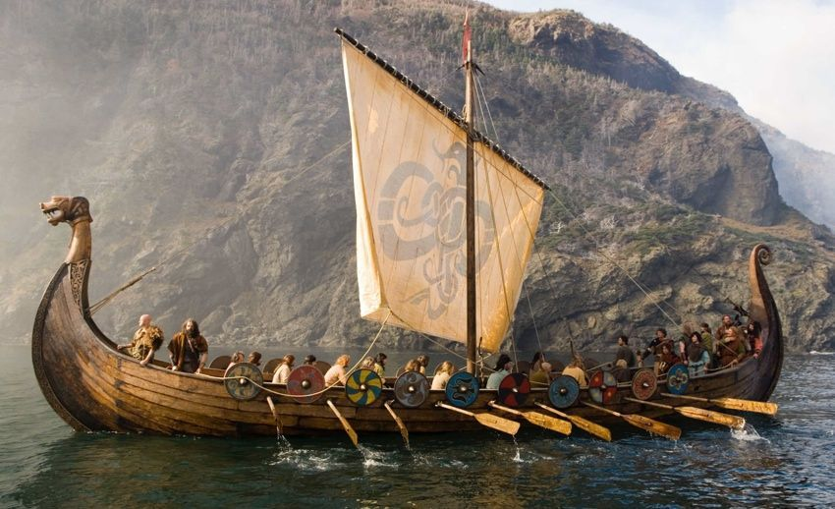
Chronic Invasions
From south: Muslims
From East: Magyars
From North: Vikings (Norse)
Driven by population pressure and warfare between kingdoms
Superior seafaring technology
Sailed to eastern Canada, northeastern US
The dissolution of the Carolingian Empire (843 CE) and the invasions of early medieval Europe in the ninth and tenth centuries

Slide 28
England
Viking invasions force consolidation of Angles, Saxons and other Germanic peoples under King Alfred (r. 871-899)
Built navy
Fortified cities against attack

Slide 29
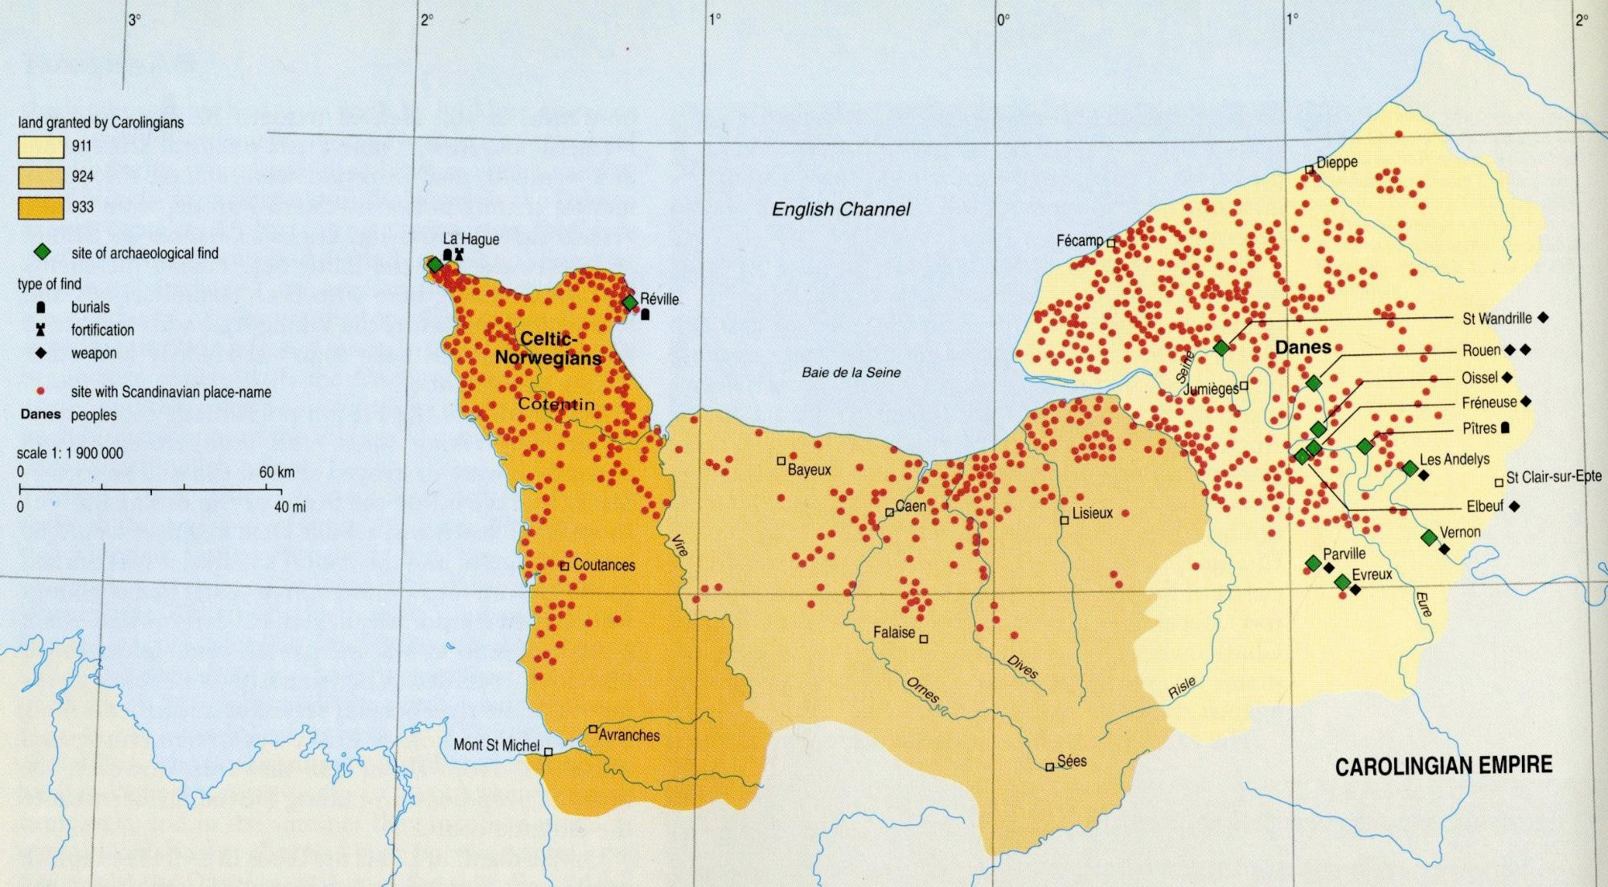

Slide 30
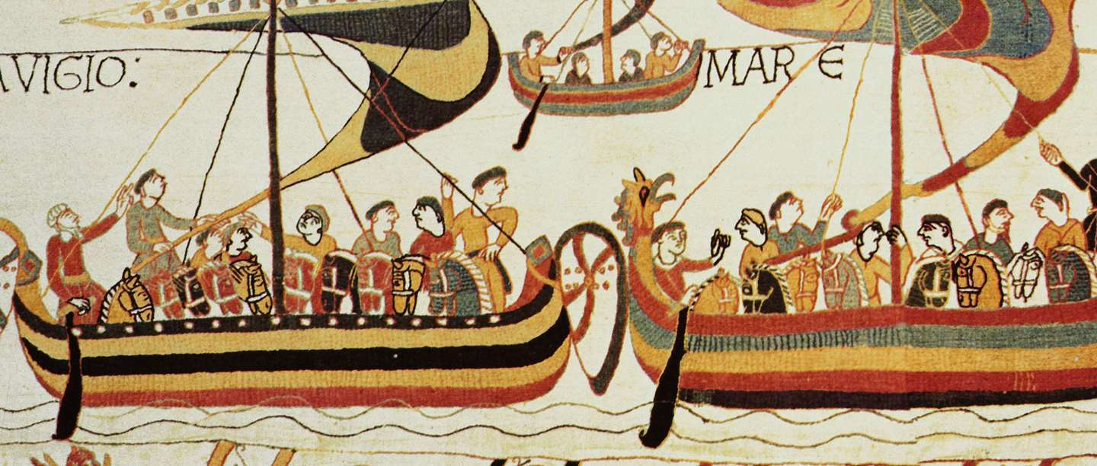
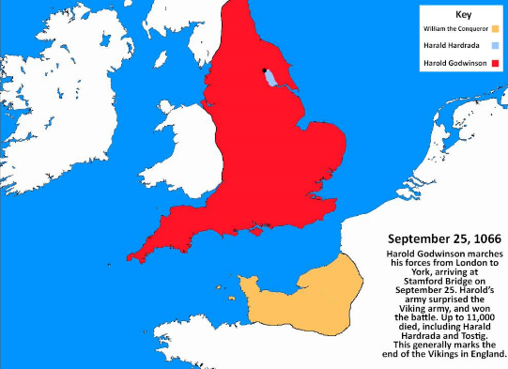
Battle of Hastings, 1066

Slide 31
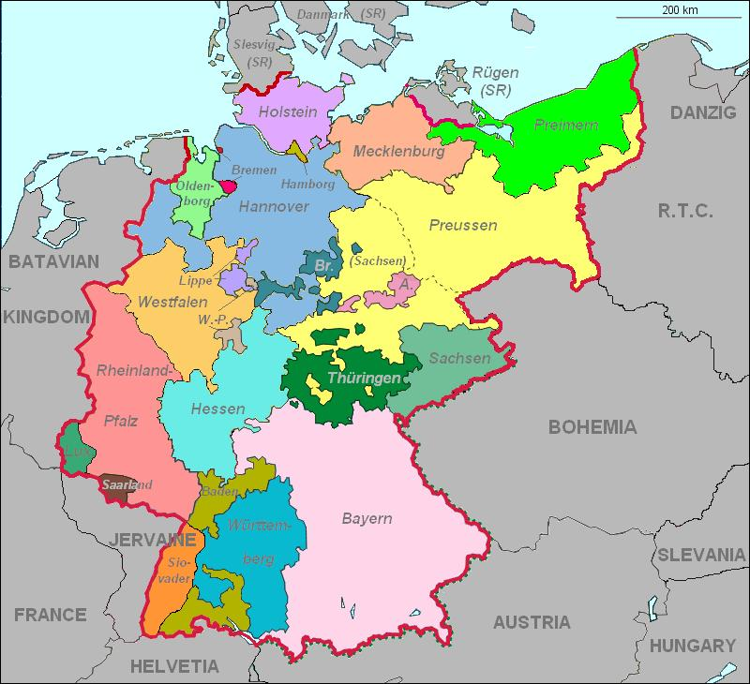
Germany
King Otto of Saxony defeats Magyars, 955
Proclaimed Holy Roman Emperor by Pope in 962
But it wasn’t…
France is not amused.

Slide 32
Early Medieval Society
Feudalism – work/services for protection in absence of strong central authorities
Lords/nobles – landowners, landed elite
Vassals – allegiance to others
Knights – for protection
Peasants/serfs - farm
Local nobles take over administration from weak central government

Slide 33
Origins of Serfdom
Slaves, free peasants in both Roman and Germanic societies
Combined both ideas = coerced labor with limited rights = serfs

Slide 34
Serfs’ Rights and Obligations
Right to pass on land to heirs
Obligation to provide labor, payments, in-kind to lord
Unable to move from land
Fees charged for most manor services, including marriage

Slide 35
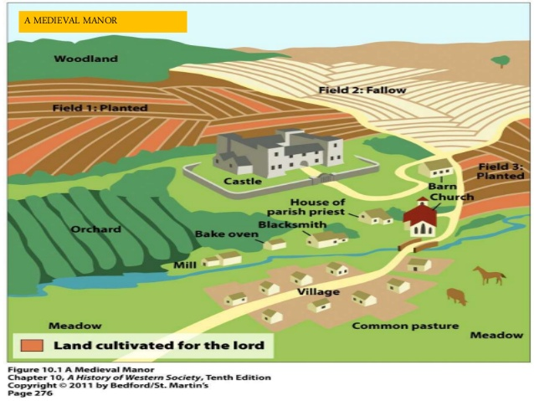
Manors
Large, diverse estates
Lord provides governance, police, justice services
Serfs provide labor, income
Entirely self-sufficient!

Slide 36
The Economy of Early Medieval Europe
Great Warming Period: c. 800 to c. 1300.
Agricultural center moves north from Mediterranean
New technologies:
8th century iron-tipped plow introduced in Europe
Draft animals bred
Water and wind mill technology
Agricultural output insufficient to support growth of cities
Population Growth of Europe, 200-1000 CE

Slide 37
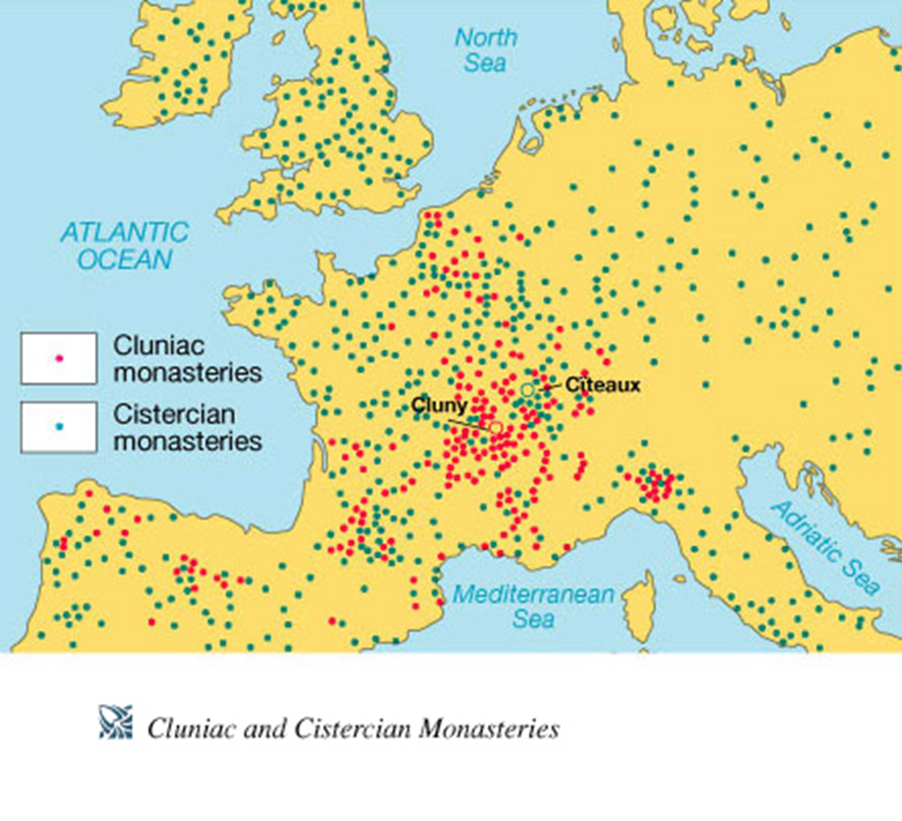
Monasticism and Society
Accumulation of large landholdings, serfs
Social welfare projects
Esp. labor contributions, care of poor and sick.
Inns, orphanages, hospitals
Expansion of literacy

Slide 38
Medieval Europe: Continuities and Changes
Continuities
Changes
Agricultural Revolution
Architecture – Romanesque/Gothic
Black Death
City-states
Competition between independent states
Decline/loss of Byzantine Empire
Divine Right of kings
Economic opportunities for women
Guilds
Independent trade cities - Hanseatic League
Little Ice Age (c. 1300-1870)
Middle class emerges – bourgeoisie / burghers
Revival of learning – vernacular, printing press
Holy Roman Empire
Roman Catholicism
Manorial System
Feudal system (until Black Death)
Mediterranean trade
Evolution of Christian Church
Warming Period

Slide 39
Political Changes
France
England
Establishment of 3 Estates
No taxes for upper classes/estates
No investment in representative government
Increase in power of kings through strong connection with Catholic Church
eventually “Divine Right of Kings”
King John
Magna Carta – Limits the power of kings (1215)
“Rule of Law” (applies to all)
Right to trial
Separation of Church and State
Nobles benefit the most
Creates Parliament (representative gvt)
Land/succession conflicts (due to feudalism) between France and England lead to Hundred Years War 1337-1453 (Joan of Arc)

Slide 40
Lay Investiture Controversy: Tension between HRE and the Church
Pope Gregory VII (1073-1085) attempts to end practice of lay investiture (laymen/secular authority appointing Church officials)
Who has ultimate power, the king or the pope???
Excommunicates HRE Henry IV who disagrees
German peoples seize opportunity to rebel
Quashed (with difficulty)
Later, the HRE will elect their own (anti)pope, Clement III (1187-1191) in response to French influence on papacy

Slide 41
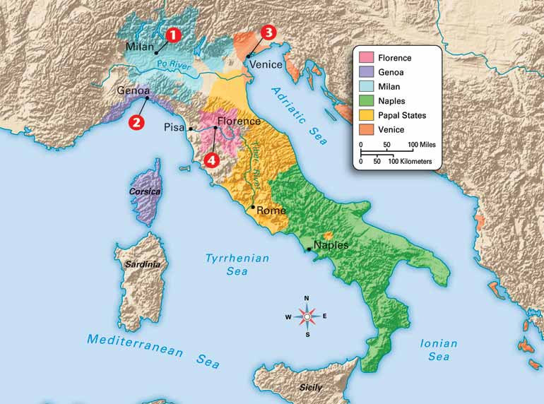
Italy
Series of ecclesiastical (Church owned) states, city-states, and principalities
Papal State directly controlled by Pope, good-sized territory in central Italy
By 12th century, city-states increasingly displace Church control in northern Italy:
Venice, Florence, Milan = trade $$$
Normans invade southern Italy, displace Byzantine and Muslim authorities

Slide 42
Iberian Peninsula
Muslims control Iberian peninsula, 8th-12th centuries
Reconquista
From 11th century on, Christian conquest of Spanish Muslim territories
Late 13th century, Muslims remain only in Granada
Spanish Inquisition in 1478-1834
Began in France in 12th cent.
Height of terror, 1492

Slide 43
Growth of the Agricultural Economy
Increasing development of arable lands
Minimized threat of invading nomads
Clearing of swamps, forests
Improved agricultural techniques
Three-field crop rotation
Heavy plow
Horseshoes, horse collars (horses faster than oxen)

Slide 44
Revival of cities and Trade
Urbanization follows increase in food supply
Merchants and artisans return first
Specialization of labor
Textile production
Mediterranean trade
Italy well-positioned for sea trade
Italian colonies established in major ports of Mediterranean & Black Seas
Wealth will contribute to Renaissance!

Slide 45
Guilds
Organizations of merchants, workers, artisans
By 13th century guilds control good portion of urban economy
Price and quality control
Membership
Created social support network

Slide 46
Urban Women
New economic opportunities for women
Representation in wide variety of trades
Dominated needle trade
Admitted to most guilds

Slide 47
Cathedral Schools
During early middle ages, European society too unstable to provide institutions of advanced learning
Some rudimentary education at monasteries, occasional scholars at courts
High middle ages (1000-1300 CE) increasing wealth makes education possible
Schools based in cathedrals
Curriculum in Latin (language of Church)
Church literature, Plato/Aristotle; some law, medicine, theology

Slide 48
Independent Cities
Awkward fit into in the framework of medieval political order
By late 11th century, towns demand charters of integration for greater self-government

Slide 49
The Hanseatic League
Independent trading cities unified through desire for economic security
Large military (navy) and smaller armies
Trade in Baltic and North seas
Poland, northern Germany, Scandinavia

Slide 50
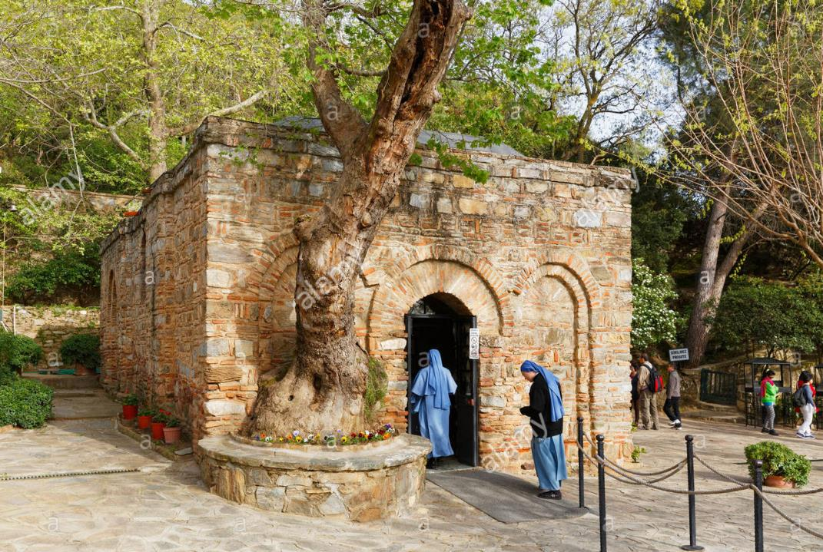
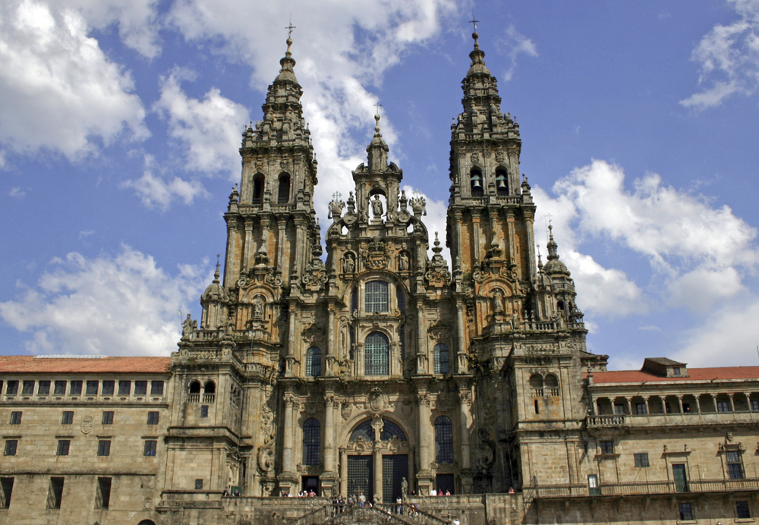
Popular Catholicism
Seven Sacraments – Baptism, matrimony, penance, Eucharist (ritual meal)
Devotion to saints – especially Mary
Relics – items related to saints collected by churches
Pilgrimage – Rome, Compostela (St. James), Jerusalem
Travel industry emerges
Wealth of European society starts criticism of materialistic nature/wealth of Church

Slide 51
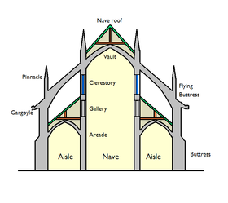
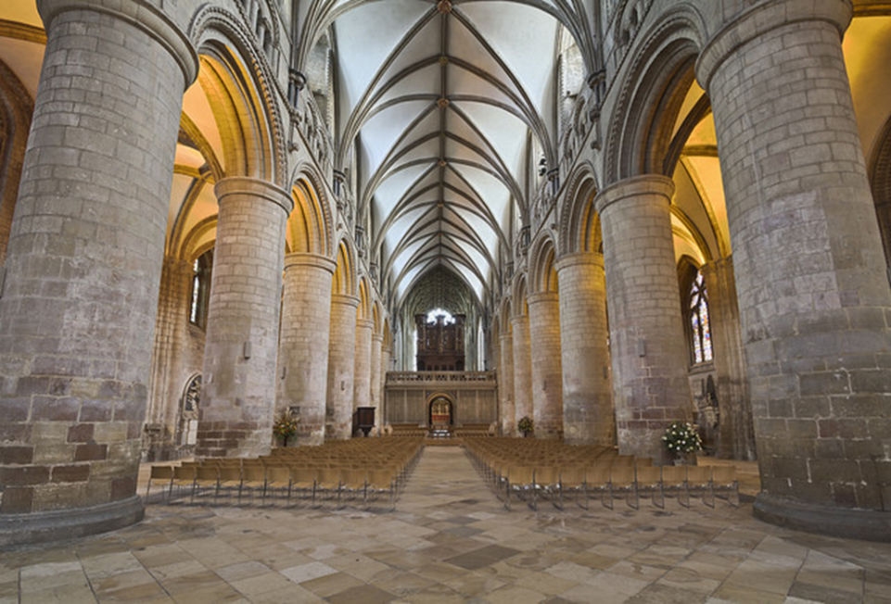
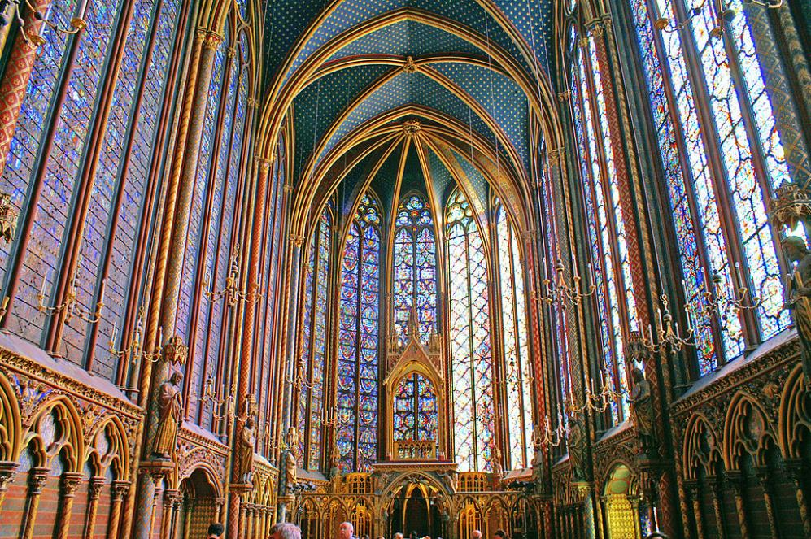
Sacred Architecture
Romanesque mid 11th c
Gothic mid 12th c.

Slide 52
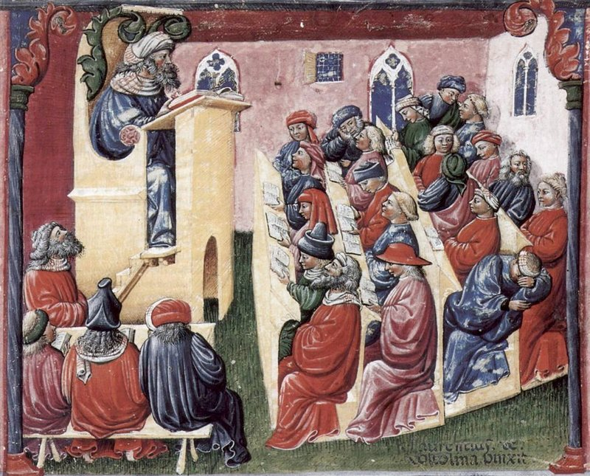
Universities
Academic guilds formed in 12th century
Higher standards of education promoted
Regulation = Academic degrees, prepared curricula

Slide 53
Chivalry
Code of conduct for nobles
Sponsored by Church to minimize fighting among Christians
Technically, knight to dedicate his efforts to promotion of Christianity
Protection of women, but objectification and repression still

Slide 54
The Beginning of the Crusades
Primogeniture leads to class of men without roots/inheritance
All inheritance to first-born son
Desire for unrestricted trade
Pope Urban II calls for liberation of Jerusalem from Muslim (Seljuk) control, 1095
Salvation promised for casualties
Rapid, enthusiastic response!
Extra History: Crusades
Mankind: Crusades

Slide 55
The First Crusade
1096-1099 Jerusalem captured, largely due to poor Muslim organization
Crusader states established
Massacre of citizens in Jerusalem (mostly Jews)
Muslim forces coalesce
Salah al-Din (Saladin) recaptures Jerusalem in 1187

Slide 56
Later Crusades and their Consequences
Five crusades by mid-13th century, none successful
Fourth Crusade, prompted by Pope and Italian merchants destroys Constantinople, 1202-1204
Yet Crusades provide direct contact with Muslim ideologies, trade
Aristotle, “Arabic” numerals, paper production, new products/foods

Slide 57
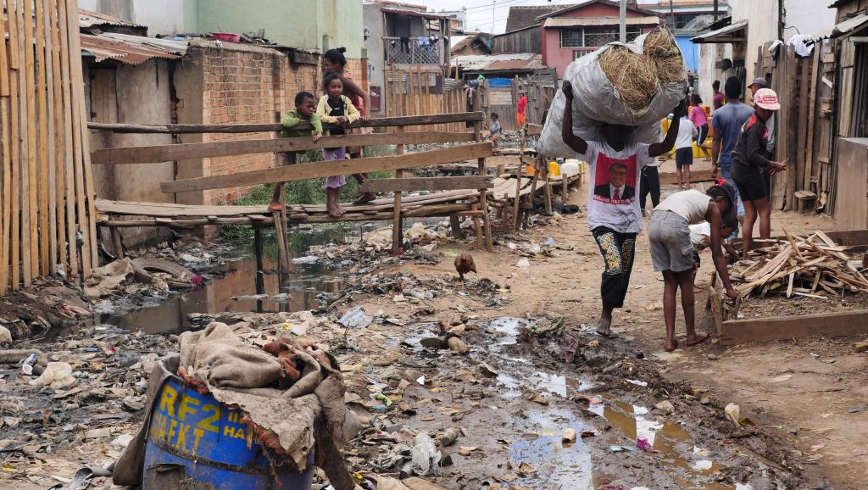
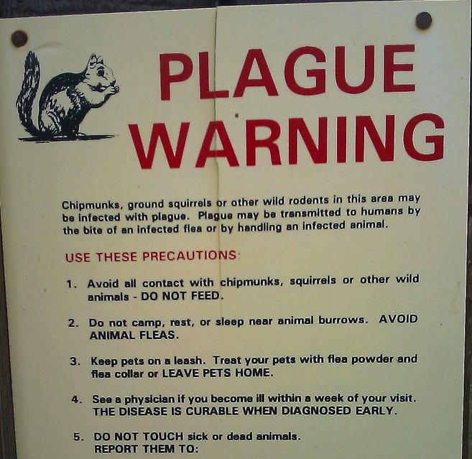
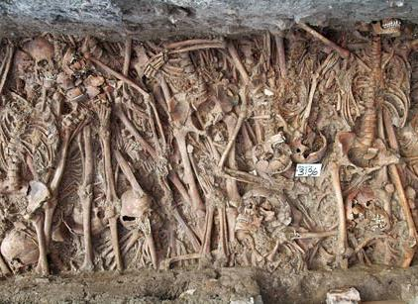
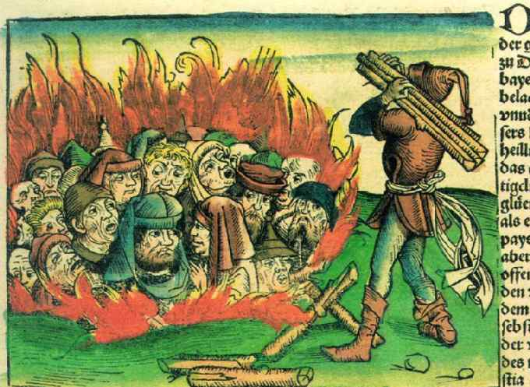
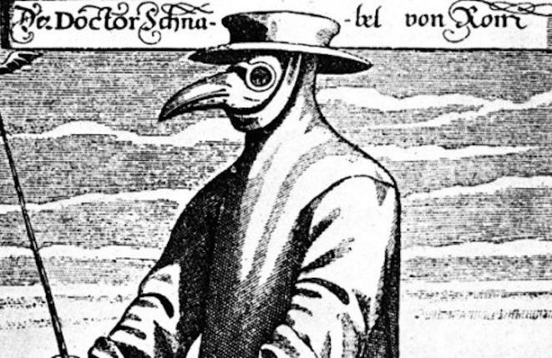
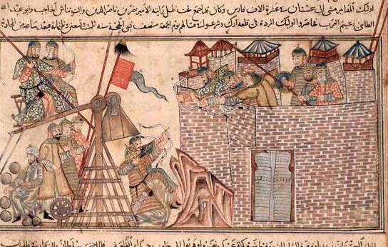
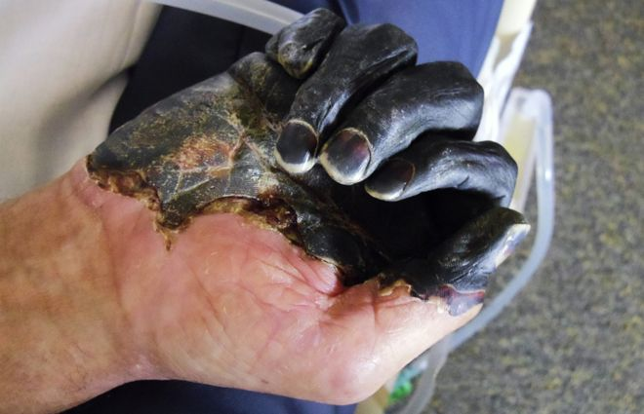
Black Death (1346-1353)
Little Ice Age (1300-1870)
European population weakened: overcrowding, unsanitary conditions in cities, famine
Fleas on rats
Golden Horde transfers Black Death to trade city of Caffa (siege weapons)
Jews made scapegoats
75-200 million die (25-75% of regional populations)
Feudalism declines; Church suffers
https://www.youtube.com/watch?v=ZztM38_nsKA

Slide 58
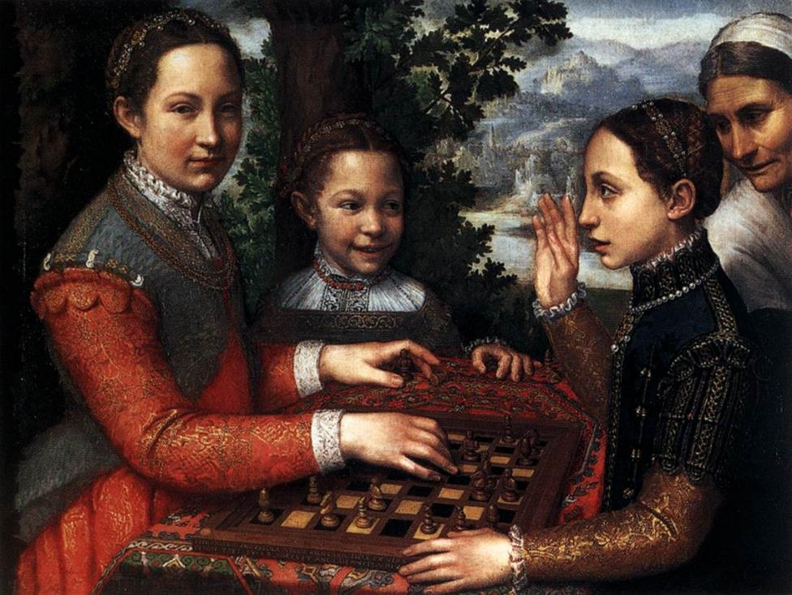
Renaissance (c. 1300-1700)
Italian wealth prompted increased spending on culture
Constantinople conquered in 1453 - Many scholars flee to Christian West
Revival of learning in Europe (esp. Greek)
Gutenberg press (1439)
Increased use of vernacular in texts = rise of nationalism
Humanism emerges – focus on the individual to understand the world
Northern Renaissance Art (humanist, daily activities, religion still evident)
Southern Renaissance Art (religious scenes, proportionality, linear perspective, human figure)

Slide 59
What have you learned?
To what degree did economic functions of cities change in this era?
How did the rise of specialized labor systems in urban areas affect production and impact social hierarchies?
Provide examples of cultural changes that occurred during the European Middle Ages.
Provide examples of political changes that occurred during the European Middle Ages.

