Slide 1
States and Societies in Sub-Saharan Africa

Slide 2
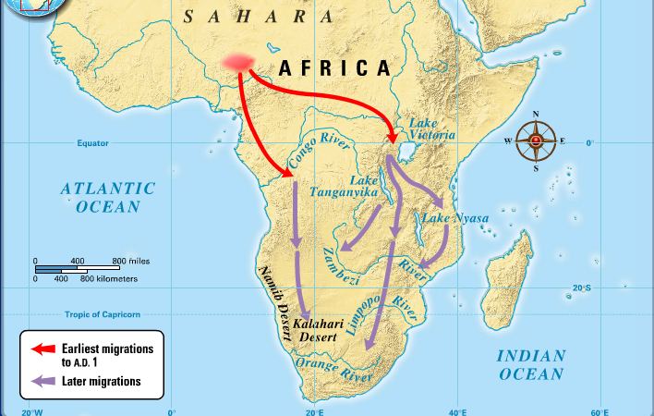
Review: Effects of Early African Migrations
Bantu-speaking peoples settle south of Equator
Agriculture, iron metallurgy, herding spreads with Bantu migrations

Slide 3
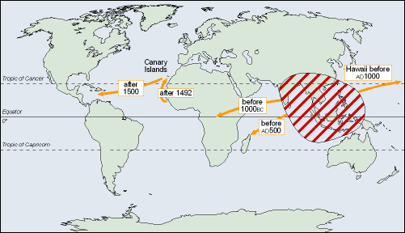
Cultivation of Bananas
Domesticated in south-east Asia
Malay sailors colonize Madagascar, 300-600 CE
  Introduce bananas, yams, chickens
Well-adapted to African climate

Slide 4
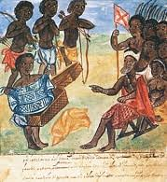
Kin-Based Societies (Sound familiar…?)
Stateless, segmented societies
No elaborate hierarchies, bureaucracies
Average population of village: 100
Ruled by elders
Network of villages resolve disputes in ad-hoc manner
Higher government authorities rare

Slide 5
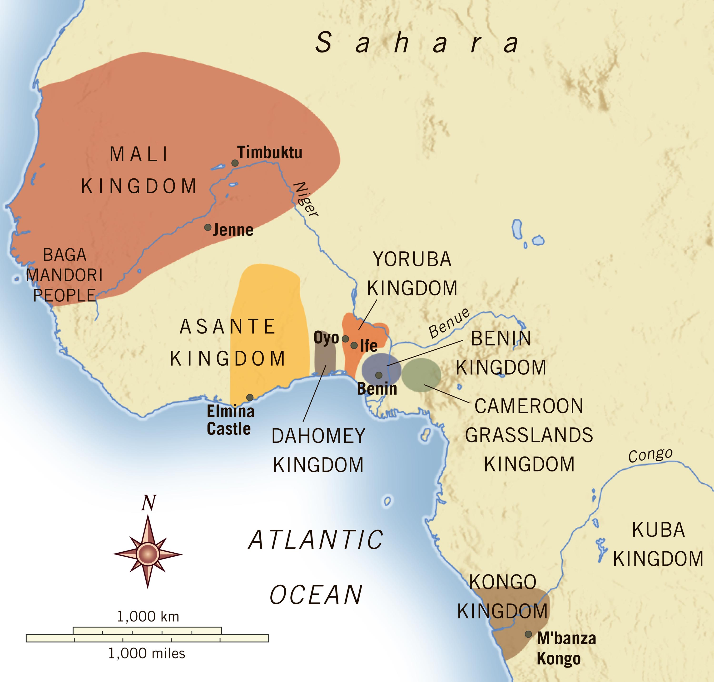
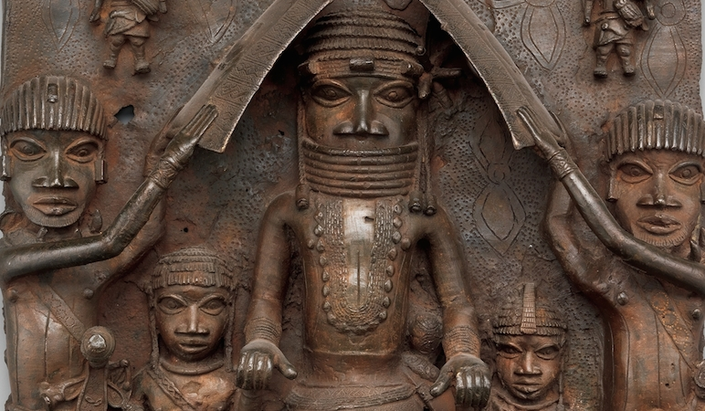
Chiefdoms
Population pressures after 1000 increase competition, disputes
Small chiefdoms appear, overrule kin-based groups
Small kingdoms form
  Ife, Benin

Slide 6
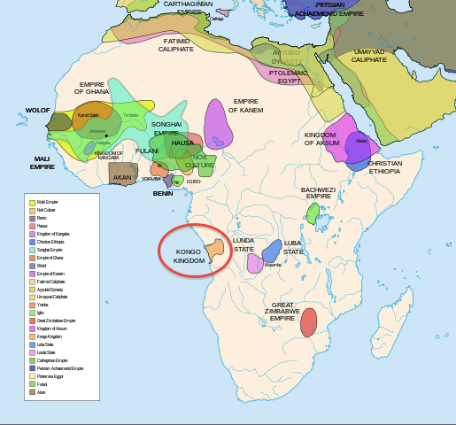
Kingdom of Kongo
Basin of the Congo (Zaire) river
Conglomeration of several village alliances
Participated actively in trade networks
Most centralized rule of the early Bantu kingdoms
Ruled 14th-17th century until undermined by Portuguese slave traders

Slide 7
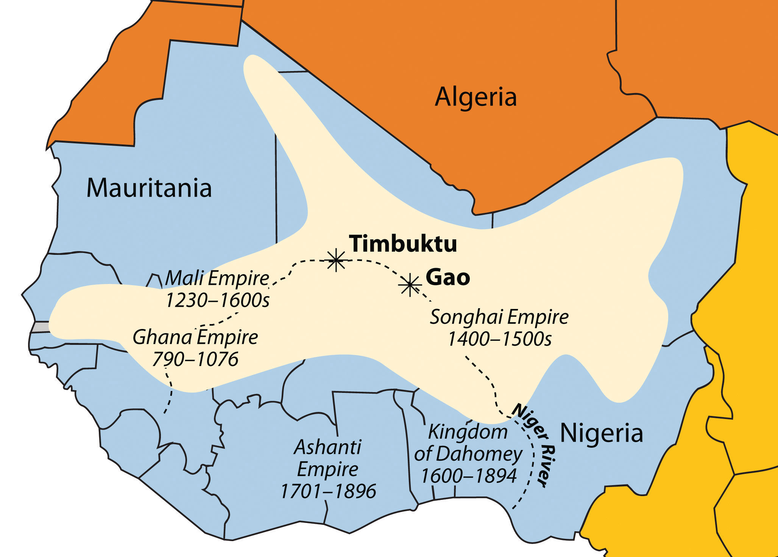
Trans-Saharan Trade and Islamic States in W. Africa
After 300 C.E. camels replaced horses and donkeys as transport animals (saddle!)
Camels' arrival quickened pace of communication across the Sahara
Islamic merchants crossed desert and established trade relations
  Created trading communities

Slide 8
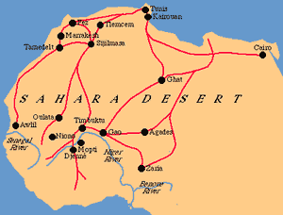
Islamic Kingdoms and Empires
Islam spreads to West Africa
  Trans-Saharan caravans
  Coastal east Africa through maritime trade
Profound influence after 8th century
Ghana kings convert to Islam by the tenth century, don’t force on others

Slide 9
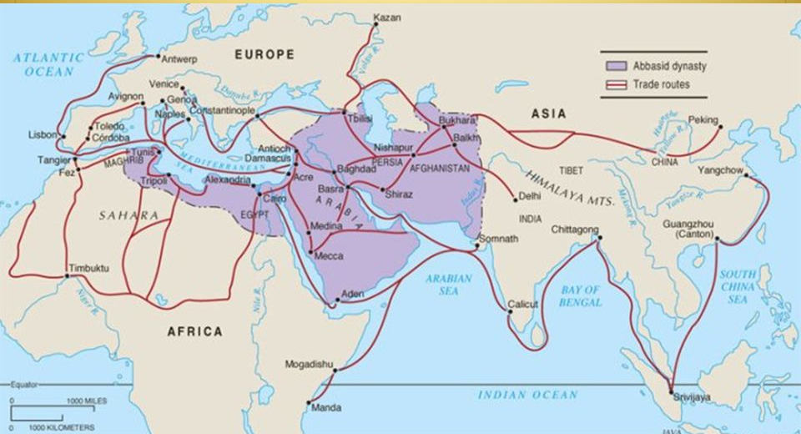
Islam in West Africa
Positive impact on trade, relations with north Africa
Synthesized Islam with local traditions (syncretic)

Slide 10
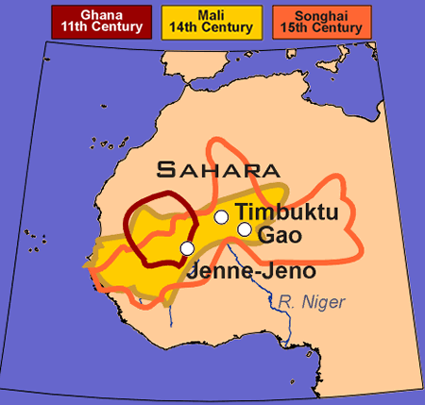
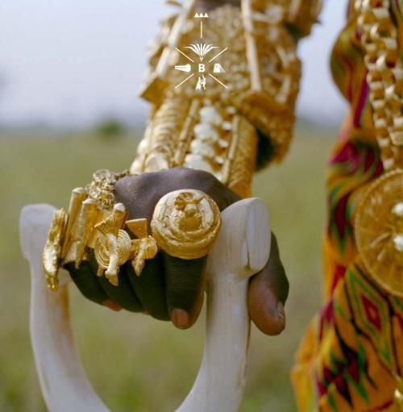
The Kingdom of Ghana
Ghana became the first of the most important commercial sites in west Africa
Provided gold (most important), ivory, and slaves for traders from N. Africa
  Exchanged for horses, cloth, “manufactured goods,” and salt
Nomadic raids from the Sahara weakened the kingdom in the early thirteenth century

Slide 11
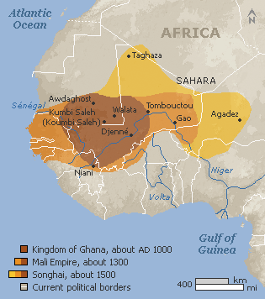
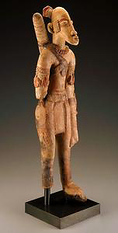
RISE OF MALI
Sundiata, or “Lion King,” built Mali empire (reigned 1230-1255 C.E.)
Controlled and taxed almost all trade passing through west Africa
Enormous caravans linked Mali to north Africa
Nominally Muslim, but did not force conversions

Slide 12
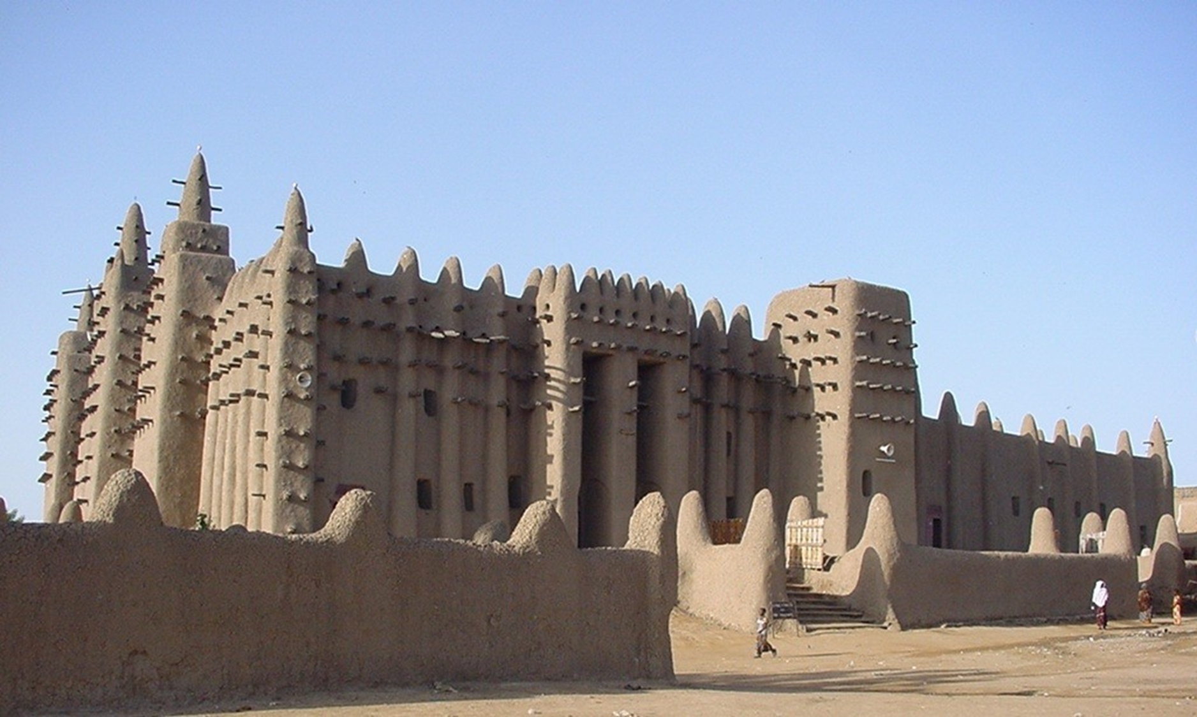
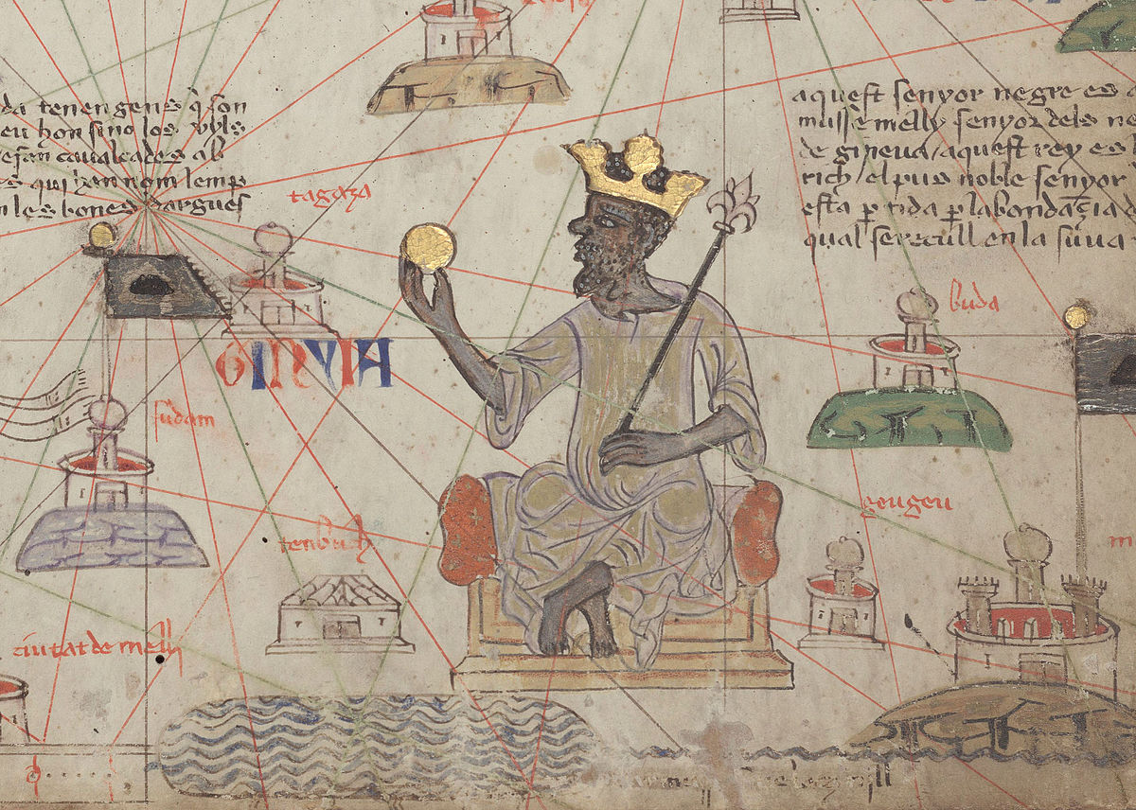
Mansa Musa (r. 1312-1337)
Sundiata's grandnephew
Made his hajj in 1324-1325 with huge caravan
Upon return to Mali, built mosques (Djenne!)
Sent students to study with distinguished Islamic scholars in northern Africa
Established Islamic schools in Mali
Decline of Mali due to factions and military pressure from neighbors and nomads

Slide 13
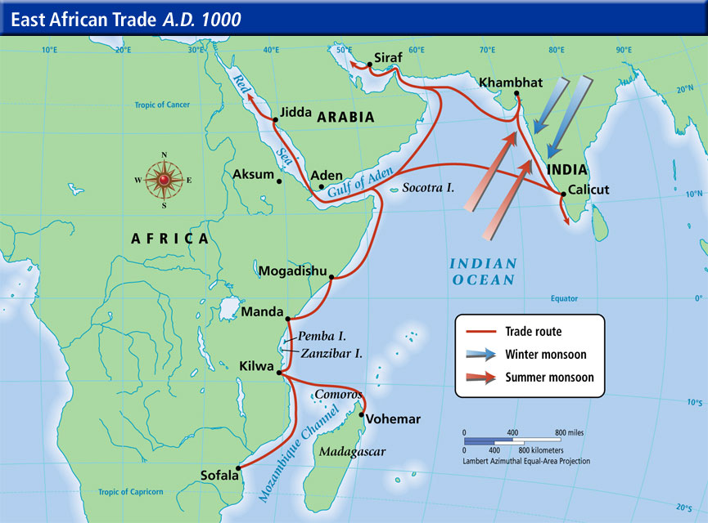
Indian Ocean Trade and Islamic States in E. Africa
East coast maritime trade weak until 2nd century
Bantu peoples populate coast
Swahili (“coasters”) engage in trade with Arabs
  Swahili language a form of Bantu, influenced by Arabic (syncretic language!)
10th century trade increases

Slide 14
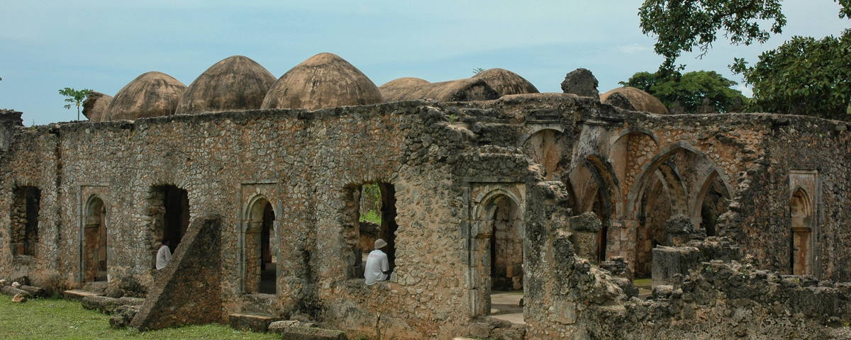
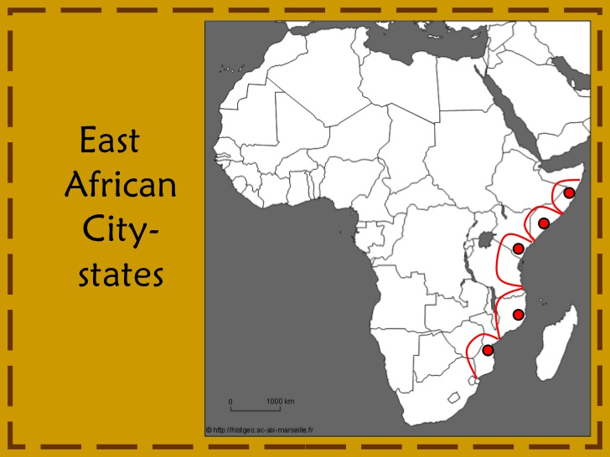
The Swahili City-States
Chiefs gained power through taxing trade on ports
Ports developed into city-states governed by kings, eleventh and twelfth centuries
  Great wealth!
Architecture moved from wood/mud to coral, stone
Chinese silk, porcelain imported

Slide 15

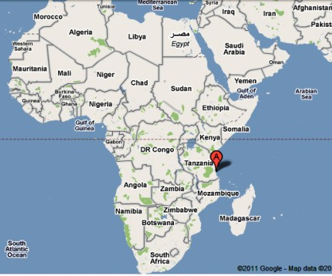

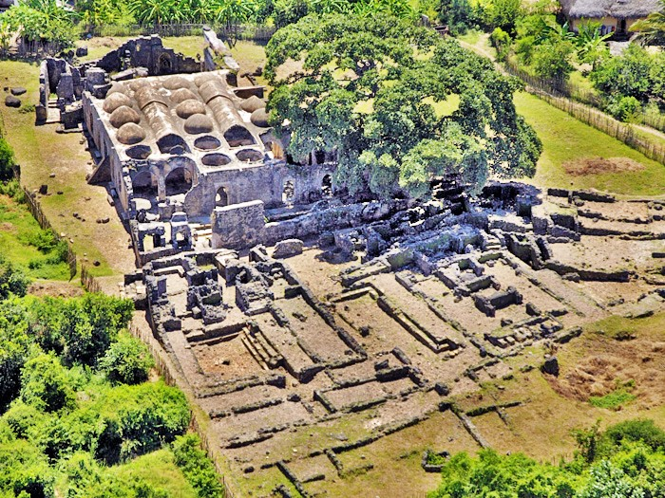
Kilwa
City-state on east African coast
Major trading center by 14th century
  Exporting over a ton of gold per year by 15th century CE

Slide 16
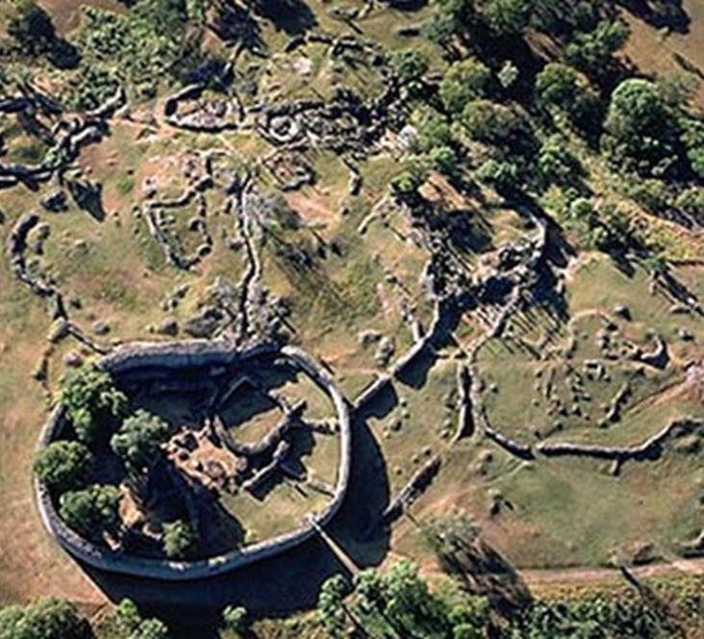
Great Zimbabwe
Powerful kingdom of E. Africa
Magnificent stone complex known as Great Zimbabwe constructed in the 12th century
18,000 occupants in the late 15th century
Kings organized flow of gold, ivory, and slaves between internal and coastal regions

Slide 17
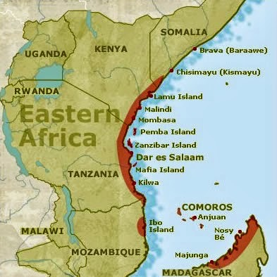
Islam in eAst Africa
Ruling elite and wealthy merchants converted to Islamic faith
Conversion promoted close cooperation with Muslim merchants
Conversion also opened door to political alliances with Muslim rulers

Slide 18
Social Structures
Men undertook heavy labor
Women were responsible for child rearing, domestic chores
Men monopolized public authority, but women enjoyed high honor as the source of life
  Many matrilineal societies
Aristocratic women could influence public affairs
Women merchants commonly traded at markets
Sometimes women organized all-female military units
Islam did little to curtail women's opportunities in sub-Saharan Africa

Slide 19
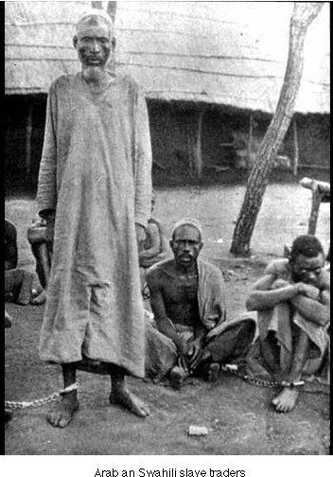
Slavery
Practiced since ancient times
Most slaves were captives of war, debtors, criminals
Worked as agricultural labor or sold in slave markets

Slide 20
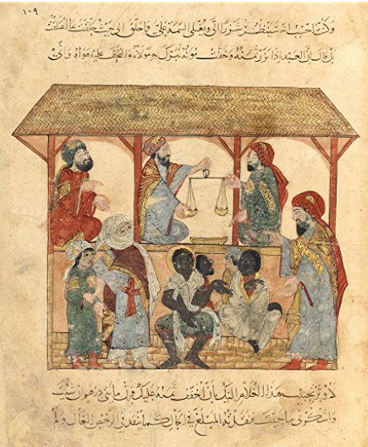
Slave Trading
Increased trans-Saharan and Indian Ocean trade stimulates slave trade, 9th c. CE
Africa replaces eastern Europe as principal source of slaves
Creates internal African slave trade
  More powerful states attack smaller kinship-based groups
  10,000-20,000 slaves per year
African slave possession a status symbol

Slide 21
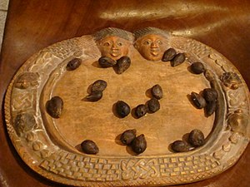
African Religion
Great diversity of religious belief
Common element: single, male creator god
  Lesser deities associated with natural phenomena
Ancestor worship
Diviners
  Religious specialists, principally men
  Oracle reading, spells, other rituals
Limited emphasis on theology
Morality, balance of nature important

Slide 22
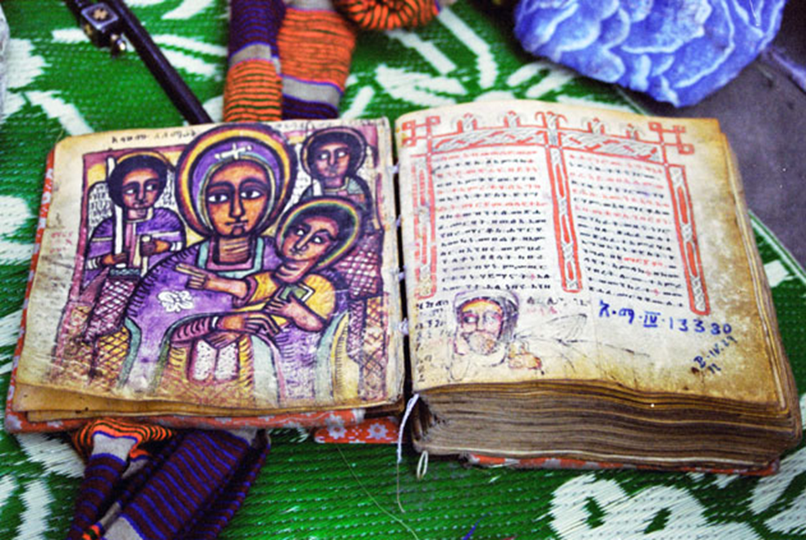
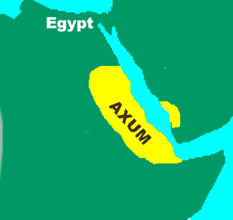
Early Christianity in North Africa
1st century: popular in Egypt, north Africa
  Weak in sub-Saharan Africa until 16th century
Christian kingdom of Axum established 4th century CE in modern Ethiopia
  Merchants, then kings convert
  Bible translated into Ethiopian
  Isolated during Islamic period; renaissance during 12th century CE
  Massive churches carved out of solid rock

Slide 23
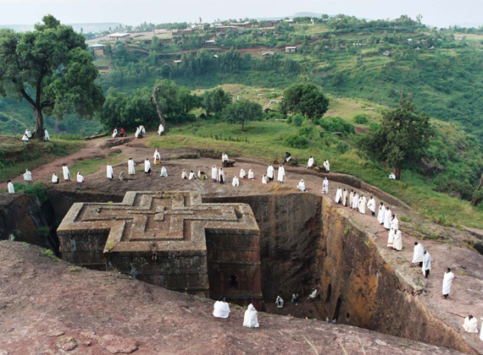
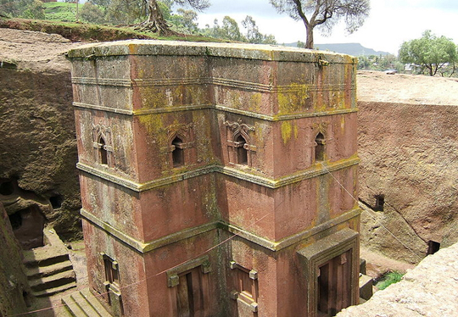
Axum

Slide 24
Fact Check!
What technology revolutionized trade in sub-Saharan Africa?
Which important crop is brought to Africa from SE Asia?
Name three kingdoms that develops on the West coast of Africa during the post-classical age.
What were the most important trade items in Africa?
What were advantages to converting to Islam?
Which Mali ruler brought attention to his empire during his hajj?
Where could a Christian kingdom be found during this time?
Describe life for women in Islamic Africa.
Name the syncretic language that developed in East Africa.
Name two post-classical kingdoms in East Africa.

