Slide 1
Chapter 22
PERIOD 4: 1450-1750

Slide 2
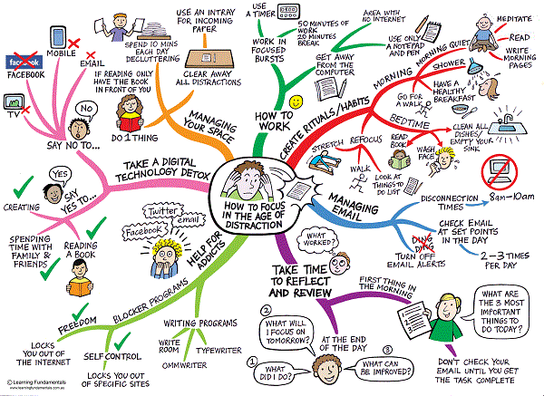
MIND MAP!

Slide 3

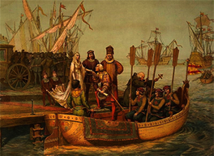
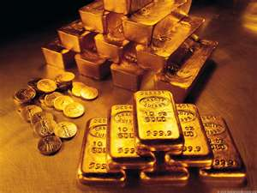
Motivation for Exploration
Europeans had long been attracted to Asia.
  Marco Polo’s account of his travels to the court of Kublai Khan and the exotic East were well known
Expansion of the Ottoman Empire into SW Asia made traveling east by land difficult.
Sea travel is faster and more profitable
Upper class desire for ginger and pepper
Spread Christianity
Search for gold and other precious metals
Adventure and glory!

Slide 4
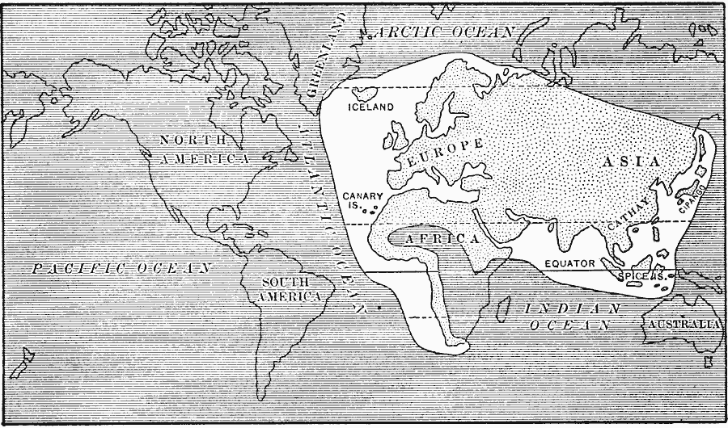

Slide 5
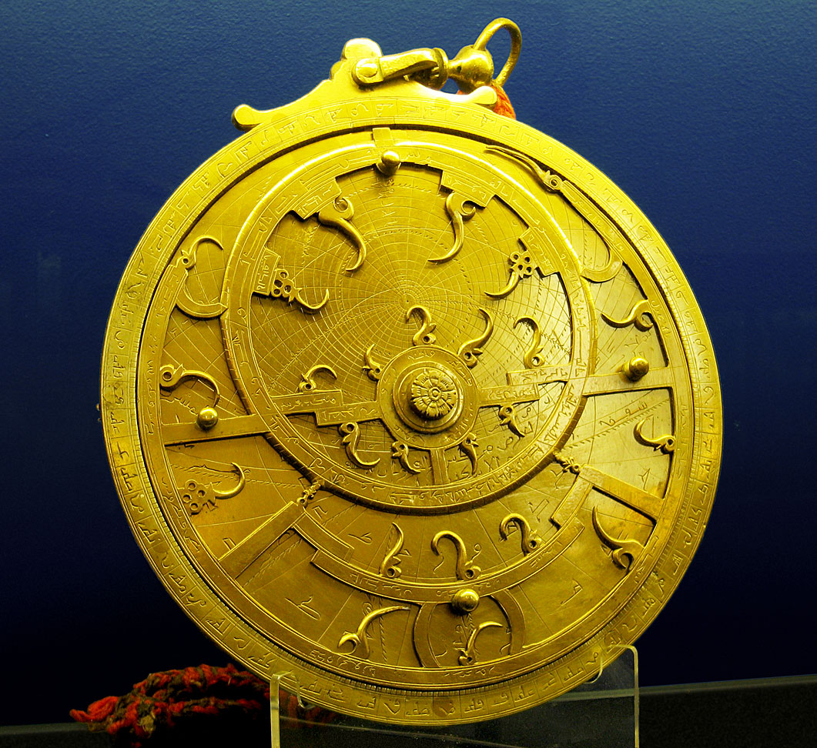
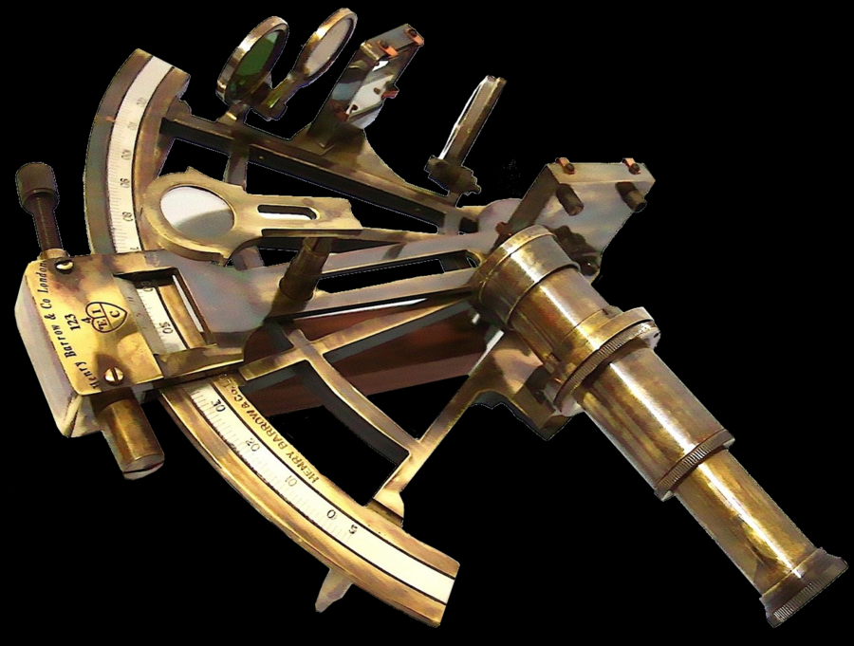
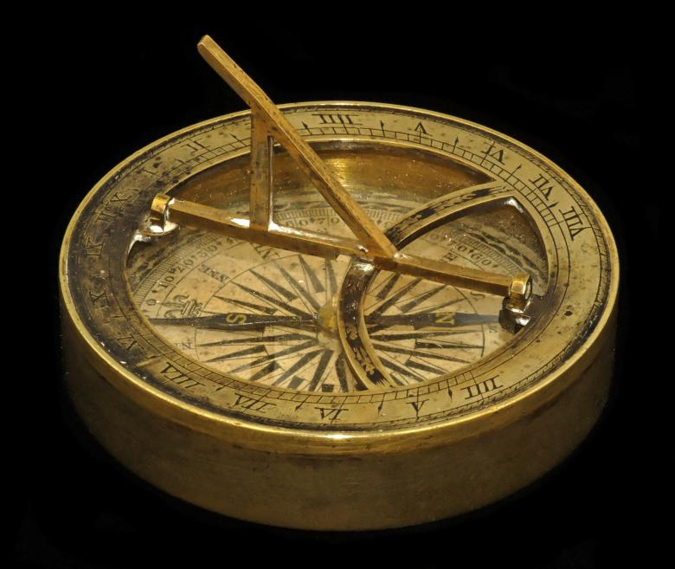
New Maritime Technologies
Astrolabe: brass circle with carefully adjusted rings marked off in degrees; used to calculate latitude (perfected by Muslims)
  Sextant will determine longitude later (1731 - British colonist in Philadelphia)
Compass: magnetically tracked direction (Chinese invention)
Caravel: stronger, sturdier ship with triangular sails (adopted from Arabs) made it possible to sail against the wind

Slide 6
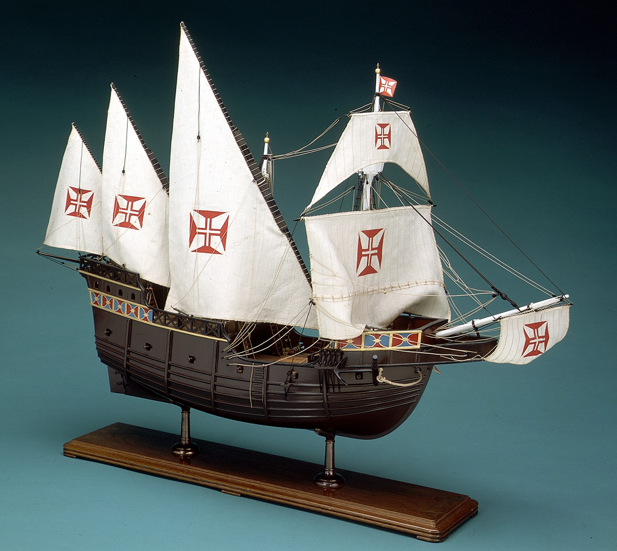
Portuguese Caravel
Made long-distance maritime travel easier.
  Could sail against the wind
  Had a deeper draft to handle large ocean swells
  More maneuverable than previous ship designs due to use of Chinese rudder

Slide 7
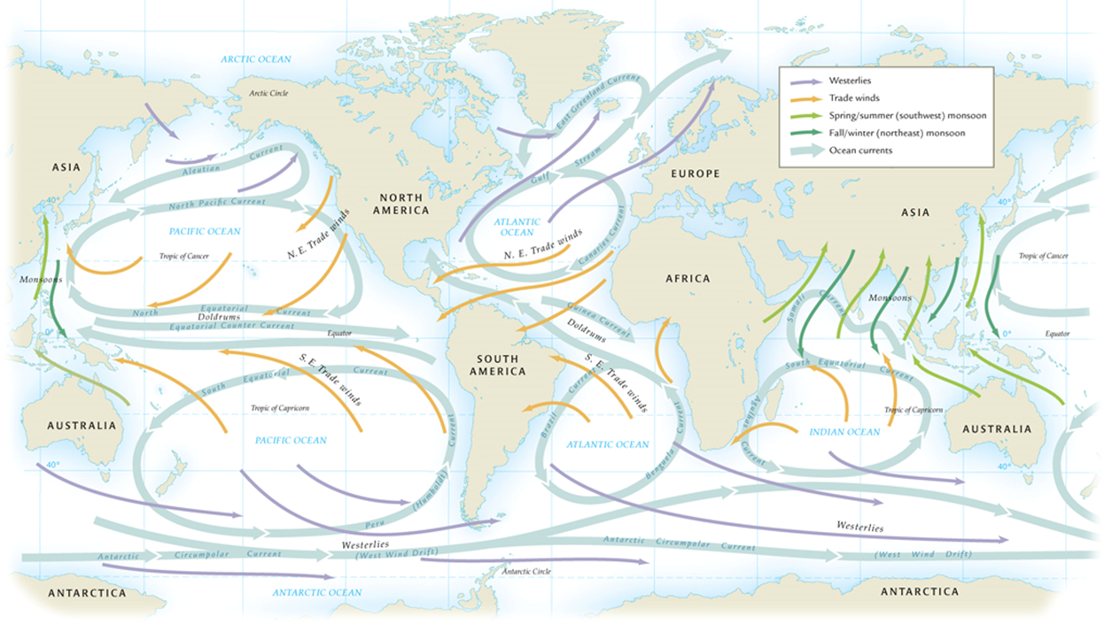
Increased Understanding of Wind and Ocean Currents

Slide 8
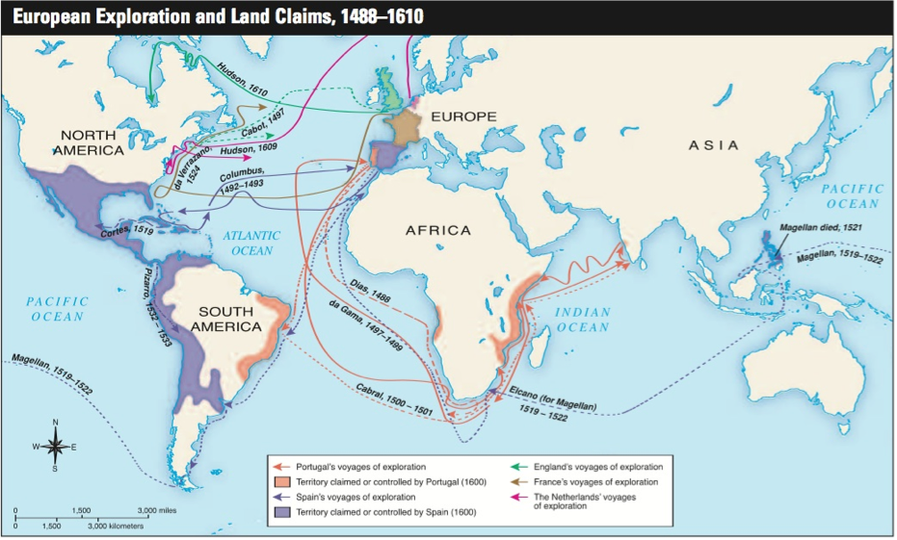

Slide 9
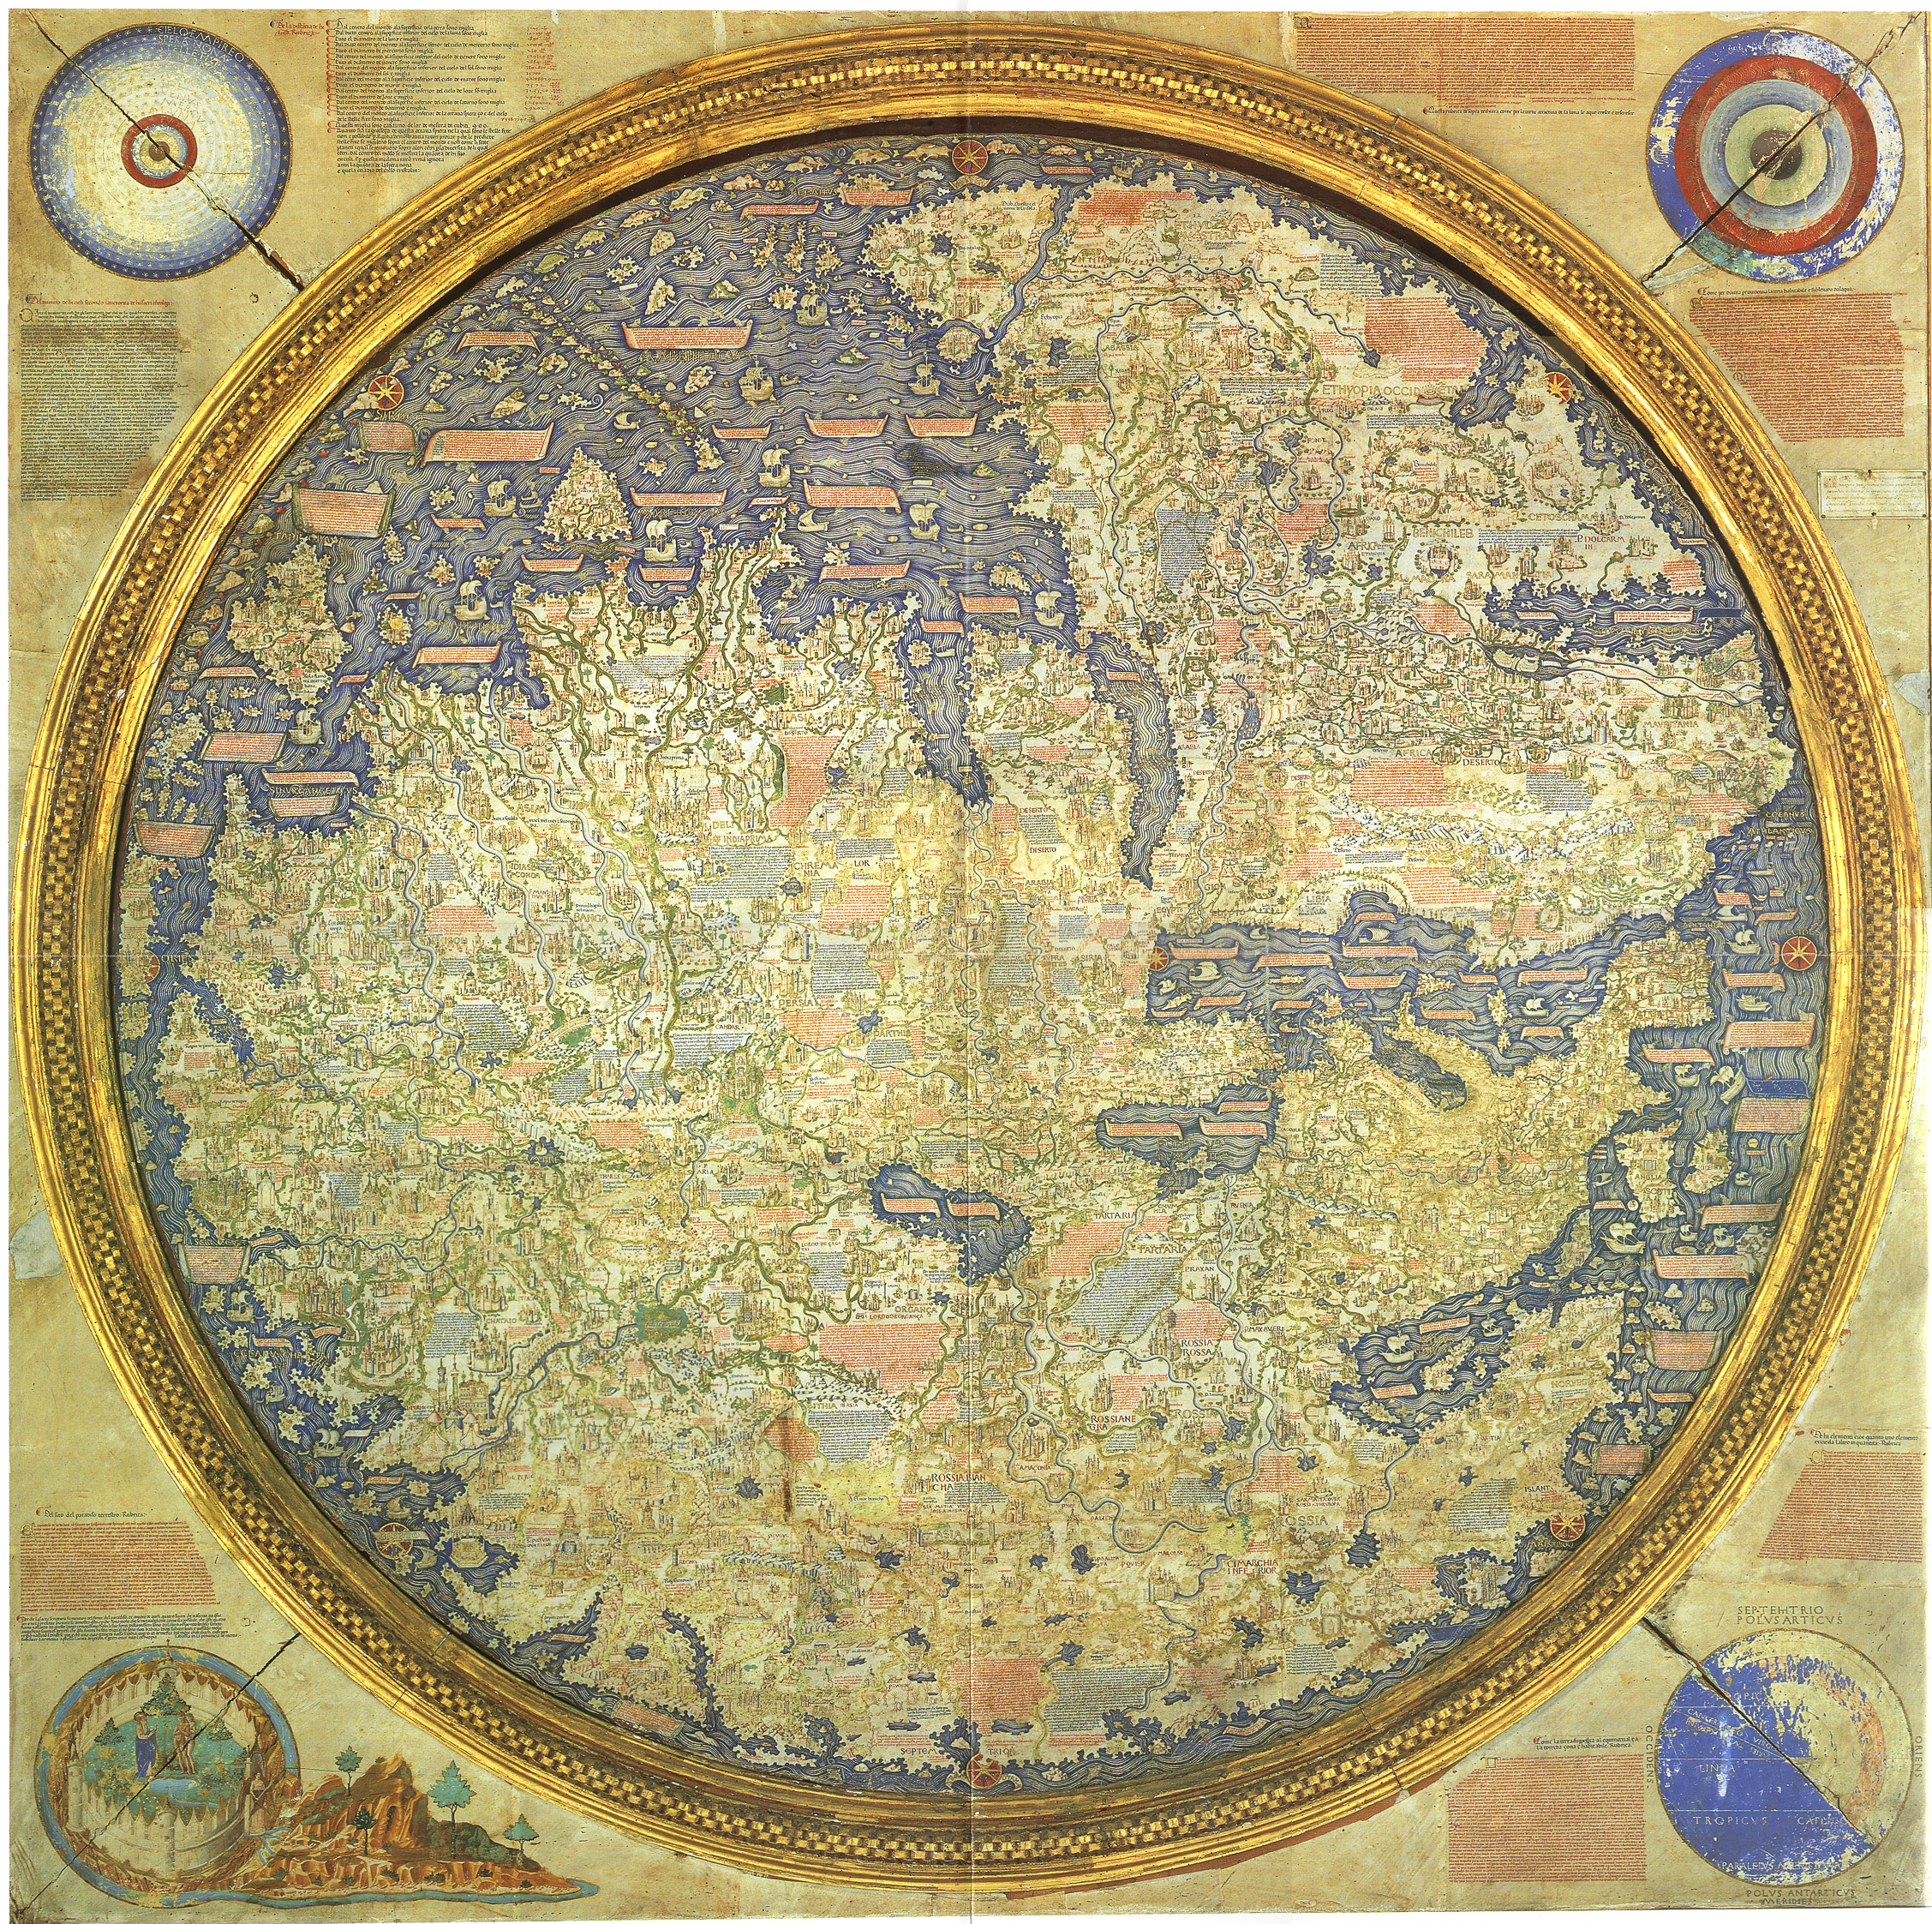
Map of known world (Europe) c. 1450

Slide 10
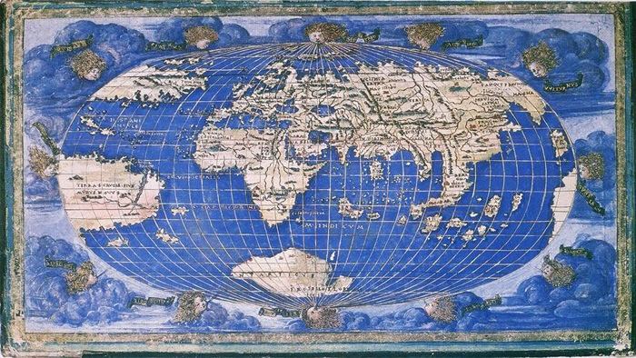
c. 1650

Slide 11
Major Explorers - Portugal
First to stress exploration – poor land attributes for agriculture!
Prince Henry the Navigator - NOT a navigator! (1394-1460)
  Established court to which he brought sailors, mapmakers, astronomers, and those interested in maritime exploration
  Sent out many expeditions – grow sugar on Azores and Madeira Islands
Bartholomeu Dias – discovers route to India (1488
  Accidentally makes it around the Cape of Good Hope in a massive storm, but crew refuses to continue to India
Vasco da Gama – first to make it around Africa to India(1497)
  Establishes trading post in Calicut (eventually…)

Slide 12
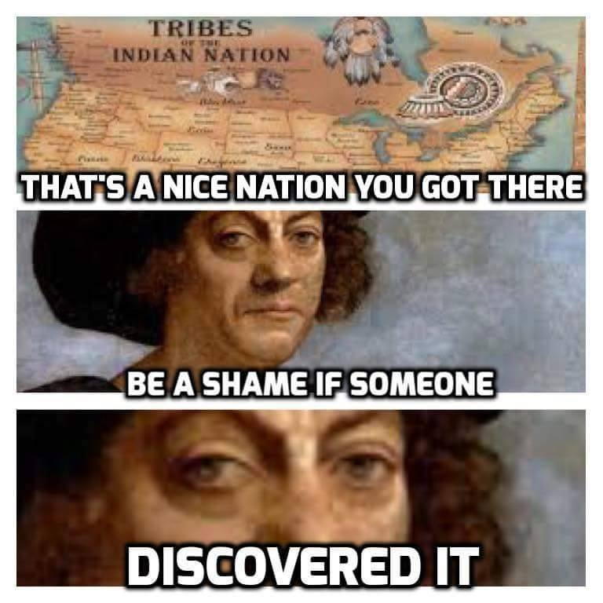
Major Explorers – Spain!?
Christopher Columbus
  PORTUGUESE SAY “NO!” TO WESTERN ROUTE
  Spanish throne and Italian bankers finance journey
  1492 discovers the existence of the Caribbean – “West Indies”
  In early 16th century English, Spanish, Dutch, and French join the exploration race

Slide 13
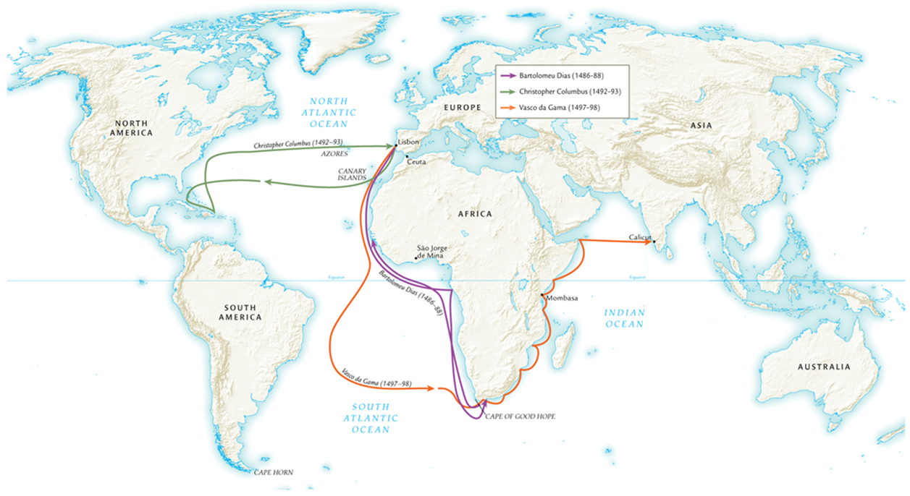
Exploration - 1486-1498

Slide 14
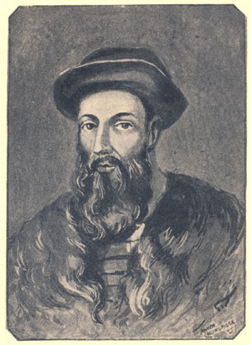
circumnavigation
Vasco Nuñez de Balboa finds Pacific Ocean while searching for gold in Panama, 1513
  Distance to Asia unknown
Ferdinand Magellan (1480-1521) not supported by Portuguese, sails in service of Spain
  Sails through Strait of Magellan at southern tip of South America
  Crew assailed by scurvy; only 18 of 250 sailors return to Spain from journey
  Magellan killed in “local political dispute” in Philippines

Slide 15
Exploration of the Pacific
Spanish build Philippines-Mexico trade route
English, Russians look for northwest passage to Asia
  Most of route clogged by ice in Arctic circle
  Norwegian Roald Amundsen completes route only in twentieth century
Sir Frances Drake (England) explores west coast of North America
Vitus Bering (Russia) sails through Bering Strait
James Cook (England) explores southern Pacific. A LOT.

Slide 16
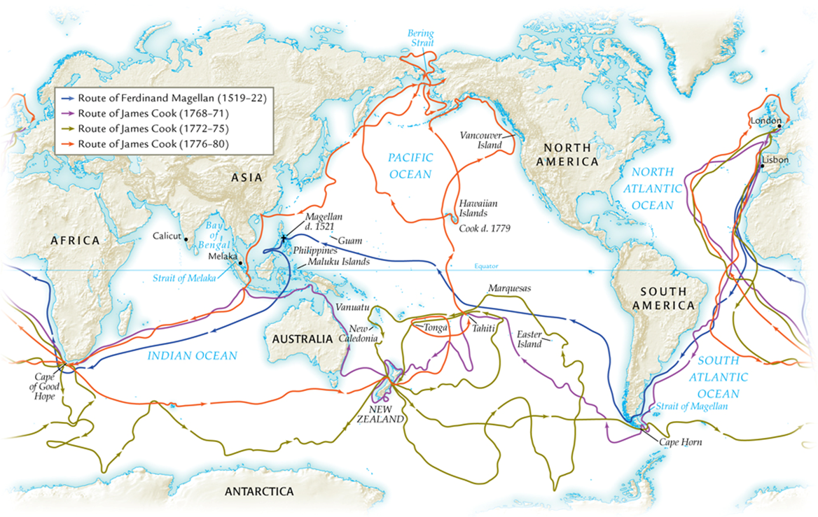

Slide 17
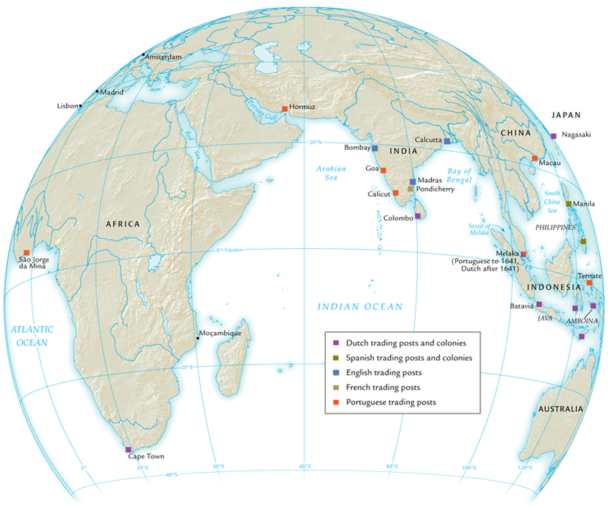
Trading Post Empires - Portugal
Portuguese first to set up trading posts
  Fifty by mid-sixteenth century
  Not to establish trade monopolies, rather to charge duties
Afonso d’Alboquerque major naval commander
  Architect of trade duties policy; violators would have hands amputated
Yet Arab traders continue to operate
Portuguese control declines by end of 16th century

Slide 18
Trading Post Empires – English and Dutch
ADVANTAGE OVER PORTUGUESE: Privately owned ships, government support; empowered with right to engage in trade, build posts, even make war; exceptionally profitable!
ENGLISH
Concentrate on Indian trade
Establish East India Company (1600)
DUTCH
In Cape Town, Colombo, southern Pacific;
Establish United East India Company (VOC) in 1602

Slide 19
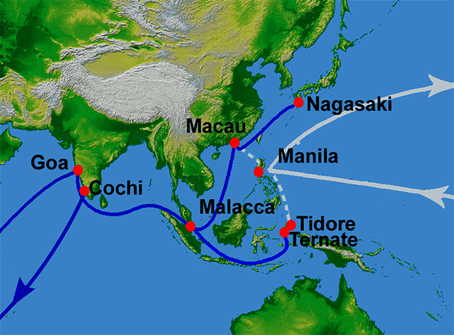
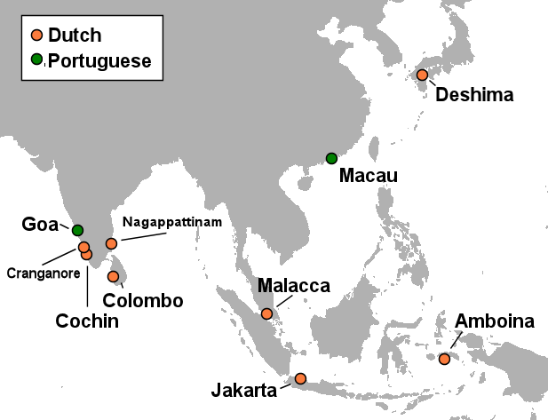
Europeans in SE Asia
Spanish conquer Philippines, name them after King Philip II
Manila becomes major port city
  Influx of Chinese traders; highly resented by Spanish, Filipinos
  Frequent massacres 17-19th centuries
  Significant missionary activity
Dutch concentrate on spice trade in Indonesia
  Establish Batavia, trading post in Java
  Less missionary activity

Slide 20
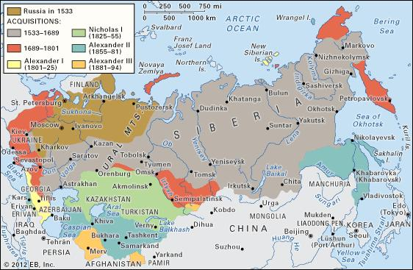
Russian Expansion in Asia
Russians take over Mongol khanates (16th century)
  Astrakhan becomes major trading city
Caucasus absorbed (18th century)
Siberian expansions in 16th-17th centuries
Trade with indigenous Siberian peoples
  Little success with missionary efforts
  Some local rebellions

Slide 21
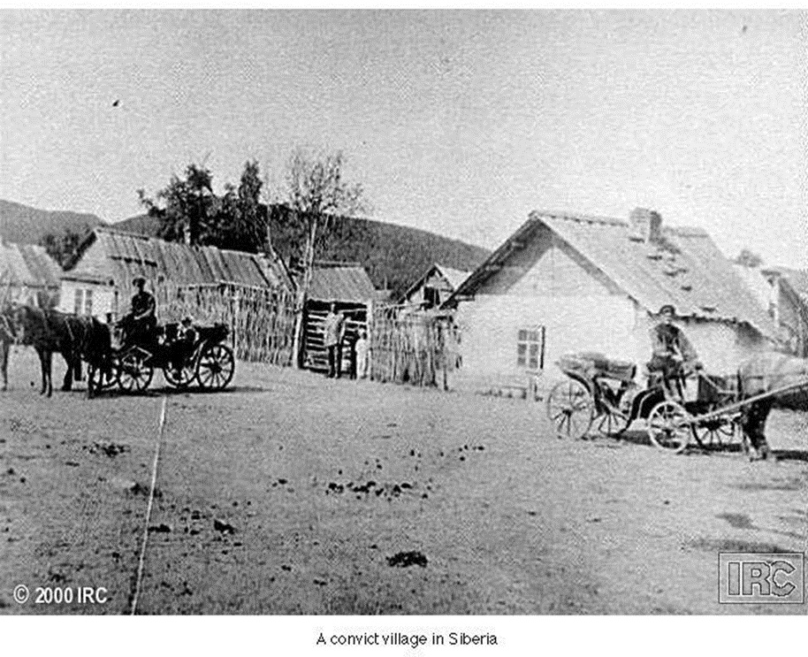
Russian Occupation of Siberia
Criminals, prisoners of war exiled to Siberia
Disgruntled peasants migrate east
  Trading posts develop
Russian population expands dramatically
  In 1763: 420,000 Russians in Siberia, outnumber indigenous peoples 2:1

Slide 22
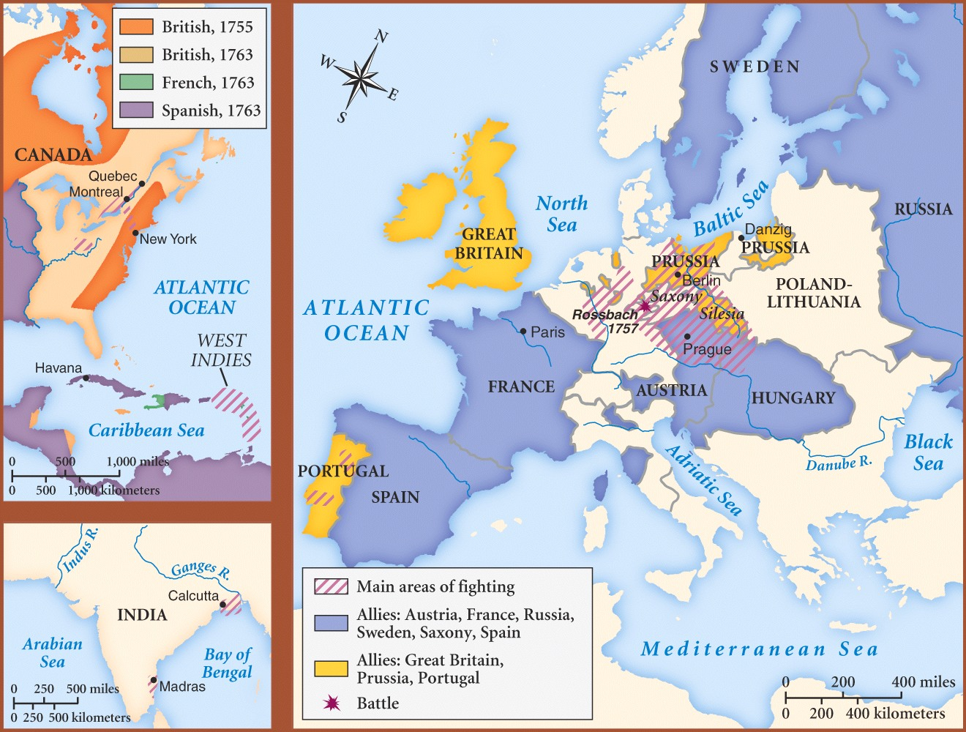
The Seven Years’ War (1756-1763)
Commercial rivalries between empires at sea
Global conflict erupts: multiple theatres in Europe, India, Caribbean, North America
  North America: merges with French and Indian War, 1754-1763
British emerge victorious; establish primacy in India, Canada

Slide 23
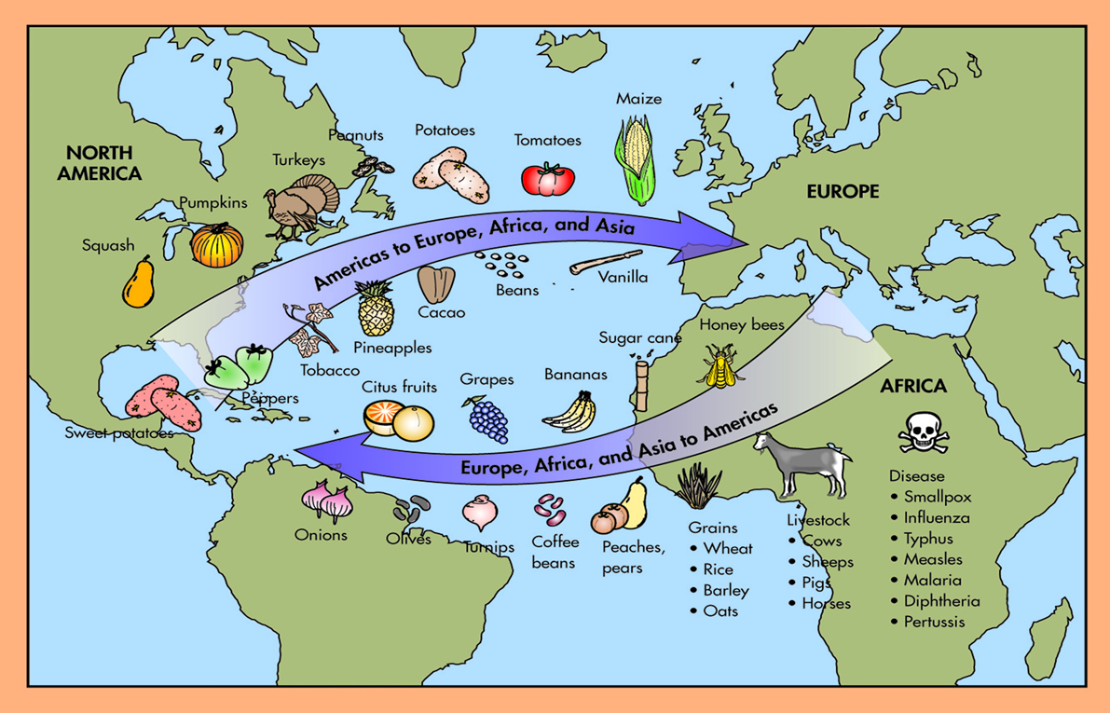
The Columbian Exchange
Named for Columbus
Global diffusion:
  Plants and crops
  Animals
  Human populations
  Disease pathogens
Links between previously independent biological zones
Permanently alters human geography, natural environment

Slide 24
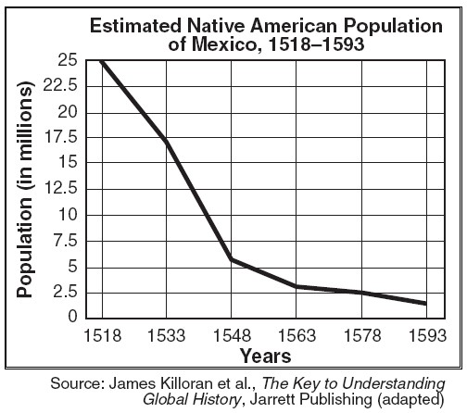
Epidemic Diseases and Population Decline
Smallpox
  Also measles, diphtheria, whooping cough, influenza
No prior exposure to these diseases in western hemisphere or Oceania
  No inherited, acquired immunities
1519 smallpox in Aztec empire
  Population declines 90% within 100 years (17 million to 1.3 million)

Slide 25
Food Crops and Animals
Columbian exchange also increases overall food supply
Introduction of European animals to Americas
  Horses, cattle, pigs, chickens, etc.
Introduction of American foods to Europe, Asia, Africa
  Maize, potatoes, beans, etc.
World Population Growth 1500-1800

Slide 26
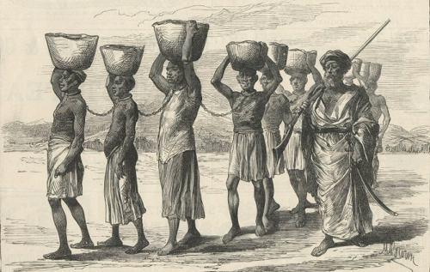
Migration
Enslaved Africans (diaspora)
  To South America, North America, Caribbean
European pioneers

Slide 27
Global Trade takes root
Origins
Environmental Effects
Transoceanic trade in Atlantic Ocean basin
  Manufactured goods from Europe
  Raw goods from Americas
The Manila galleons
  1565-1815, Spanish galleons dominate Pacific Ocean trade
  Chinese luxury goods for American raw materials, especially silver
Fur-bearing animals hunted to extinction or
near-extinction
  Also whales, codfish, other animals with industrial uses
Relentless human exploitation of the natural environment

Slide 28
