Slide 1
Tradition and Change in East Asia
LIST: What connections can you make between east Asian and other civilizations from 1450-1750?

Slide 2
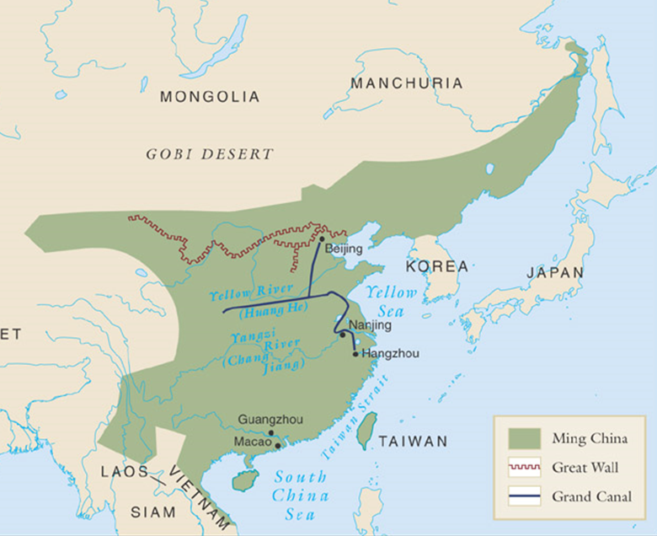
The Ming Dynasty (1368-1644)
Ming (“Brilliant”) dynasty comes to power after Mongol Yuan dynasty driven out
Founded by Emperor Hongwu (r. 1368-1398)
Used traveling officials called Mandarins and large number of eunuchs to maintain control
  Sterile, could not build hereditary power base
Emperor Yongle (r. 1403-1424) experiments with sea expeditions, moves capital north to Beijing to deter Mongol attacks (monitor)
  Zheng He voyages

Slide 3
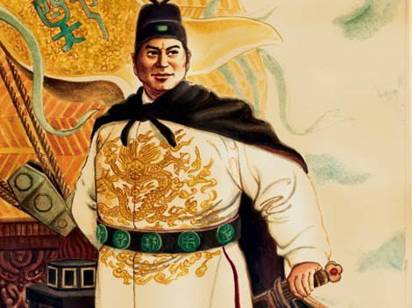
Exploration and Colonization
Ming dynasty hesitant to have large foreign populations
  Mongol experience
  Allowed small populations in port cities
Yongle engaged Admiral Zheng He to mount seven massive naval expeditions, 1405-1433
Placed trade under imperial control
Demonstrated strength of Ming dynasty
Successful, but aborted as Mongols presented new threat in the north

Slide 4
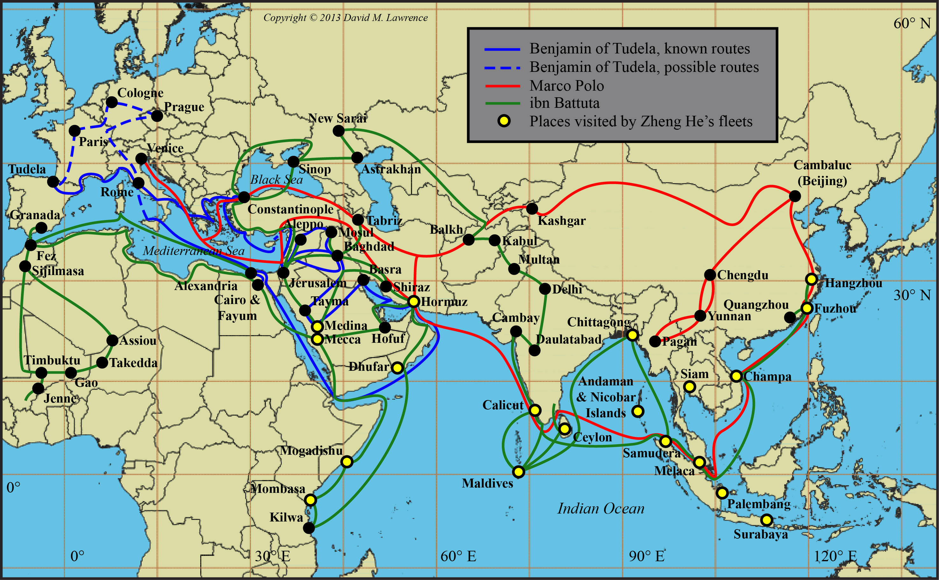
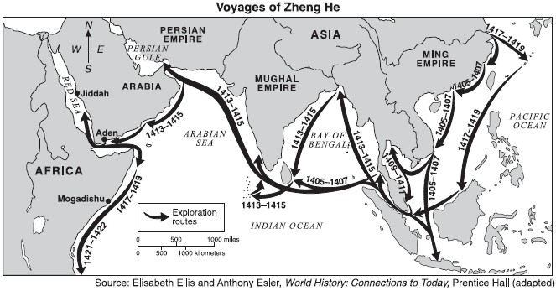

Slide 5
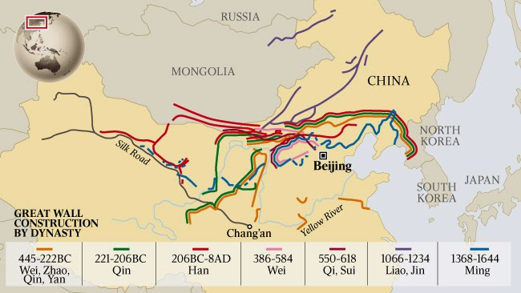
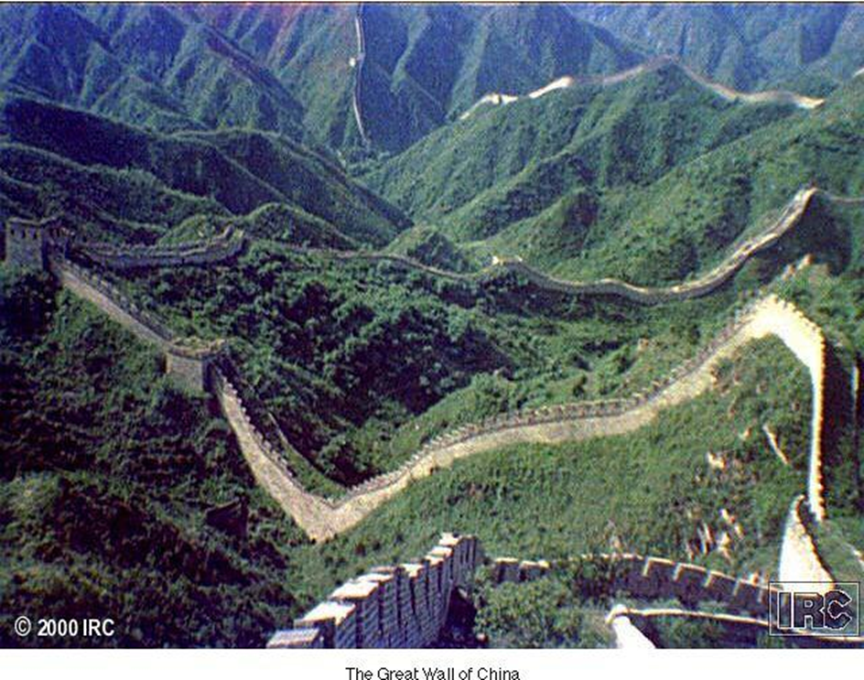
The Great Wall
Origins before 4th century BCE; ruins from Qin dynasty in 3rd century BCE
Rebuilt under Ming rule, 15th-16th centuries
  1,550 miles, 33-49 feet high
  Guard towers
  Room for housing soldiers

Slide 6
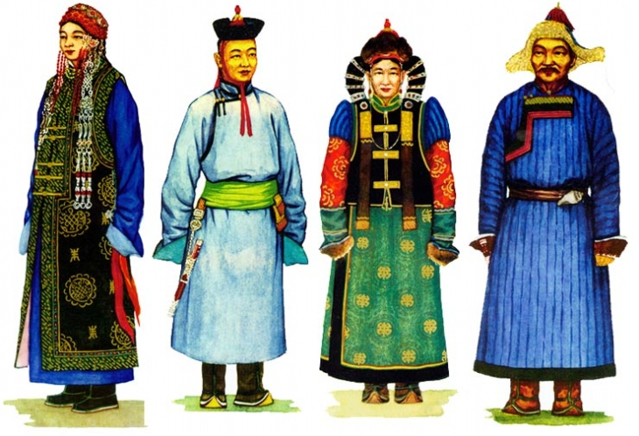
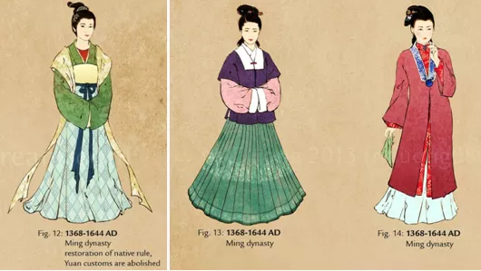
Eradicating the Mongol Past
Ming emperors encourage abandonment of Mongol names, dress
Support study of Confucian classics
Civil service examinations renewed

Slide 7
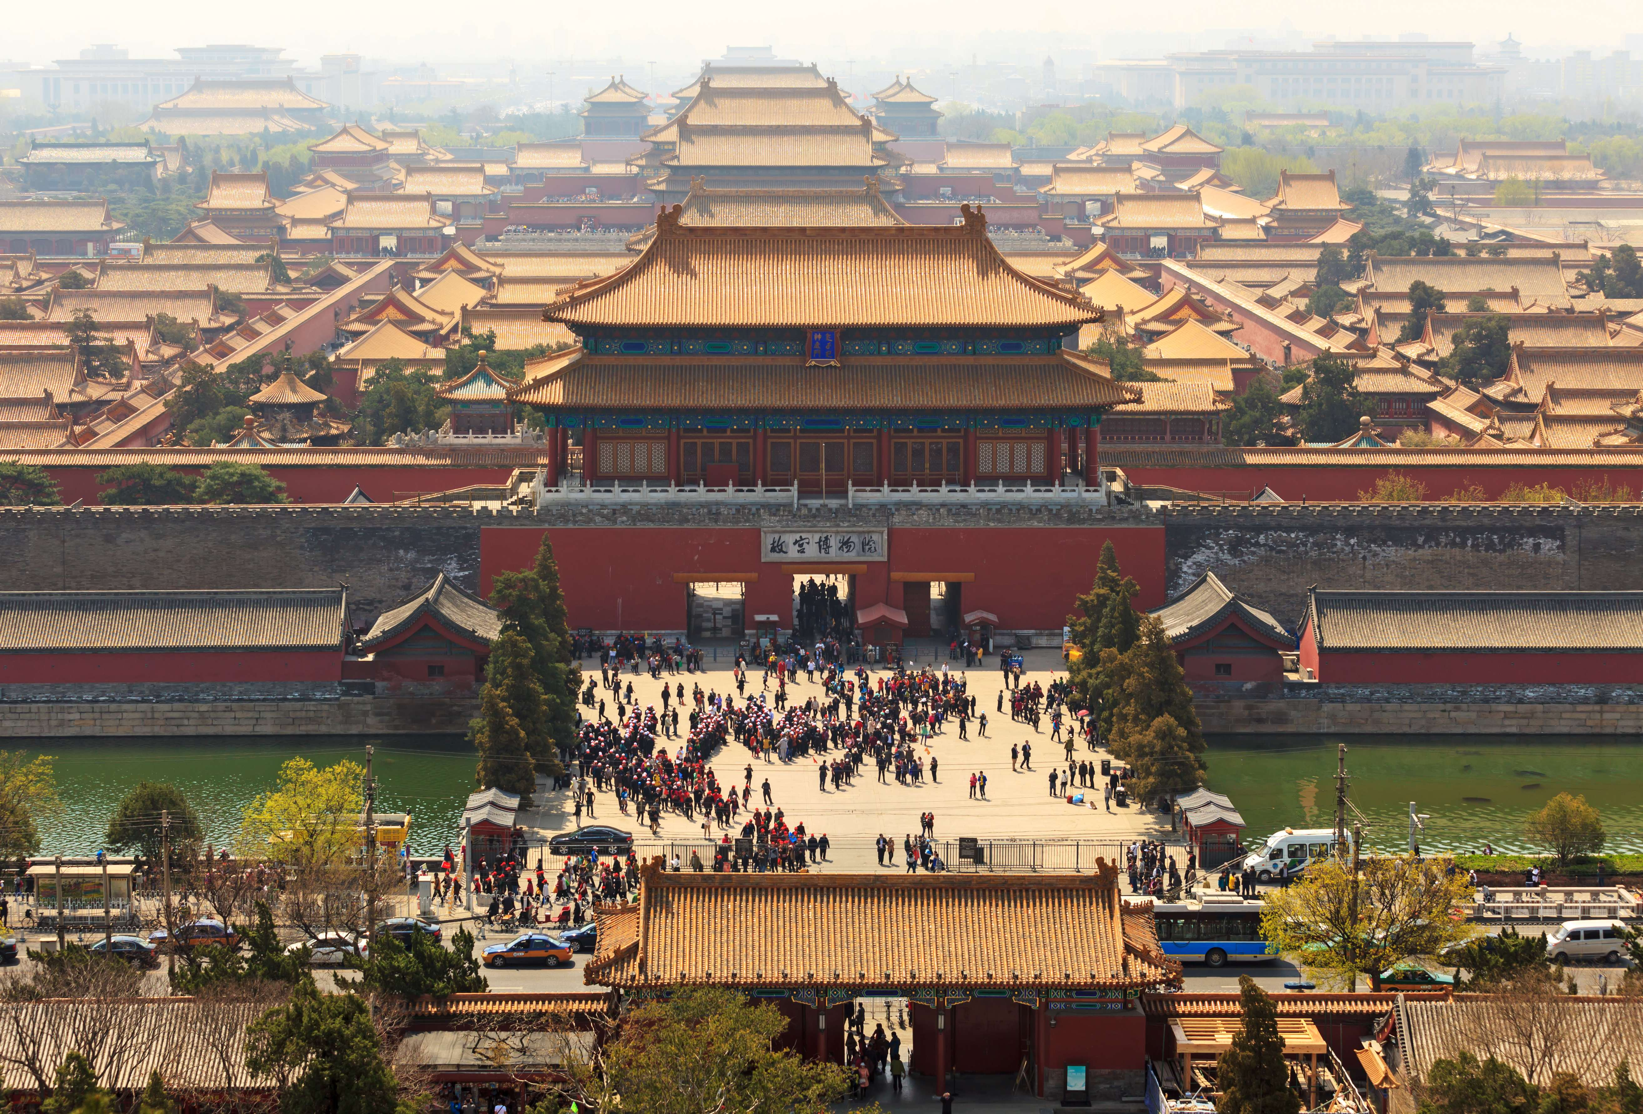
Ming Decline
16th century maritime pirates harm coastal trade
  Navy, government unable to respond effectively
Emperors secluded in Forbidden City, palace compound in Beijing
  Hedonism
  Emperor Wanli (r. 1572-1620) abandons imperial activity to eunuchs

Slide 8
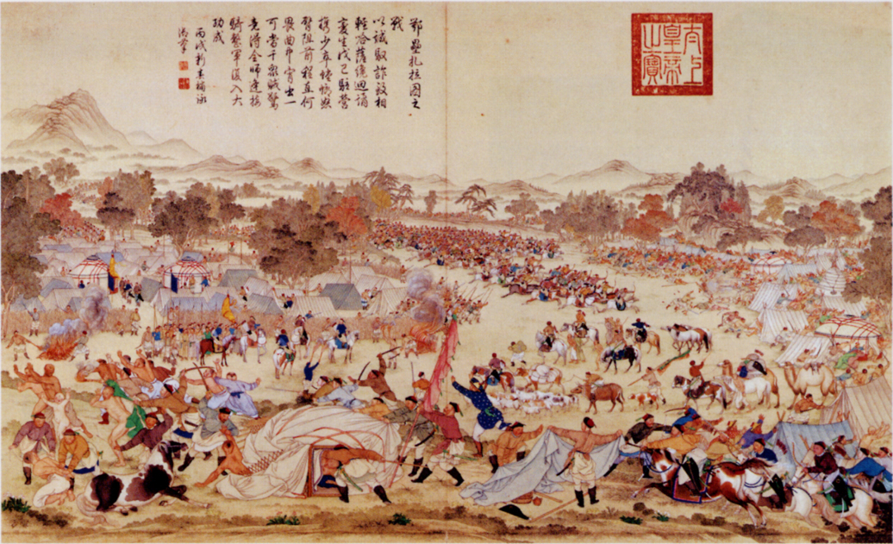
Ming Collapse
Little Ice Age (1300-1860) leads to famines, peasant rebellions in early 17th century
Rebels take Beijing in 1644
Manchu fighters enter from the north and retake city to “help Ming”
  Manchus refuse to allow reestablishment of Ming dynasty
Establish Qing (“Pure”) Dynasty

Slide 9
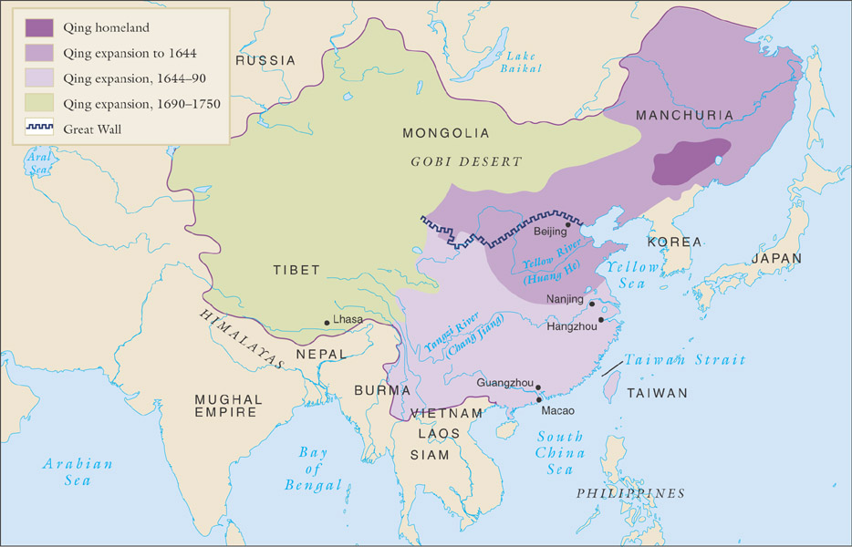
The Qing empire, 1644-1911

Slide 10
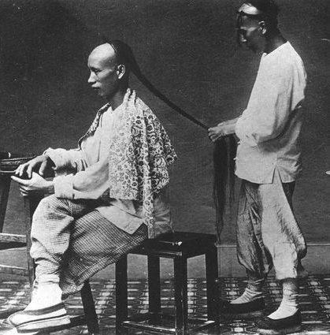
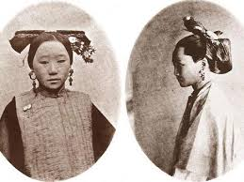
The Qing Dynasty (1644-1911)
Manchus originally pastoral nomads, north of Great Wall
Establish control over Korea, Mongolia, China
  War with Ming loyalists to 1680
  Support from many Chinese fed up with Ming corruption
Manchus forbid intermarriage and study of Manchu language by Chinese; force Manchu hairstyles as sign of loyalty (queue)

Slide 11
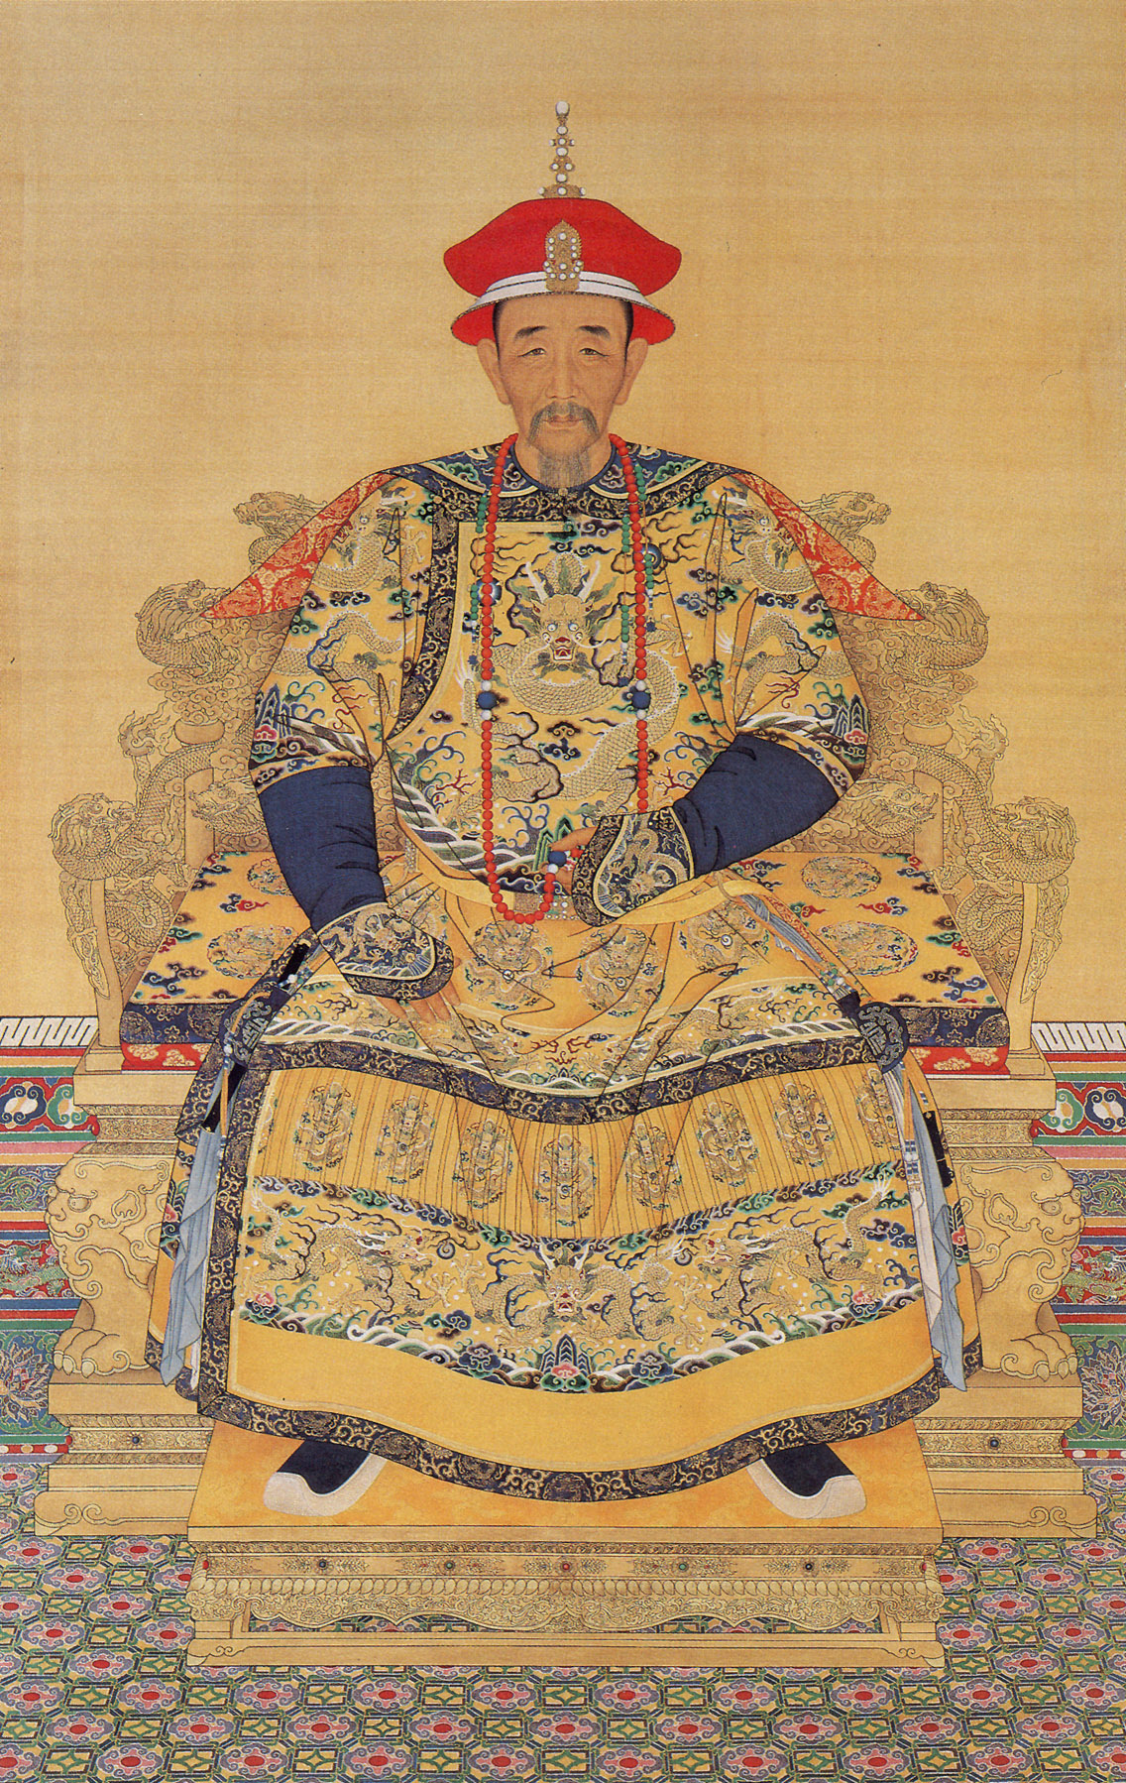
Emperor Kangxi (r. 1661-1722)
Confucian scholar, poet (“enlightened”)
Military conquests: island of Taiwan, Tibet, central Asia
Grandson Emperor Qianlong (r. 1736-1795) expands territory
  Height of Qing dynasty
Great prosperity; tax collection cancelled on several occasions!
Re-established tradition of responsibilities to eunuchs late in reign.

Slide 12
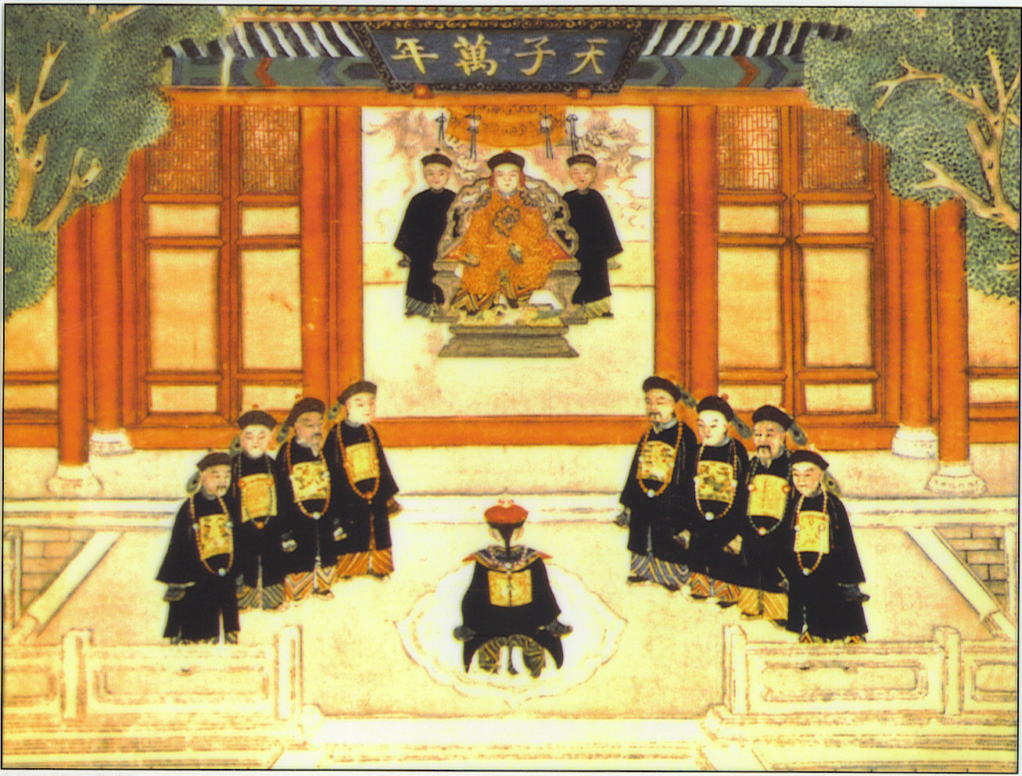
The “Son of Heaven”
Ming, Qing Emperors considered quasi-divine
Hundreds of concubines, thousands of eunuch servants
Clothing designs, name characters forbidden to rest of population
The kowtow continues: three bows, nine head-knocks

Slide 13
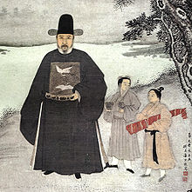
The Scholar-Bureaucrats
Ran government on a day-to-day basis
Graduate from intense civil service examinations
  Open only to men
  Curriculum: Confucian classics, calligraphy, poetry, essay writing
  Also: history, literature

Slide 14
The Civil Service Examinations
District, provincial, and metropolitan examination (elimination) levels
Only 300 allowed to pass at highest level
  Multiple attempts common
Students expected to bring food/water, bedding, chamber pots, ink for three-day uninterrupted examinations
  Assigned tiny room to work
  Students searched for printed materials before entering private cells
Make a meme for me!

Slide 15
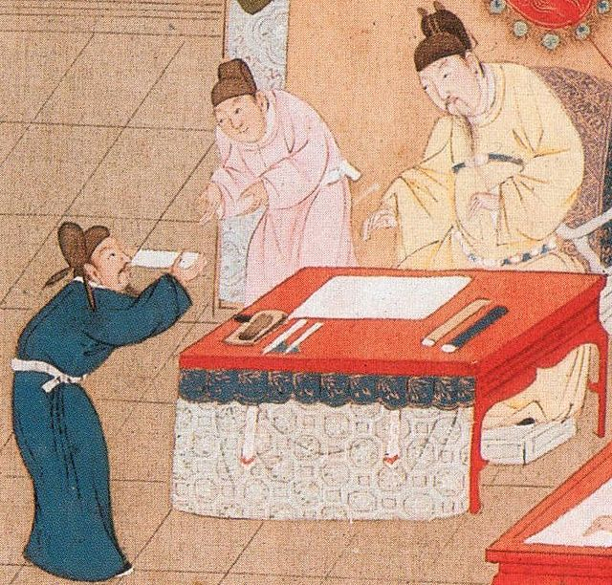
Examination System and Society
Ferocious competition
Qing dynasty: 1 million degree holders compete for 20,000 government positions
  Remainder turn to teaching, tutoring positions
Some corruption, cheating
Advantage for wealthy classes: hiring private tutors, etc.
But open to all, tremendous opportunity for social mobility

Slide 16
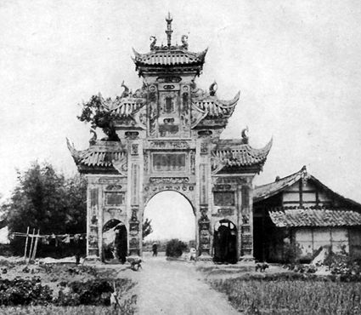
Gender Relations
Males receive preferential status
Economic factor: girls join husband’s family
  Infanticide common
Widows strongly encouraged not to remarry
  Chaste widows honored with ceremonial arches
Men control divorce
  Grounds: From infidelity to talking too much!

Slide 17
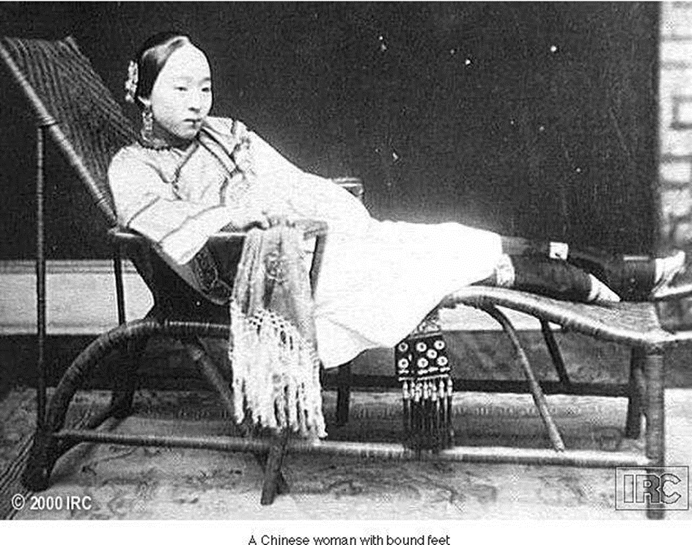
Foot binding Continues
Origins in Song dynasty (960-1279 CE)
Perceived aesthetic value
Statement of social status and/or expectations
  Commoners might bind feet of especially pretty girls to enhance marriage prospects

Slide 18
Population Growth and Economic Development
Only 11% of China arable
  Intense, garden-style agriculture necessary
American food crops introduced in 17th century
  Maize, sweet potatoes, peanuts
Rebellion and war reduce population in 17th century
  Offset by increase due to American crops

Slide 19

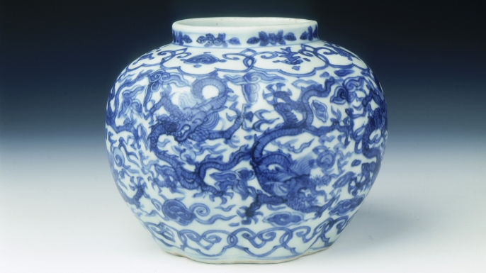
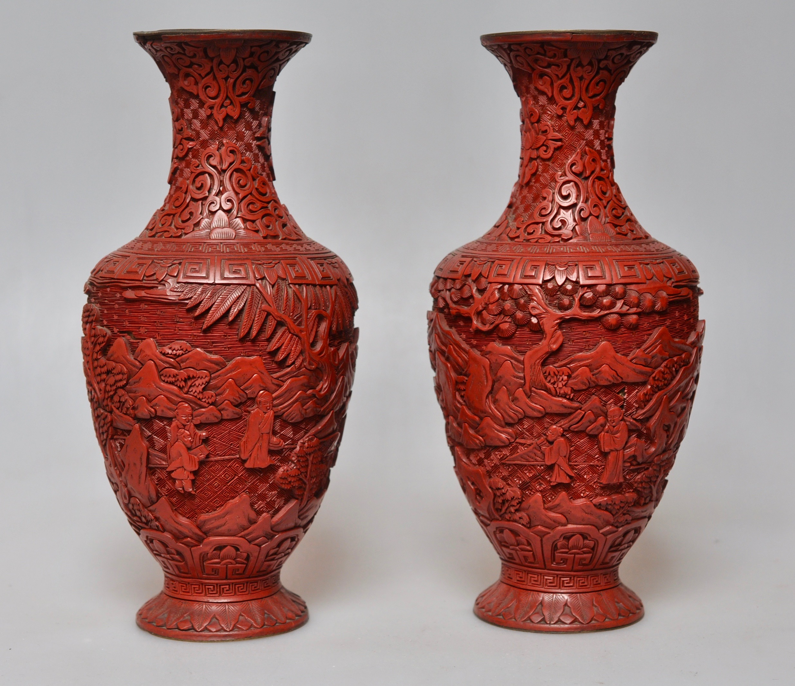
Foreign Trade
Export silk, porcelain, tea, lacquerware
Chinese, in turn, import relatively little
  Spices, animal skins, woolen textiles
Received silver bullion from Americas for exports
After Emperor Yongle’s early maritime expeditions (1405-1433), Ming dynasty abandons large-scale maritime trade plans
Chinese merchants continue to be active in southeast Asia, esp. Manila
Extensive dealings with Dutch VOC

Slide 20
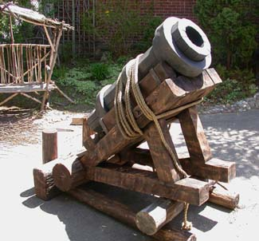
Government and Technology
During Tang and Song dynasties (7th-13th centuries), China a world leader in technology
Stagnates during Ming and Qing dynasties
  European cannons purchased, based on early Chinese invention of gunpowder
Government suppressed technological advancement, fearing social instability would result
  Mass labor over productivity

Slide 21

Classes in Chinese Society
Privileged Classes
  Scholar-bureaucrats, gentry (educated nobility)
  Distinctive clothing with ranks
  Immunity from some legal proceedings, taxes, labor service
Working classes
  Peasants, artisans/workers, merchants
  Confucian doctrine gives greatest status to peasants
  Merchant activity not actively supported
Lower classes
  Military, beggars, slaves

Slide 22
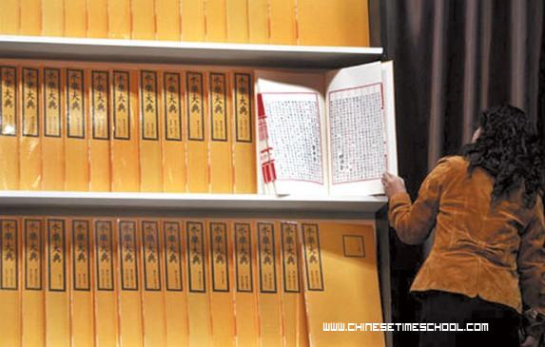
Neo-Confucianism
Version of Confucian thought promoted by Zhu Xi (1130-1200 CE)
  Confucian morality with Buddhist spirituality and logic
Education at various levels promoted
  Hanlin Academy, Beijing
  Provincial schools
Compilation of massive Yongle Encyclopedia
Development of popular novels as well

Slide 23
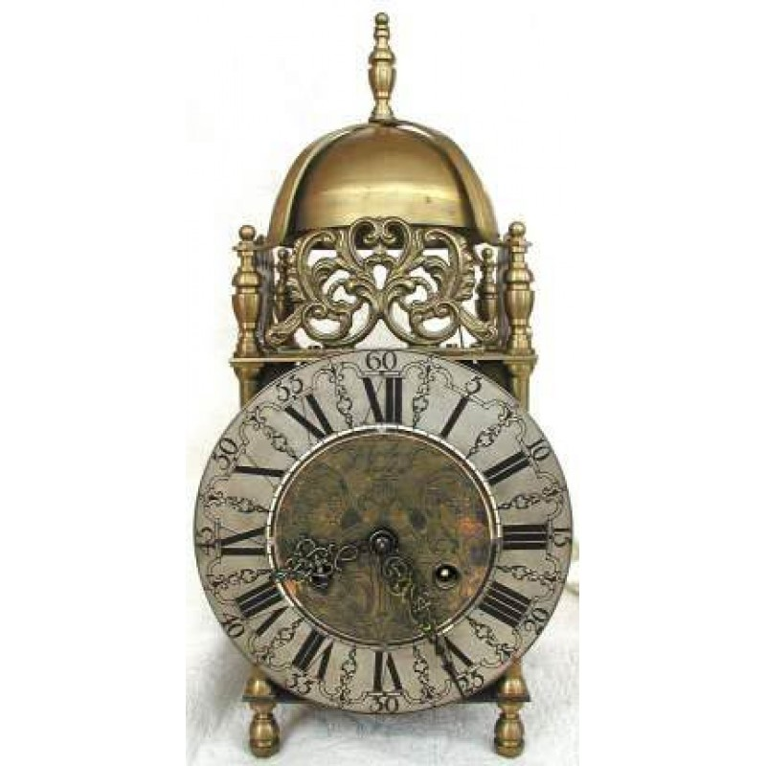
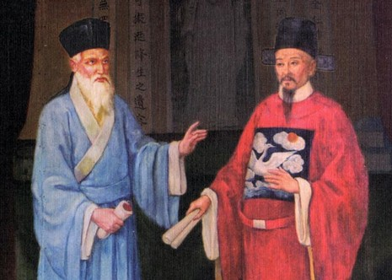
Christianity in China
Nestorian, Roman Catholic Christians had presence in China
  Disappeared with plague and social chaos of 14th century
Jesuits return under Matteo Ricci (1552-1610), attempt to convert Ming Emperor Wanli
  Mastered Chinese before first visit in 1601
Brought western mechanical technology
    Prisms, harpsichords, clocks

Slide 24
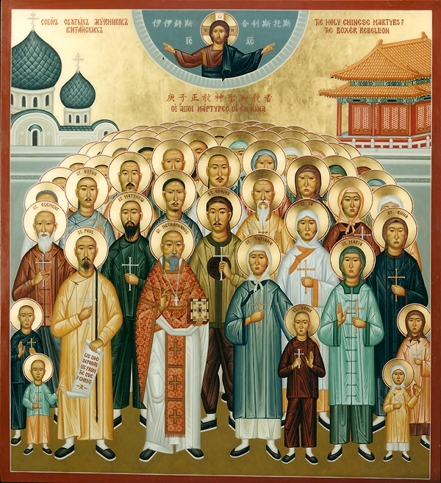
Confucianism and Christianity
Argued that Christianity was consistent with Confucianism
  Claimed differences due to Neo-Confucian distortions
Yet few converts in China
  Only 200,000 mid 18th century,
  Christian absolutism difficult accept (must reject Chinese ideologies)
Franciscans and Dominicans convince Pope that Jesuits compromising Christianity with Chinese traditions
Pope bans ancestor worship; Emperor Kangxi bans Christianity in China

Slide 25
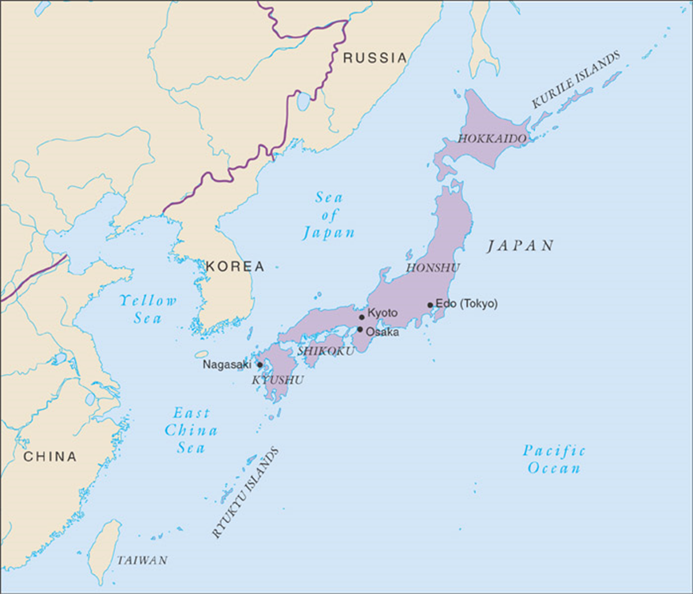
The Unification of Japan
Shoguns rule Japan, 12th-16th centuries
  Large landholders with private armies
  Emperor merely a figurehead
  Constant civil war: 16th century considered sengoku era, “country at war”
Tokugawa Ieyasu (r. 1600-1616) establishes military government
  Bakufu: (temporary) “tent government”
  Establishes Tokugawa dynasty (1600-1867)

Slide 26
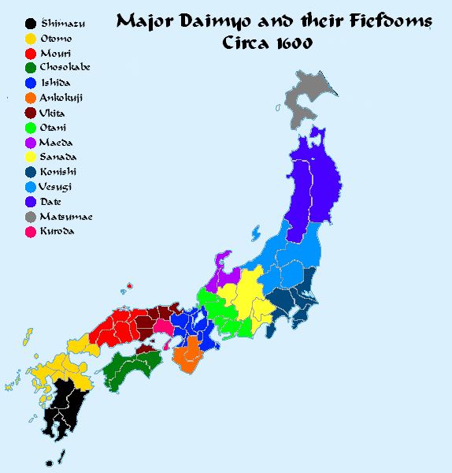
Control of Daimyo (“Great Names”)
Approximately 260 powerful territorial lords
  Independent militaries, judiciaries, schools, foreign relations, etc.
From capital Edo (Tokyo), shogun requires “alternate attendance”: daimyo forced to spend every other year at court
  Controlled marriage, socializing of daimyo families
Beginning 1630s, shoguns restrict foreign relations
  Travel, import of books forbidden
  Policy strictly maintained for 200 years

Slide 27
Economic Growth in Japan
End of civil conflict contributes to prosperity
New crop strains, irrigation systems improve agricultural production
Yet population growth moderate
  Contraception, late marriage, abortion
  Infanticide: “thinning out the rice shoots”

Slide 28
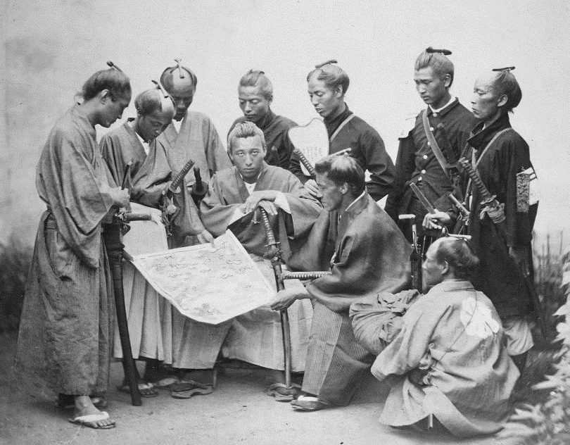
Social Change
End of civil disturbances create massive unemployment of Daimyo, Samurai warriors
Encouraged to join bureaucracy, pursue scholarship
Many declined into poverty
Urban wealthy classes develop from trade activity

Slide 29
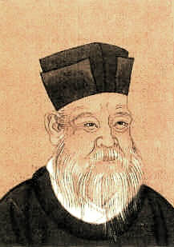
Neo-Confucianism in Japan
Chinese cultural influence extends through Tokugawa period
  Chinese language essential to curriculum
  Zhu Xi and Neo-Confucianism remain popular (filial piety = loyalty to superiors)
“Native Learning” popular in 18th century with intellectuals
  Folk traditions, Shinto
  Rejection of Neo-Confucianism and Buddhism as “foreign”

Slide 30
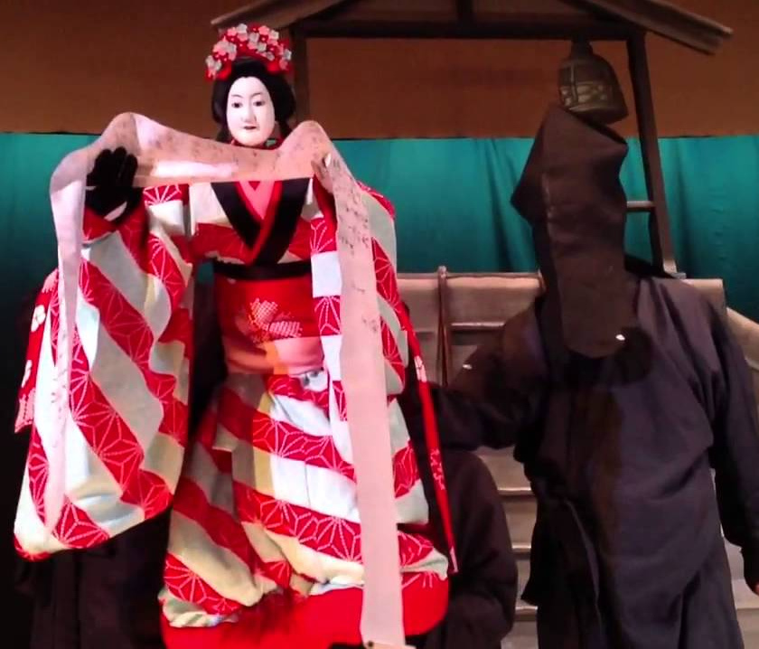
Floating Worlds (Ukiyo)
Urban culture expressed in entertainment and pleasure industries
  Marked contrast to bushido ethic of Stoicism
Novels - Ihara Saikaku (1642-1693), The Life of a Man Who Lived for Love
Kabuki theatre, men playing women’s roles
Bunraku puppet theatre
Ukiyo-e art – depicted interests of the common people

Slide 31
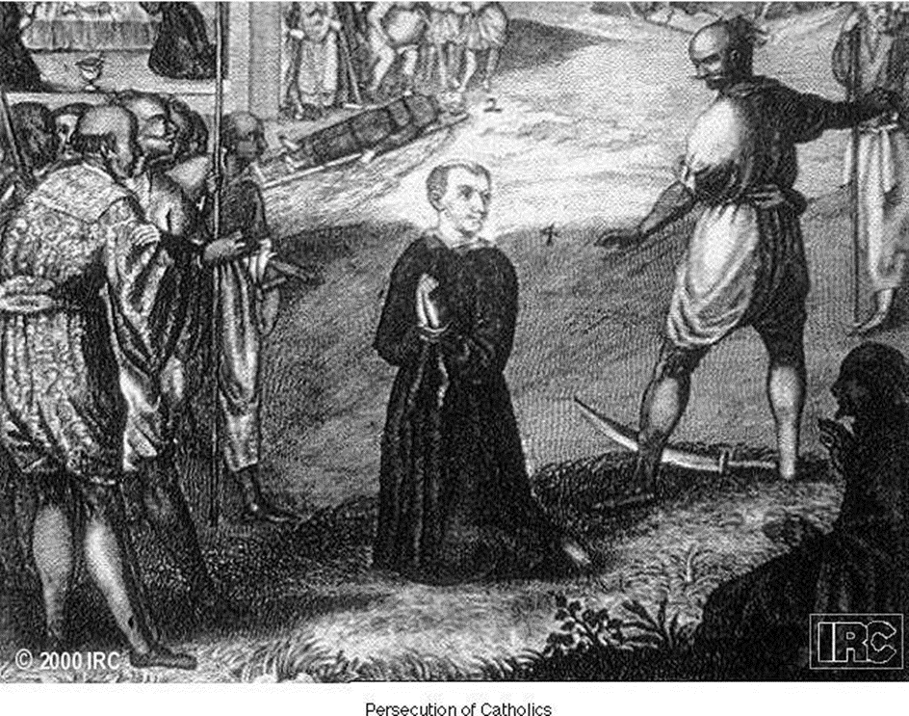
Christianity in Japan
Jesuit Francis Xavier in Japan, 1549
Remarkable success among daimyo
  Daimyo also hoping to establish trade relations with Europeans
Government backlash
  Fear of foreign intrusion
  Confucians, Buddhists resent Christian absolutism
Anti-Christian campaign 1587-1639 restricts Christianity, executes staunch Christians
  Sometimes by crucifixion

Slide 32
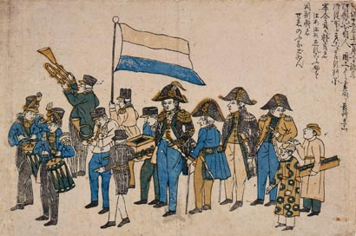
Dutch Learning
Dutch presence at Nagasaki principal route for Japanese understanding of the world
Before ban on foreign books lifted (1720), Japanese scholars study Dutch to approach European science, medicine, art

