Slide 1
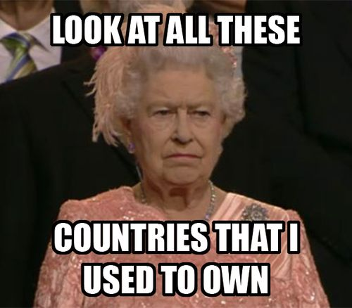
IMPERIALISM:
The Building of Global Empires

Slide 2
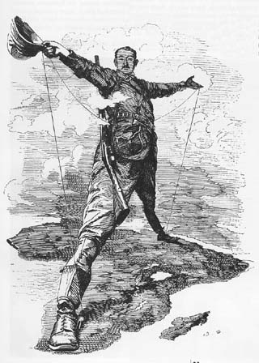
The idea of Imperialism
Imperialism - Domination of European powers (eventually US and Japan too) over subject lands in the larger world
Empires of modern world differ from those of ancient times
  Political, economic, social, and cultural systems dominate subject lands
E-M-P-I-R-E

Slide 3
Motivations for Imperialism: E – M – P…
Economic - CAPITALISM!
  Obtain raw materials to produce goods (supply)
  Expansion of markets (demand)
  Increase profits
Military
  Distract from social and political issues at home
  Ensure dominance/control of desired resources
Political
  Claim land for the “mother country”
  Ensure country has access to greater resources than others
  Control another country’s government (stability)
  Secure homeland by removal of criminal/dissident populations

Slide 4
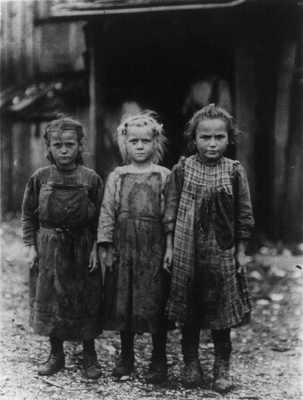
Domestic Political Considerations
Crises of industrialism
Pressure from nascent Socialism
Imperial policies distract proletariat from domestic politics
  Cecil Rhodes: imperialism alternative to civil war

Slide 5


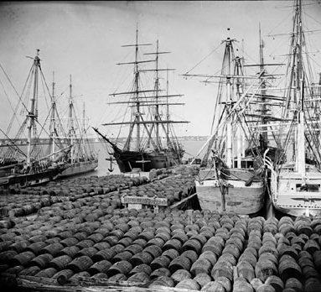
Geopolitical considerations
Strategic footholds
  Waterways
  Supply stations
  Imperial rivalries

Slide 6
Motivations for Imperialism: …I – R – E
Ideological
  “improve” non-Europeans’ way of life (ideas, clothing, way of life, etc.)
  Manifest Destiny!
  “White Man’s Burden”
Religious
  Convert native people to Christianity
  Indoctrinate next generation
Exploratory
  Map new lands
  Discover new exploitable resources (first!)

Slide 7
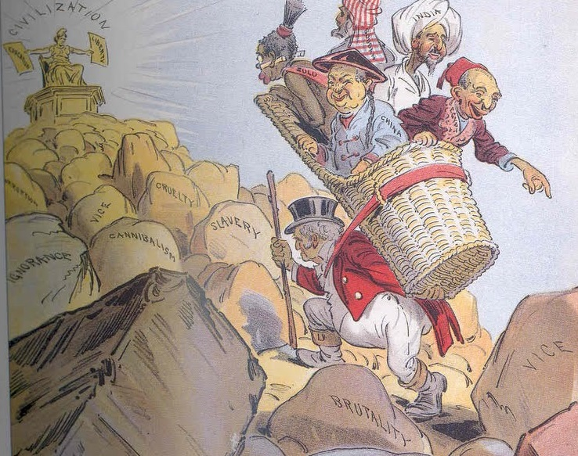
The “White Man’s Burden”
Rudyard Kipling (1864-1936)
  Raised in India, native Hindi speaker
  Boarding school in England, then return to India (1882)
Notes:
Take up the White Man's burden--
Send forth the best ye breed--
Go, bind your sons to exile
To serve your captives' need;
To wait, in heavy harness,
On fluttered folk and wild--
Your new-caught sullen peoples,
Half devil and half child.
Take up the White Man's burden--
In patience to abide,
To veil the threat of terror
And check the show of pride;
By open speech and simple,
An hundred times made plain,
To seek another's profit
And work another's gain.
Take up the White Man's burden--
The savage wars of peace--
Fill full the mouth of Famine,
And bid the sickness cease;
And when your goal is nearest
(The end for others sought)
Watch sloth and heathen folly
Bring all your hope to nought.
Take up the White Man's burden--
No iron rule of kings,
But toil of serf and sweeper--
The tale of common things.
The ports ye shall not enter,
The roads ye shall not tread,
Go, make them with your living
And mark them with your dead.
Take up the White Man's burden,
And reap his old reward--
The blame of those ye better
The hate of those ye guard--
The cry of hosts ye humour
(Ah, slowly!) toward the light:--
"Why brought ye us from bondage,
Our loved Egyptian night?"
Take up the White Man's burden--
Ye dare not stoop to less--
Nor call too loud on Freedom
To cloak your weariness.
By all ye will or whisper,
By all ye leave or do,
The silent sullen peoples
Shall weigh your God and you.
Take up the White Man's burden!
Have done with childish days--
The lightly-proffered laurel,
The easy ungrudged praise:
Comes now, to search your manhood
Through all the thankless years,
Cold, edged with dear-bought wisdom,
The judgment of your peers.

Slide 8
White Man’s Burden
“I contend that we (Britons) are the first race in the world, and the more of the world we inhabit, the better it is for the human race…It is our duty to seize every opportunity of acquiring more territory and we should keep this one idea steadily before our eyes that more territory simply means more of the Anglo-Saxon race, more of the best, the most human, most honorable race the world possesses.”
-Cecil Rhodes

Slide 9
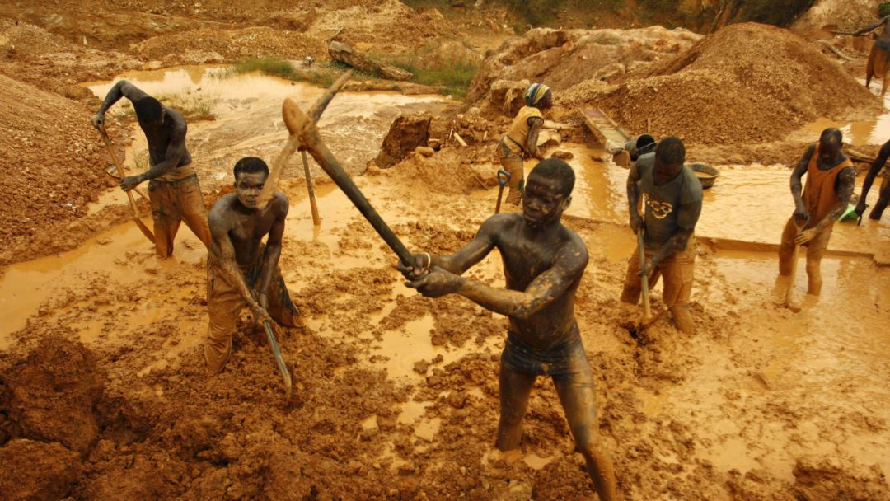
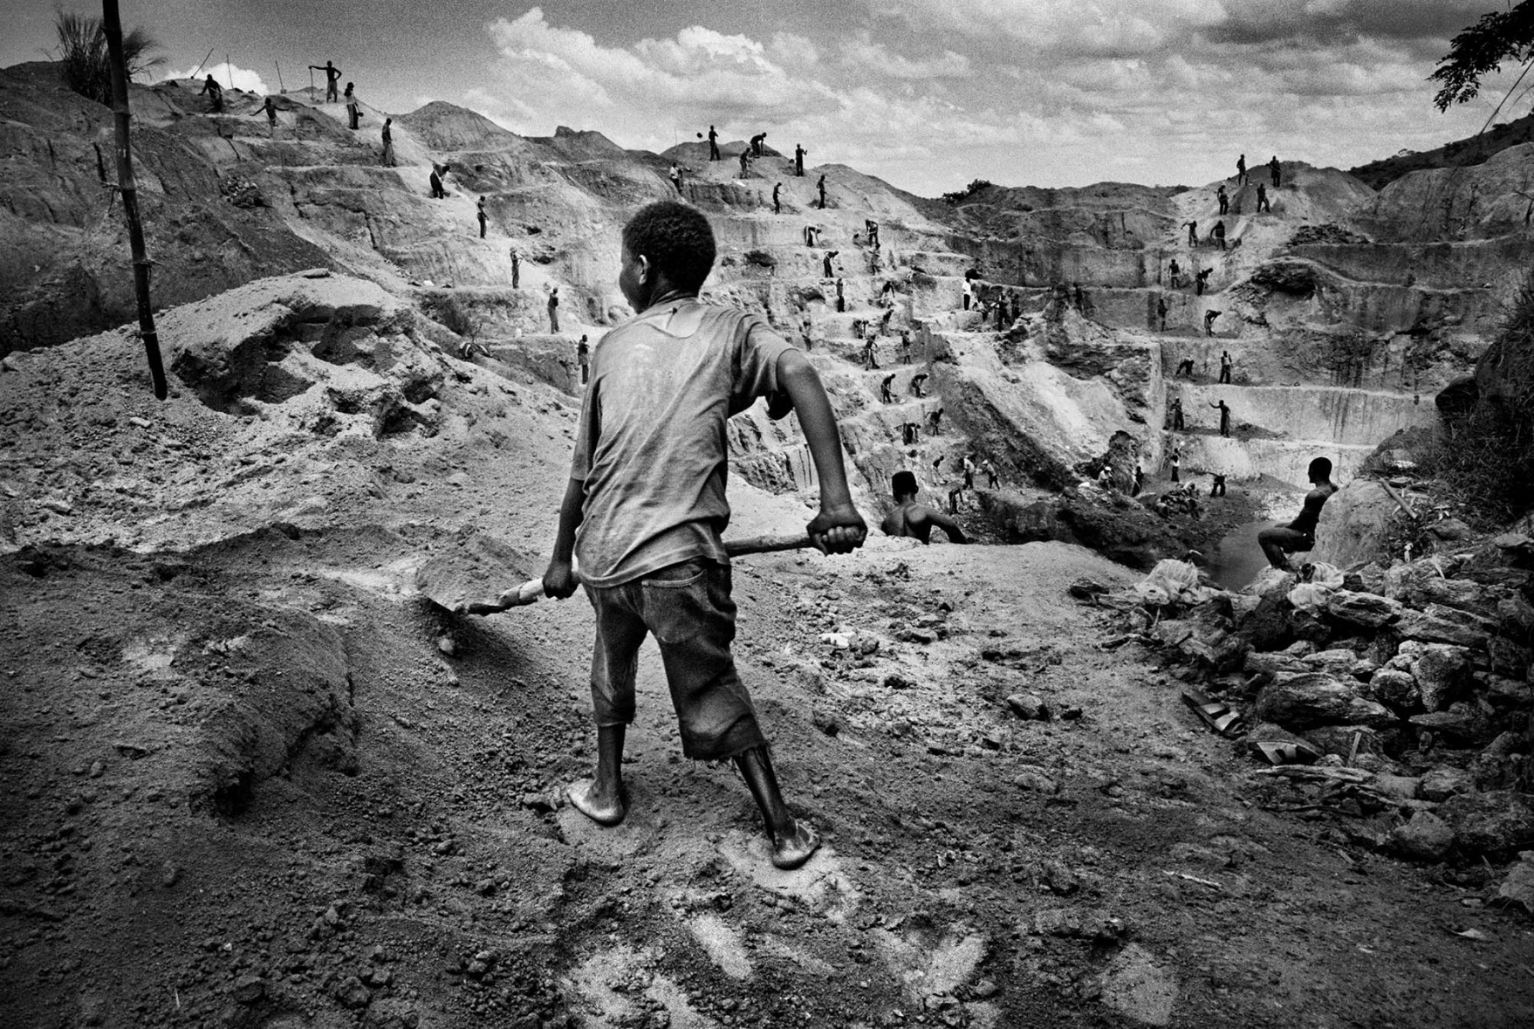
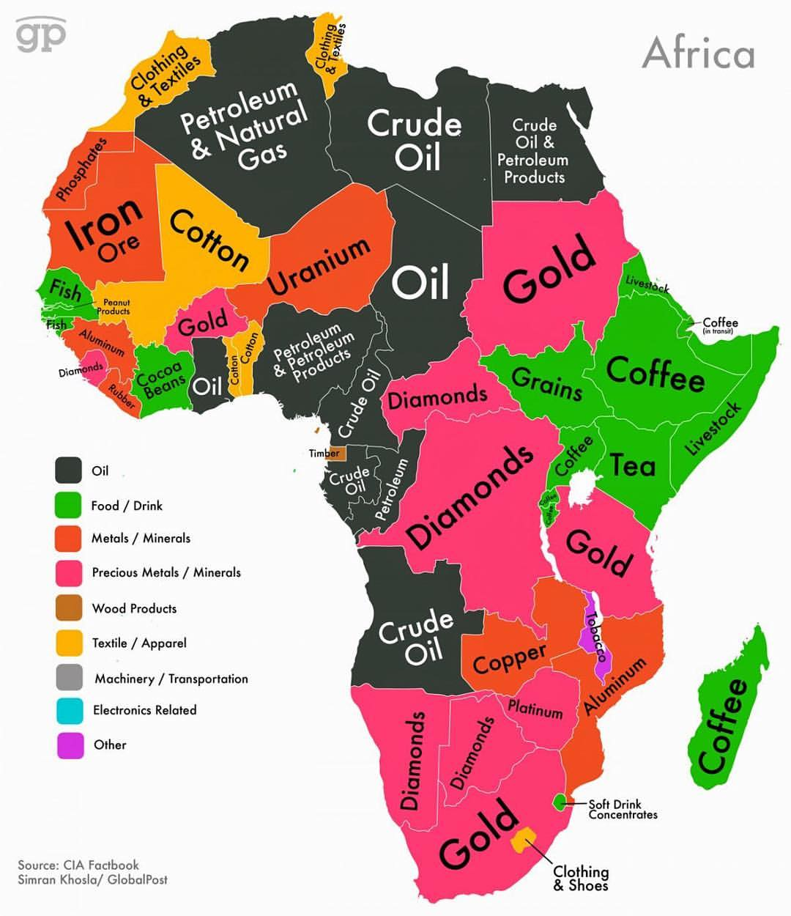
Modern African resources

Slide 10
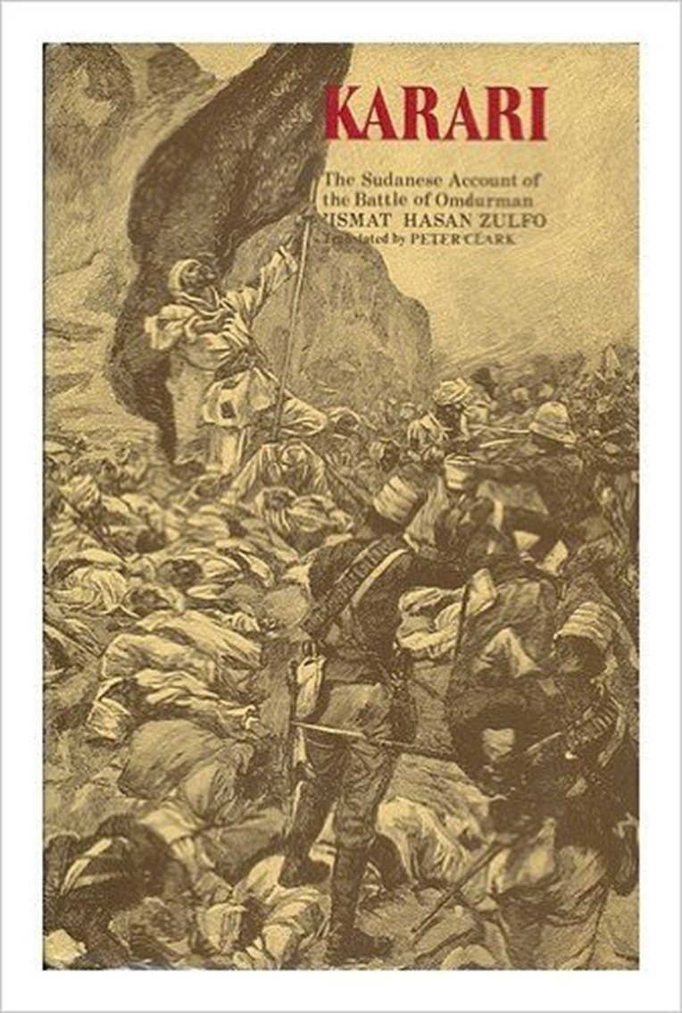
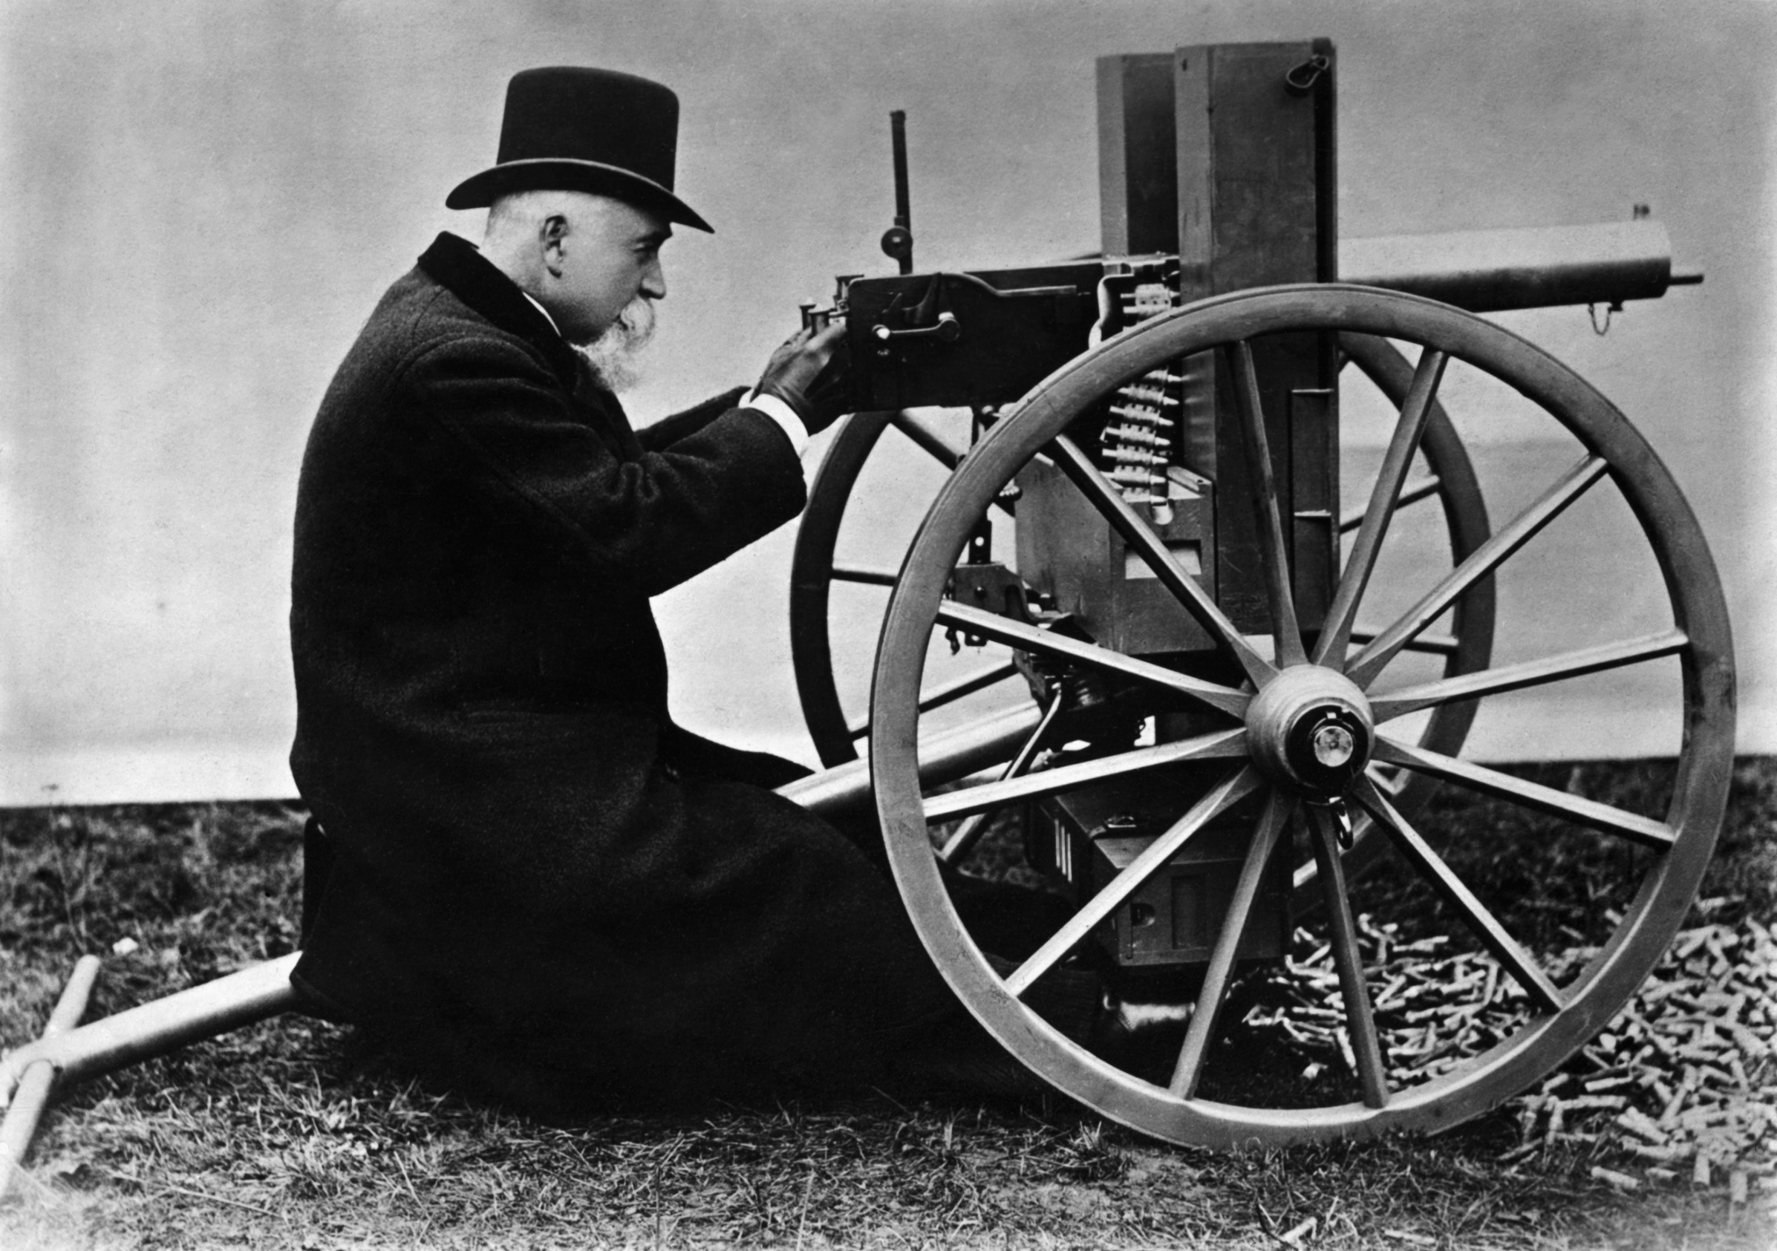
Tools of Empire: Weaponry
Firearms: from muskets to rifles to machines guns
Gatling gun (1862) to Maxim gun (1883), 11 rounds per second
In Battle of Omdurman 1898, British troops killed eleven thousand Sudanese in five hours
  British: six gunboats, twenty machine guns, 368 killed

Slide 11
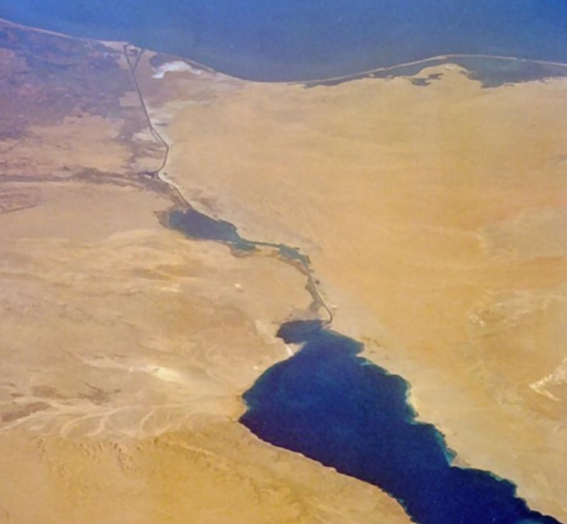
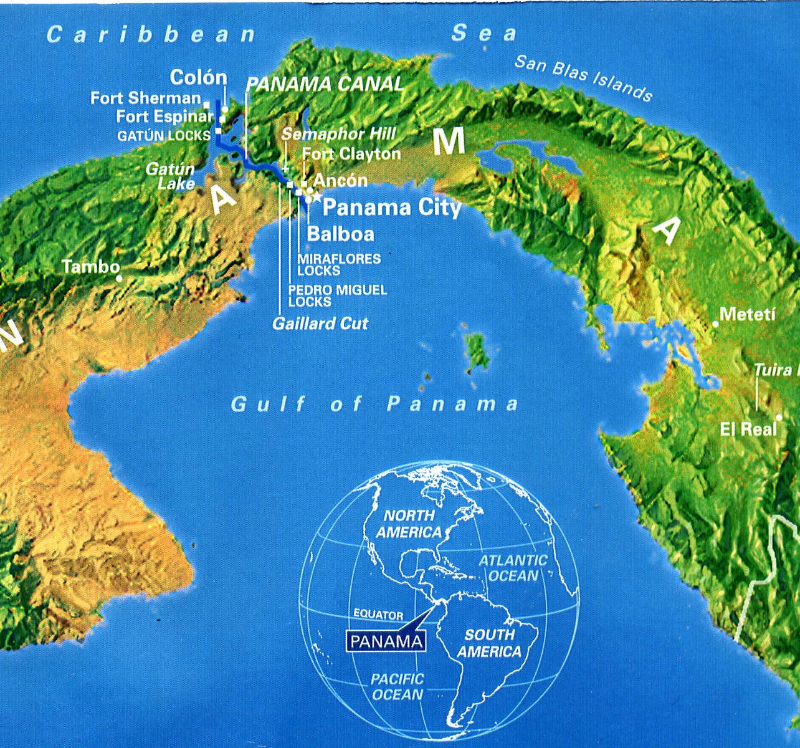
Tools of Empire: Transportation
Transportation
  Steamships
  Railroads
Infrastructure
  Suez Canal (1859-1869)
  Panama Canal (1904-1914)

Slide 12
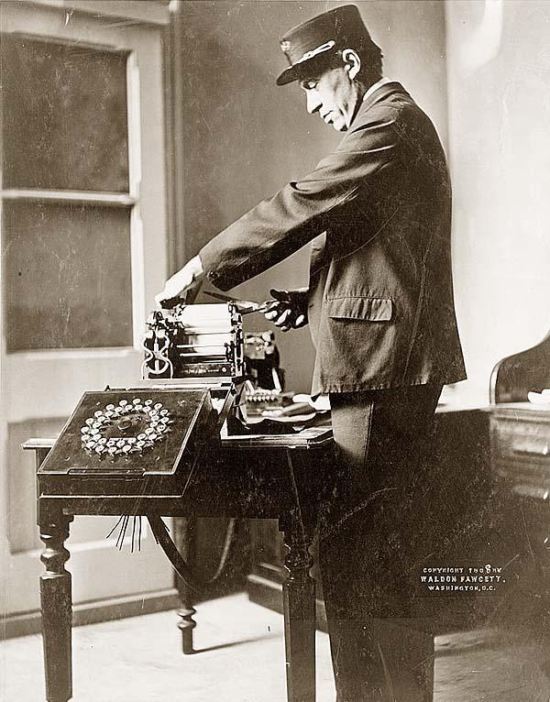
Tools of Empire: Communications
Communication technologies linked imperial lands with colonies
Correspondence
  1830 Britain-India: 2 years
  After Suez Canal, 2 weeks
Telegraph (invented 1830s, globally by 1900)
  1870s, development of submarine cables
  Britain-India: 5 hours!

Slide 13
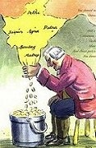
The Jewel of the British Crown: India
Company rule under EIC
Monopoly on India trade
  Cotton, coffee, tea, indigo, OPIUM!
Originally had permission from Mughal emperors
Mughal empire weakens after death of Aurangzeb, 1707
EIC took advantage of Mughal decline: began conquest of India in 1750s

Slide 14
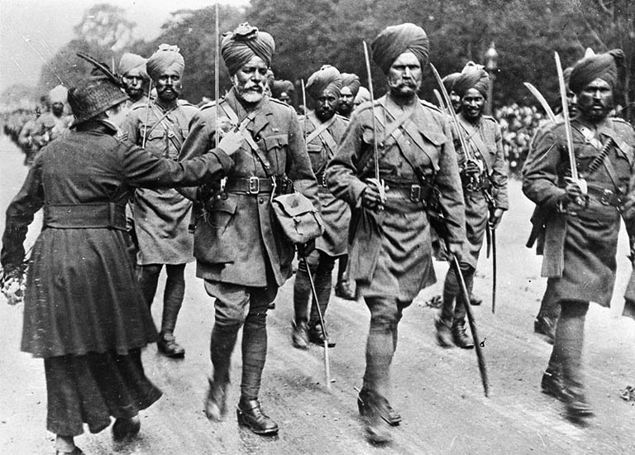
British Conquest
Built trading cities and forts at Calcutta, Madras, Bombay
Ruled domains with small British force and Indian troops (sepoys)

Slide 15
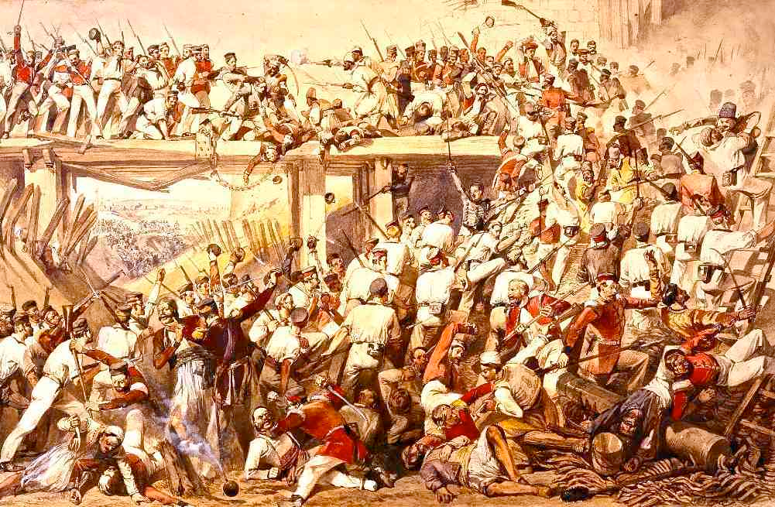
Sepoy Revolt, 1857
Enfield rifles
Cartridges in wax paper greased with animal fat
  Problem for Hindus: beef
  Problem for Muslims: pork
Sepoys capture garrison
  60 soldiers, 180 civilian males massacred (after surrender)
Attacks on British civilians led to swift British reprisals
  375 women and children murdered
British retake fort, hang rebels

Slide 16
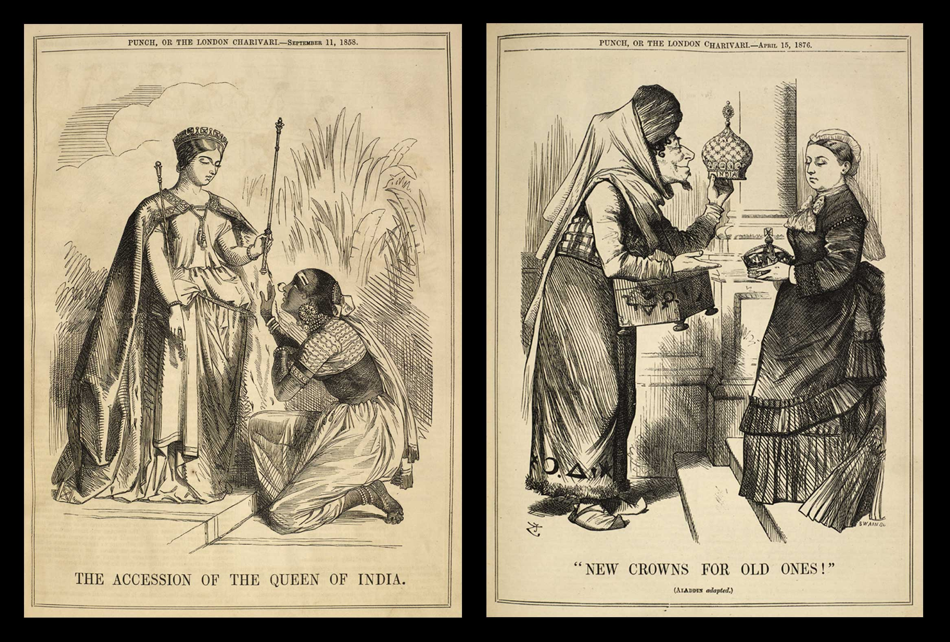
Britain establishes direct rule (1858)
British officials appointed a viceroy and formulated all domestic and foreign policy
  Pre-empts East India Company
Established civil service staffed by English
Indians held low-level bureaucratic positions

Slide 17
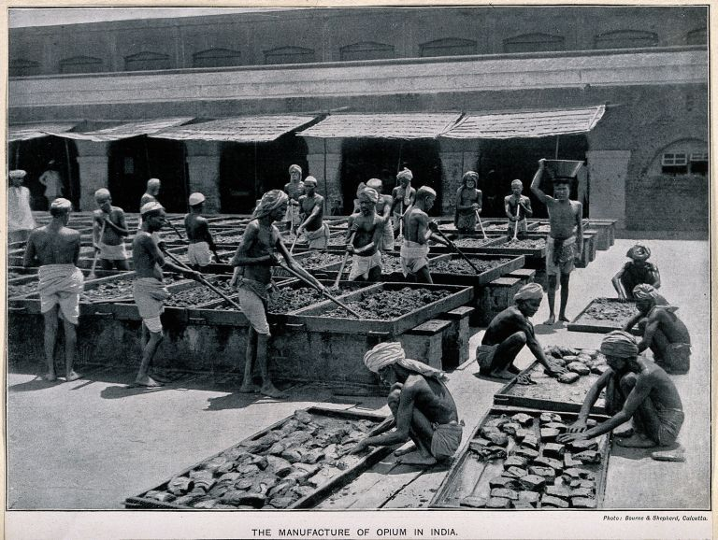
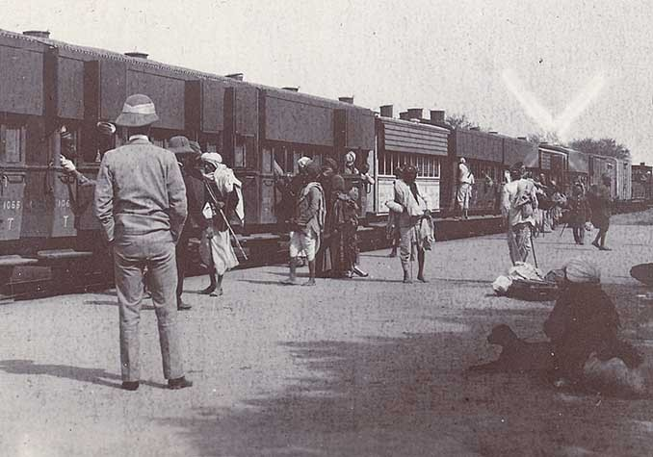
British Rule in India and Ceylon (Sri Lanka)
Introduction of commercial crops
  Tea, coffee, opium
Built railroads and telegraph lines, new canals, harbors, and irrigation methods

Slide 18
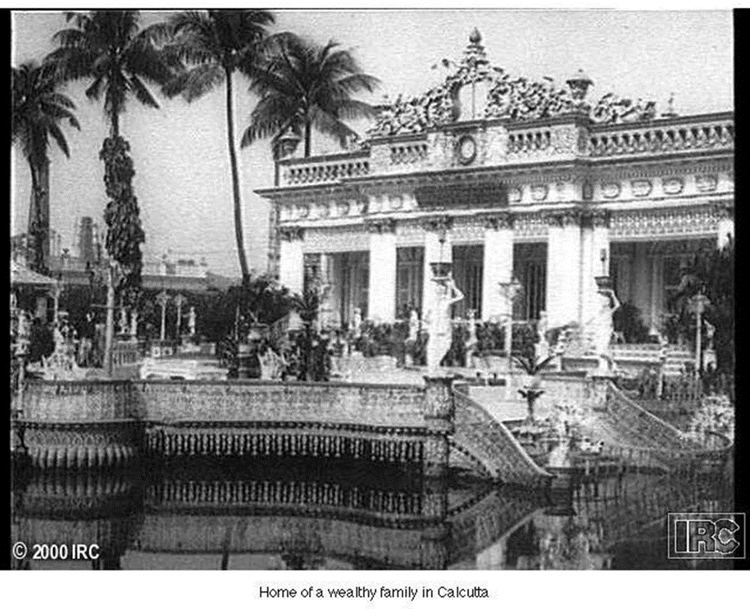
British Rule in India and Ceylon (Sri Lanka)
Stamp of British culture on Indian environment
British rule tried not interfere with Indian culture or Hindu religion
Established English-style schools for Indian elites
Outlawed Indian customs considered offensive, such as the sati
Veneer on poor Muslim-Hindu relations

Slide 19
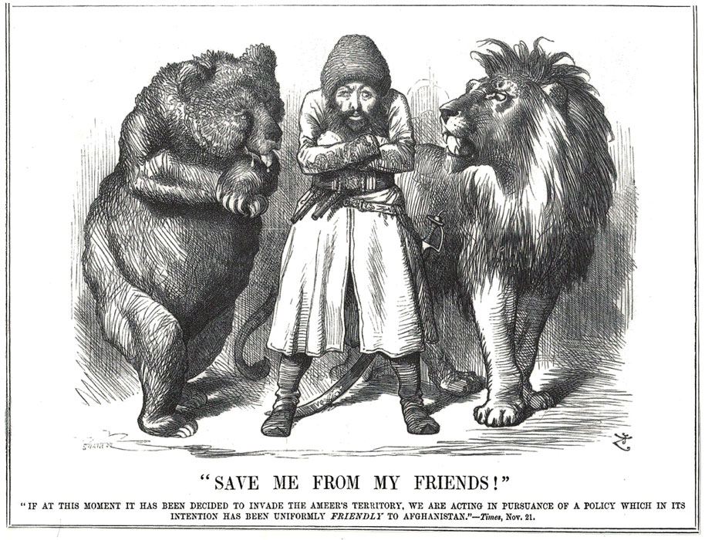
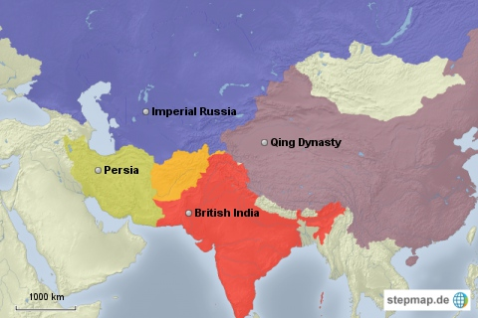
Imperialism in Central Asia
British, French, Russians complete for central Asia
  France drops out after Napoleon
  By 1860s Russian expansion reached northern frontiers of British India
  The “Great Game”- Russian vs. British intrigue in Afghanistan
  Preparation for imperialist war
  Russian and British explorers mapped, scouted, but never colonized Afghanistan
  Russian Revolution of 1917 forestalled war
  Russian dominance of central Asia lasted until 1991

Slide 20
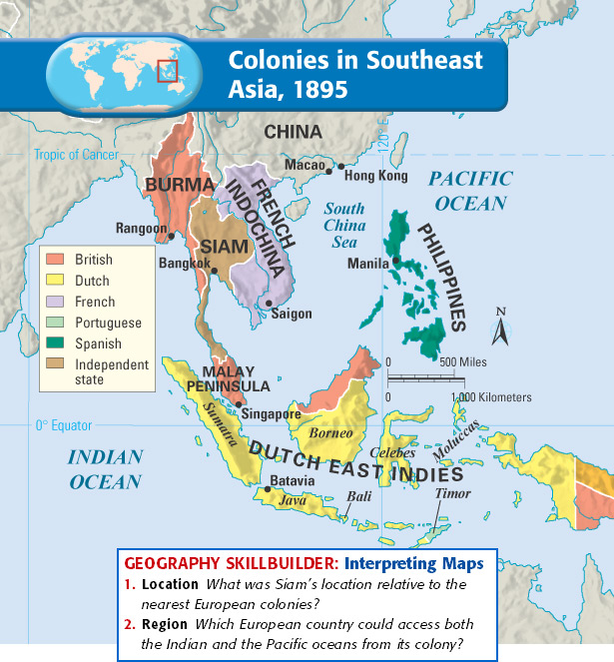
Imperialism in Southeast Asia
Spanish holds Philippines until 1898
Dutch East India Company held tight control of Indonesia (Dutch East India)
British establish presence from 1820s
  Conflict with kings of Burma (modern Myanmar) 1820s, established colonial authority by 1880s
  Port of Singapore founded 1824; was base for conquest of Malaysia, 1870s

Slide 21
Imperialism in Southeast Asia
French Indochina created, 1859-1893
  Consisted of Vietnam, Cambodia, Laos: former tribute states of Qing dynasty
French encouraged conversion to Christianity, established western-style schools
Kingdom of Siam (Thailand) left in place as buffer between Burma and Indochina

Slide 22
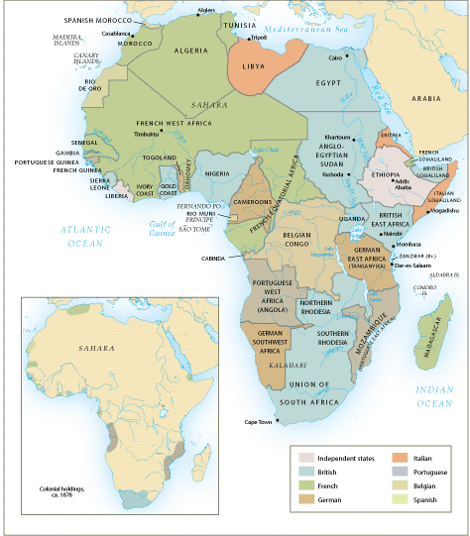
The Scramble for Africa (1875-1900)
French, Portuguese, Belgians, and English competing for “the dark continent”
Britain establishes strong presence in Egypt, Rhodesia
  Suez Canal
  Rhodesian gold. diamonds

Slide 23
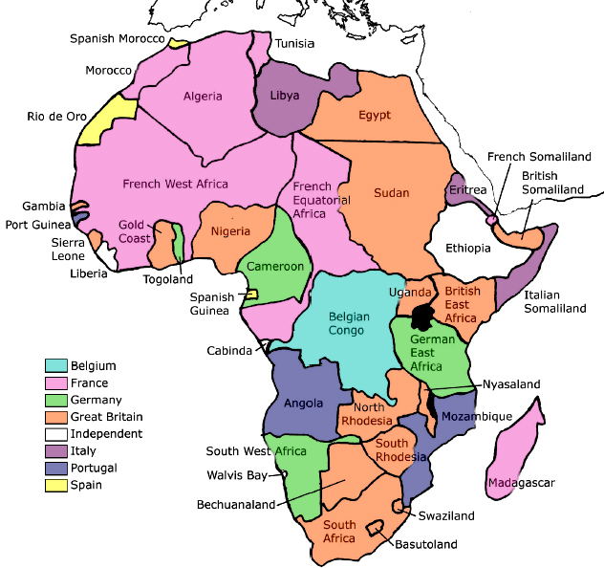
Rewriting African History
Between 1875 and 1900, European powers seized almost the entire continent
Early explorers charted the waters, gathered information on resources
Missionaries like David Livingstone (1841) set up mission posts
Henry Stanley sent by Leopold II of Belgium to create colony in Congo, 1870s
To protect their investments and Suez Canal, Britain occupied Egypt, 1882

Slide 24
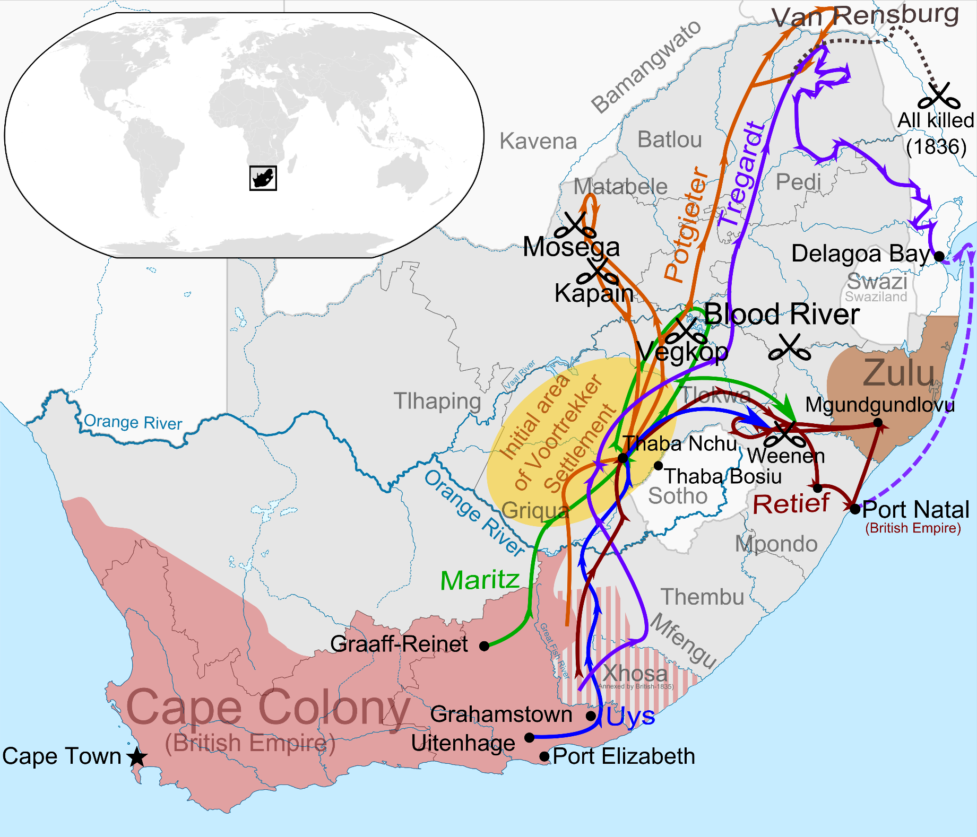
South African (Boer) War 1899-1902
Dutch East India establishes Cape Town (1652)
  Farmers (Boers) follow to settle territory, later called Afrikaners
  Competition and conflict with indigenous Khoikhoi and Xhosa peoples
British takeover in 1806, slavery a major issue of conflict (abolished slavery in 1833)
  Afrikaners migrate eastward: the Great Trek, overpower Ndebele and Zulu resistance with superior firepower
  Establish independent Republics

Slide 25
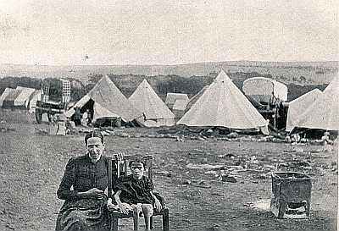
South African (Boer) Wars 1899-1902
Discovery of gold and diamonds in new Afrikaner lands leads to influx of British settlers
Boer War, 1899-1902: British defeated Afrikaners
1910 integrated into Union of South Africa

Slide 26
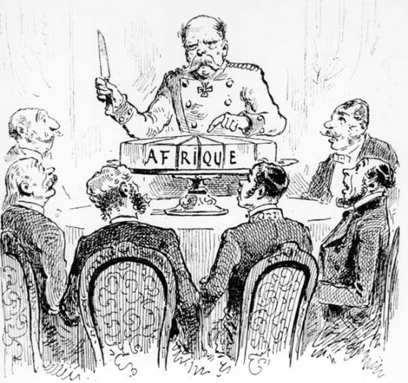
The Berlin West Africa Conference (1884-1885)
Fourteen European states, United States
  No African states present
  Rules of colonization: any European state can take “unoccupied” territory after informing other European powers
  Must get signature(s) from native leaders
European firepower dominates Africa
  Exceptions: Ethiopia fights off Italy (1896); Liberia a dependency of the US

Slide 27
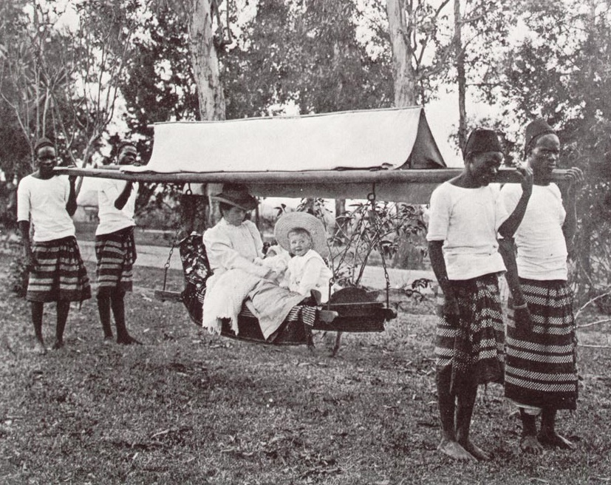
Systems of Colonial Rule
Concessionary companies
  Private companies get large tracts of land to exploit natural resources
  Companies get freedom to tax, recruit labor: horrible abuses
  Profit margin minimal
Direct Rule (French model)
  “civilizing mission”
  Chronic shortage of European personnel; language and cultural barriers
  French West Africa: 3600 Europeans rule 9 million

Slide 28
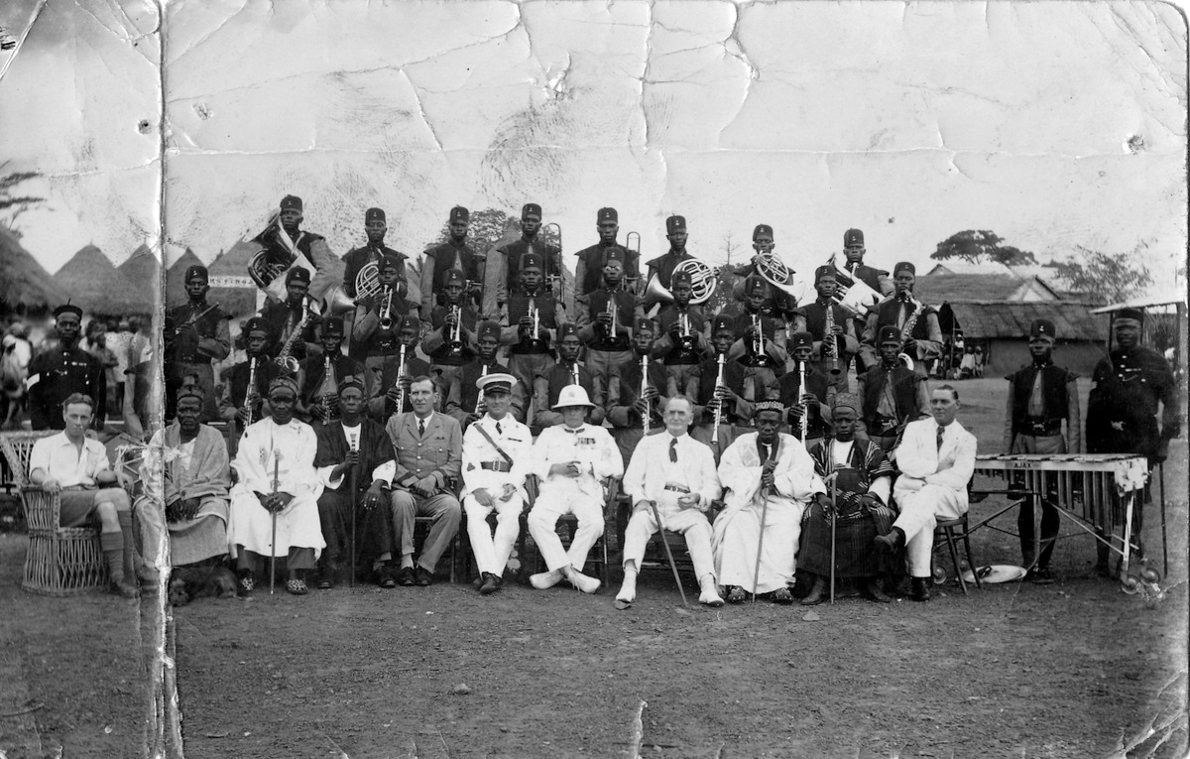
Systems of Colonial Rule: Indirect Rule (british model)
Worked best in African societies that were highly organized
Assumed firm tribal boundaries where often none existed

Slide 29
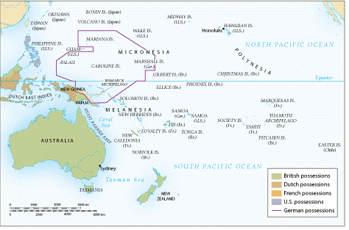
European Imperialism in Australia and New Zealand
1770, Captain James Cook reached Australia, reported it suitable for settlement
English use Australia as a penal colony starting in 1788
Gold discovered 1851; voluntary migrants follow;
Smallpox, measles devastate natives
Territory called “terra nullus” (land of no one)
New Zealand: natives forced to sign Treaty of Waitangi (1840), placing New Zealand under British “protection”

Slide 30
European and Native Population in Australia and New Zealand

Slide 31
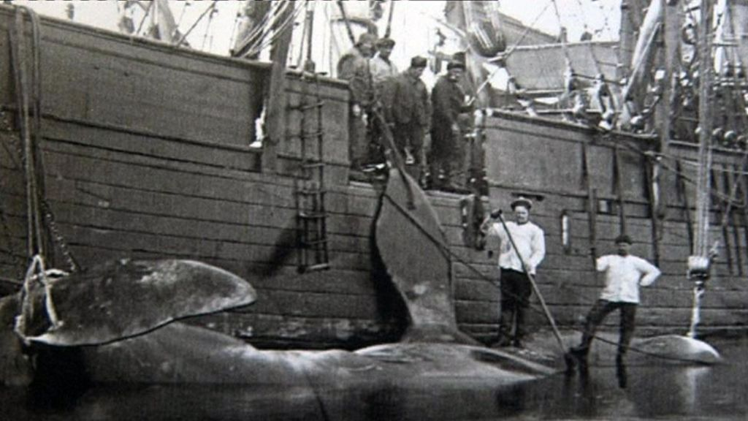
European Imperialism in the Pacific Islands
Early visitors to the Pacific were mostly whalers, merchants, some missionaries
Late nineteenth century, European states sought coaling stations and naval ports
By 1900, all islands but Tonga claimed by France, Britain, Germany and United States.
  Tonga remains independent, but relies on Britain
Island plantations produced sugarcane, copra (dried coconut kernels to make oil), guano

Slide 32
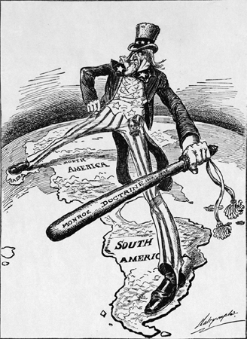
US Imperialism
President James Monroe warns Europeans not to engage in imperialism in western hemisphere (1823)
  The Monroe Doctrine: all Americas a U.S. Protectorate
1867 purchased Alaska from Russia
1875 established protectorate over Hawai’i
  Locals overthrow queen in 1893, persuade US to acquire islands in 1898

Slide 33
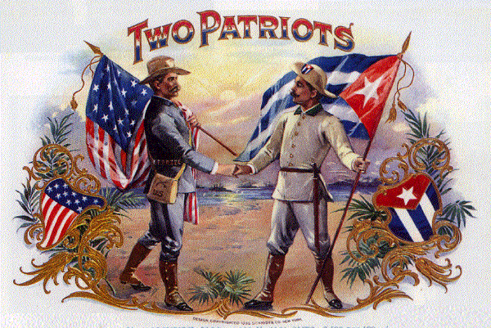
Spanish-Cuban-American War (1898-1899)
US declares war in Spain after battleship Maine sunk in Havana harbor, 1898
  Takes possession of Cuba, Puerto Rico, Guam, Philippines
  US intervenes in other Caribbean, Central American lands, occupies Dominican Republic, Nicaragua, Honduras, Haiti
United States backed Filipino revolt against Spain, purchased and took over the colony
1902-1904, bitter civil war killed two hundred thousand Filipinos, ended in U.S. victory

Slide 34
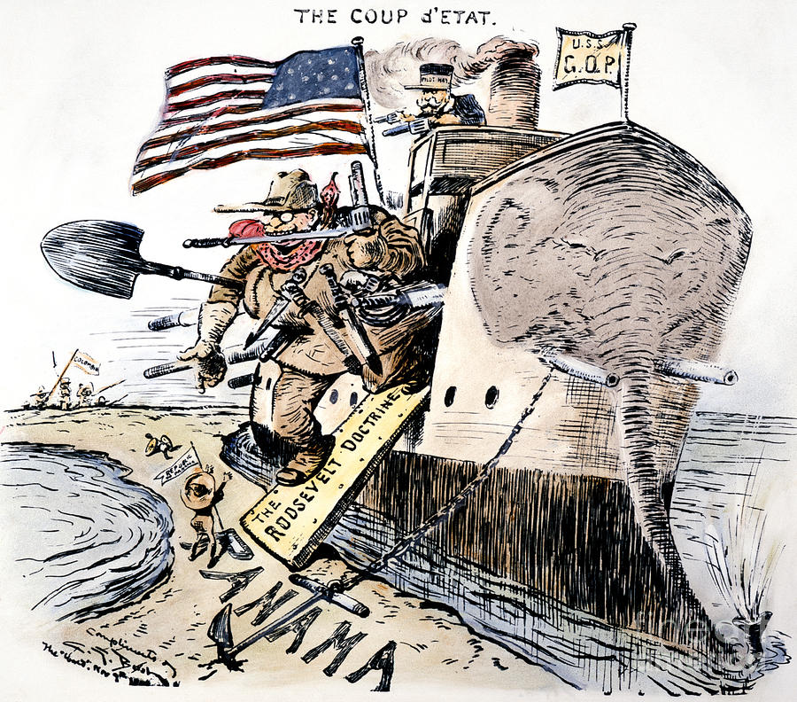
The Panama Canal
President Theodore Roosevelt (in office 1901-1909)
Colombian government refused U.S. request to build canal at Panama isthmus
United States helped rebels establish the state of Panama for the right to build a canal supports insurrection against Colombia
Rebels win, establish state of Panama (1903)
U.S. gains territory to build canal, Panama Canal Zone; completed 1914
Roosevelt Corollary of Monroe Doctrine
  U.S. right to intervene in domestic affairs of other nations if U.S. investments threatened

Slide 35
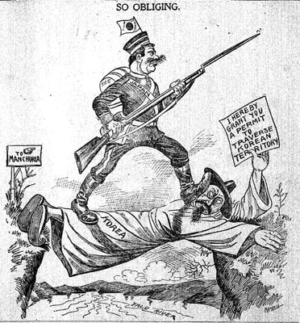
Early Japanese Expansion
Resentment over Unequal Treaties of 1860s
Early Japanese expansion in nearby islands
1876 Japanese purchase warships from Britain, established military academies
Dominate Korea
Sino-Japanese War (1894-1895) over Korea results in Japanese victory
Russo-Japanese War (1904-1905) over Manchuria also ends in Japanese victory

Slide 36
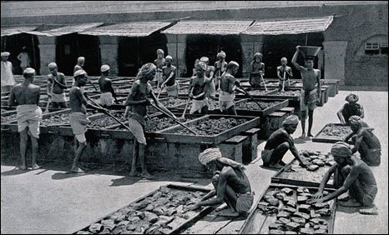
Economic Legacies of Imperialism
Colonized states encouraged to exploit natural resources rather than build manufacturing centers
Encouraged dependency on imperial power for manufactured goods made from native raw product
  Indian cotton

Slide 37


ENVIRONMENTAL Legacies of Imperialism
New crops transformed landscape and society
  Rain forests of Ceylon converted to tea plantations
  Ceylonese women recruited to harvest tea
  Rubber plantations transformed Malaya and Sumatra

Slide 38
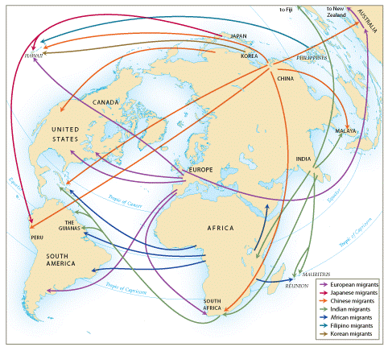
Labor Migrations
Fifty million Europeans migrated 1800-1914 (mostly to temperate lands), over half to the United States
  Work as free cultivators, industrial laborers
Indentured labor migration more typical from Asia, Africa, and Pacific islands
  About 2.5 million globally during 1820-1914
  Tended to work on tropical and subtropical plantations
    Indian laborers to Pacific island and Caribbean plantations
    Japanese laborers to Hawaiian sugar plantations
Large-scale migrations reflected global influence of imperialism

Slide 39
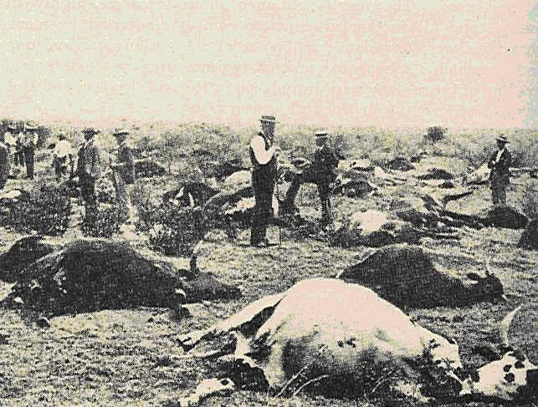
Colonial Conflict
Resistance and insurrections against colonial rule
  Xhosa destroyed crops and killed their cattle so their ancestors would kill the British in their lands (1856-1857); massive famine follows
  Rebels sprinkle selves with magic water (maji maji) as protection against modern weapons; 75000 killed

Slide 40
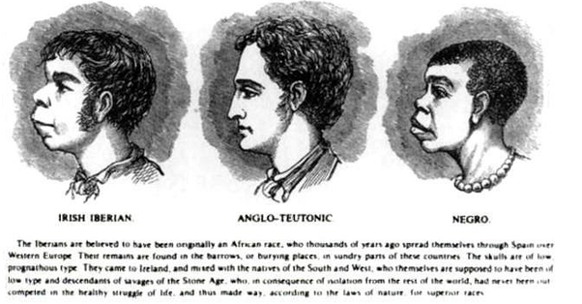
Scientific Racism
Race became the measure of human potential; Europeans considered superior
Social Darwinism: "survival of fittest" used to justify European domination
Colonial experience only reinforced popular racism
  Assumed moral superiority of Europeans
  Racist views in U.S. treatment of Filipinos, Japanese treatment of Koreans

Slide 41
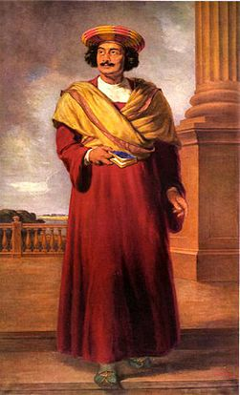
Nationalism and Anti-colonial Movements
Ram Mohan Roy (1772-1883), Bengali called “father of modern India”
Reformers call for self-government, adoption of selected British practices (e.g. ban on sati)
  Influence of Enlightenment thought, often obtained in European universities
Indian National Congress formed 1885
  1906 joins with All-India Muslim League

