Slide 1
Islamic Empires
The “Gunpowder” Empires

Slide 2
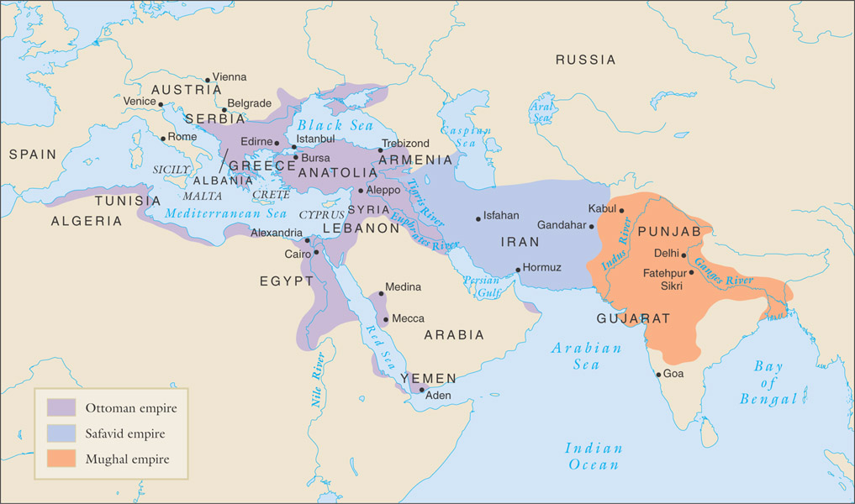
The Islamic empires, 1500-1800

Slide 3
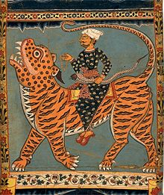
The Ottoman Empire (1289-1923)
Osman leads bands of seminomadic Turks to become ghazi: Muslim religious warriors
Captures Anatolia with light cavalry and volunteer infantry
  Later, heavy cavalry
In Balkans, forced Christian families to surrender young boys to military service: devshirme
  Often grew up to be exceptionally loyal Janissaries (soldiers or bureaucrats)

Slide 4
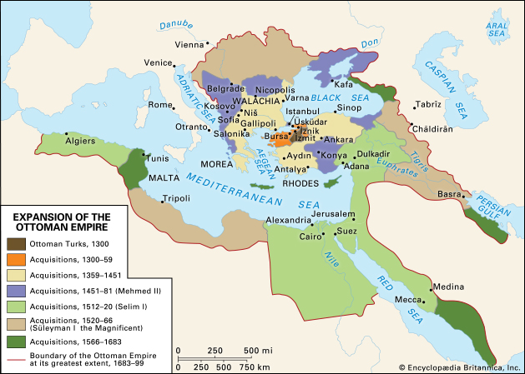

Slide 5
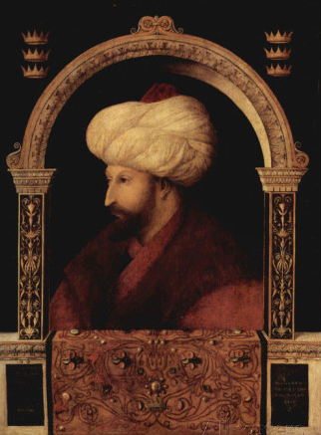
Expansion: Mehmed II (“the Conqueror,” r. 1451-1481)
Capture of Constantinople, 1453
  Inadvertently launches European Renaissance
Renamed Istanbul
Transformation from warrior sultan to emperor of “two lands” (Europe, Asia) and “two seas” (Black Sea, Mediterranean)
Planned to capture Pope, unsuccessful

Slide 6
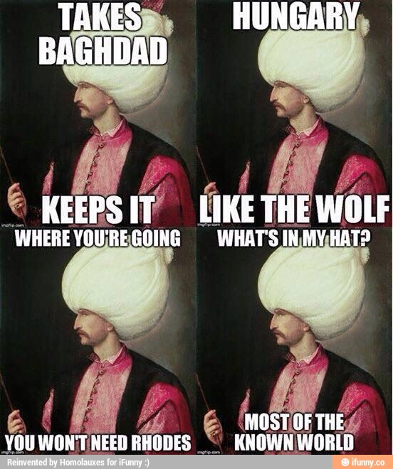
EXPANSION: SuleIman the Magnificent (r. 1520-1566)
Expanded into Asia, Europe
Besieged Vienna, 1529
Develops naval power

Slide 7
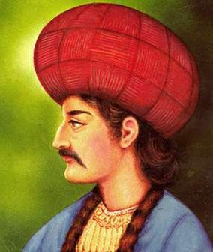
The Safavid Empire Is Born
Ismail young military leader, r. 1501-1524
  Orphaned, parents killed by enemies
Becomes Shah, proclaims official religion of realm Twelver Shiism
  Twelve infallible imams after Muhammad
  12th imam in hiding, ready to take power
  Wore distinctive red hat, called quzilbash (“red heads”)
Empire called Safavid, after Safi al-Din (1252-1334), Sufi thinker

Slide 8
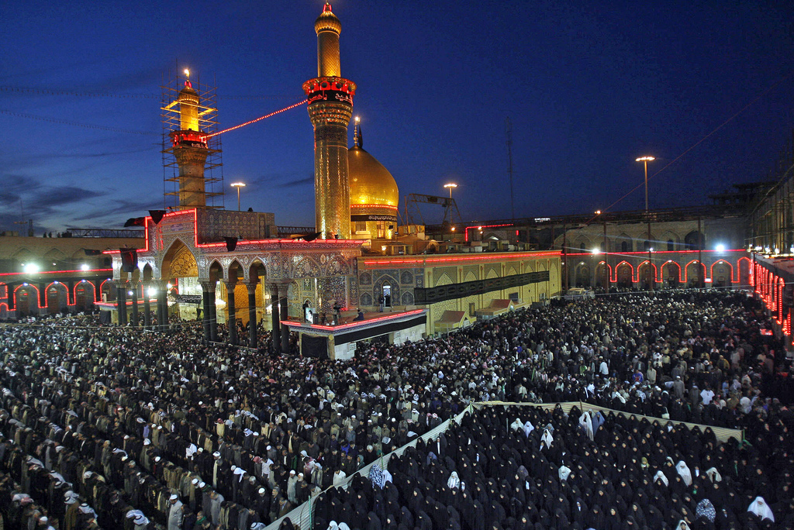
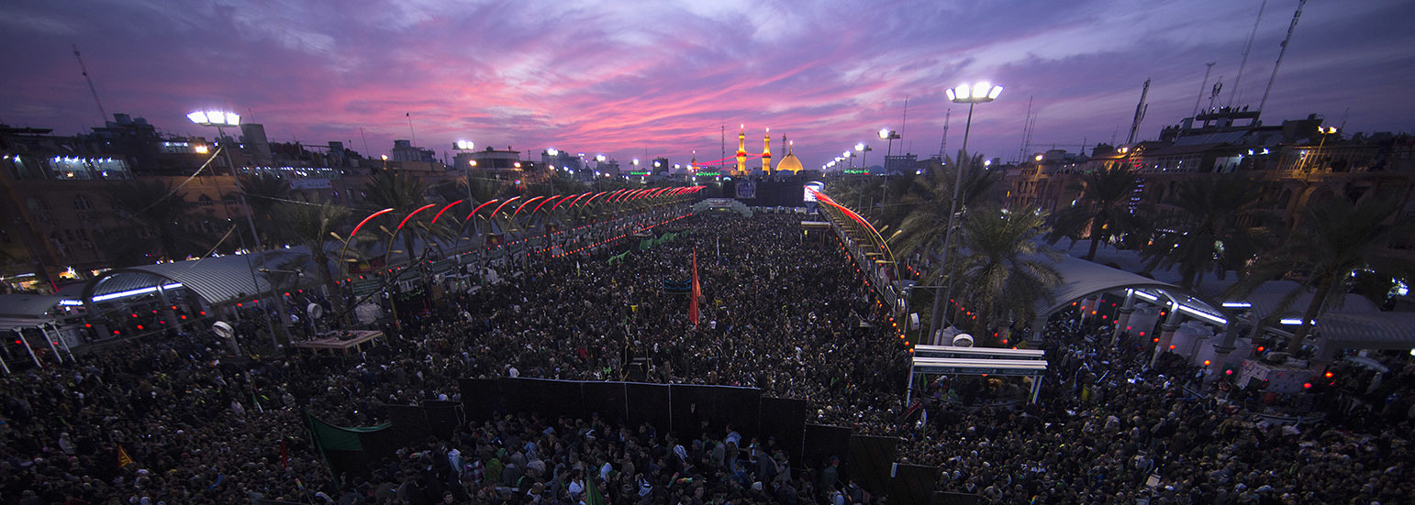
Shiite Pilgrims IN Karbala, IRAQ
Imam Husayn shrine (Third Imam)

Slide 9
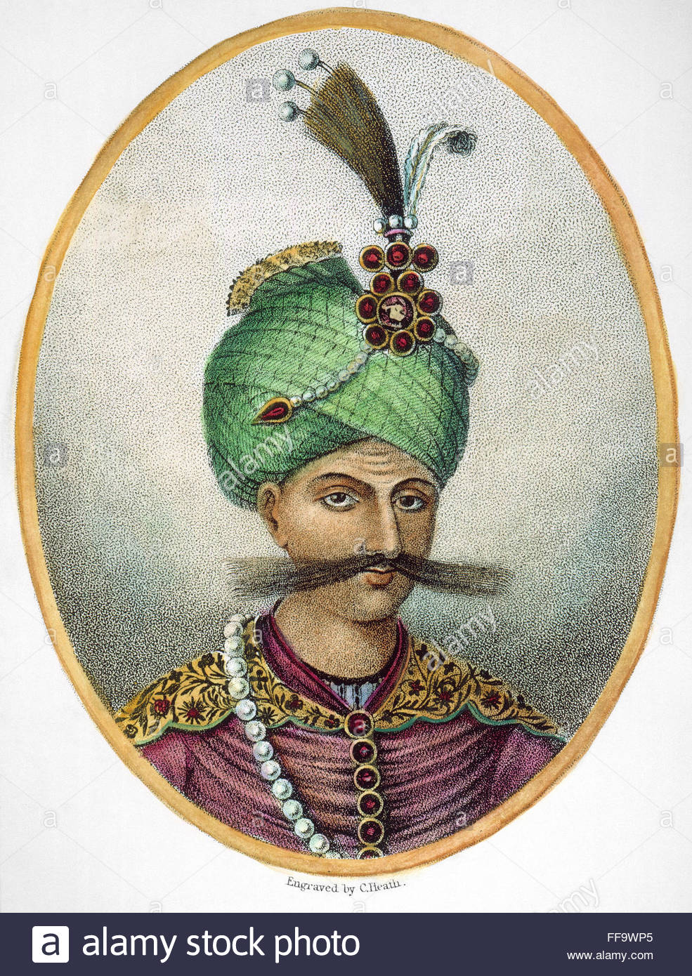
Ottomans Attack: Battle of Chaldiran (1514)
Ottoman Selim the Grim attacks Safavids
Heavy use of Ottoman gunpowder technology gives them the upper hand
Ismail escapes; two centuries of ongoing conflict
Shah Abbas the Great (r. 1588-1629) revitalizes weakened Safavid empire
  Reforms administration, military
  Expands trade
  Military expansion

Slide 10
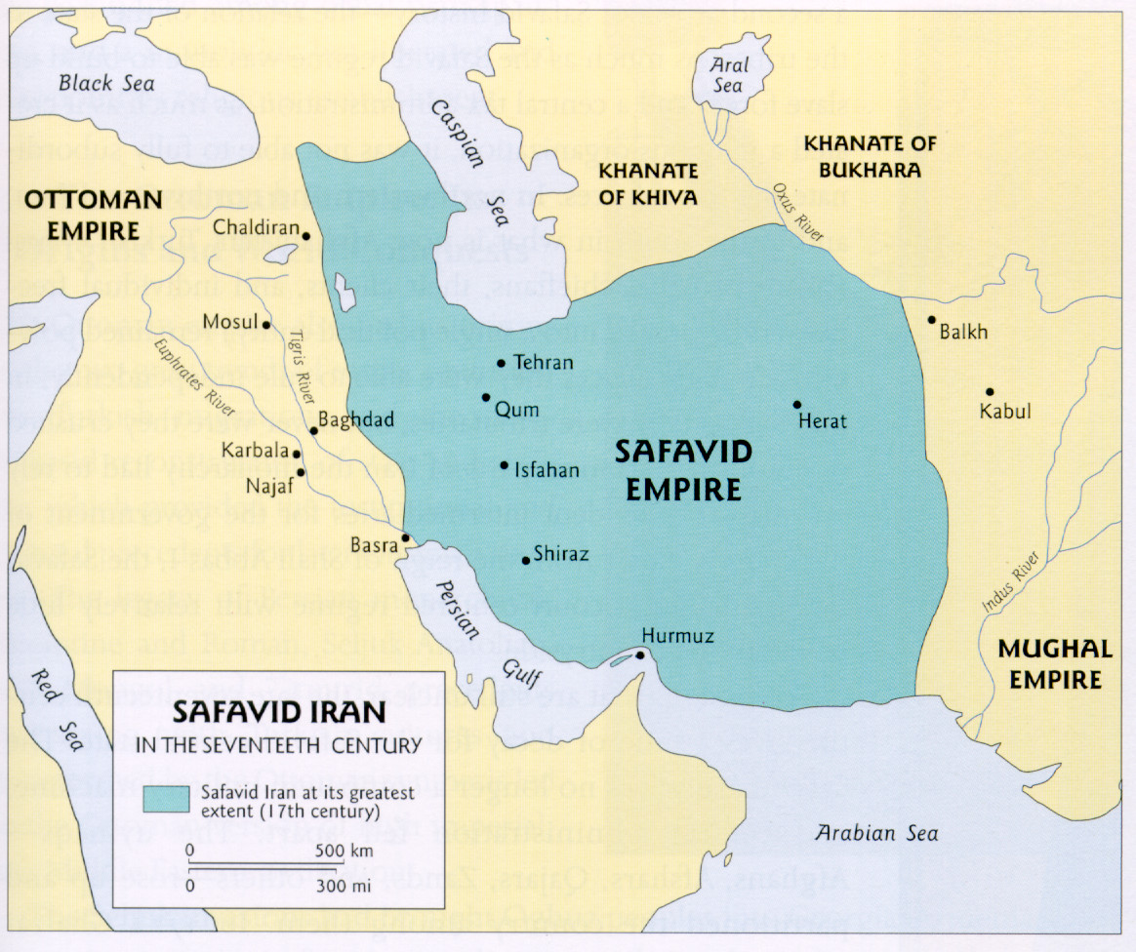

Slide 11
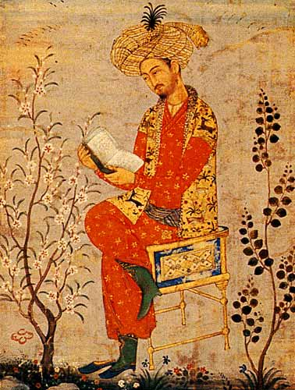
The Mughal Empire To the East
Babur, a Chagatai (khanate) Turk, invades northern India for plunder, 1523
Gunpowder technology gives Babur advantage
Founds Mughal (Persian for Mongol) dynasty
Expands through most of Indian subcontinent

Slide 12
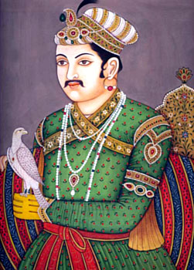
Akbar (r. 1556-1605)
Grandson of Babur
Wins fear and respect after throwing Adham Khan, leader of the army, out the window – twice. (Second time just to make sure he was dead…)
Created centralized government
Tax collection through zamindars
Expands: destroys Hindu kingdom of Vijayanagar
Religiously tolerant, promoted “Divine Faith”
  Syncretic form of Islam and Hinduism

Slide 13
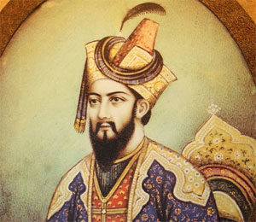
Aurangzeb (r. 1659-1707)
Expands Mughal empire into southern India
Hostile to Hinduism and Sikhism
  Demolished Hindu temples, replaced with mosques
  Tax on Hindus to encourage conversion
What is Sikhism?
John Greene and the Mughals

Slide 14
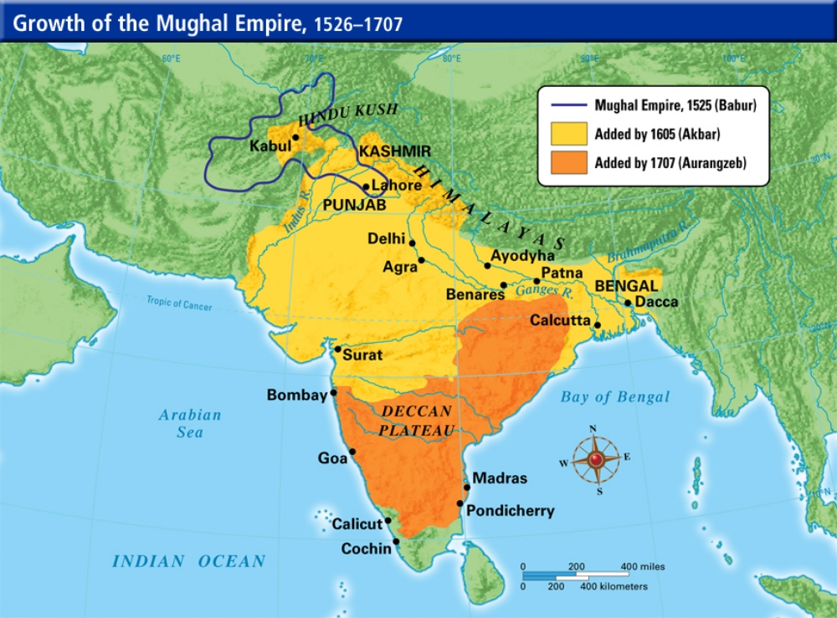

Slide 15
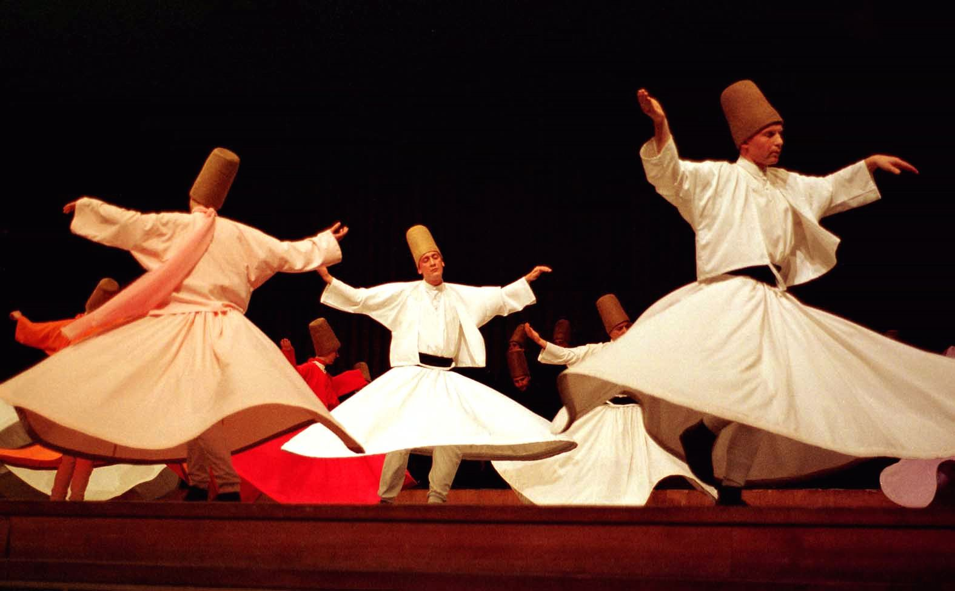
Common Elements of Ottoman, Safavid and Mughal Empires
Empires based on military conquest (“gunpowder empires”)
Prestige of dynasty dependent on piety and military prowess of the ruler
  Close relations with Sufism, ghazi tradition
Steppe Turkish traditions
  Issuance of unilateral decrees
  Intra-family conflicts over power
    1595 Sultan massacres 19 brothers (some infants), 15 expectant women (strangulation with silk)

Slide 16
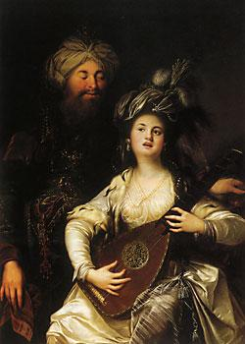
Women and Politics
Women officially banned from political activity
But tradition of revering mothers, stemming from Genghis Khan
Süleyman the Magnificent defers to concubine Hürrem Sultana
  Originally Roxelana, Ukrainian woman
  Convinces husband to murder eldest son in favor of her own child

Slide 17

Agriculture and Trade
American crops affect less dramatic change in Muslim empires
Coffee, tobacco important
  Initial opposition from conservative circles, fearing lax morality of coffee houses
Population growth also reflects territorial additions and losses
Trade with English East India Company, French East India Company, and Dutch VOC

Slide 18
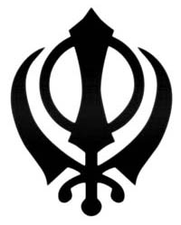
Religious Diversity
Ottoman Empire: Christians, Jews
Safavid Empire: Zoroastrians, Jews, Christians
Mughal Empire: Hindus, Jains, Zoroastrians, Christians, Sikhs
Mughal Akbar most tolerant
  Received Jesuits politely, but resented Christian exclusivity
  Enthusiastic about syncretic Sikhism, self-serving “Divine Faith”

Slide 19
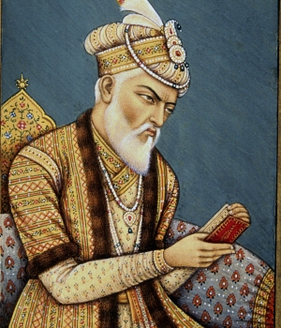
Status of Religious Minorities
Non-Muslim protected people: dhimmi
  Payment of special tax: jizya
  Freedom of worship, property, legal affairs
Ottoman communities: millet system of self-administration
Mughal rule: Muslims supreme, but work in tandem with Hindus
  Under Akbar, jizya abolished
  Reactionary under Aurangzeb

Slide 20
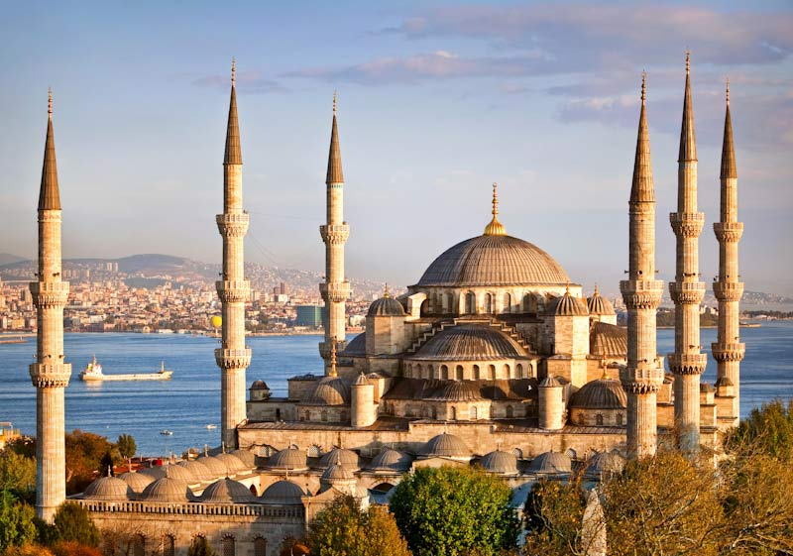
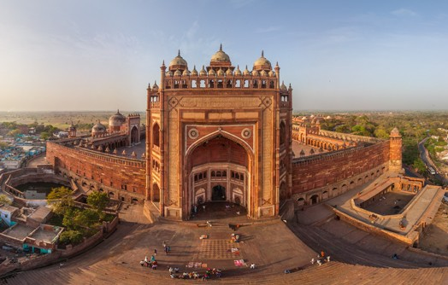
Capital Cities
Istanbul cultural capital of Ottoman empire, massive monumental architecture
Rededication of Hagia Sofia church as Aya Sofiya mosque (1453)
Ishafan major Persian city
Akbar builds magnificent Fatehpur Sikri
  Chooses site without sufficient water supply, abandoned
  Taj Mahal example of Mughal architecture

Slide 21
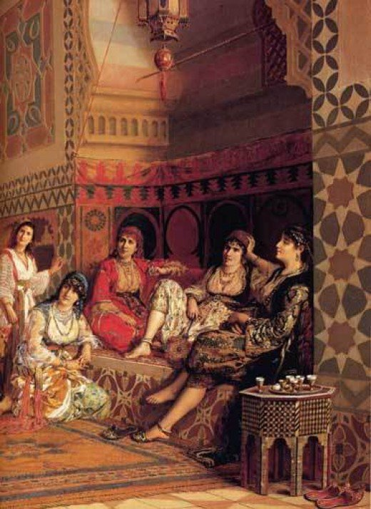
Deterioration of Imperial Leadership
Ottoman princes become lazy through luxury
  Selim the Sot (r. 1566-1574)
  Ibrahim the Crazy (r.1640-1648)
Attempts to isolate them compounds the problem
Religious tensions between conservatives and liberals intensify
  Role of women
Wahhabi movement in Arabia denounces Ottomans as unfit to rule
  Force destruction of observatory, printing press
Safavid Shiites persecute Sunnis, non-Muslims and even Sufis

Slide 22
Economic and Military Decline
Foreign trade controlled by Europeans
Military, administrative network expensive to maintain
  Janissaries mutiny when paid with debased coinage, 1589, other revolts follow
Unproductive wars
European military technology advances faster than Ottomans can purchase it

Slide 23
Cultural Conservatism
Europeans actively studying Islamic cultures for purposes of trade, missionary activities
Islamic empires less interested in outside world
Swiftly fell behind in technological development
  Ex: Jews from Spain establish 1st printing press in Anatolia in late 15th century, but printing of books in Turkish and Arabic forbidden until 1729
    Handwritten books preferred; weak levels of dissemination

