Slide 1
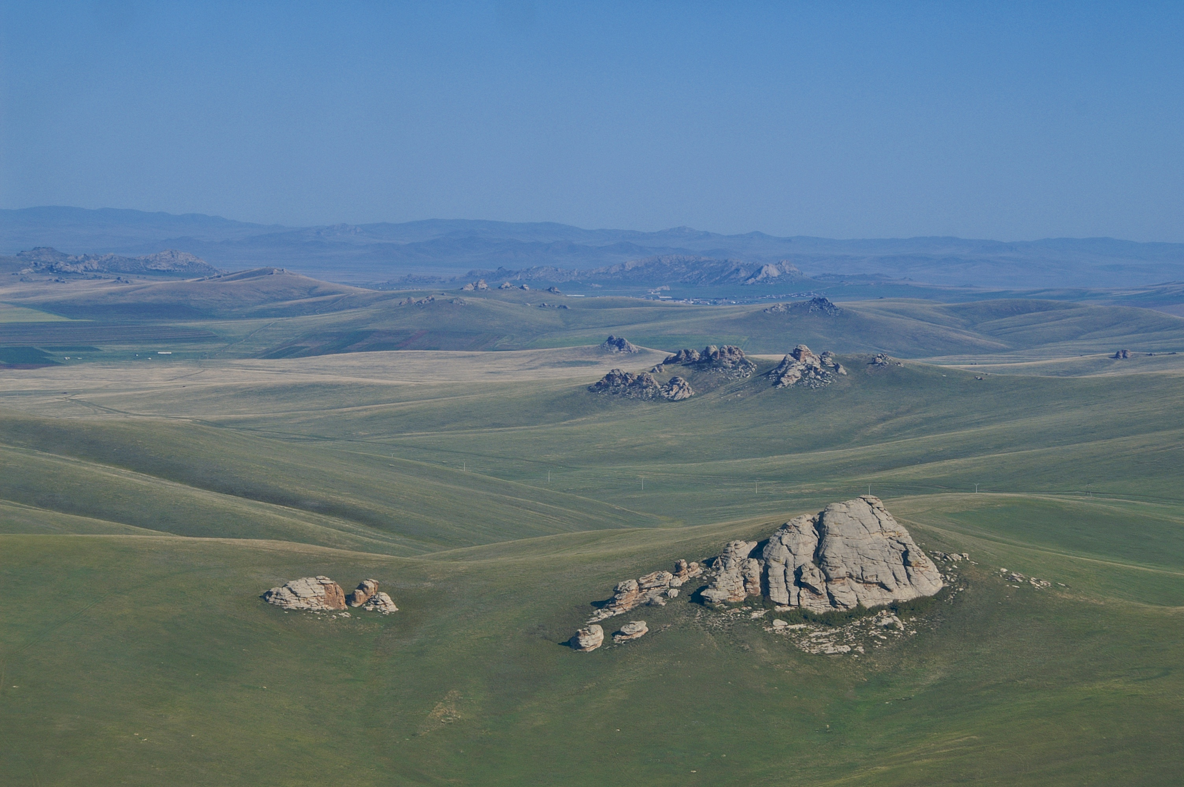
Nomadic Empires and Eurasian Integration

Slide 2
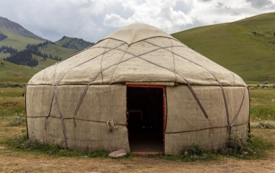
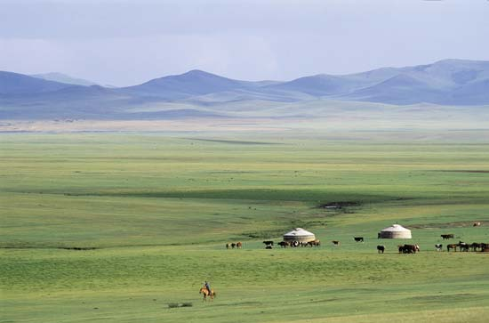
Nomadic Economy and Society
Turks descended from Turkic-language peoples in central Asia
Rainfall in central Asia too little to support large-scale agriculture
Grazing animals thrive, central Asians turn to animal herding
  Food and drink (kumiss)
  Clothing (wool/leather)
  Shelter (yurts)
Migratory cycles follow pasturelands
Small-scale farming, rudimentary artisanry

Slide 3
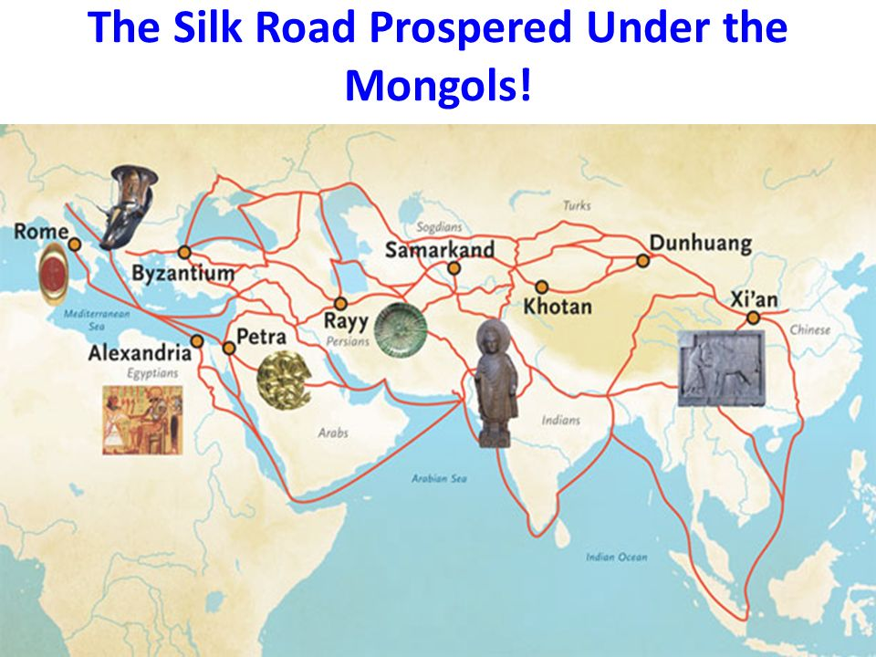
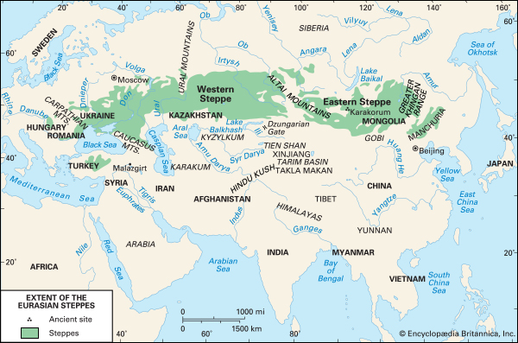
Nomadic Economy
Trade links between nomadic and settled peoples
Engaged in long-distance travel
  Caravan routes

Slide 4
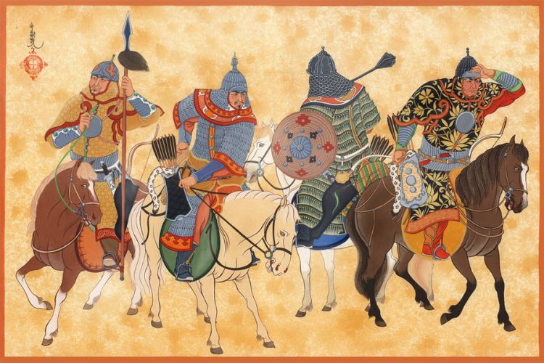
Nomadic Society
Governance basically clan-based
Charismatic individuals become nobles, occasionally assert authority
Unusually fluid status for nobility
  Hereditary, but could be lost through incompetence
  Advancement for meritorious non-nobles
Women wielded considerable influence (think Sparta)

Slide 5
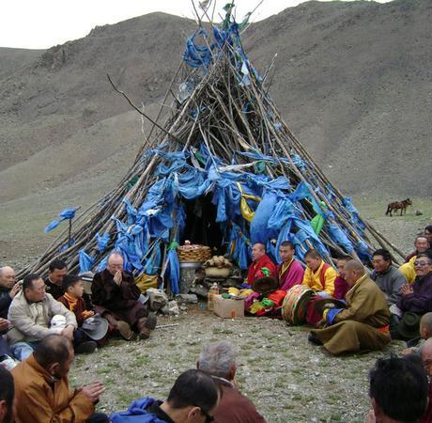
Nomadic Religion
Shamans center of pagan worship
Appeal of Buddhism, Nestorian Christianity, Islam, Manichaeism
Turkish script developed, partially to record religious teachings

Slide 6
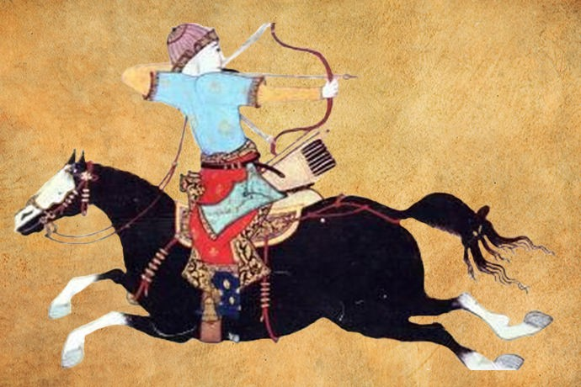
Military Organization
Large confederations under a khan (“ruler”)
Exceptionally strong cavalries
  Mobility
  Speed
Superior archery

Slide 7
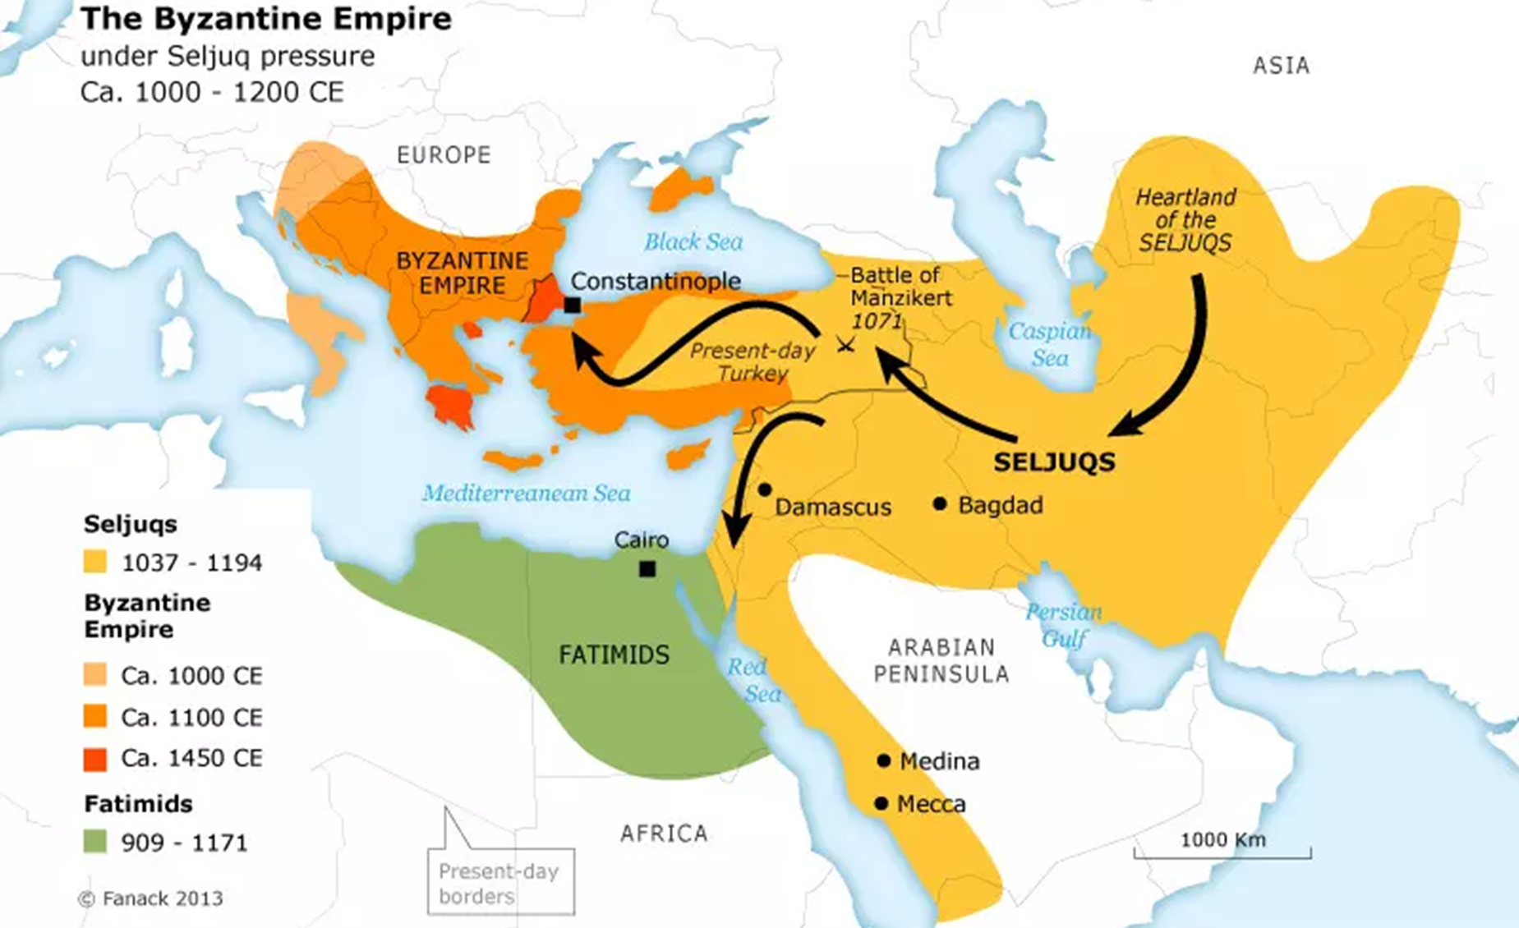
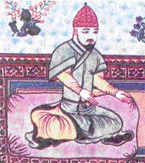
Saljuq Turks and the Abbasid Empire
8-10th centuries Turkish peoples on border of Abbasid empire
  Service in Abbasid armies
Eventually came to dominate Abbasid caliphs
1055 Saljuq leader, Tughril Beg, recognized as sultan (“chieftan”/”ruler”)
  consolidated his hold on Baghdad, then extended rule to other parts of the empire
  Abbasid caliphs served as figure heads of authority
  Saljuks look to Anatolia’s wealth next

Slide 8
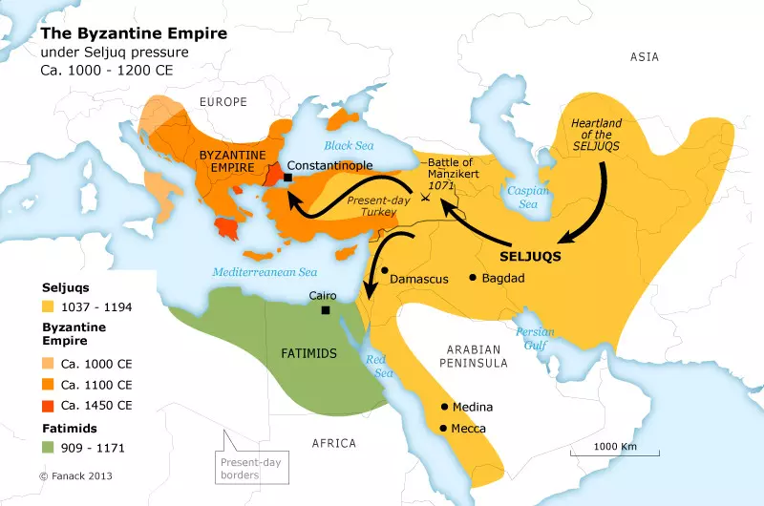
SEljuq Turks and the Byzantine Empire
1071 Seljuq Turks defeat Byzantine army at Manzikert, take emperor captive
  Many Byzantine peasants welcome them as liberators
Large-scale invasion of Anatolia by Turks
Many conversions to Islam
Ottoman Turks conquer Constantinople 1453

Slide 9
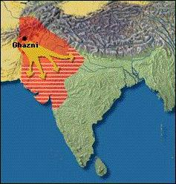
Ghaznavid Turks and the Sultanate of Delhi
Mahmud of Ghazni invades northern India from Afghanistan
At first for plunder, later to rule
Northern India completely dominated by 13th century
Persecution of Buddhists, Hindus

Slide 10
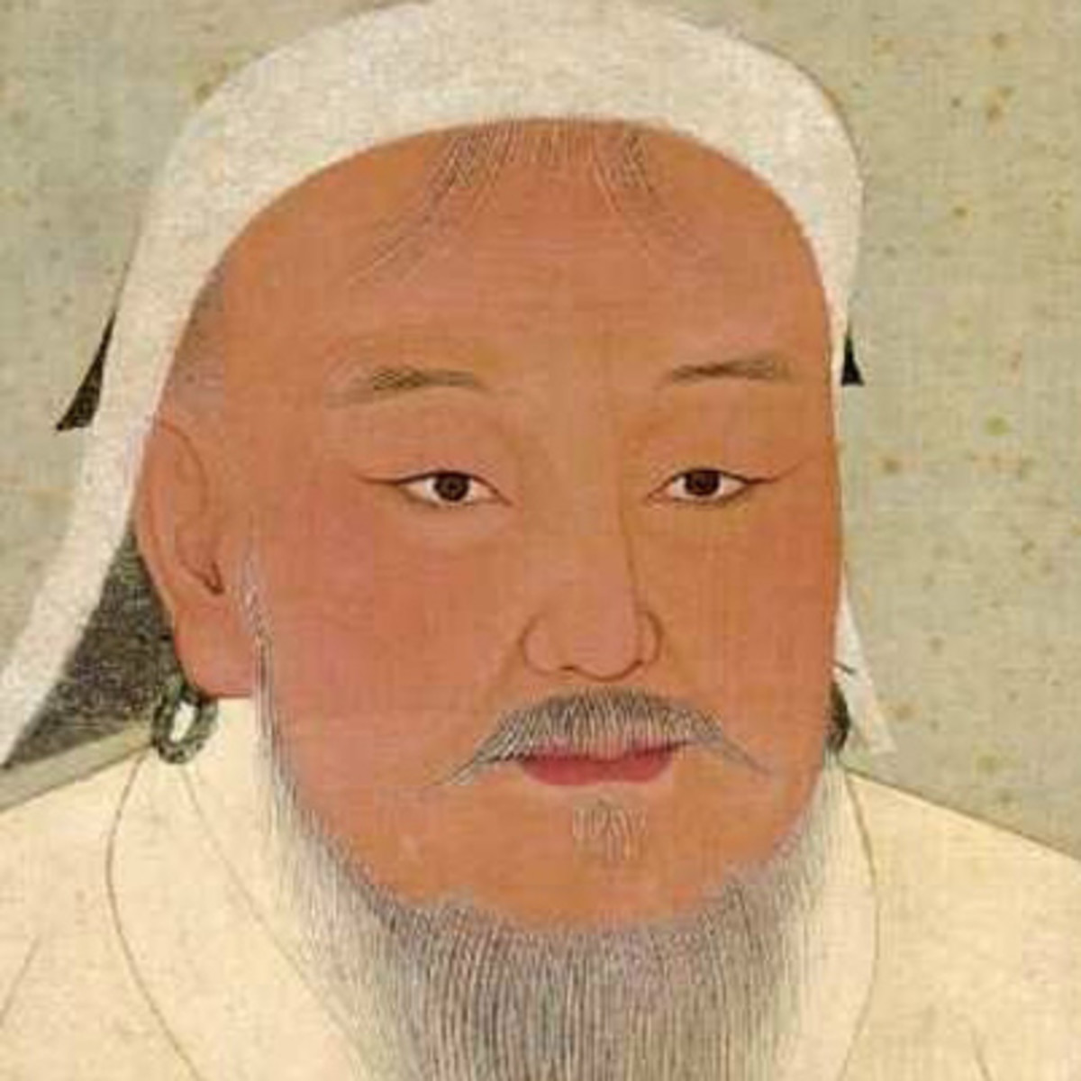
the Making of the Mongol Empire
Temüjin (1167-1227)
Father prominent warrior, poisoned c. 1177, forced into poverty
Mastered steppe diplomacy: courage, loyalty, elimination of enemies
Brought all Mongol tribes into one confederation
1206 proclaimed Chinggis Khan: “Universal Ruler”
  In West, Genghis Khan

Slide 11
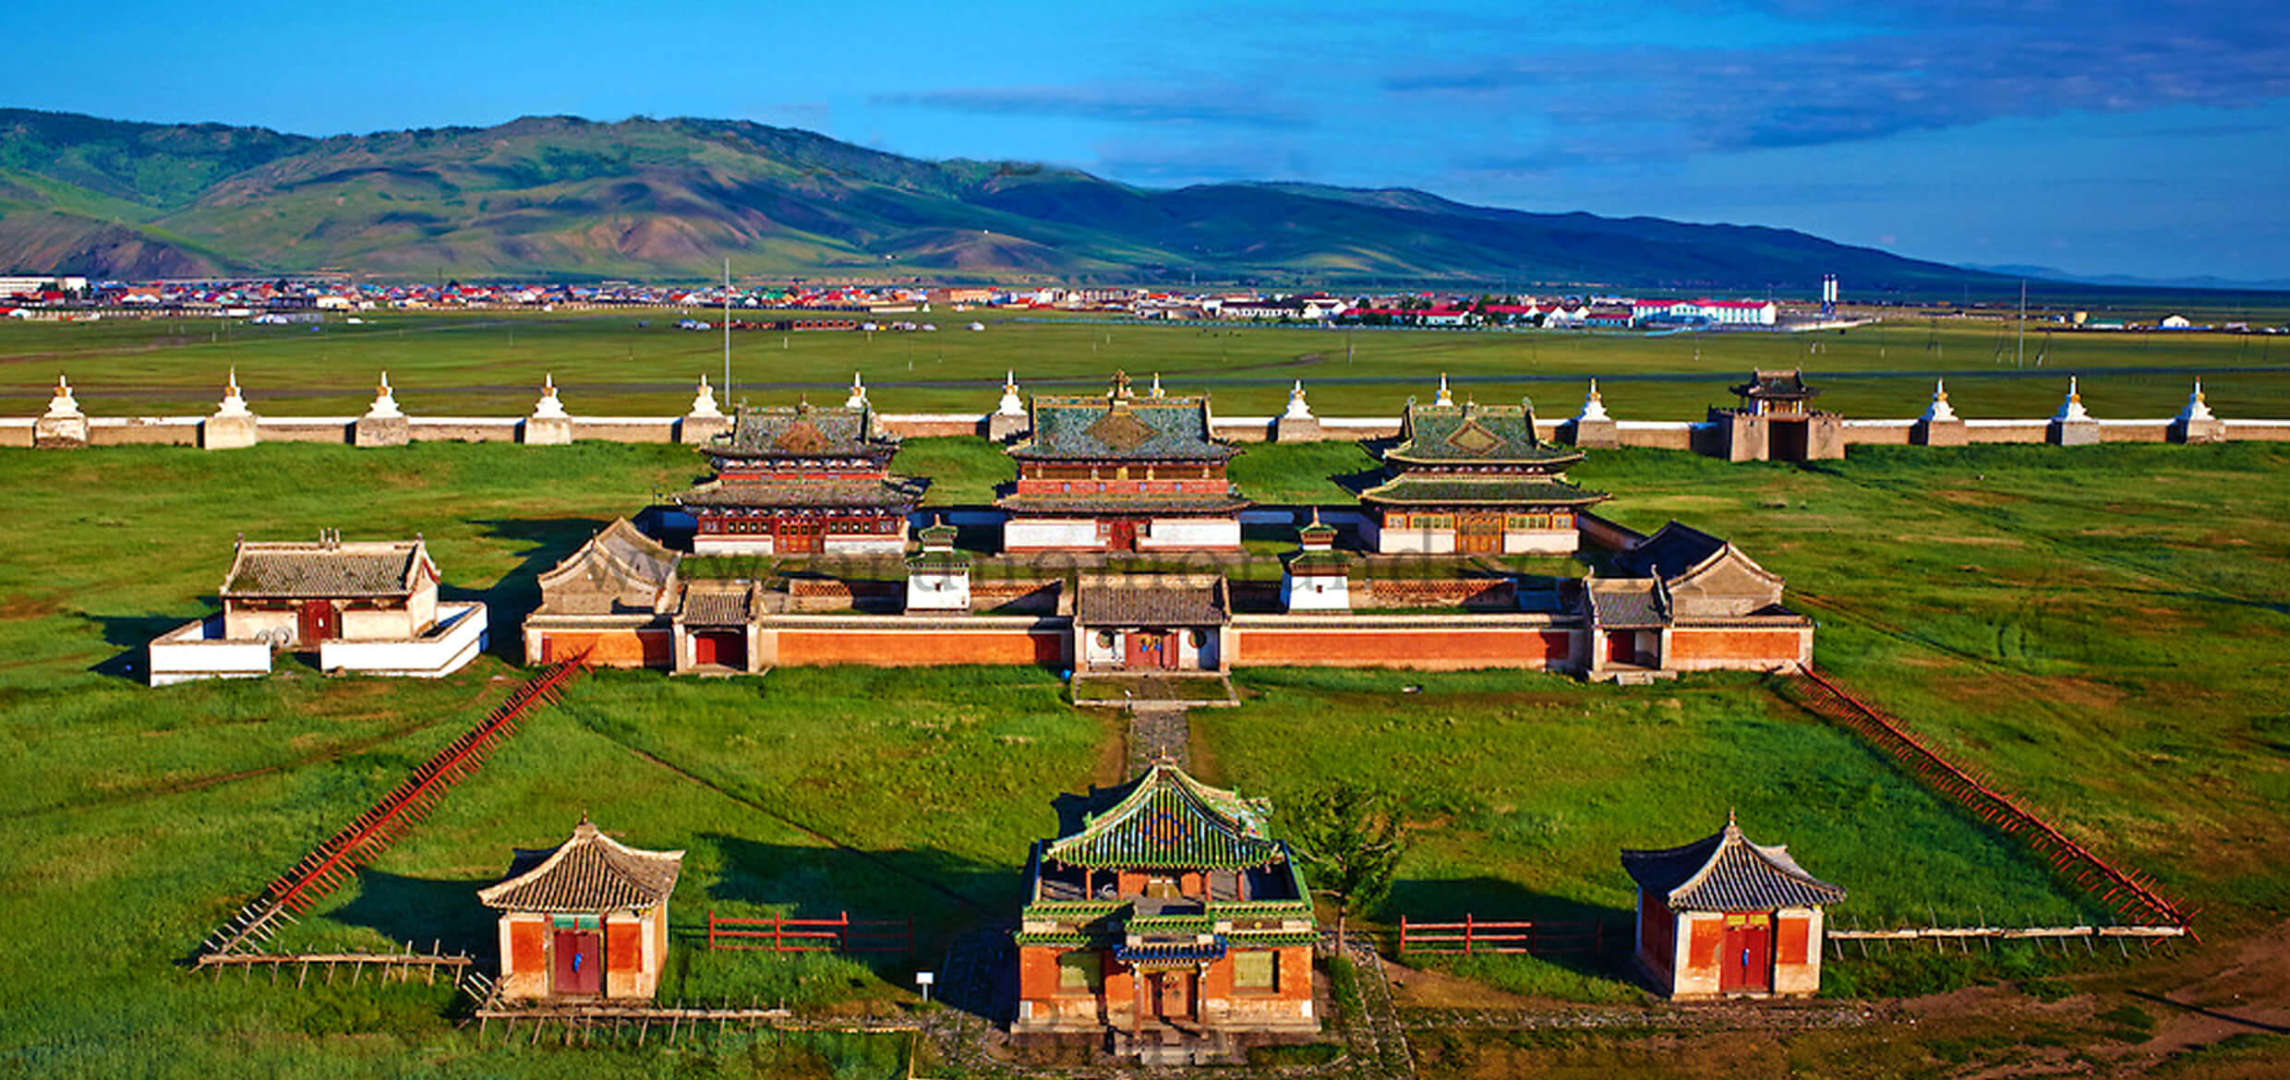
Mongol Political Organization
Broke up tribal organization
Formed military units from men of different tribes
Promoted officials on basis of merit and loyalty
Established distinctly non-nomadic capital at Karakorum

Slide 12
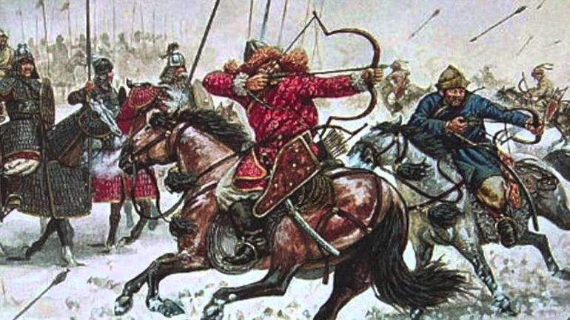
Mongol Arms
Mongol population only 1 million (less than 1% of Chinese population)
  Army c. 100,000 - 125,000
Rewarded enemies who surrender, cruel to enemies who fight
Fostered rumors to grow fear
Huns as archers/horsemen (start at 1:17)

Slide 13
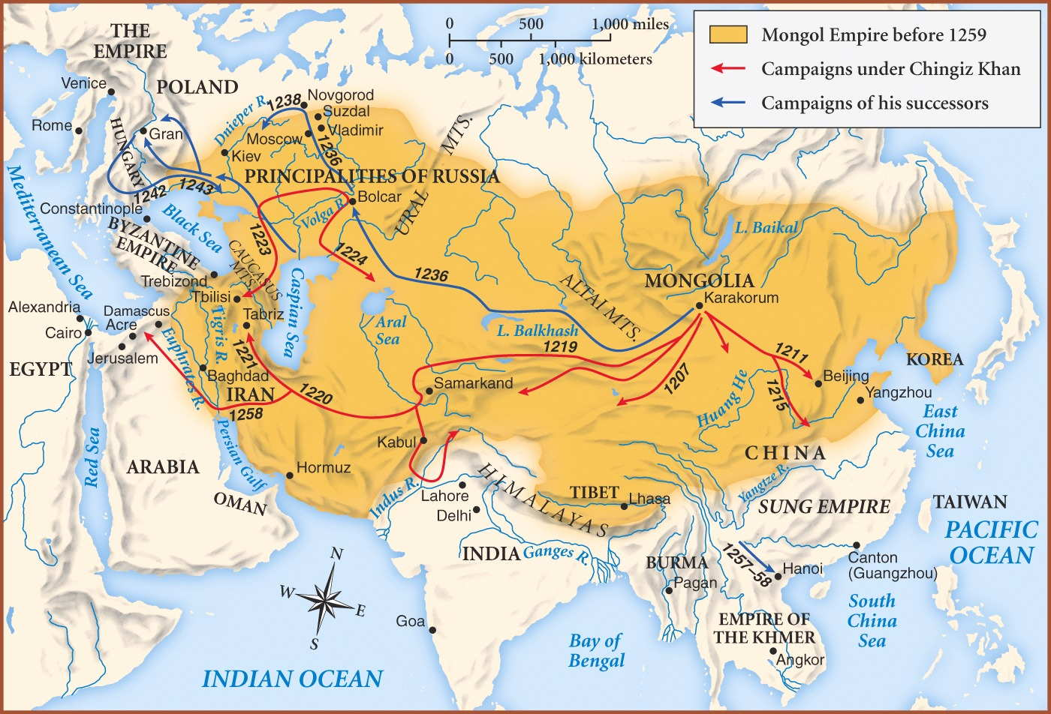
Mongol Conquests
No honor in fighting – only winning.
Conquered China (by 1220)
Conquered Afghanistan (1221), Persia (1223)
  Mongol emissaries murdered
Mongols ravaged Persia
  Large-scale, long-term devastation: qanat systems/ buildings destroyed, mass executions
Genghis Khan sired children to solidify loyalties
  Appr. 16 million descendants!

Slide 14
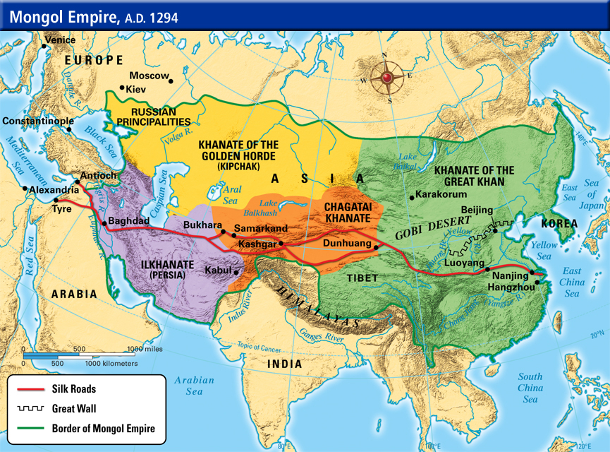
A Divided Empire
Death of Chinggis Khan leads to in-fighting
Empire divided into 4 parts
  Great Khans = China
  Descendants of Chagatai = Khanate of Chagatai
  Persia = Ilkhans
  Golden Horde = Russia
Tension between empires

Slide 15
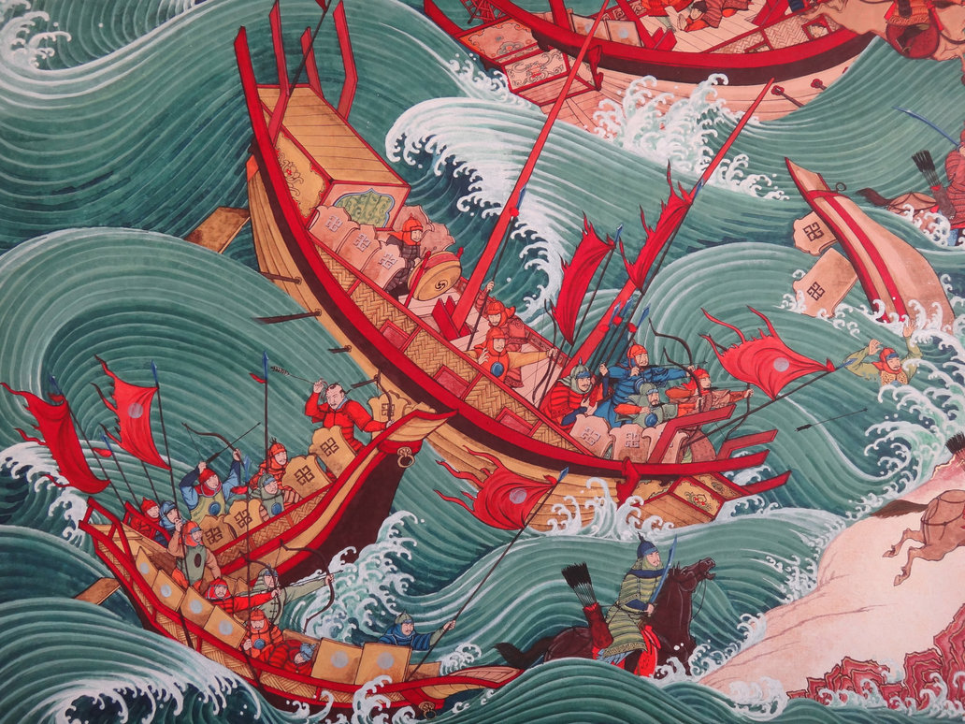
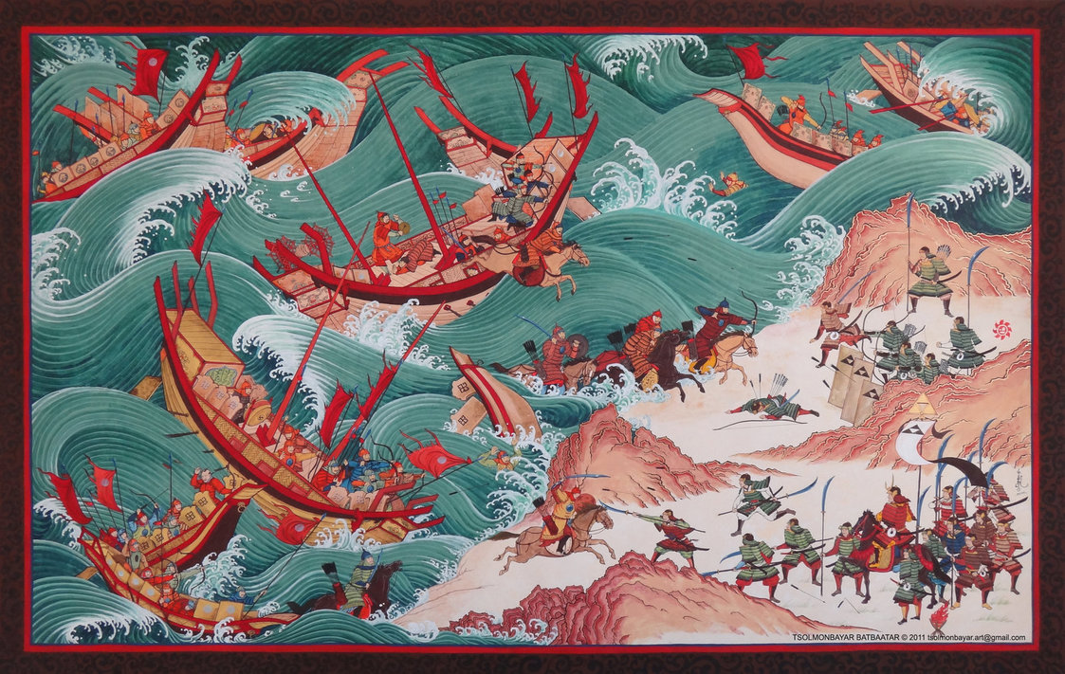
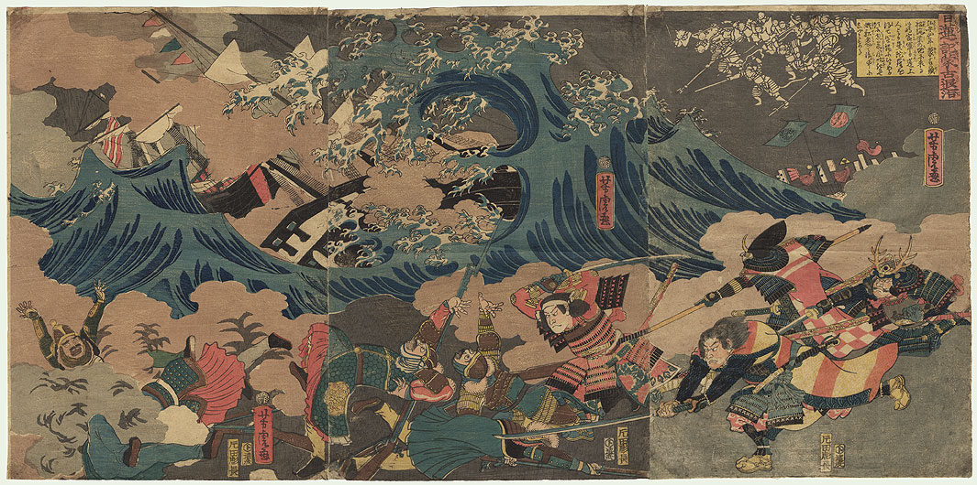
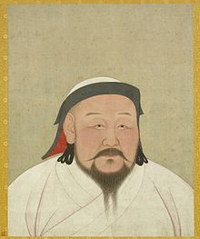
Kublai Khan (r. 1264-1294)
Grandson of Chinggis Khan
  Rule of China
Ruthless warrior, but religiously tolerant
  Hosted Marco Polo
Established Yuan dynasty (to 1368)
  Capital in Khanbaliq (Beijing)
Unsuccessful forays into Vietnam, Cambodia, Burma, Java
Two attempted invasions of Japan (1274, 1281) turned back by typhoons (kamikaze: “divine winds”)

Slide 16
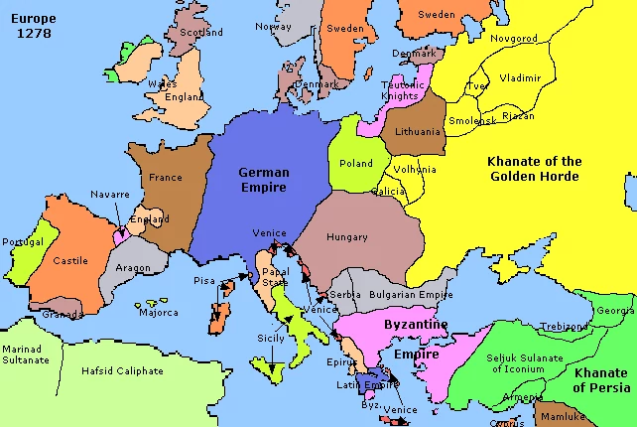
The Golden Horde
Conquest of Russia, 1237-1241
  Established tributary relationship to 15th century (Russian princes create army)
  Rule over Crimea to late 18th century
Raids into Poland, Hungary, Germany

Slide 17
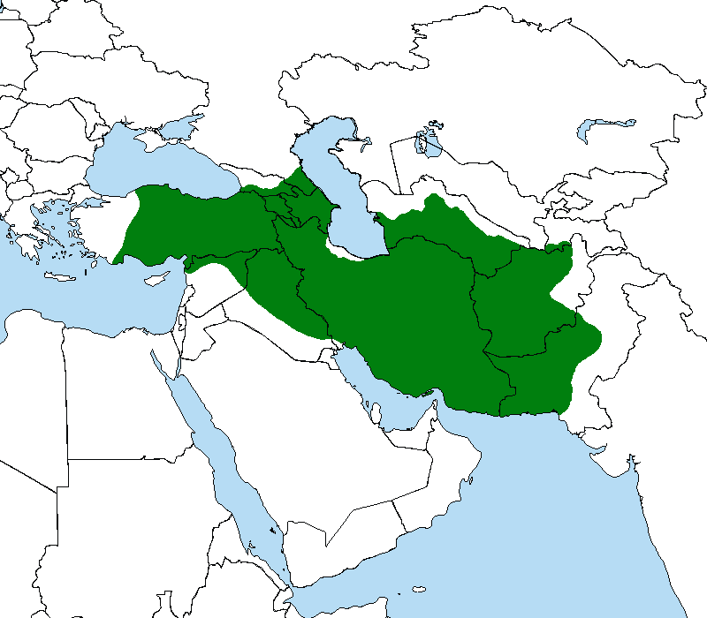
The Ilkhanate of Persia
Abbasid empire toppled
Baghdad sacked, 1258
  200,000 massacred
Expansion into Syria checked by Egyptian forces

Slide 18
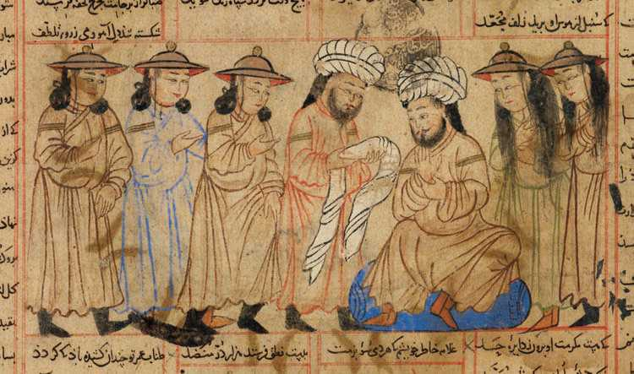
Mongol Rule in Persia
Nomadic conquerors had to learn to rule sedentary societies
  Inexperienced; Lost control of most lands within a century
Persia: depended on existing administration to deliver tax revenues
  Left matters of governance to bureaucracy
Eventually assimilated into Islamic lifestyle
By 1295, Massive conversions lead to massacres of Christians and Jews

Slide 19
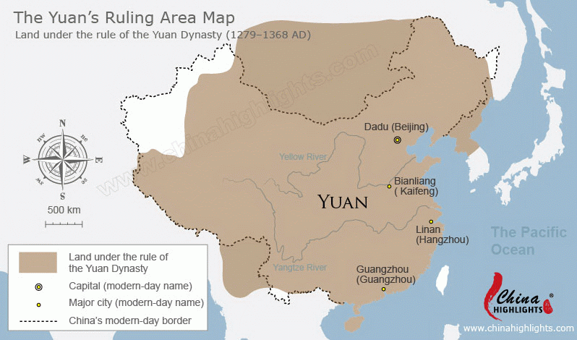
Mongol Rule in China: Yuan DYnasty
Strove to maintain strict separation from Chinese
  Intermarriage forbidden
  Chinese forbidden to study Mongol language
  Considered eliminating all Chinese
Imported administrators from other areas (esp. Arabs, Persians)
  Dismantled Confucian governance
Religious freedoms

Slide 20
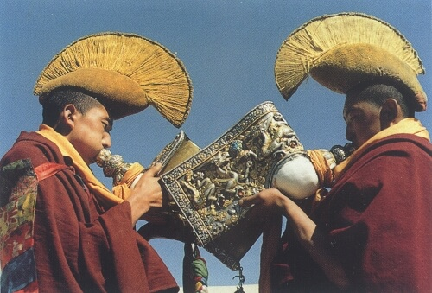
The Mongols and Buddhism
Shamanism remains popular
Lamaist school of Buddhism (Tibet) gains strength among Mongols
  Large element of magic, similar to shamanism
  Ingratiating attitude to Mongols: khans as incarnations of Buddha

Slide 21
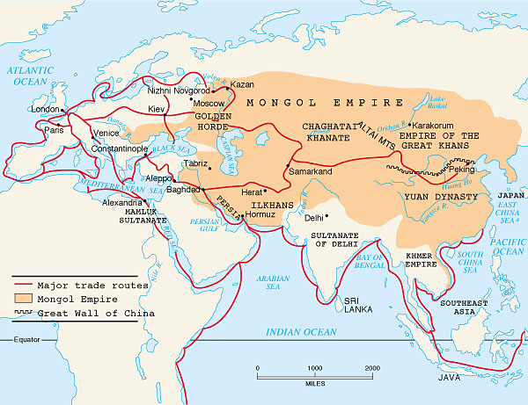
The Mongols and Eurasian Integration
Experience with long-distance trade
  Protection of traveling merchants
  Volume of trade across central Asia increases
Diplomatic missions protected
Missionary activity increases
Mongol resettlement policies to attain artisans and administrators

Slide 22
Decline of the Mongol Empire in Persia
Overspending, poor tax returns from overburdened peasantry
Ilkhan attempts to replace precious metal currency with paper in 1290s
  Failure, forced to rescind
Factional fighting after 1304
Last ilkhan dies without heir in 1335, Mongol rule collapses

Slide 23
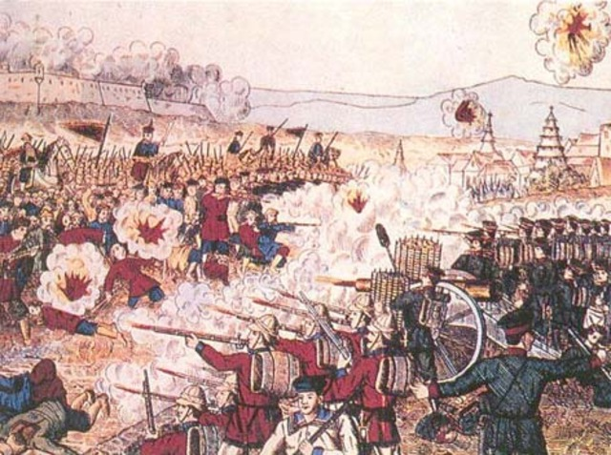
Decline of the Yuan Dynasty in China
Mongols spend bullion that supported paper currency
  Massive inflation
From 1320s, major power struggles
Bubonic plague erupts in SW China in 1330.
  Spreads to SW Asia/Europe by 1340s
In 1368, Mongols flee peasant rebellion (White Lotus movement)

Slide 24
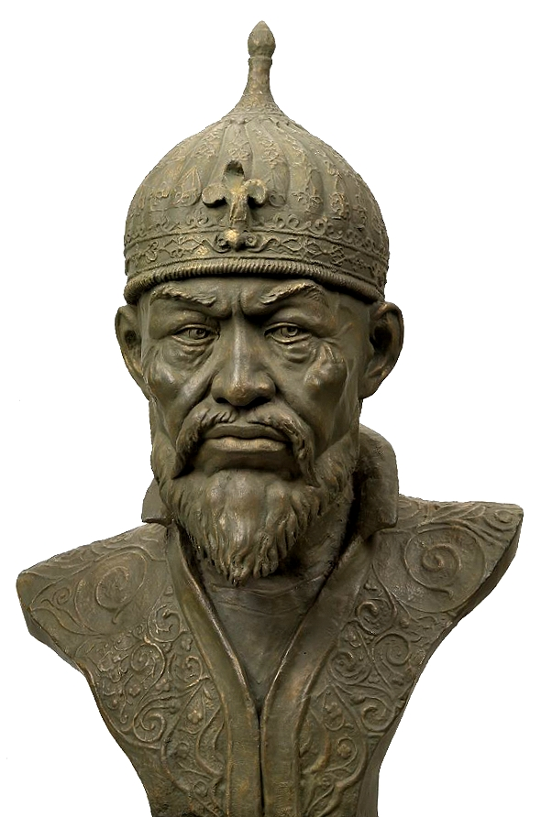
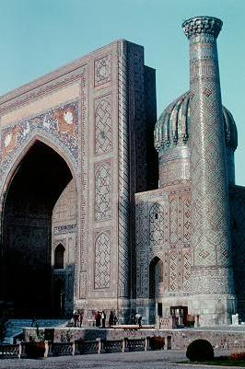
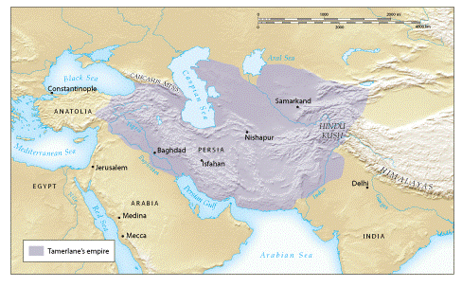
Tamerlane the Conqueror (c. 1336-1405)
Turkish conqueror: Timur the Lame (“Tamerlane”)
  Ruthless, ferocious, brilliant
United Turkish nomads in Khanate of Chaghatai
Major military campaigns throughout Asia
  Built capital in Samarkand
Died en-route to China
Empire dissolves within a century from poor governance

Slide 25
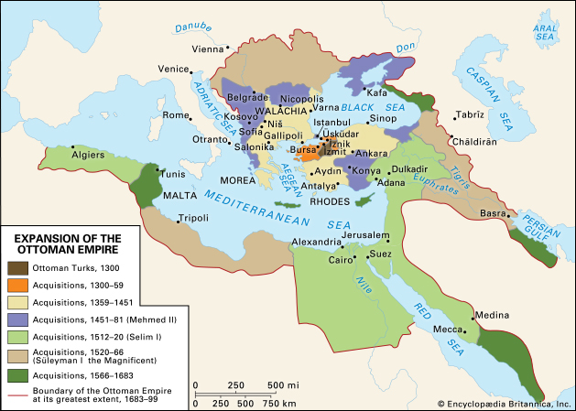
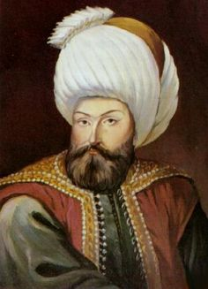
The Ottoman Empire
Osman, charismatic leader in NW Anatolia, unites Turks
Declares independence from Saljuq sultan in 1299
Attacks Byzantine empire
  Followers known as Osmanlis (Ottomans)

Slide 26
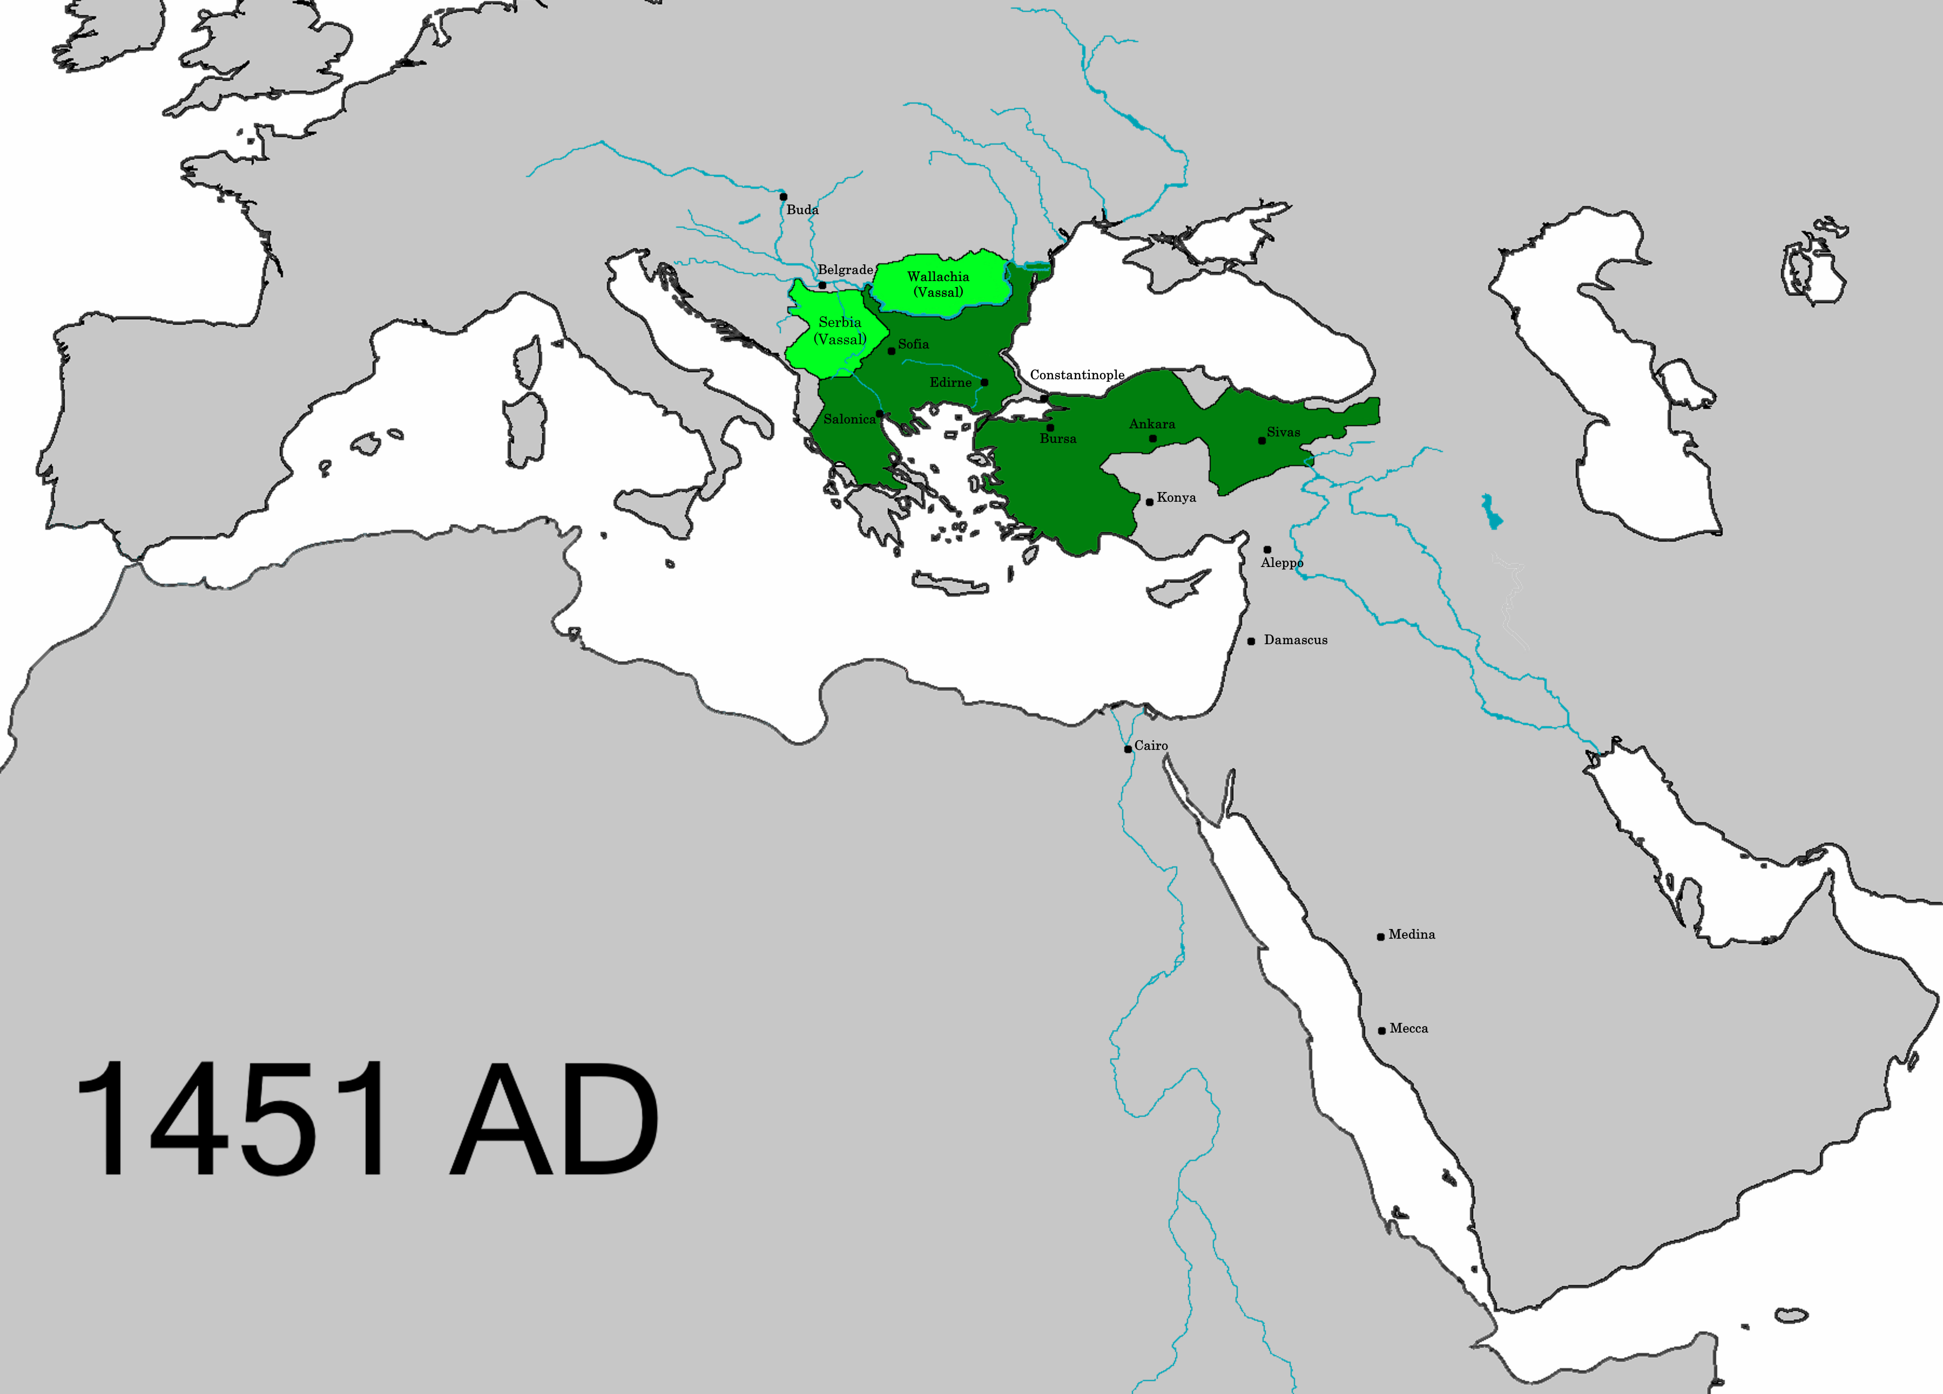
Ottoman Conquests
1350s conquests in the Balkans
Local support for Ottoman invasion
  Peasants unhappy with fragmented, ineffective Byzantine rule
Tamerlane crushes Ottoman forces in 1402, but Ottomans recover by 1440s

Slide 27
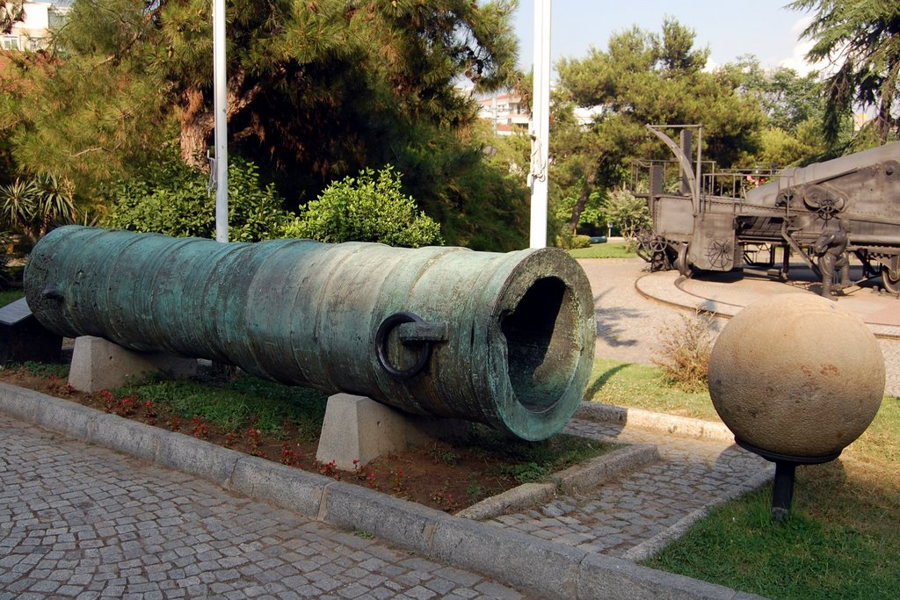
The Capture of Constantinople, 1453
Sultan Mehmed II (“Mehmed the Conqueror”) starts campaign of expansion in 1440s
Conquers Constantinople in 1453
  Renamed city Istanbul, capital of Ottoman empire

