Slide 1
APWH Turning Points
When the big stuff happened!
(There are more dates here than I require you to know.)

Slide 2
8000BCE-600BCE
Early Foundations Age (“Period 1”)
Early civilizations emerge. Agriculture, social stratifications, codified laws, religions.

Slide 3
c. 8000 BCE
Beginning of agriculture
Emergence of sedentary communities; domestication of animals

Slide 4
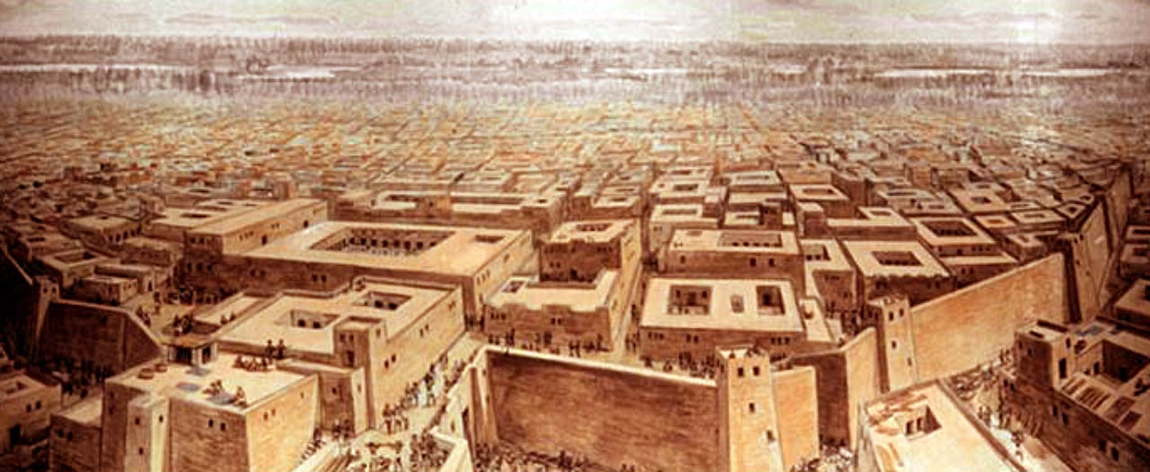
c. 3300-1700 BCE
Indus Valley Civilization
Evidence of urban planning and centralized government

Slide 5
c. 3000 BCE
Bronze Age
Stronger tools and weapons available increase productivity and warfare

Slide 6
c. 1770
Babylonian Empire
Hammurabi’s Code developed. Model for future laws codes and influential on Hebrew scriptures.

Slide 7
c. 1300 BCE
Iron Age
Less-expensive metal makes use of metal tools widespread. Larger armies.

Slide 8
c. 626 BCE to 539 BCE
Neo-Babylonian Empire
Major Jewish diaspora (Babylonian Captivity). Cyrus defeats empire and frees Jews. Cyrus Cylinder.

Slide 9
600BCE – 600CE
Classical Age (“Period 2”)
Establishment of first true empires. “Golden Age” of many civilizations to be emulated by later civilizations.

Slide 10
c. 600 BCE
Lives of Siddhartha Gautama (Buddhism), Confucius (Confucianism) and Laozi (Daoism)
Major thinkers react to times of war and upheaval. Emergence of quintessentially Chinese philosophies

Slide 11
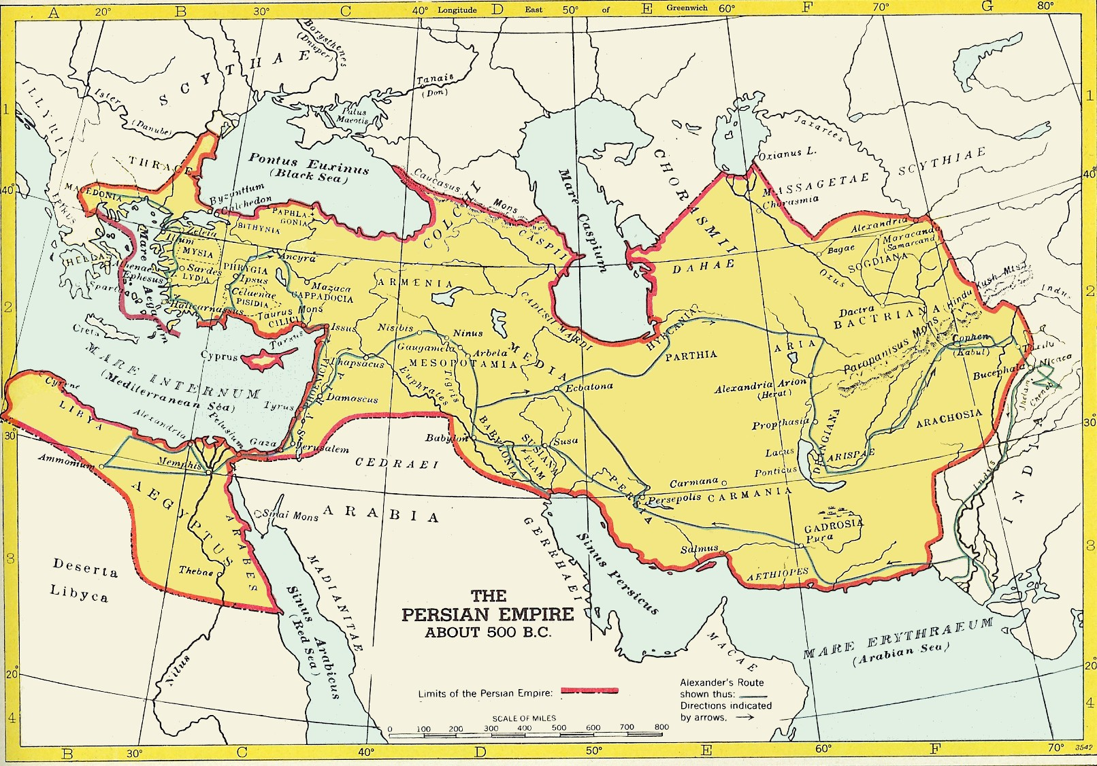
522–486 BCE
Reign of Darius I
Height of Persia/Achaemenid Empire. Beginning of Persian Wars. Use of satrapies.

Slide 12
c. 500-300 BCE
Greek Golden Age
Height of Athenian power. Greek trade throughout Mediterranean, Black Sea and Anatolian Peninsula.

Slide 13
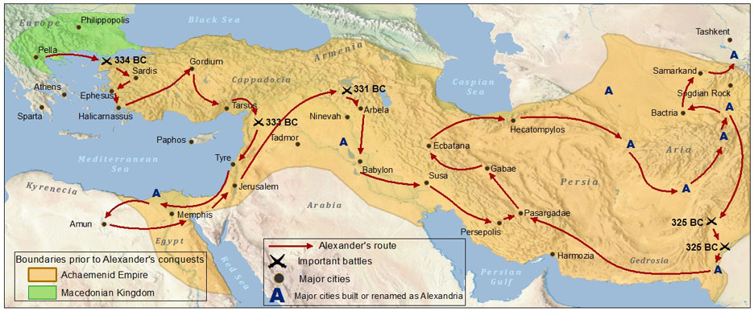
323 BCE
Death of Alexander the Great
End of Hellenistic expansion

Slide 14
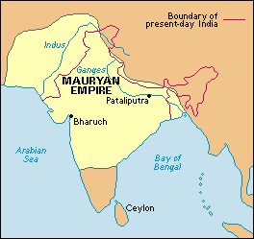
322 BCE-184 BCE
Mauryan Dynasty
Unification of India after Greek interference. Expansion of Indian Ocean trade. Buddhism replaces Hinduism under Ashoka.

Slide 15
221 BCE
Unification of China. Standardization of weights and measures. Connection of Great Wall begins. Use of legalism.
Qin Dynasty

Slide 16
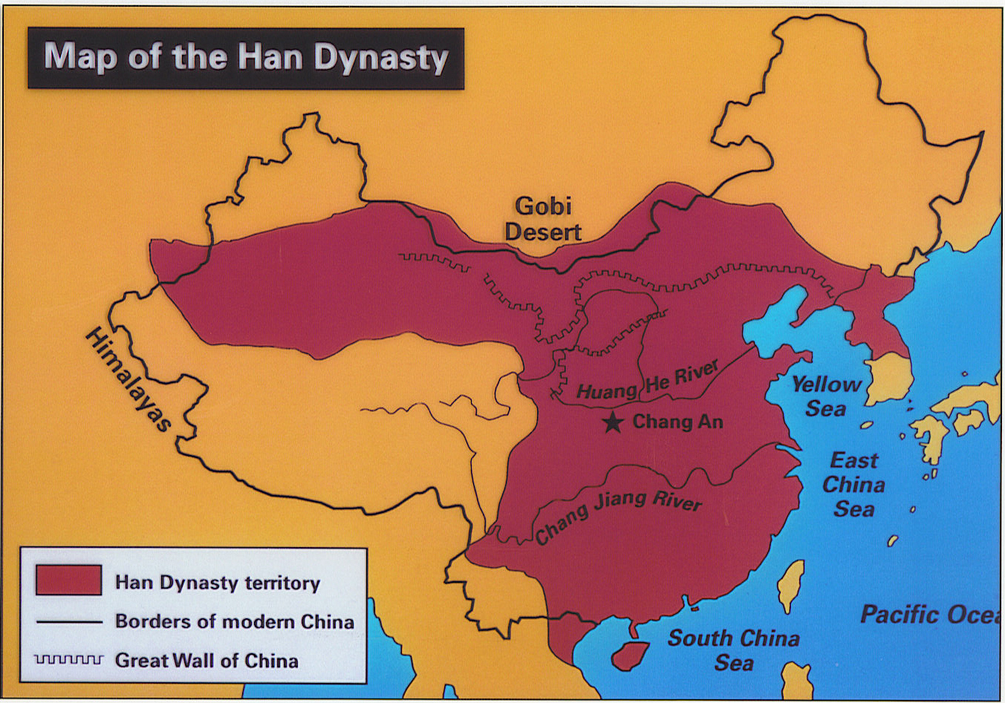
206BCE - 220 CE
Han Dynasty
Golden Age of China. Confucian exam established, Silk Road expanded to Europe/India; Pax Sinica

Slide 17
27BCE - 180 CE
Pax Romana
Roman expansion throughout Europe and into Asia. Connection of Silk Road to East. Use of slavery increases!

Slide 18
32 CE
Christianity begins
Establishment of second (major) Abrahamic religion.

Slide 19
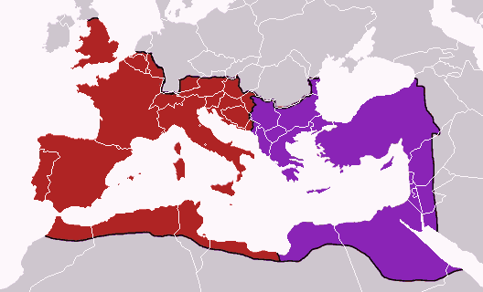
285 CE
Diocletian splits Roman Empire
Beginning of the end of Rome. Rise of Greek culture in the East.

Slide 20
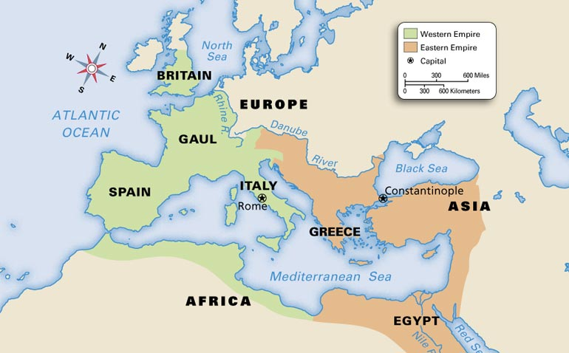
333 CE
Roman capital moved to Constantinople
Mediterranean trade hub shifts east. Rome further weakened as resources moved east.

Slide 21
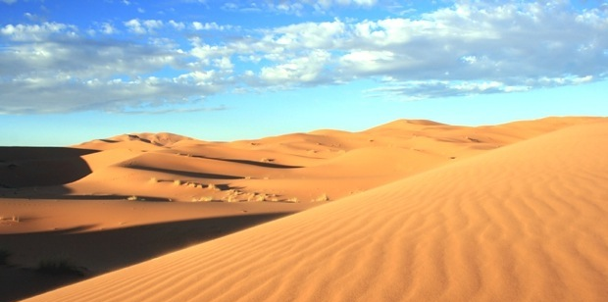
c. 400 CE
Camel saddle invented
Trans-Saharan trade emerges

Slide 22
“Fall” of Rome
476 CE
Disintegration of centralized state in Europe. Rise of Eastern Orthodoxy.

Slide 23
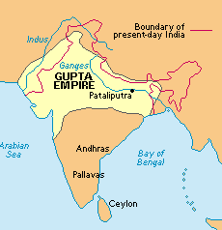
320 - 550 CE
Gupta Empire
Golden Age of learning in India. Return to Hinduism.

Slide 24
527 - 565CE
Expansion of Byzantine influence in Mediterranean and Anatolia. Constantinople. Revised law codes. Commission of major works of art and architecture.
Justinian rules Byzantine empire

Slide 25
600 CE – 1450 CE
Post-classical Age (“Period 3”)
Interaction of Islam and Christianity. Golden Age of Indian Ocean Trade. Restructuring of civilizations on classical models.

Slide 26
618-907CE
Tang Dynasty
Spread of Buddhism in China. Expansion of civil service exam. Fast-ripening rice! An Lushan Rebellion most devastating in history.

Slide 27
622 CE
Founding of Islam
Establishment of third Abrahamic religion. Competition for land/resources between Islam/Christianity emerges. Split of Sunni/Shia. Emergence of Sufism.

Slide 28
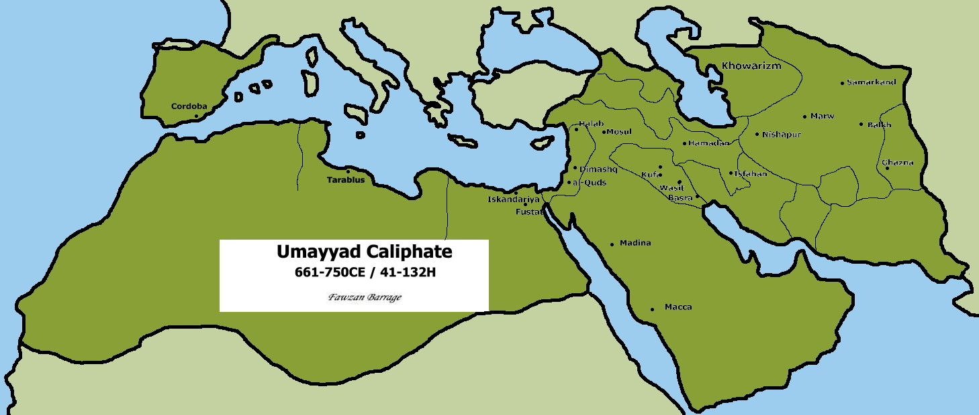
661-750 CE
Umayyad Caliphate
Islam reaches Spain

Slide 29
732 CE
Battle of Tours
Spread of Islam into Europe halted

Slide 30
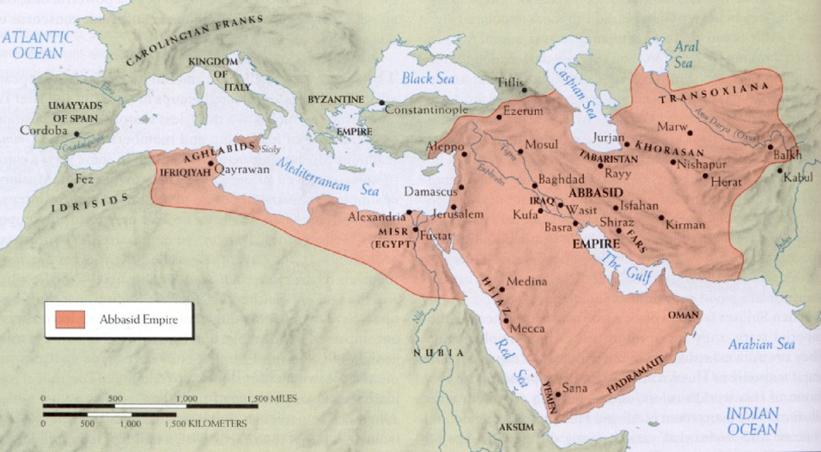
750 - 1258 CE
Abbasid Caliphate
Baghdad major trading/intellectual; center. Viziers, extensive trade, Turkish migration, translation of Western texts. Heavy Persian influence on culture.

Slide 31
800 CE
Charlemagne crowned Holy Roman Emperor
First “unification” of Europe after fall of Rome. Creation of Holy Roman Empire.

Slide 32
c. 800-1300 CE
Great Warming Period
Increase in agricultural production, general population growth, and establishment of stronger centralized states. Will lead to increased warfare.

Slide 33
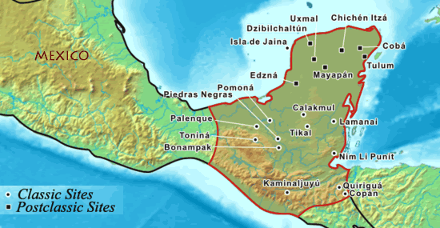
c. 900 CE
Collapse of Classical Maya
End of centralized authority in Central America and loss of written language. Power vacuum for Aztecs.

Slide 34
c. 1000 CE
High Middle Ages begins
Warming period reaches state where agriculture is prolific. Population rises. States strengthen, and warfare increases in Europe.

Slide 35
1054 CE
Great Schism
Split of Catholic and Orthodox Churches, further isolating Western and Eastern Europe.

Slide 36
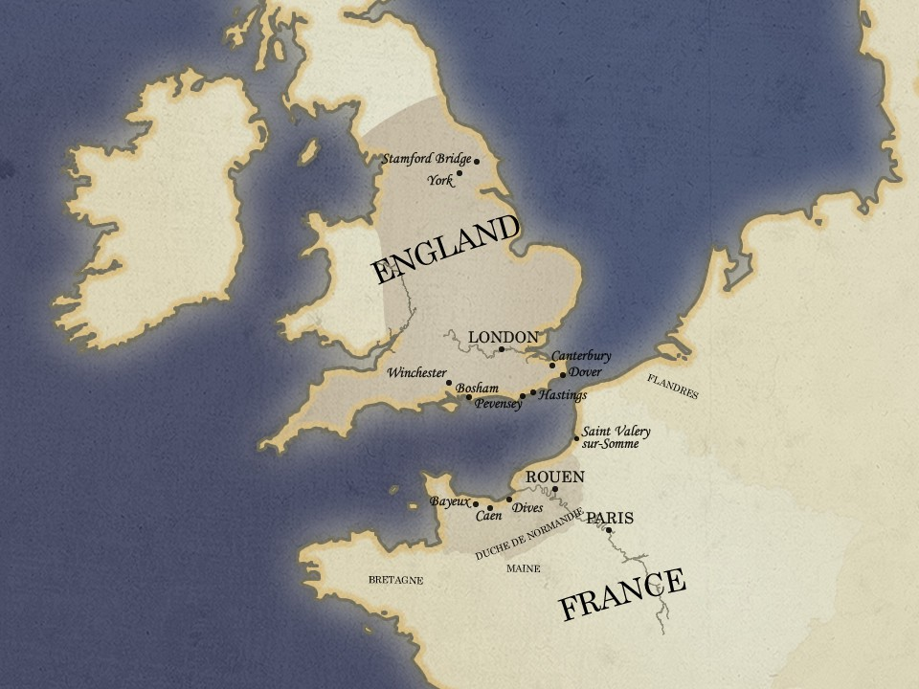
1066 CE
Norman conquest of England
Vikings (under William the Conqueror) create strong state in England, bringing it into the fold of continental Europe.

Slide 37
1204 CE
Christians sack Constantinople, further weakening it against Muslim pressure.
Fourth Crusade

Slide 38
1206 CE
Largest land empire in history begins under Genghis Khan; Pax Mongolica; Plague appears.
Mongol Empire emerges

Slide 39
1215 CE
Power of the monarchy in England becomes limited. Inspirational/influencial document during Age of Revolution.
Magna Carta signed

Slide 40
1258 CE
End of the Abbasid Caliphate.
Baghdad sacked by Mongols

Slide 41
c. 1300-1700
Period of artistic and scientific advancement due to increased European wealth.
Renaissance

Slide 42
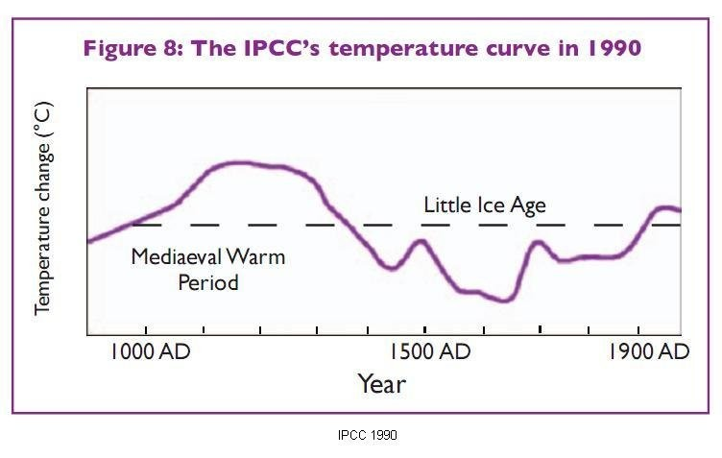
c. 1300-1870
Little Ice Age
Reductions in agriculture leads to social unrest and famines. Massive migrations. Rise of the potato.

Slide 43
1347 - 1348 CE
Rapid shift in European demographics leads to weakening of feudal system and the Catholic Church.
Bubonic Plague in Europe

Slide 44
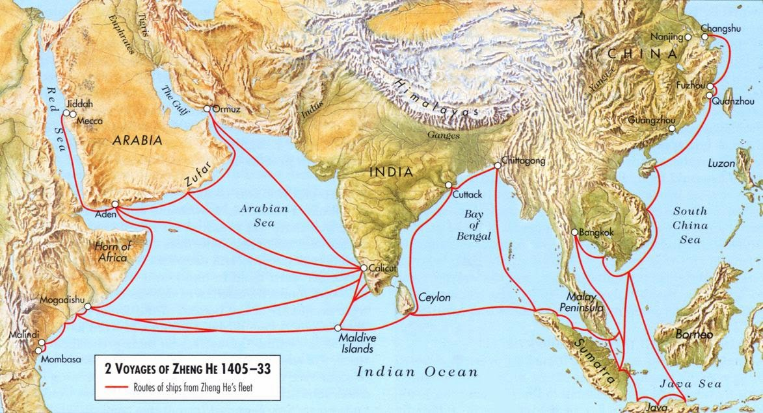
1405 – 1433 CE
Zheng He’s voyages
China begins isolationism during Ming Dynasty.

Slide 45
1438 CE
Construction of roads linking areas along the west coast of South America. Gold as commodity (will attract the Spanish…).
Rise of Inca

Slide 46
1453 CE
End of European influence in Eastern Mediterranean trade. New Islamic monopoly leads to Age of Exploration. Intellectual resources shift west reinforcing Renaissance.
Constantinople falls to Ottomans

Slide 47
1450 – 1750 CE
Early Modern Age (“Period 4”)
Interconnectivity of global empires and cultures. Spread of new crops and European hegemony.

Slide 48
1492 CE
Columbus “discovers” America
Sorry, indigenous peoples of the Americas…

Slide 49
1517 CE
Protestant Reformation begins
Literacy rates increase, religious anxiety and witch hunts increase. Beginning of Christian religious wars.

Slide 50
1600 CE
Rise of Tokugawa Shogunate
Unification and isolationist policy of Japan. Christians persecuted.

Slide 51
1618-1648 CE
Religious war that resulted in the economic and environmental destruction of Germany. Famine follows.
Thirty Years’ War

Slide 52
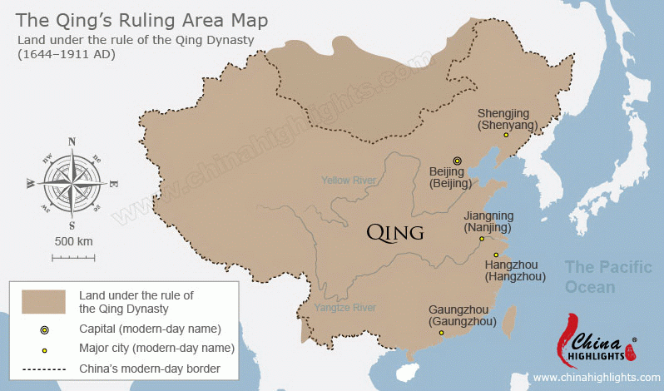
1644 – 1912 CE
Qing Dynasty
Manchurians in China! Opium Wars, Spheres of Influence, last dynasty of China.

Slide 53
1689 CE
Glorious Revolution
English Bill of Rights established. Constitutional monarchy!

Slide 54
1750-1900 CE
Spread of Enlightenment ideas. Age of Revolutions begins. Industrialization! Establishment of world’s first democratic republic.
Modern Age (“Period 5”)

Slide 55
c. 1760 CE
Capitalism becomes a real thing. Beginning of European and US economic and military hegemony. Population explosion.
Industrial Revolution begins in England

Slide 56
1776 CE
American Revolution
Start of “revolutionary fever” and the accumulation of intense French debt.

Slide 57
1789 CE
French Revolution
End of French feudalism, rise of Napoleon, end of absolute monarchy.

Slide 58
1799 CE
Napoleon crowned emperor (France)
Beginning of Napoleonic Wars

Slide 59
1804 CE
Haitian Independence
First and only successful slave revolt.

Slide 60
1815 CE
After Napoleonic Wars, European borders redrawn to balance power.
Congress of Vienna

Slide 61
1839-1878 CE
Tanzimat Reforms (Ottoman)
Failed attempt to modernize Ottoman Empire. Will continue to deteriorate.

Slide 62
1848 CE
Year of revolutionary fever for Europe! Exceptions are England (constitutional monarchy) and Russia (tsars…)
Year of Revolutions

Slide 63
1853 CE
Commodore Perry “opens” Japan
End of Japanese isolationism. Beginning of the end for Tokugawa shogunate.

Slide 64
1861 CE
Tsar Alexander II frees serfs
Last vestiges of feudalism ended. Russia begins to industrialize.

Slide 65
1885 CE
Berlin Conference
Division of Africa

Slide 66
1898 CE
Spanish-American War
U.S. asserts itself as international power.

Slide 67
1900 CE – present
Contemporary Age (“Period 6”)
Age of military technology, global integration and scientific breakthroughs.

Slide 68
1905 CE
Japan becomes a true military adversary. Russia realizes that it needs to step up industrialization.
Russo-Japanese War

Slide 69
1911 CE
End of Confucian China. Battle between communism (CCP) and Kuomintang.
Chinese Revolution

Slide 70
1914-1918 CE
World War I
First total warfare scenario. Targeting of civilian populations, and new deadlier military weapons.

Slide 71
1917 CE
Russian Revolution
End of reign of the tsars. Transition to communism.

Slide 72
1929 CE
Stock Market Crash
Great Depression begins

Slide 73
1937 CE
Rape of Nanjing / Nanking
Unofficial beginning of World War II

Slide 74
1939-1945 CE
World War II
End of Great Depression. Beginning of Atomic Age.

Slide 75
1947 CE
Truman Doctrine
Start of Cold War

Slide 76
1948 CE
Birth of Israel
First national state for the Jewish. Beginning of direct conflict with Palestine and Pan-Arab states.

Slide 77
1950-1953 CE
Korean War
Proxy War that established communist North and republican South Koreas.

Slide 78
1956 CE
Suez Canal Nationalized
Egypt takes control of essential maritime trade route to the east.

Slide 79
1957 CE
Independence of Ghana
First peaceful African independence movement. Set the tone for the ideal transition to statehood.

Slide 80
1959 CE
Cuban Revolution
Cuba becomes communist.

Slide 81
1962 CE
Cuban Missile Crisis
Conflict encourages communication between U.S. and Soviet Union to avoid nuclear war.

Slide 82
1966-1976 CE
Cultural Revolution (China)
China spends ten years without an education system and endures extremely repressive censorship.

Slide 83
1989 CE
Tiananmen Square
Chinese students unsuccessfully push for greater freedom in China

Slide 84
1989 CE
Internet available for consumer use
Digital information becomes available to the public transforming the fabric of communication and learning

Slide 85
1991 CE
End of Cold War
USSR dissolves

Slide 86
2001 CE
9/11 Attacks
Global terrorism takes forefront of domestic and international security

Slide 87
2004 CE
Facebook founded
Era of global organization and connection through social media

Slide 88
2011 CE
Arab Spring begins
Fuse that triggers revolutionary fever in Middle East.

