Slide 1

The Expansive Realm of Islam

Slide 2
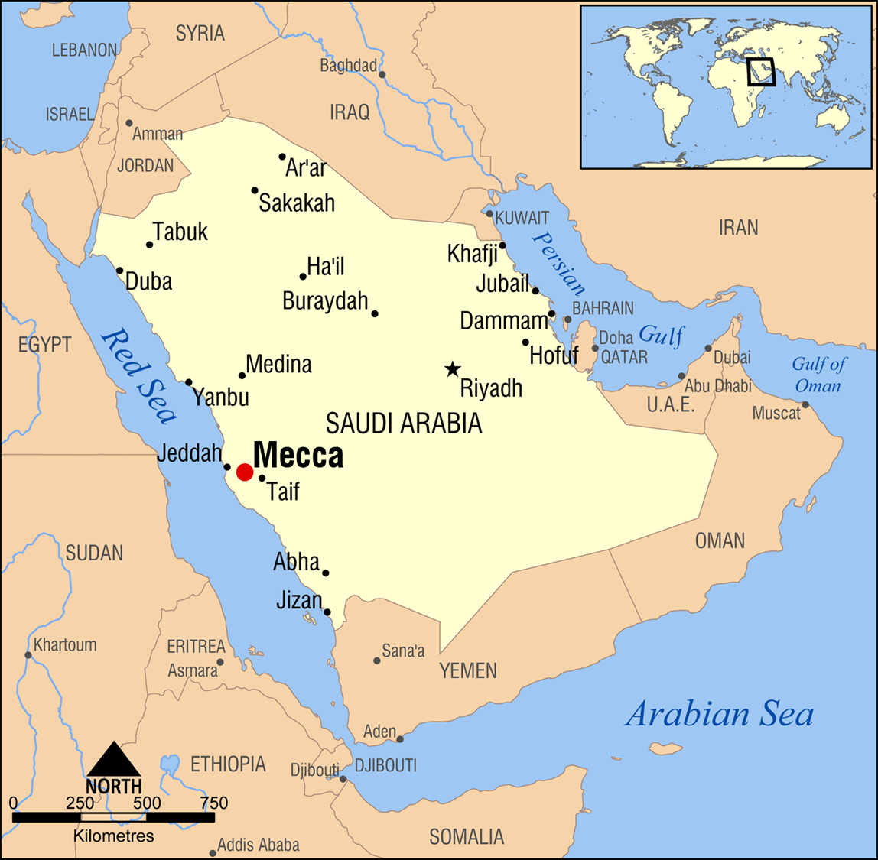
Muhammad and His Message
Born 570 to merchant family in Mecca
Orphaned as a child
Marries wealthy widow c. 595, works as merchant
Familiarity with paganism, Christianity and Judaism as practiced in Arabian peninsula

Slide 3
Muhammad’s Spiritual Transformation
Visions c. 610 CE
Archangel Gabriel visits
Converts to monotheism – Allah = God

Slide 4
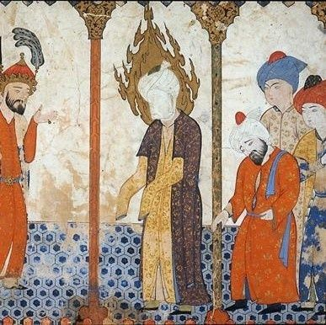
The “Seal of the Prophets”
Muhammad = the final prophet
Accepted the authority of Abraham, Moses, and Jesus
Held Hebrew scriptures and the Christian New Testament in high esteem
Muhammad had been entrusted a more complete revelation, one that communicated Allah’s plan for the world

Slide 5
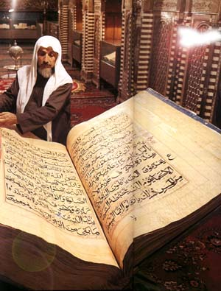
The Quran
Record of revelations received during visions
Tradition of Muhammad’s life: Hadith

Slide 6
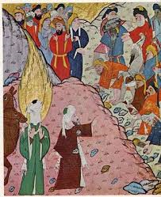
Conflict at Mecca
Muhammad’s monotheistic teachings offensive to polytheistic pagans
Economic threat to existing religious industry
Denunciation of greed affront to local aristocracy

Slide 7

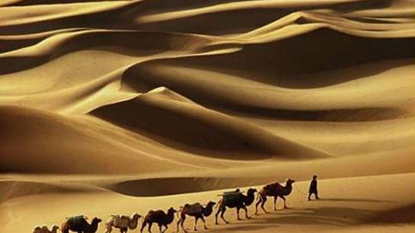
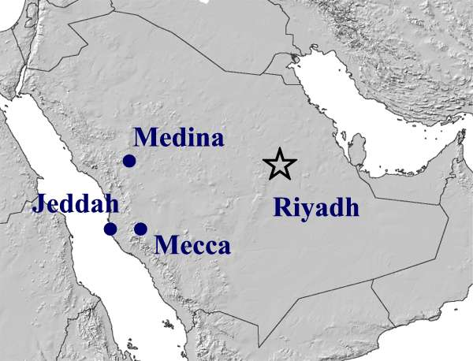
The Hijra
In 622 CE, Muhammad flees to Yathrib (Medina)
  Year 1 in Muslim calendar
Organizes followers into communal society (the umma)
Sets legal, spiritual code

Slide 8
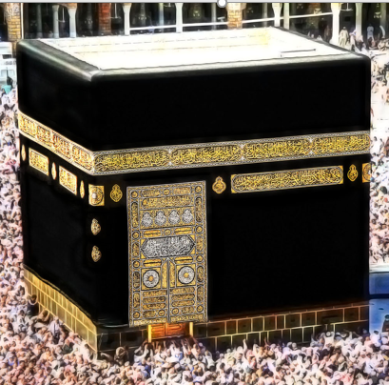
Muhammad’s Return to Mecca
Attack on Mecca, 630
Conversion of Mecca to Islam
Destruction of pagan sites, replaced with mosques
  Ka’aba preserved in honor of importance of Mecca
  Approved as pilgrimage site for Muslims
During daily prayers, all Muslims face Mecca, where the Kaa’ba is located
  Represents first house of Islamic worship

Slide 9
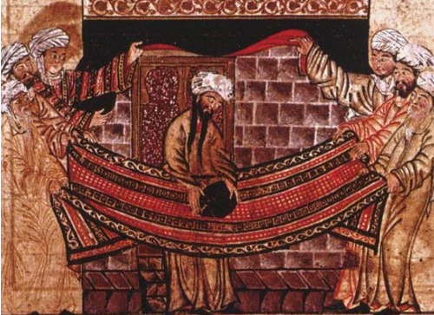
A 1315 illustration of Islamic elders lifting the stone to set it into the corner of the Kaaba

Slide 10
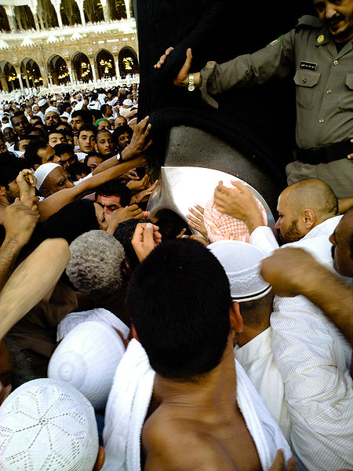
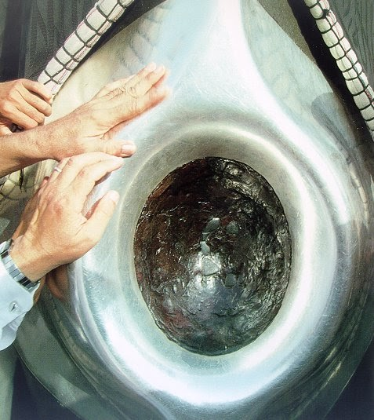

Slide 11
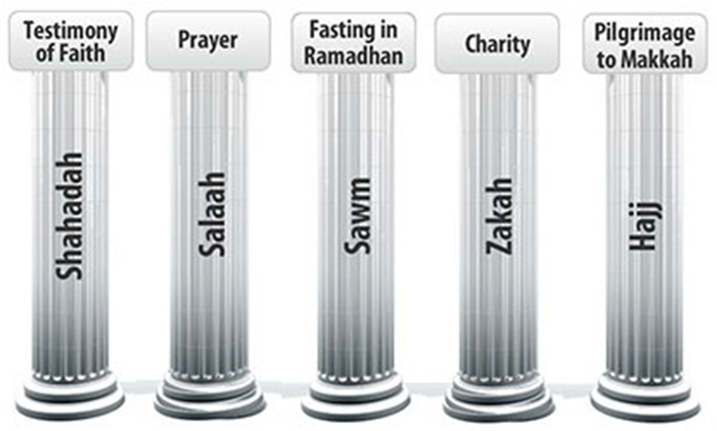
The Five Pillars of Islam
No god but Allah and Muhammad is His prophet
Daily prayer (5xs)
Fasting during Ramadan
Charity
Pilgrimage to Mecca (Hajj)

Slide 12
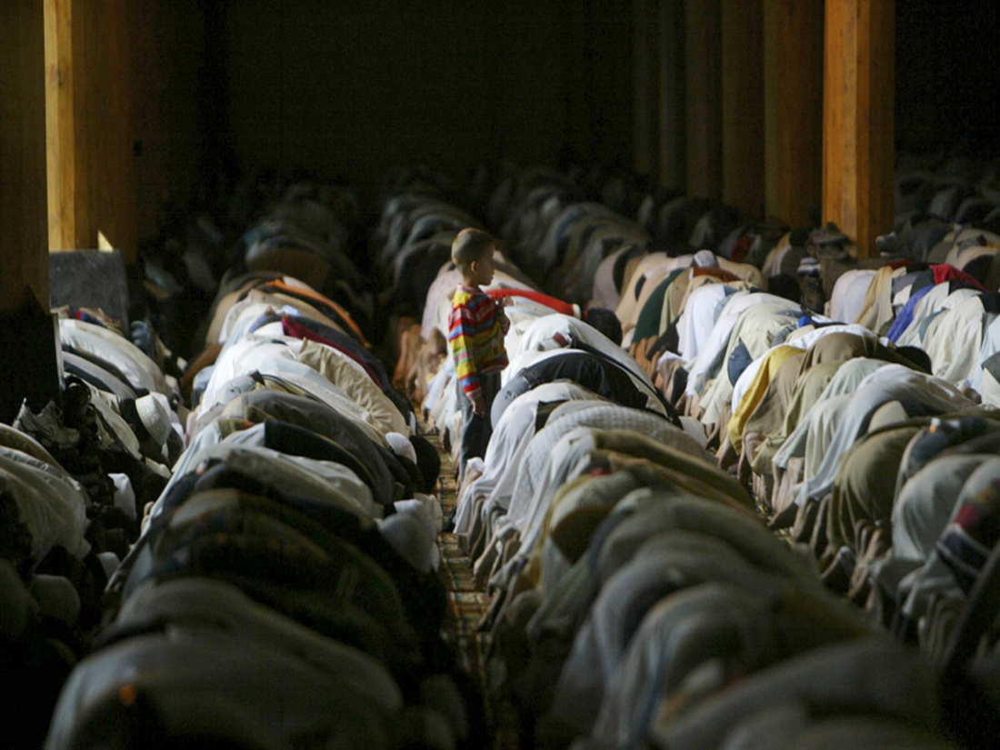
The Five Pillars: Worship
  Salat - Ritual prayer five times a day
  Dawn, noon, mid-afternoon, sunset, and nightfall.
  Towards Ka’ba shrine in Mecca.
  All males gather together on Friday for the noon prayer and listen to a sermon by the leader of the community (imam).

Slide 13
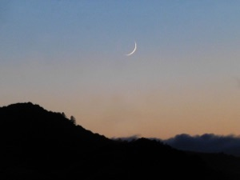
The Five Pillars: Fasting
Sawm: During the month of Ramadan (last month of Islamic lunar year) Muslims abstain from food, drink, and sex during daylight hours.
    There are also additional prayers and acts of devotion.
    Holiest day: Eid Al-Fitr (last day of Ramadan)
    Additional zakat

Slide 14
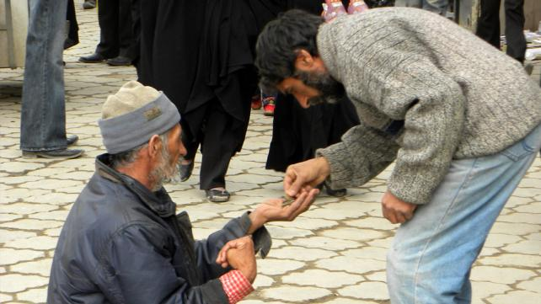
The Five Pillars: Almsgiving
Zakat - All adult Muslims of sufficient means are to pay this tax, which goes to the needy.

Slide 15
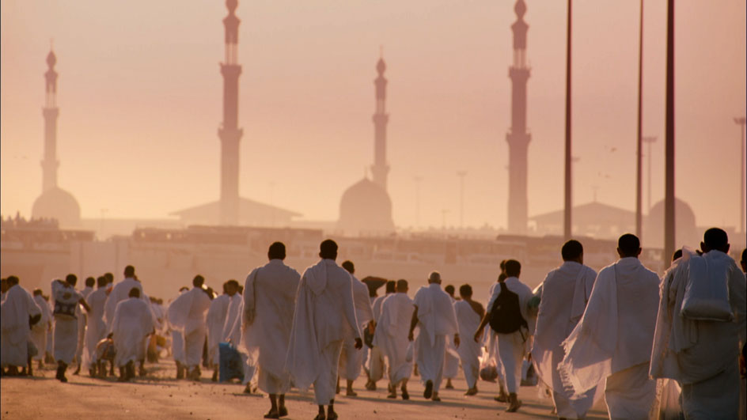
The Five Pillars: Pilgrimage
Hajj - Pilgrimage to Mecca
  During the last month of the Islamic year (Ramadan), every Muslim of sufficient means must make the journey to Mecca at least once in their lifetime.

Slide 16
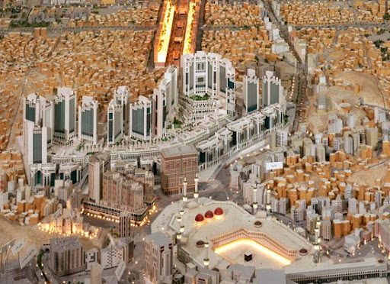

Slide 17
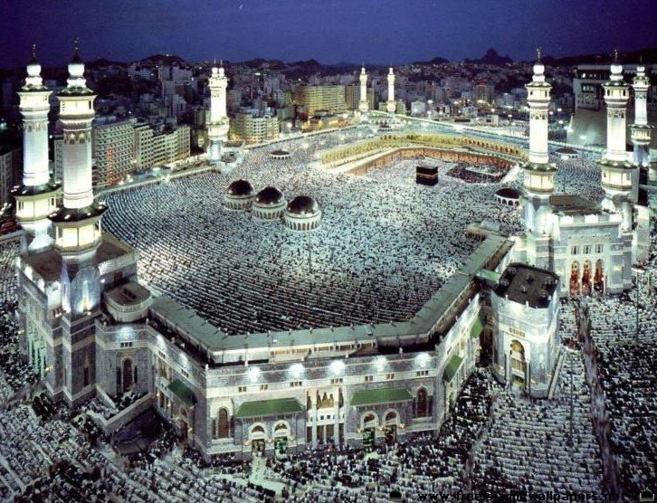

Slide 18
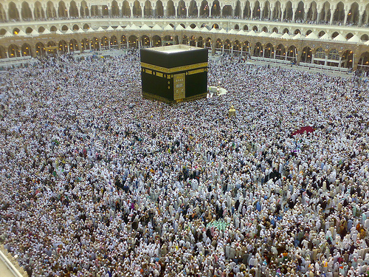
  timelapse hajj

Slide 19
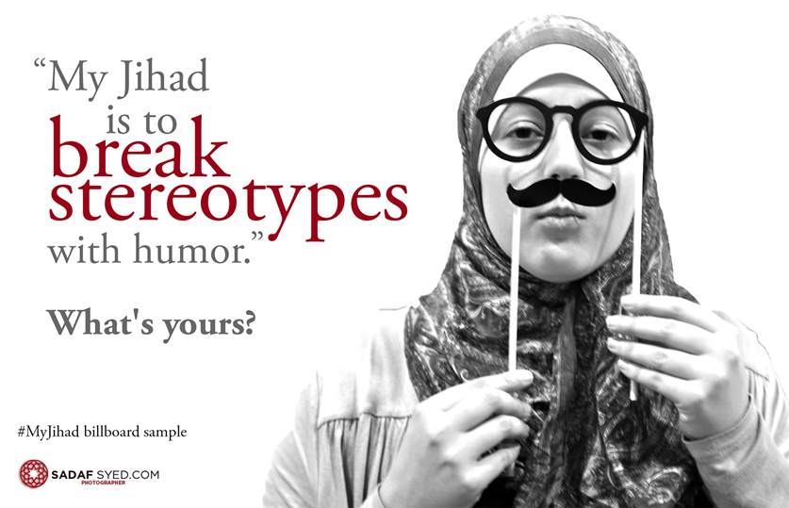
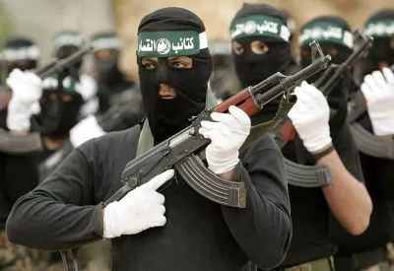
Jihad
“struggle”
  Against vice
  Against ignorance of Islam
“holy war”
  Against unbelievers who threaten Islam

Slide 20
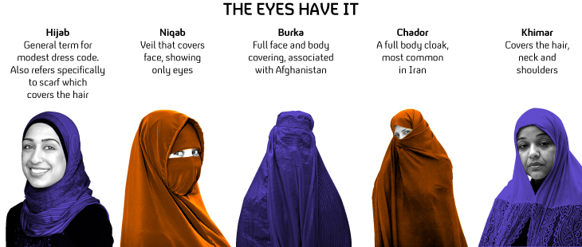
Islamic Law: The Sharia
Codification of Islamic law
Based on Quran, hadith, logical schools of analysis
Extends beyond ritual law to all areas of human activity

Slide 21
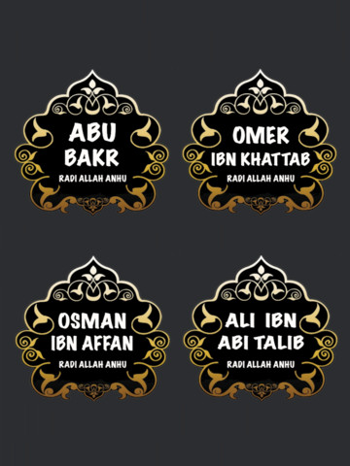
Succession of Muhammad
Muhammad selects Ali to be successor (caliph), but passed over for Abu Bakr after death of prophet – creates tension
“Rightly Guided Caliphs” Abu Bakr, Umar, Uthman, Ali (elective monarchy)
After death of Ali, discontent over leadership creates factions:
  Shia - Twelve Imams (Ali, Hasan, Husain, and Husain's descendants) were the successors to Muhammad, even if they did not hold political power.
  Sunni –whoever held political power was considered the successor to Muhammad

Slide 22
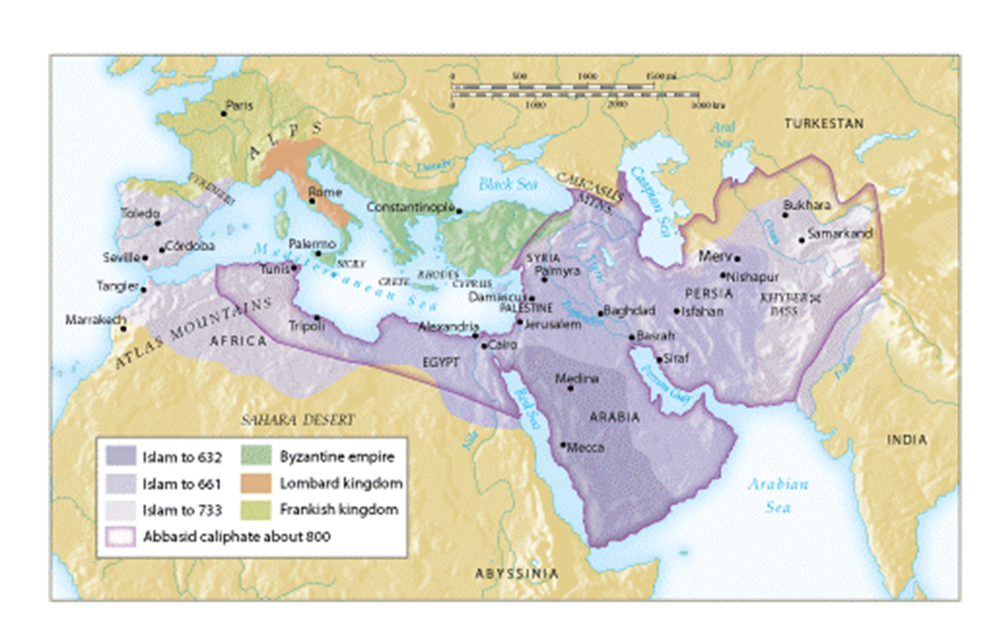
The Expansion of Islam
Highly successful attacks on Byzantine, Sassanid territories
Difficulties governing rapidly expanding territory

Slide 23
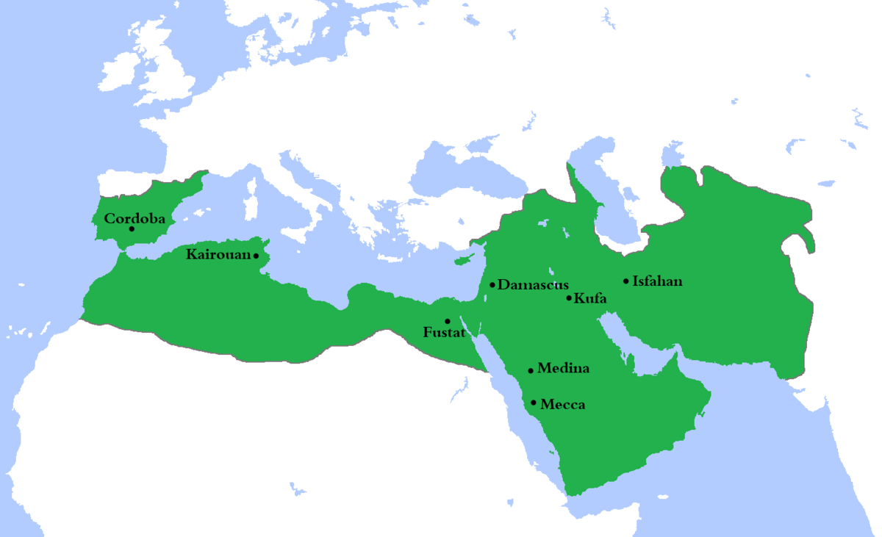
The Umayyad Dynasty (661-750 CE)
From Meccan merchant class
“Arab kingdom” - reflecting traditional Muslim disapproval of the secular nature of the Umayyad state.
  Hereditary monarchy!
Brought stability to the Islamic community
Expansion into Spain
Capital: Damascus, Syria

Slide 24
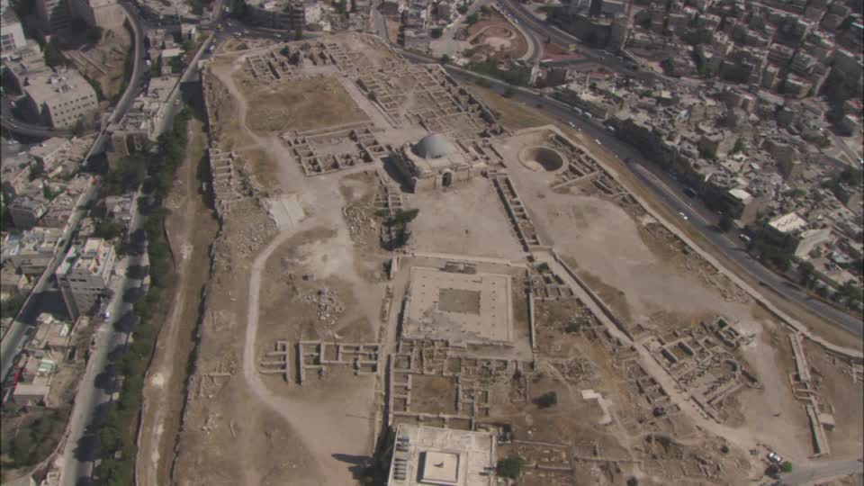
Policy toward Conquered Peoples
Favoritism of Arab military rulers causes discontent
Limited social mobility for non-Arab Muslims
Head tax (jizya) on non-Muslims
Luxurious Umayyad living causes further decline in moral authority

Slide 25
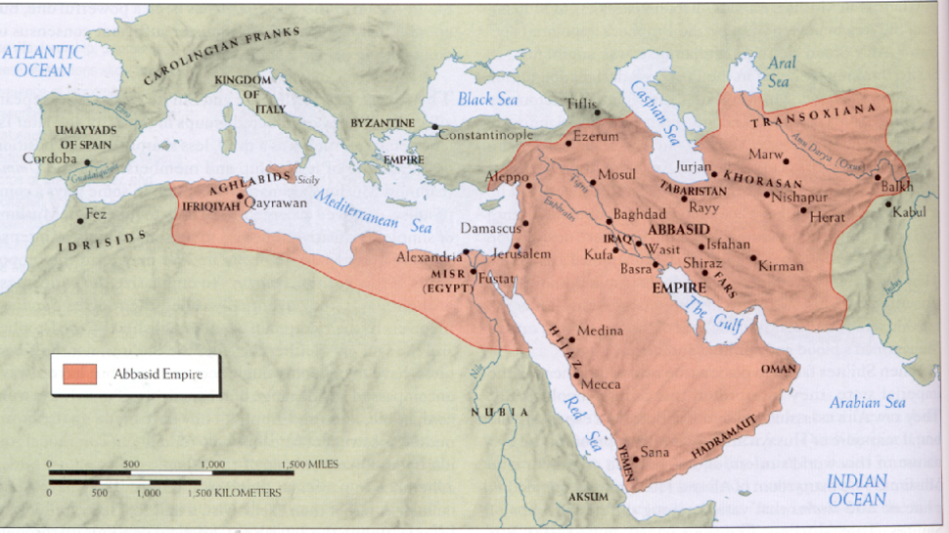
The Abbasid Dynasty (750-1258 CE)
Abu al-Abbas, a Sunni Arab, allied with Shia, non-Arab Muslims
Seizes control of Persia and Mesopotamia
Defeats Umayyad army in 750
  Invited Umayyads to banquet, then massacred them

Slide 26
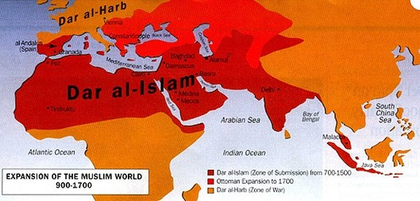
Nature of the Abbasid Dynasty
Diverse nature of administration (i.e. not exclusively Arab)
Militarily competent, but not bent on imperial expansion
Content to administer the empire as inherited
Dar al-Islam - Muslims can practice in a nation ruled by Islamic law

Slide 27
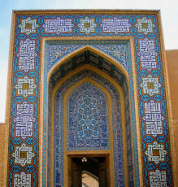
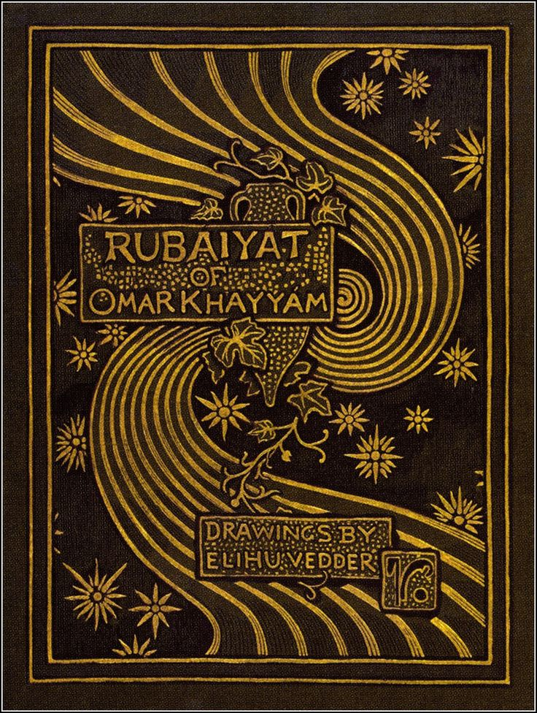
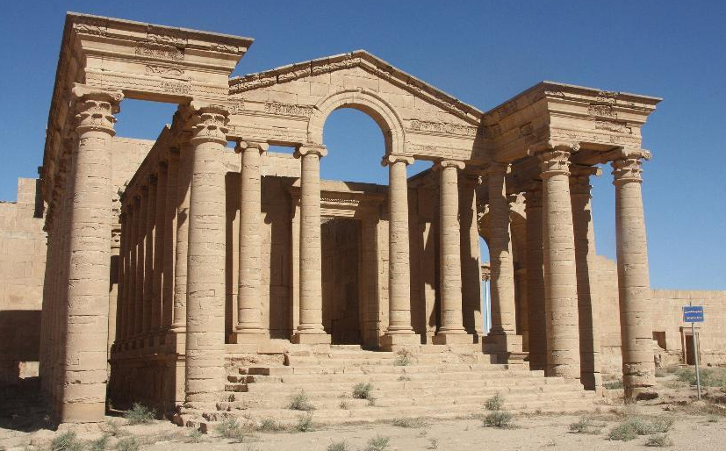
Abbasid Administration
Persian influence
Court at Baghdad
  Becomes major center of commerce
Influence of Islamic scholars
Ulama (elite Muslim scholars) and qadis (judges) sought to develop policy based on the Quran and Sharia

Slide 28
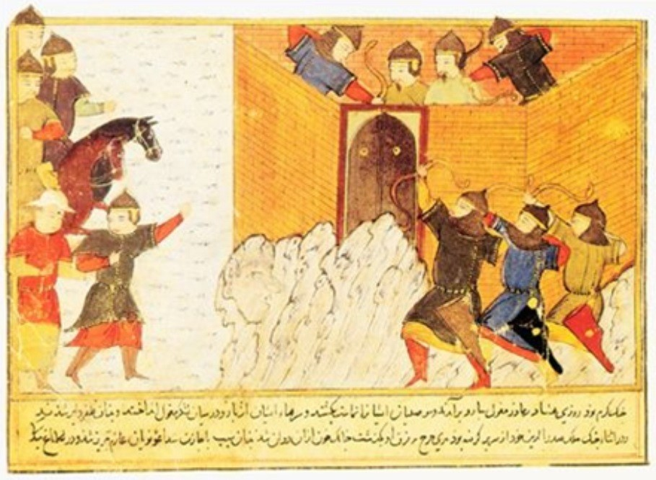
Abbasid Decline
Vast empire too large and diverse to maintain
Standardization of taxes – gold!
Viziers (prime ministers) become increasingly powerful
Assassination attempts on leadership
Civil war ensues over succession
Provincial governors assert regional independence
Abbasid caliphs become puppets of Persian nobility
Later, under Seljuq Turk influence, sultan becomes “power” of throne
Mongols sack Baghdad in 1258

Slide 29
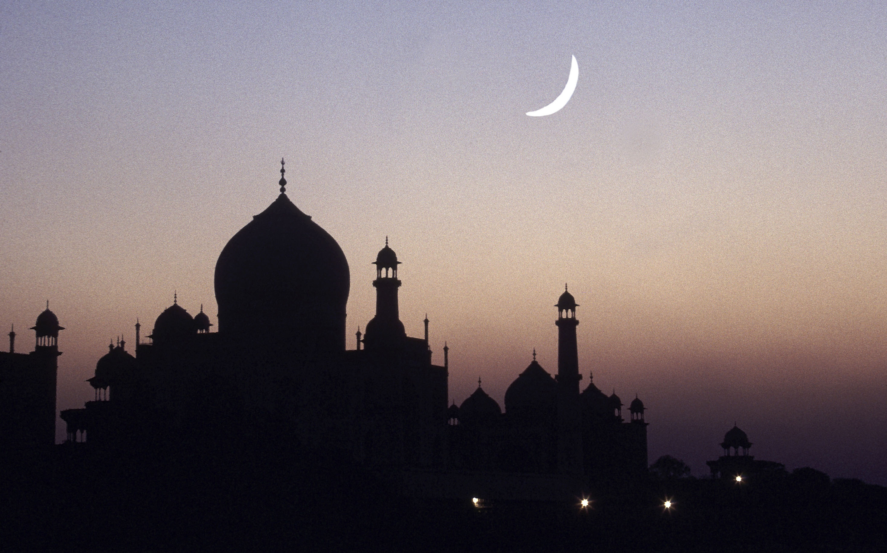
Quick Review
Name three important “texts” of Islam.
Name the Five Pillars (any order).
Which tax is paid to the poor?
Which tax is paid by “people of the book?”
Which caliphate used Damascus as capital?
Which caliphate used Baghdad?
What are the two major factions of Islam?
What is the holiest site of Islam?
What is a visit to this site called?
What is the name of the area where Muslims can practice in a nation ruled by Islamic law?

Slide 30
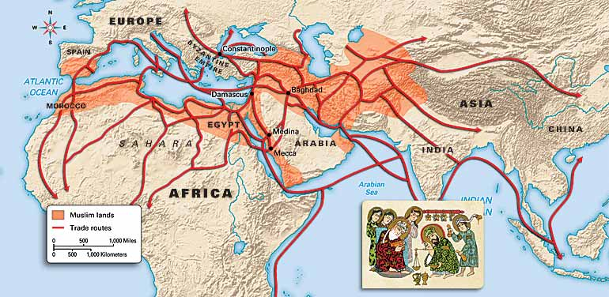
Economy of the Early Islamic World
Spread of food and industrial crops
  Trade routes from India to Spain
Western diet adapts to wide variety
New crops adapted to different growing seasons
  Cotton, paper industries develop
Agricultural sciences develop
Major cities emerge

Slide 31
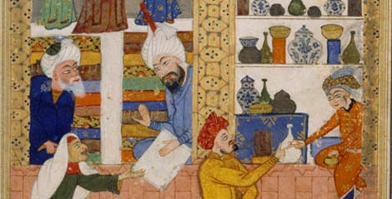
Formation of a Hemispheric Trading Zone
Historical precedent of Arabic trade
Dar al-Islam encompasses silk routes
  Ice exported from Syria to Egypt in summer, 10th century
Camel caravans
Maritime trade, esp. Indian Ocean

Slide 32
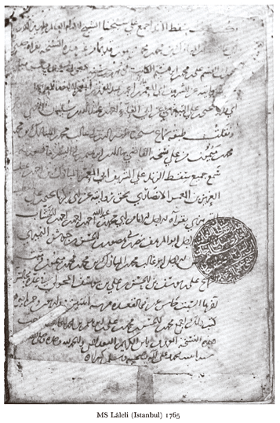
Banking and Trade
Uniformity of Islamic law throughout dar al-Islam promotes trade
Scale of trade causes banks to develop
  Sakk (“check”)
Joint ventures common to reduce risk

Slide 33
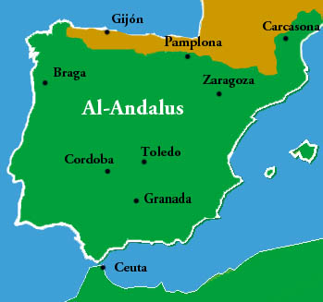
Al-Andalus (Islamic Spain)
Muslim Berber conquerors from North Africa take Spain, early 8th c.
Allied to Umayyads, refused to recognize Abbasid dynasty
  Formed own caliphate
  Tensions, but interrelationship
Will “return” Greek texts to Europe

Slide 34
Changing Status of Women
Quran improves status of women
  Outlawed female infanticide
  Brides, not husbands, claim dowries
Yet male dominance preserved
  Patrilineal descent
  Polygamy: polygyny permitted, polyandry forbidden
  Veil adopted from ancient Mesopotamian practice

Slide 35
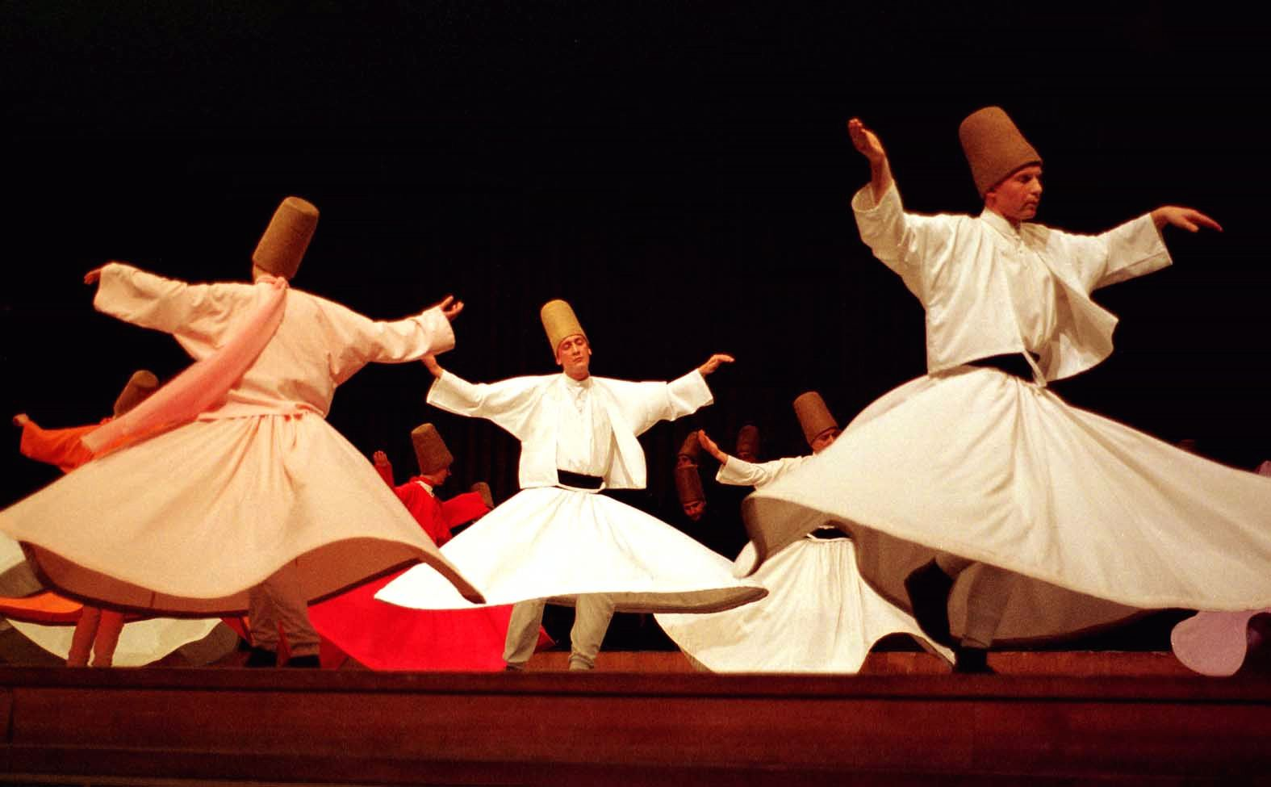
Sufism
Sufi missionaries
  Impossibility of intellectual comprehension of Allah; devotion, mystical ecstasy instead
  Some tension with orthodox Islamic theologians
  Wide popularity spreads Islam over vast areas
    Responsible for MANY conversions!
What is Sufism

Slide 36
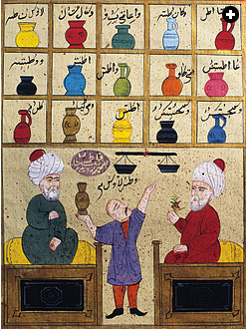
Cultural influences on Islam
Persia
  Administration and governance
  Literature (Rumi, Omar Khayyam)
  Art
India
  Mathematics, science, medicine
  “Hindi” numbers
Greece
  Philosophy, esp. Aristotle
  Commentary, especially by Ibn Rushd (aka. Averroes in Europe) 1126-1198

