Slide 1
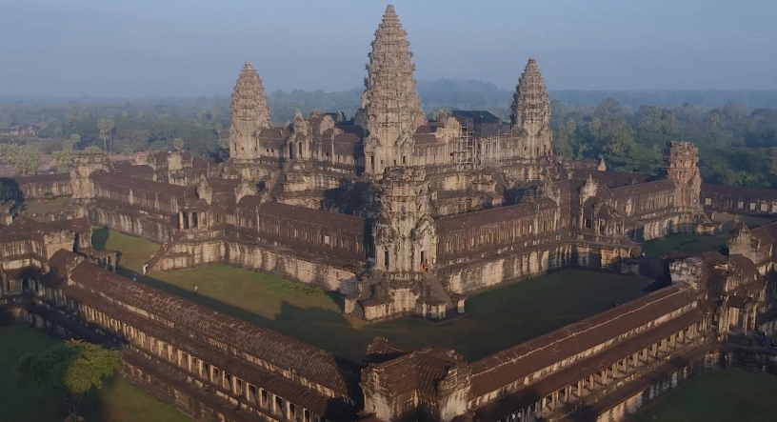
India and the Indian Ocean Basin
(aka. Diversity, Diversity, Diversity!)

Slide 2
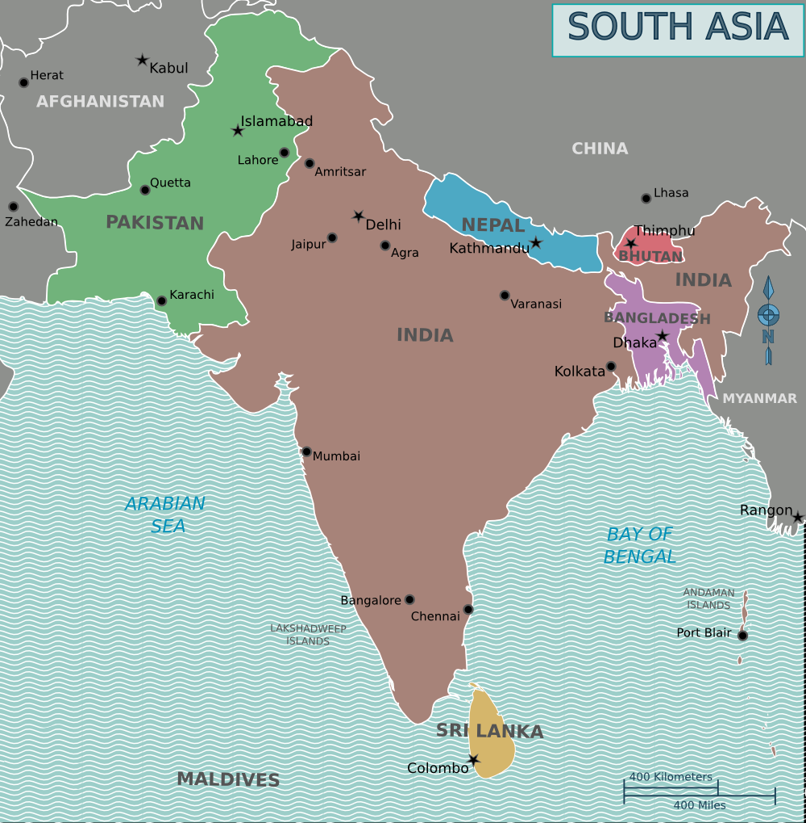
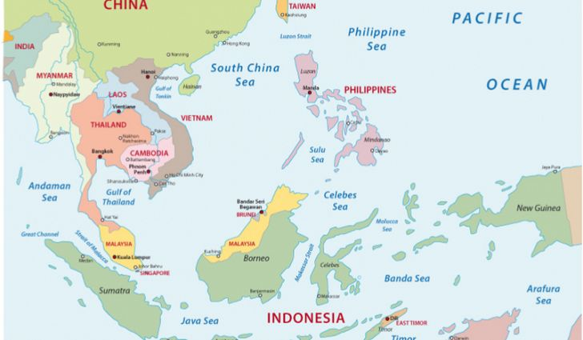

Slide 3
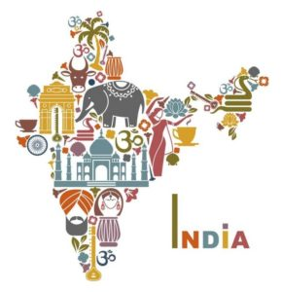
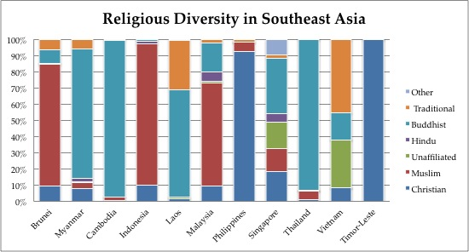
S and SE Asia in a nutshell: Diverse and Wealthy
Religious and ethnic diversity creates conflict
  From Hindu to Buddhist
    Theravada in SE
    Mahayana in South
  Buddhist returning to Hinduism
  Hindu to Islam
  Later: Islam AND Sikhism AND Hinduism
Trade makes empires wealthy

Slide 4
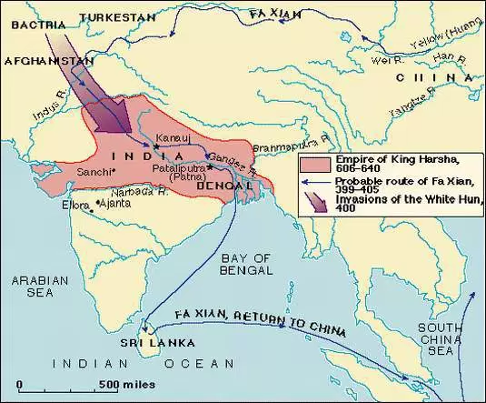
India after the Fall of The Gupta Dynasty
Invasion of White Huns from Central Asia beginning 451 CE
Gupta state collapsed mid-6th c.
Chaos in northern India
  Local power struggles
  Invasions of Turkish nomads, absorbed into Indian society

Slide 5
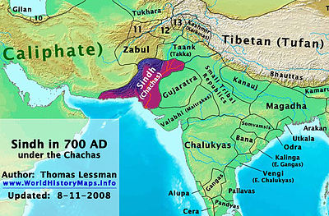
Introduction of Islam to Northern India
EXPANSION:
Muslim Arabs conquer Sindh (northwest India), 711
  Sindh stood at the fringe of the Islamic world
Strength of Islam not nearly as strong as in West
Held by Abbasid dynasty until 1258

Slide 6
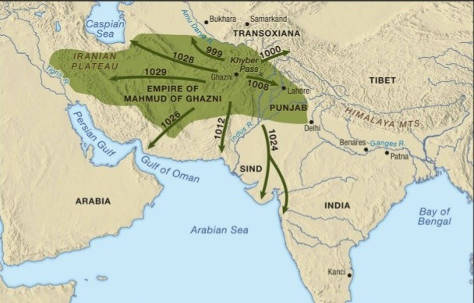
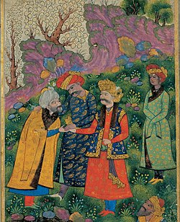
Mahmud of Ghazni
RAIDS:
Leader of the Turks in Afghanistan
17 raids into India, 1001-1027
Plunders, destroys Hindu and Buddhist temples
  Often builds mosques atop ruins

Slide 7
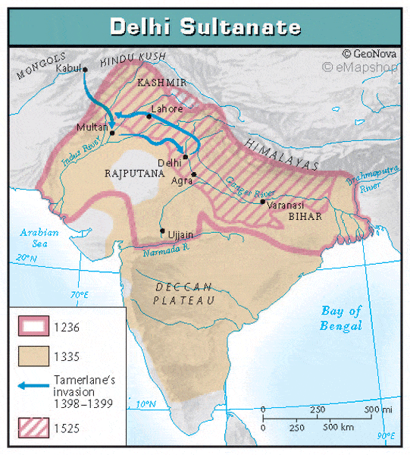
North India: Sultanate of Delhi
Consolidation of Mahmud’s raiding territory = Sultanate of Delhi
Capital: Delhi
Ruled northern India 1206-1526
Weak administrative structure
  Reliance on cooperation of Hindu kings
19 out of 35 Sultans assassinated!

Slide 8
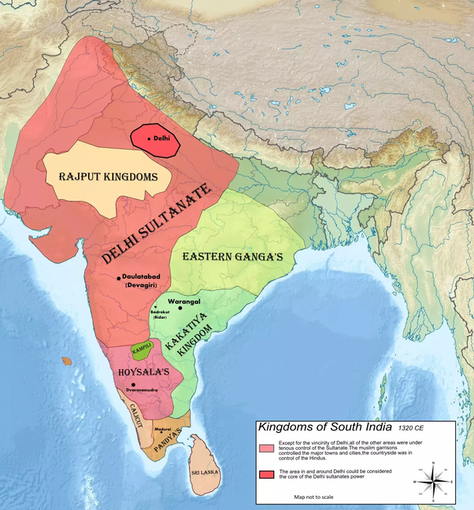
Rajput Kingdoms
Series of kingdoms from numerous clans constantly warring with each other for power.
Hindu, but vulnerable to threats from Islam.
Shrinks substantially as Delhi Sultanate becomes powerful

Slide 9
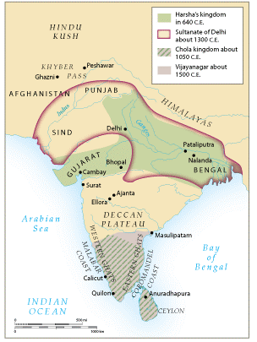
Hindu Kingdoms of Southern India
The south: politically divided but relatively peaceful
Chola Kingdom, 850-1267
  Maritime power from South China Sea to Arabian Sea
Kingdom of Vijayanagar
  Mid-fourteenth century - 1565
  Originally supported by Sultanate of Delhi
  Leaders renounce Islam in 1336
    Yet maintain relations with Sultanate

Slide 10
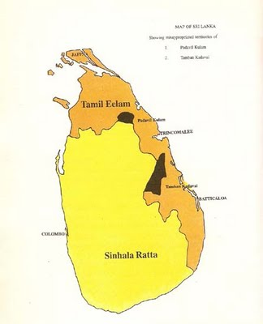
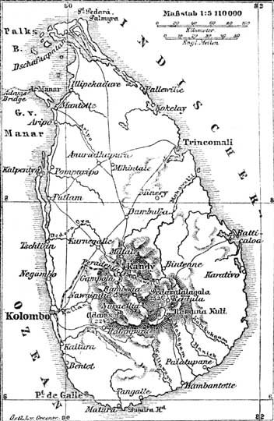
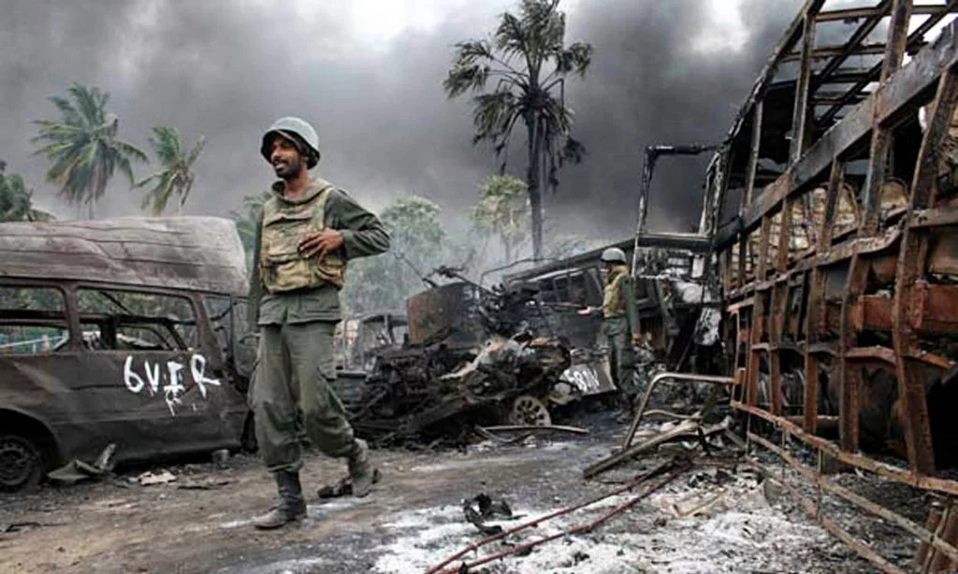
Sinhala Kingdom (543BCE – 1815CE)
Immigrants arrive (early) from India.
Multiple kingdoms established
Predominantly Buddhist by 3rd century
Later, Tamils brought by England will be Hindus and Christians
Sri Lankan Civil War (1983-2009)

Slide 11
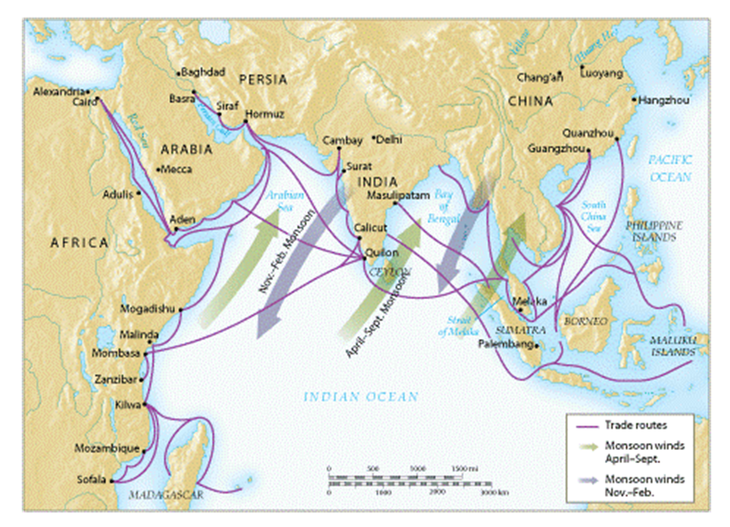
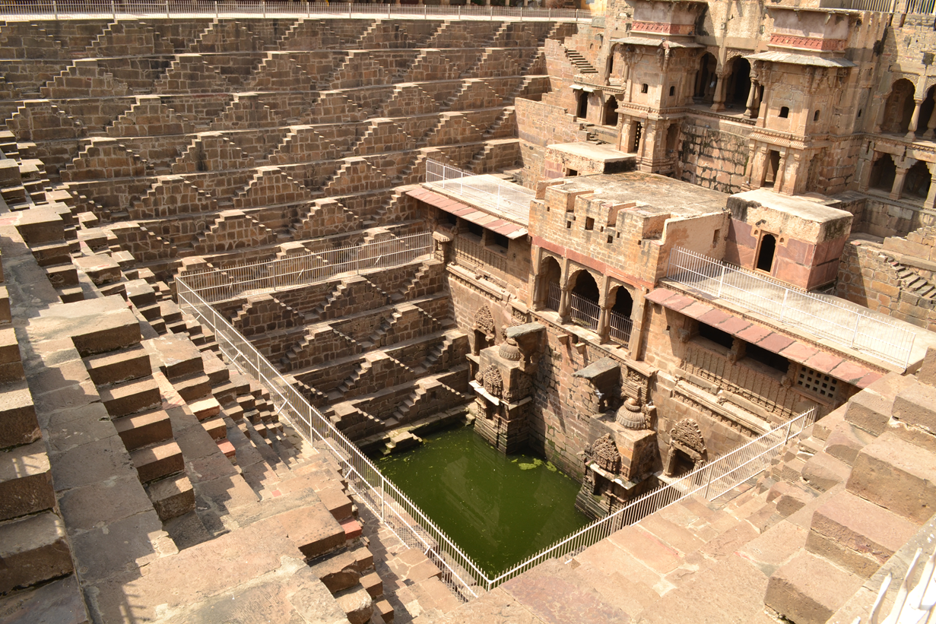
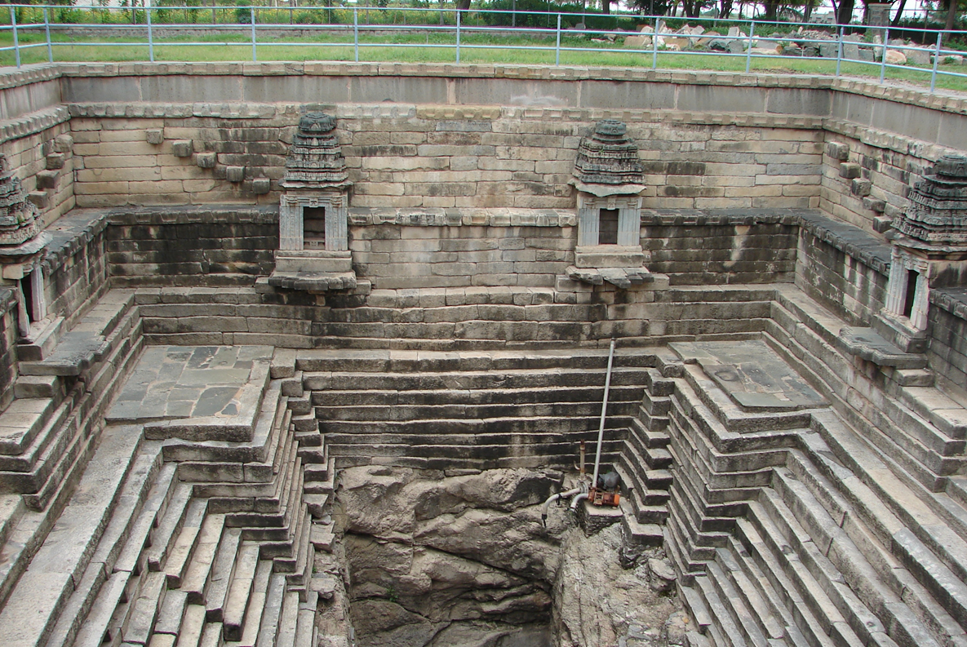
Agriculture in the Monsoon World
Spring/summer: rain, wind from SW
Fall/winter: dry, wind from NE
Seasonal irrigation crucial to avoid drought/famine, esp. southern India
Massive construction of reservoirs, canals, tunnels, stepwells
  One reservoir constructed during the 11th century covered 250 square miles!
Often managed by religious complexes or monasteries.
Population growth: 53 million in 600 C.E. to 105 million in 1500 C.E.
Urbanization took place in Delhi and other large port cities

Slide 12
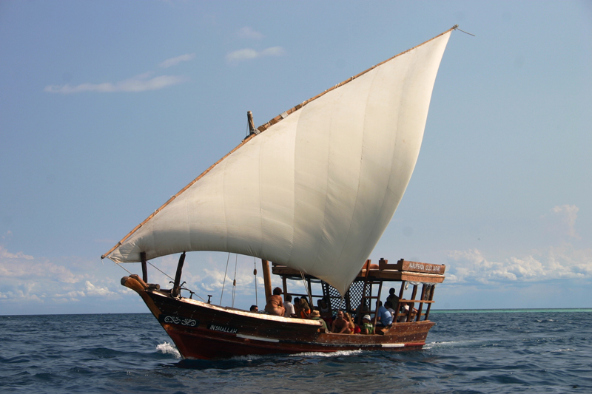
Cross-Cultural Trade in the Indian Ocean Basin
Trade increases in post-classical period
Larger ships
  Dhows and junks common
Establishment of emporia (large trading centers)
  Cosmopolitan port cities serve as warehouses for trade
Specialized products developed (high-carbon steel)
Export of cotton, precious metals/jewels, import of spices

Slide 13

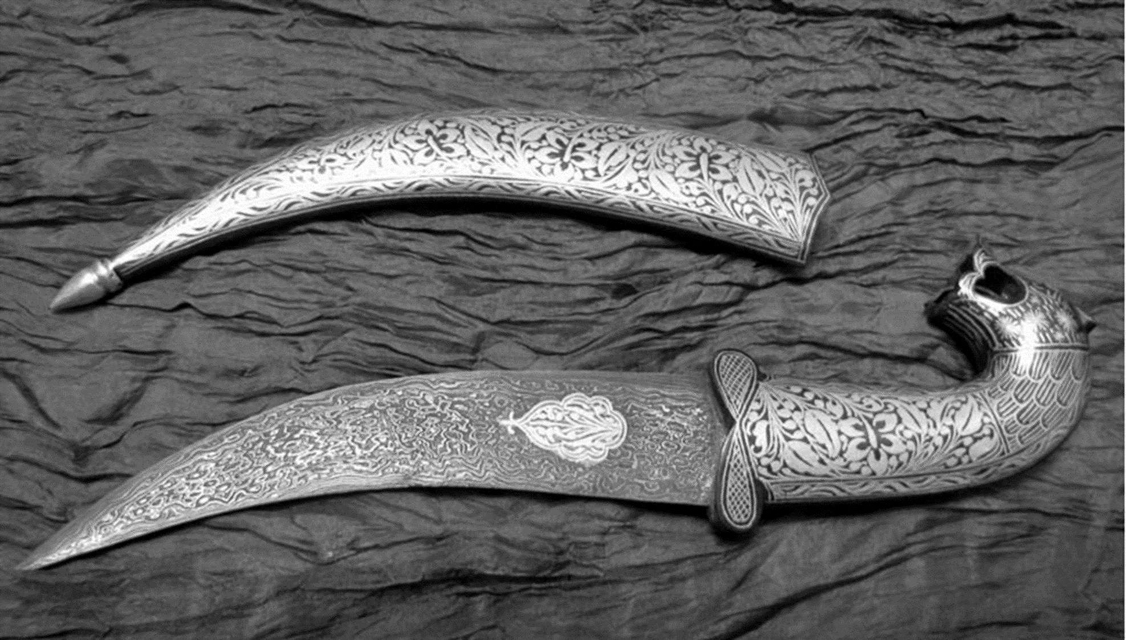

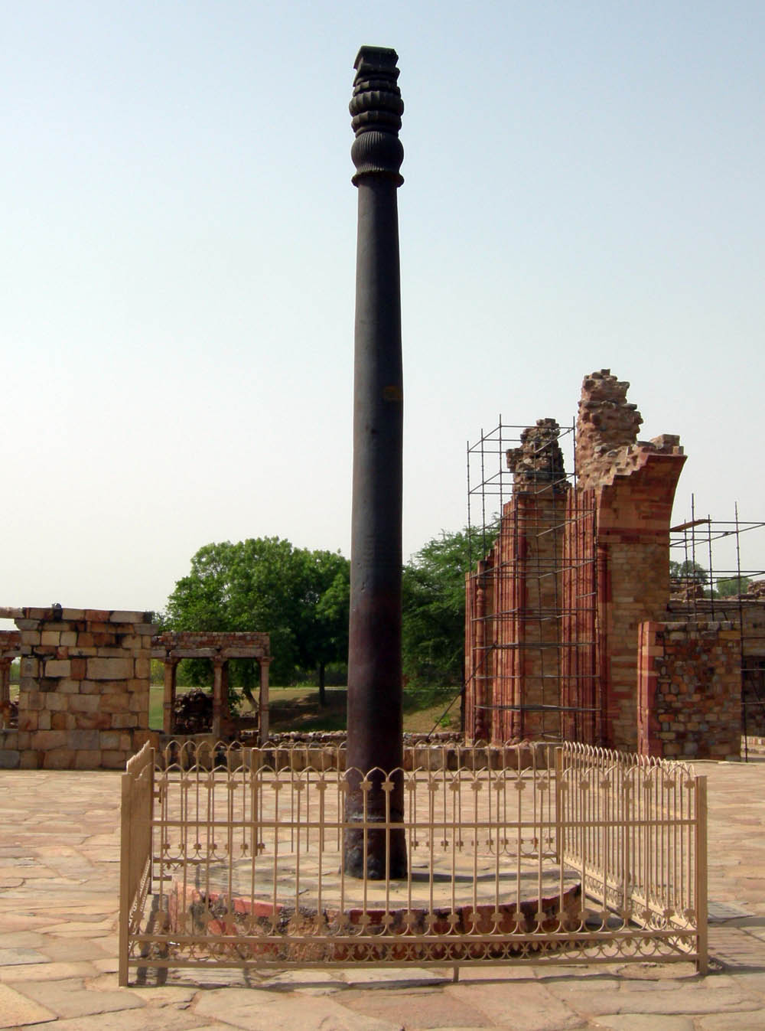
Trade goods
Specialized products developed: sugar, leather, stone, carpets, cotton, iron and high carbon steel
  Steel perfected in India c. 400 BCE (“Wootz”)
Silk and porcelain from China
Spices from southeast Asia
Pepper, gems, pearls, and cotton from India
Incense and horses from Arabia and southwest Asia
Gold, ivory, and slaves from east Africa

Slide 14
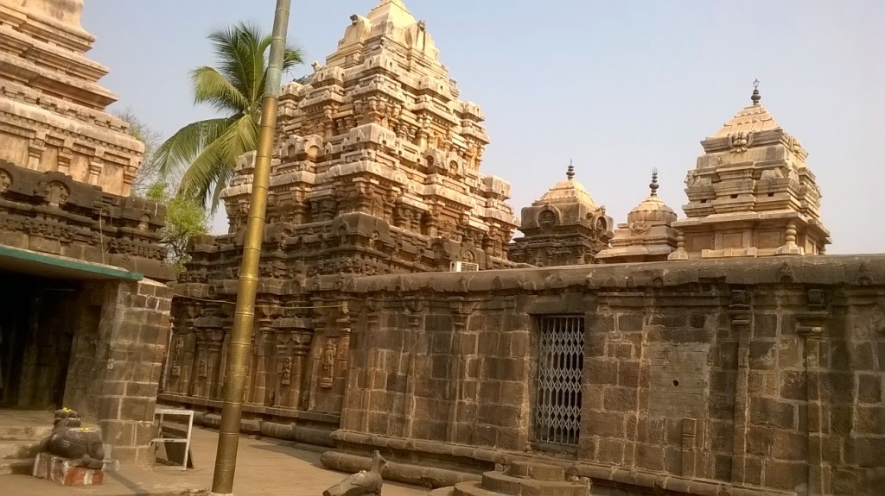
Temples and Indian Society
More than religious centers
  Center of coordination of irrigation, other agricultural work
Some temples possessed large tracts of land, hundreds of employees
Education providers
Tax collectors
Banking services

Slide 15
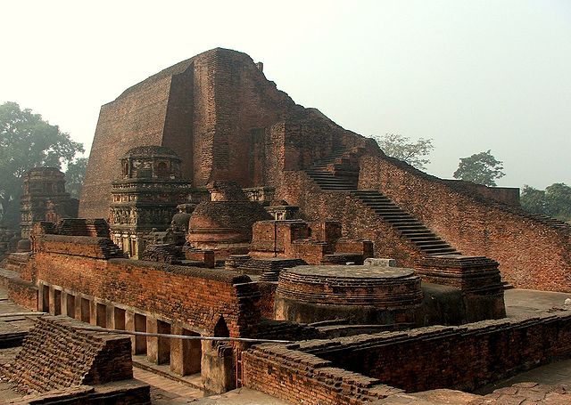
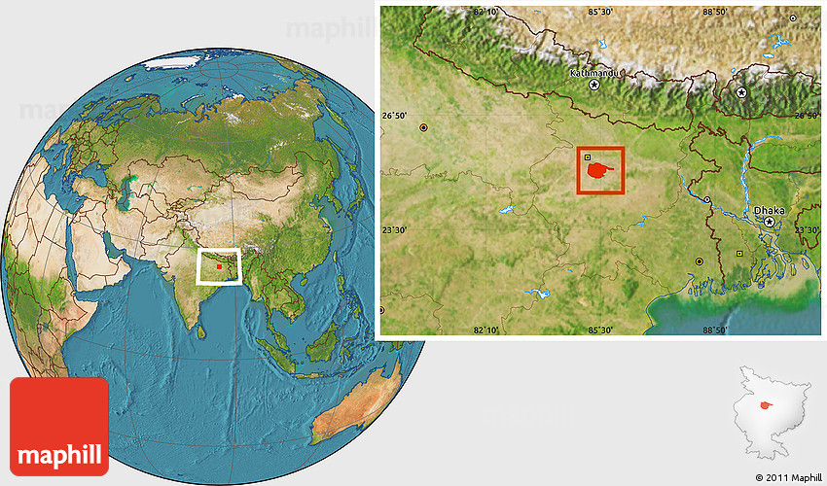
Decline of Buddhism
Buddhism displaced as Turkish invasions destroy holy sites, temples
1196 Muslim forces destroy library of Nalanda
  Thousands of monks exiled

Slide 16
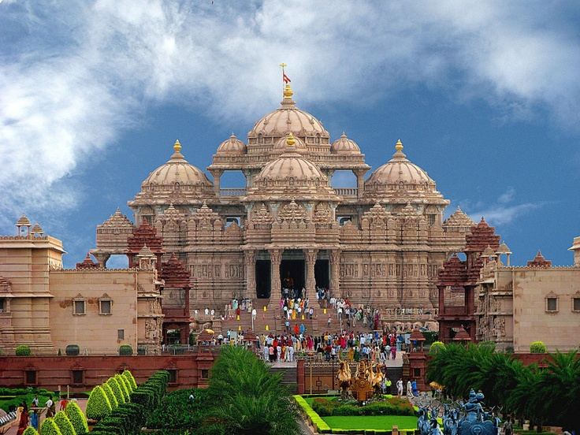
Challenges to Caste and Society
Caste provided guidance in absence of centralized political authority
  helped integrate immigrants (Turks, Muslim merchants) into Indian society
Expansion of caste system, especially to southern India
Increased urbanization
Economic development
  Development of increased Jati (sub-castes)
  Similar to worker’s guilds

Slide 17
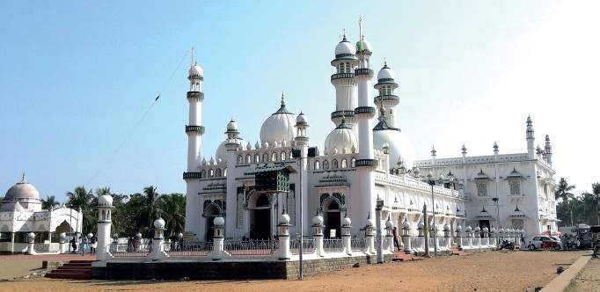
Conversion to Islam
Conversion to Islam slow: 25 million converts by 1500 (1/4 of total population)
Some converted for improving their lower social statuses
  Often an entire caste or sub caste adopted Islam en-masse
  Social status remained consistent
Sufis most effective missionaries
  They had a devotional approach to Islam
  Permitted followers to observe old rituals and venerate old spirits

Slide 18
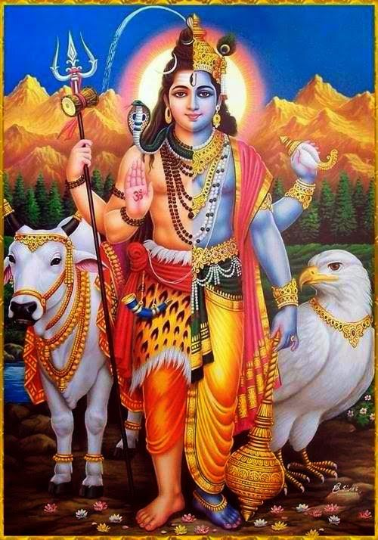
Evolution of Hinduism
Growth of devotional cults: to achieve mystic union with gods as a way of salvation
  Esp. Vishnu, Shiva
Bhakti movement
Especially popular in southern India, spreads to north

Slide 19
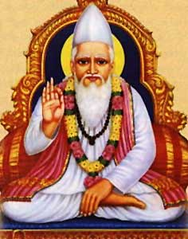
The Bhakti Movement
Growth of devotional cults: to achieve mystic union with gods as a way of salvation
Guru Kabir (1440-1518)
  Taught that Shiva, Vishnu, Allah all manifestations of one Deity
Attempt to bring Hinduism and Islam closer together
12th c. southern Hindu movement, spread to north
Largely unsuccessful, but will pave the way for Sikhism later

Slide 20
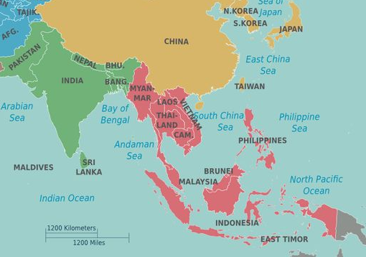
Indian Influence in Southeast Asia
Influence dates from 500 BCE
Evidence of Indian ideas and traditions
  Kingship - rajas
  Religions (Hinduism, Buddhism)
  Literature
Caste system not influential

Slide 21
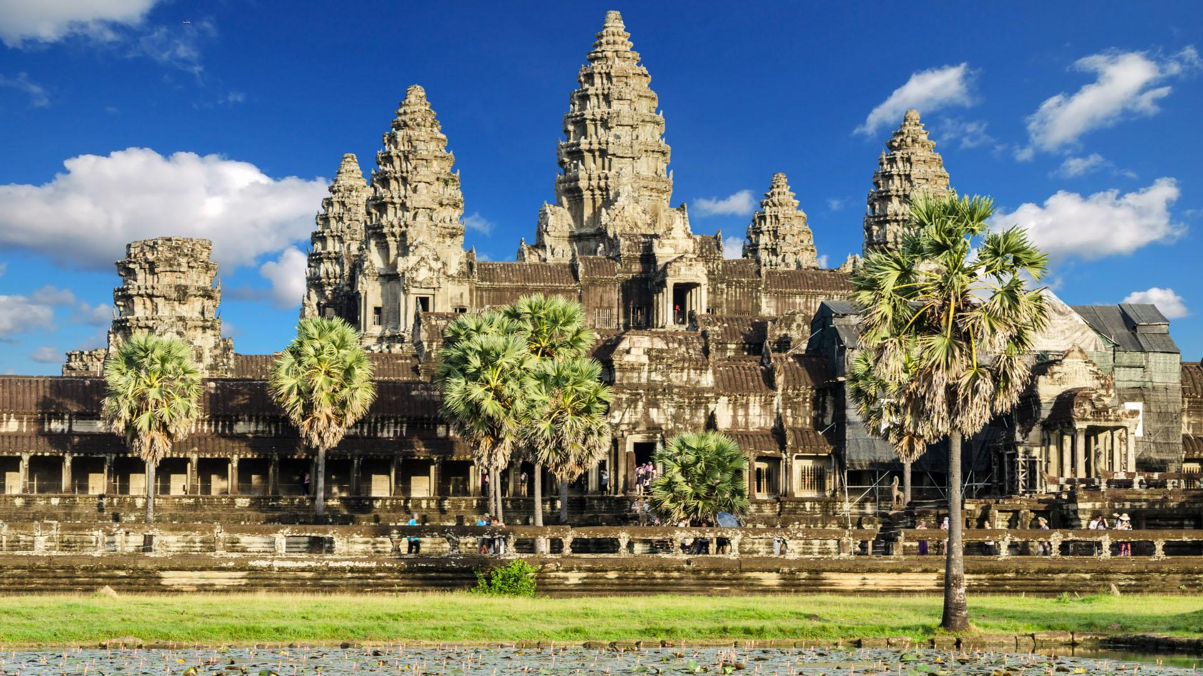
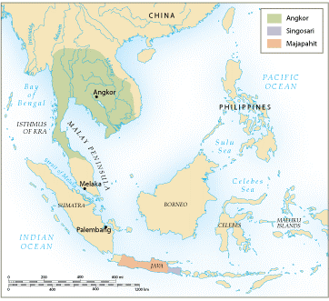
Early States of Southeast Asia
Kingdom of Angkor
  Cambodia, 889-1431 CE
  Built by Khmers at Angkor Thom, later Angkor Wat
    The city was a microcosmic reflection of Hindu world order
    Magnificent religious city complexes: Turned to Buddhism during the 12th and 13th centuries
  Thais invaded the capital in 1431, and Khmers abandoned it

Slide 22
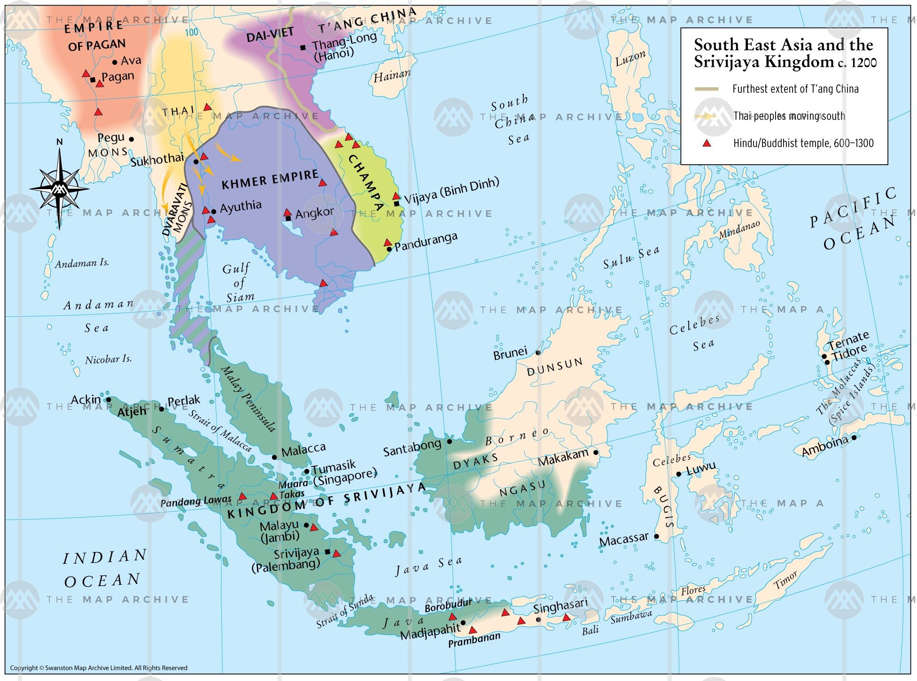
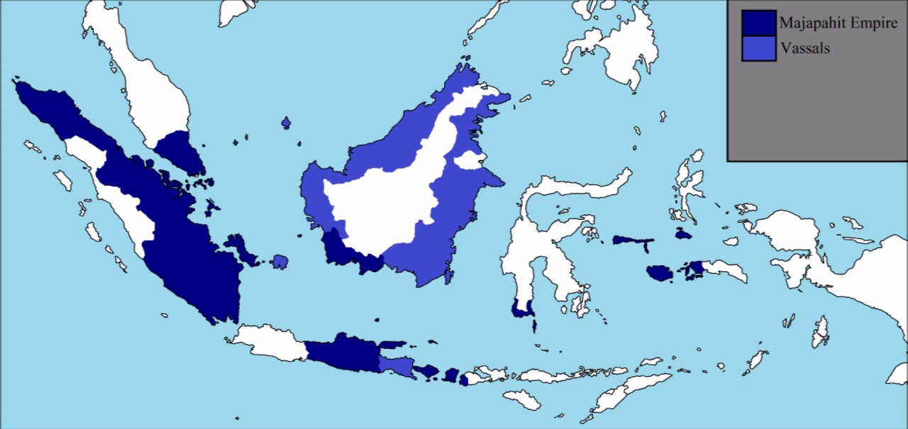
Empires in SE Asia
Srivajaya Empire (670 - c. 1200)
  Hindu kingdom on Sumatra
  Became wealthy through charging fees for ships traveling through from China/India
Majapahit Kingdom (1293-1520)
  Buddhist kingdom on Java
  Became wealthy through charging fees for ships traveling through from China/India, especially Strait of Malacca

Slide 23
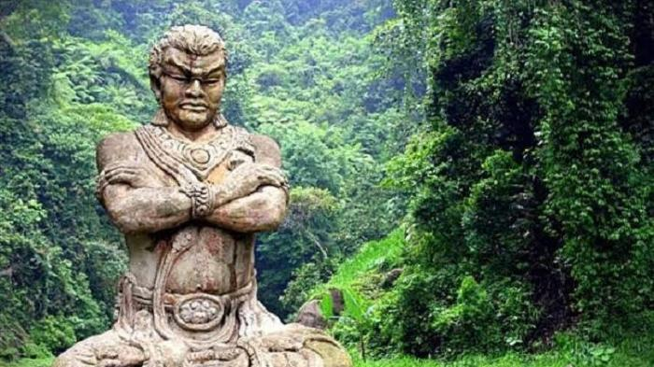
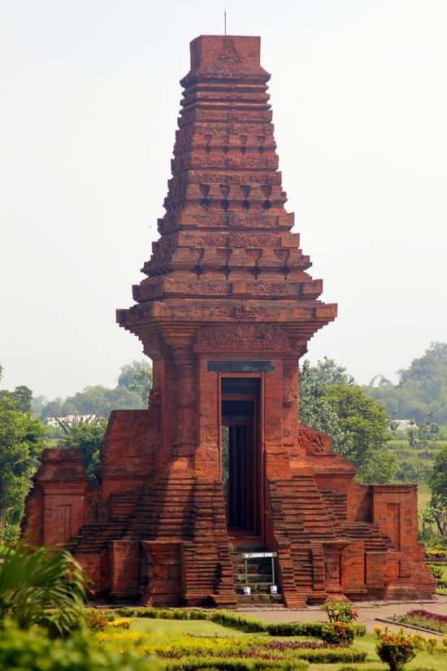
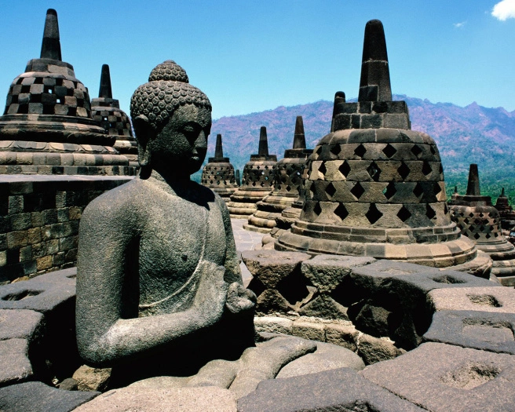
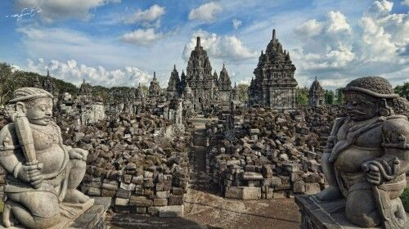

Slide 24
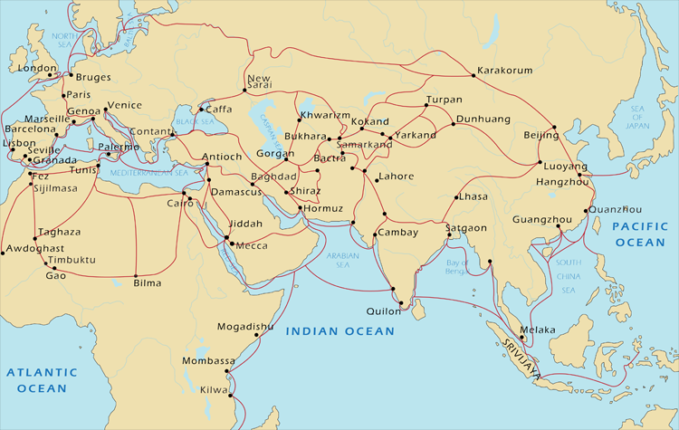
Merchants and Islam
TRADE:
Arabic trade with India predates Islam
Muslim merchants formed small communities in all major cities of coastal India
Dominated trade between India and the west to 15th century
Established local communities in S/SE Asia

Slide 25
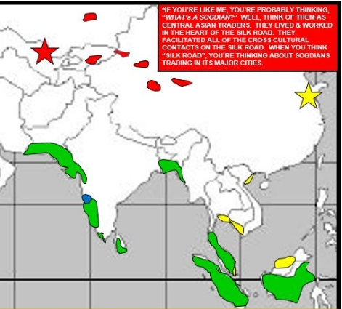
Islam in Southeast Asia
Early populations of Muslim traders
Ruling elite converted in cities while rural residents retained their traditions
Islam was not an exclusive faith in southeast Asia
Sufis appealed to a large public in these countries
  Many who convert retain some Hindu or Buddhist traditions

Slide 26
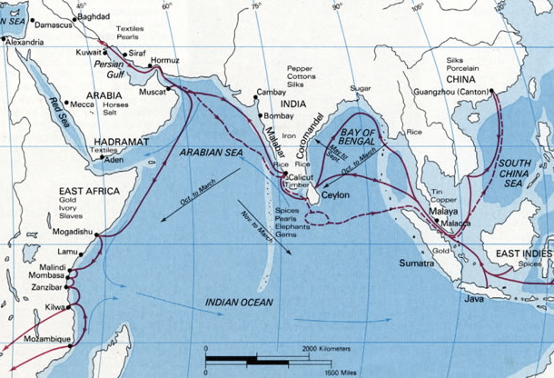
State of Melaka
Founded late 14th c. CE by rebellious prince of Sumatra
Dominated maritime trade routes
Mid-15th c. converts to Islam
Crash Course: Indian Ocean Trade

Slide 27
Fact Check!
What major difference existed between Hinduism as practiced in India and Southeast Asia?
Which sect of Islam was responsible for most South and Southeastern conversions?
What provided structure in Indian society in the absence of centralized rule?
How did the post-Gupta experiences of Northern and Southern India differ?
What is a major difference between the sultanate of Delhi and the kingdom of Vijaynagar?
What was (is) a major environmental barrier to maintaining civilization in southern India?
What role did Hindu temples play in Indi in the post-classical age?
How did Angkor Wat reflect religious ideas of India?
What were eclectic merchant cities called?
How did the spread of Islam in South and Southeastern India compare to the spread of Islam in Africa?

