Slide 1
Worlds Apart: The Americas

Slide 2
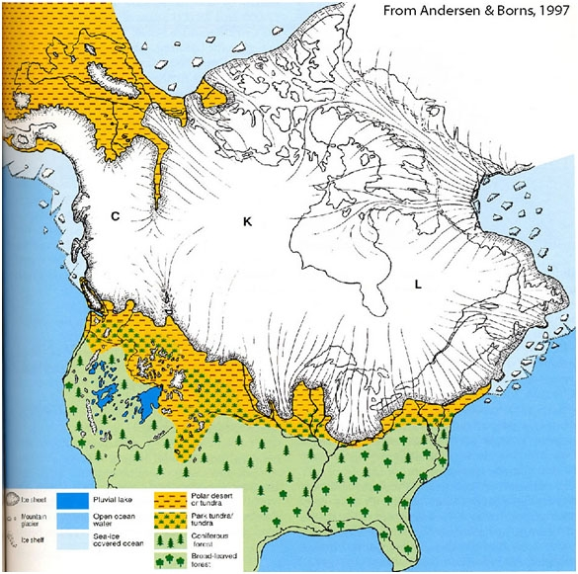
Ice Age Migrations
Migration to Mesoamerica
Large wave of humans traveled from Siberia to Alaska around 13,000 B.C.E.
By 9500 B.C.E., humans reached the southernmost part of South America
As hunting became difficult, agriculture began (7500 B.C.E.)

Slide 3
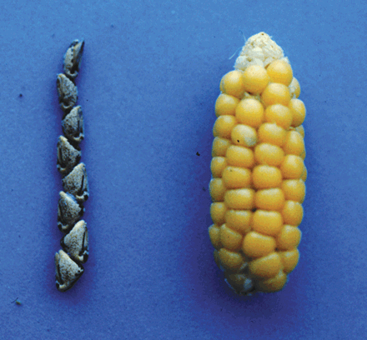
Early Agriculture
Early agriculture: beans, squashes, chilies; later, maize became the staple (5000 B.C.E.)
Agricultural villages appeared after 3000 B.C.E.
No large domesticated animals, no wheeled vehicles

Slide 4
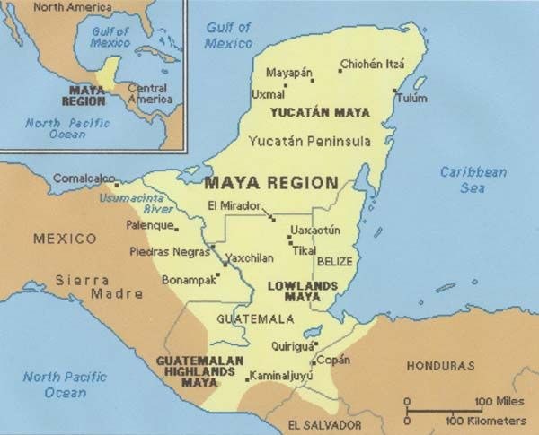
Maya Civilization
1800 BCE-900CE

Slide 5
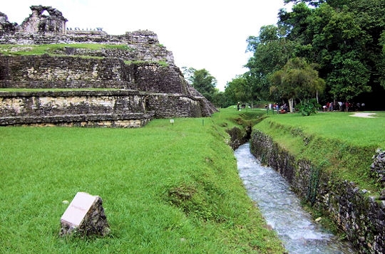
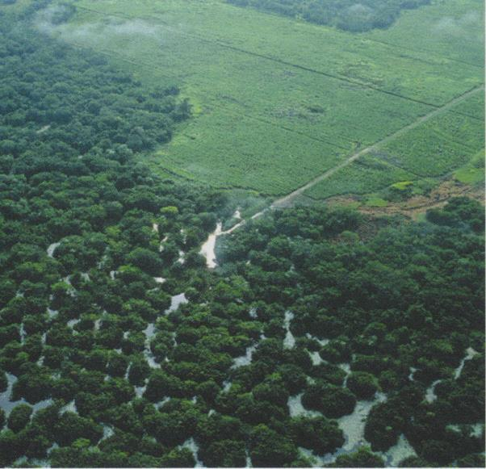
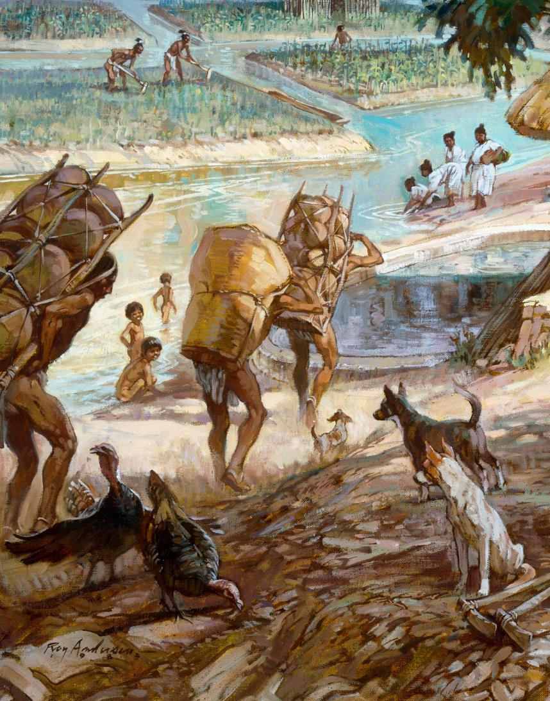
Agriculture
Staples: maize, squash, beans, chili peppers, tomatoes, avocados; venison
Slash-and-burn
Irrigation
Cenotes

Slide 6
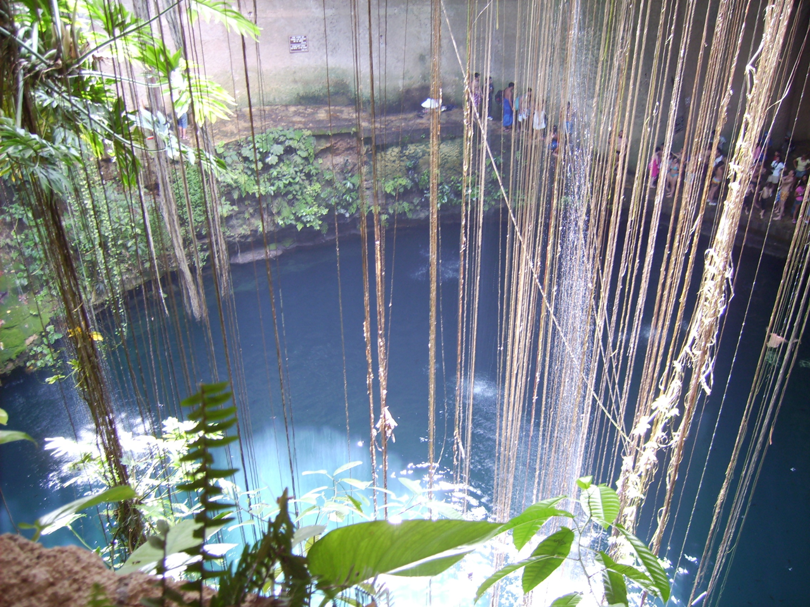
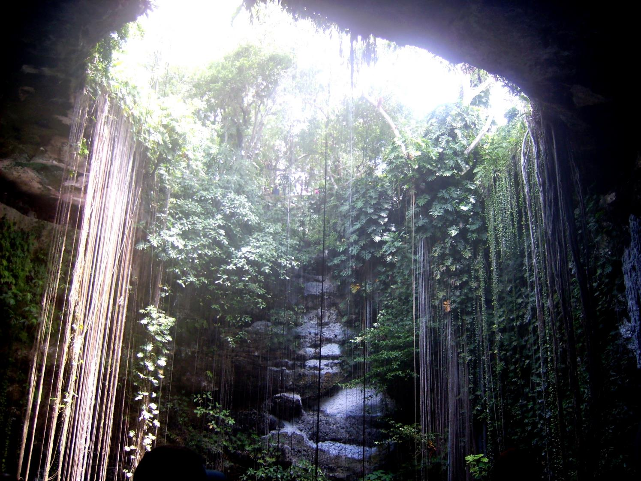

Slide 7


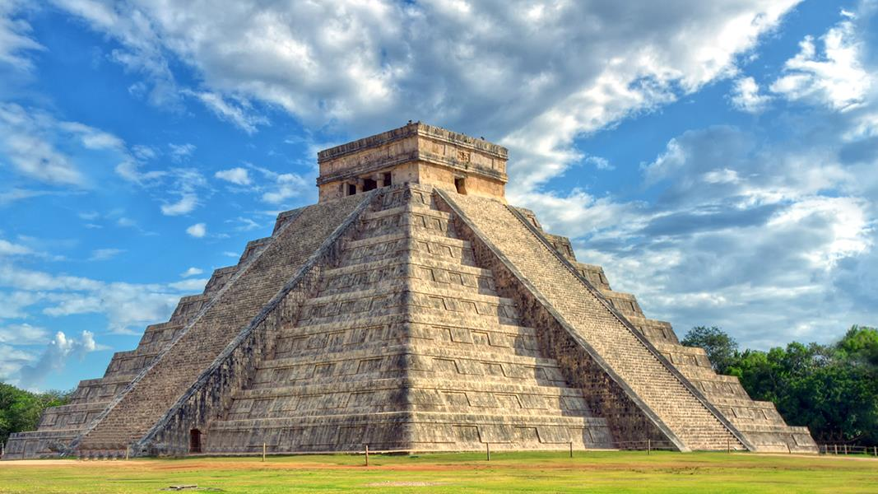
Maya Warfare
Warfare for purposes of capturing enemy soldiers
Ritual sacrifice of enemies
  Enslavement
  Small kingdoms engage in constant conflict until begins to absorb captives
    SoChichén Itzá me nevertheless choose death
    Center of empire develops

Slide 8
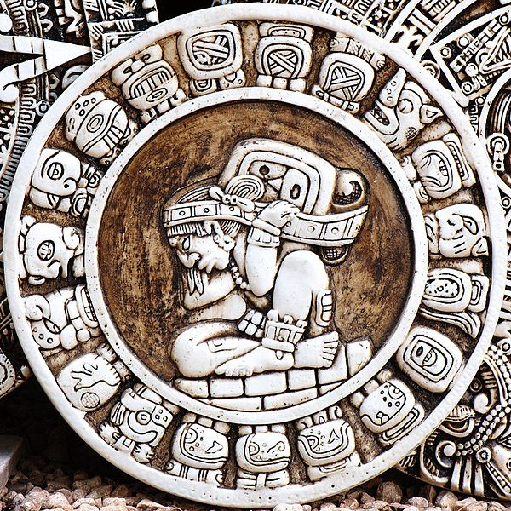
Mayan innovation and Technology
Astronomy
Complex math
  Invention of “Zero”
Calendar of 365.242 days (17 seconds off)
  Solar calendar of 365 days
  Ritual calendar of 260 days
Management of calendar lends authority to priesthood
  Timing of auspicious moments for agriculture

Slide 9
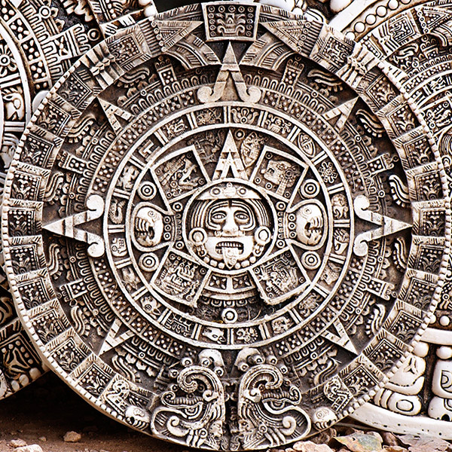
Mayan vs. Aztec Calendar

Slide 10
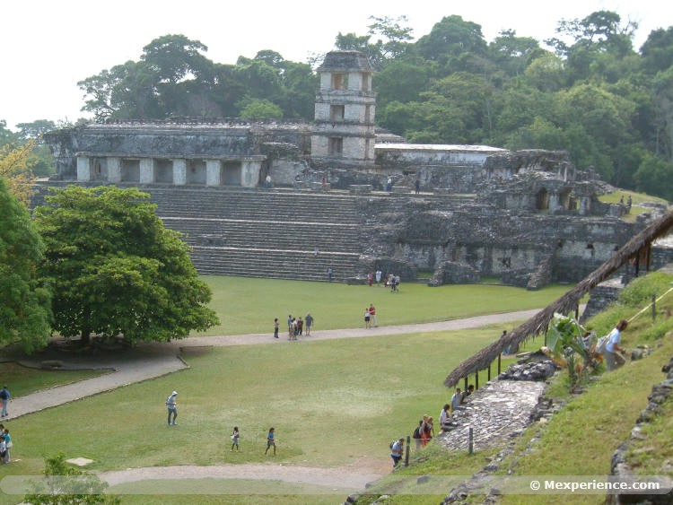

Slide 11
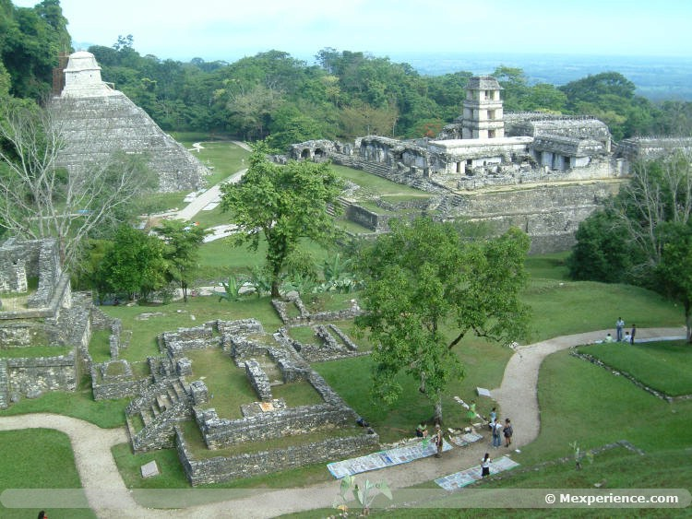

Slide 12
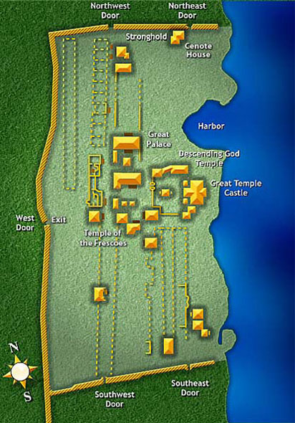
http://www.cancun.com/Mayan_Ruins/Tulum/Map/

Slide 13
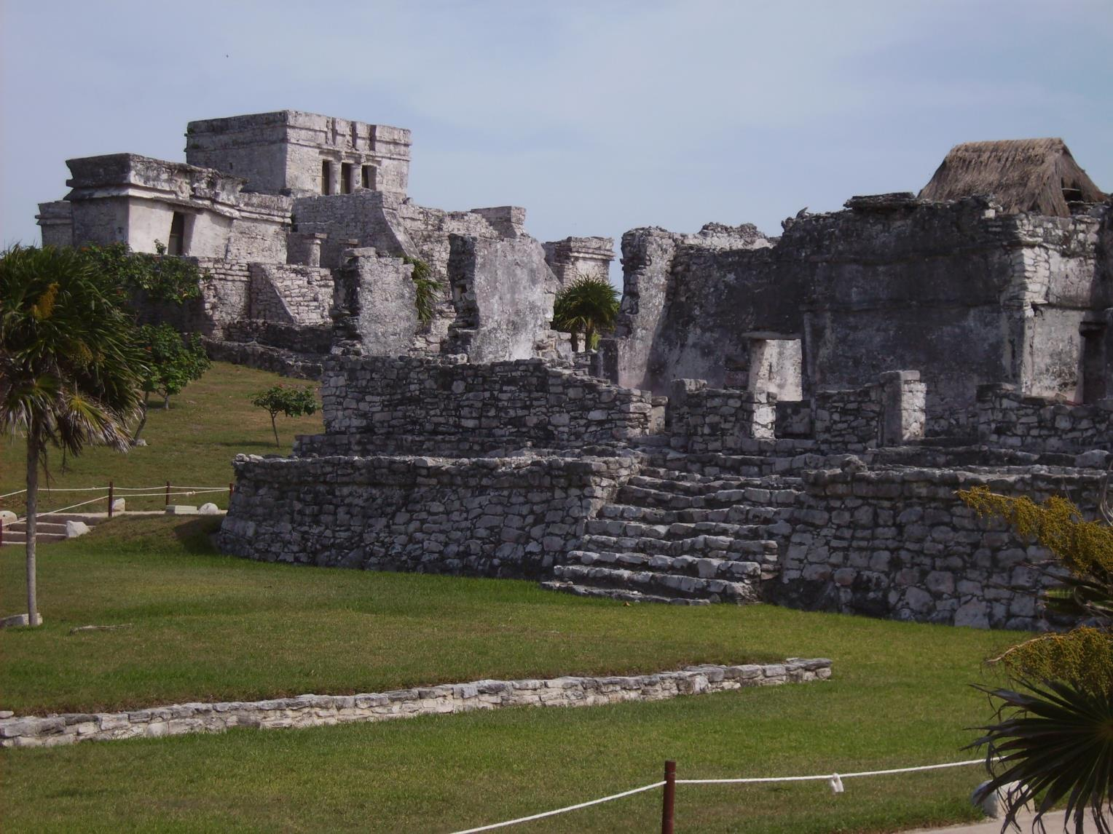

Slide 14
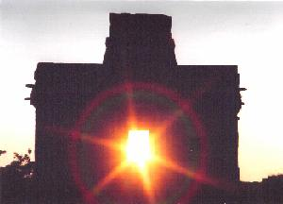
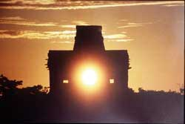

Slide 15
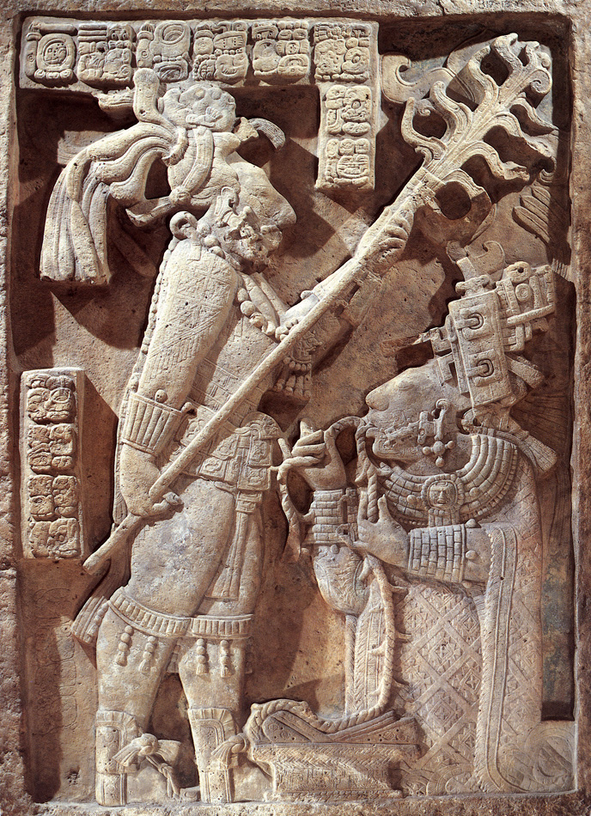
Mayan Language and Religion
Ideographs and a syllable-alphabet
  Most writings destroyed by Spanish conquerors
  Deciphering work began in 1960s
Popol Vuh: Mayan creation myth
  gods created humans out of maize and water
Agricultural cycle maintained in exchange for honors and sacrifices
Bloodletting rituals
  Human sacrifices follow after removal of fingers, piercing to allow blood flow

Slide 16
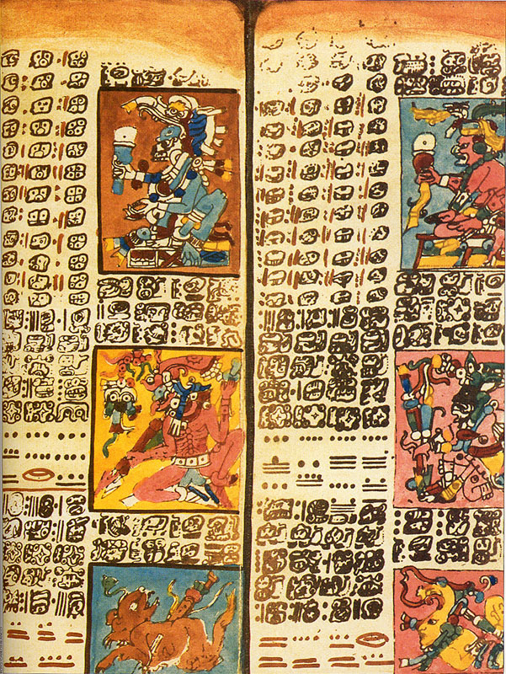
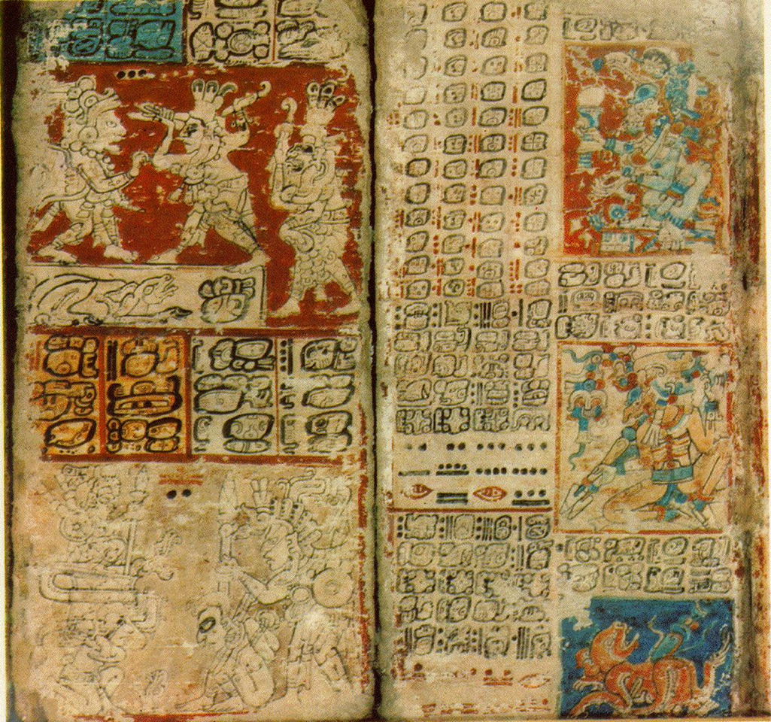
Dresden Codex

Slide 17
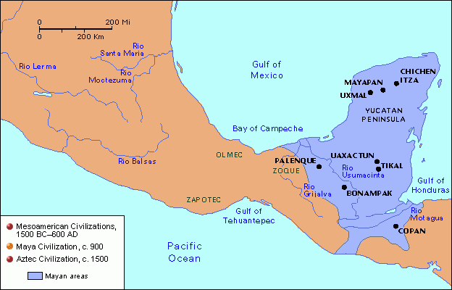
Chichen Itza
New Wonder of the World

Slide 18
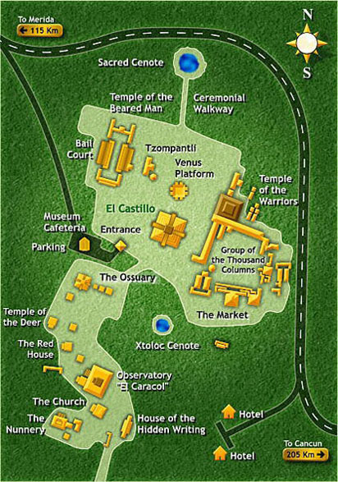
http://www.cancun.com/Mayan_Ruins/Chichen_Itza/Map

Slide 19
Calendar Perfection of
Temple (El Castillo)
Every Winter and Summer solstice, a shadow is cast on the side of the stairs of El Castillo that looks like a slithering snake.
Tens of thousands of people journey to Chichén Itza every year to see this phenomenon!

Slide 20
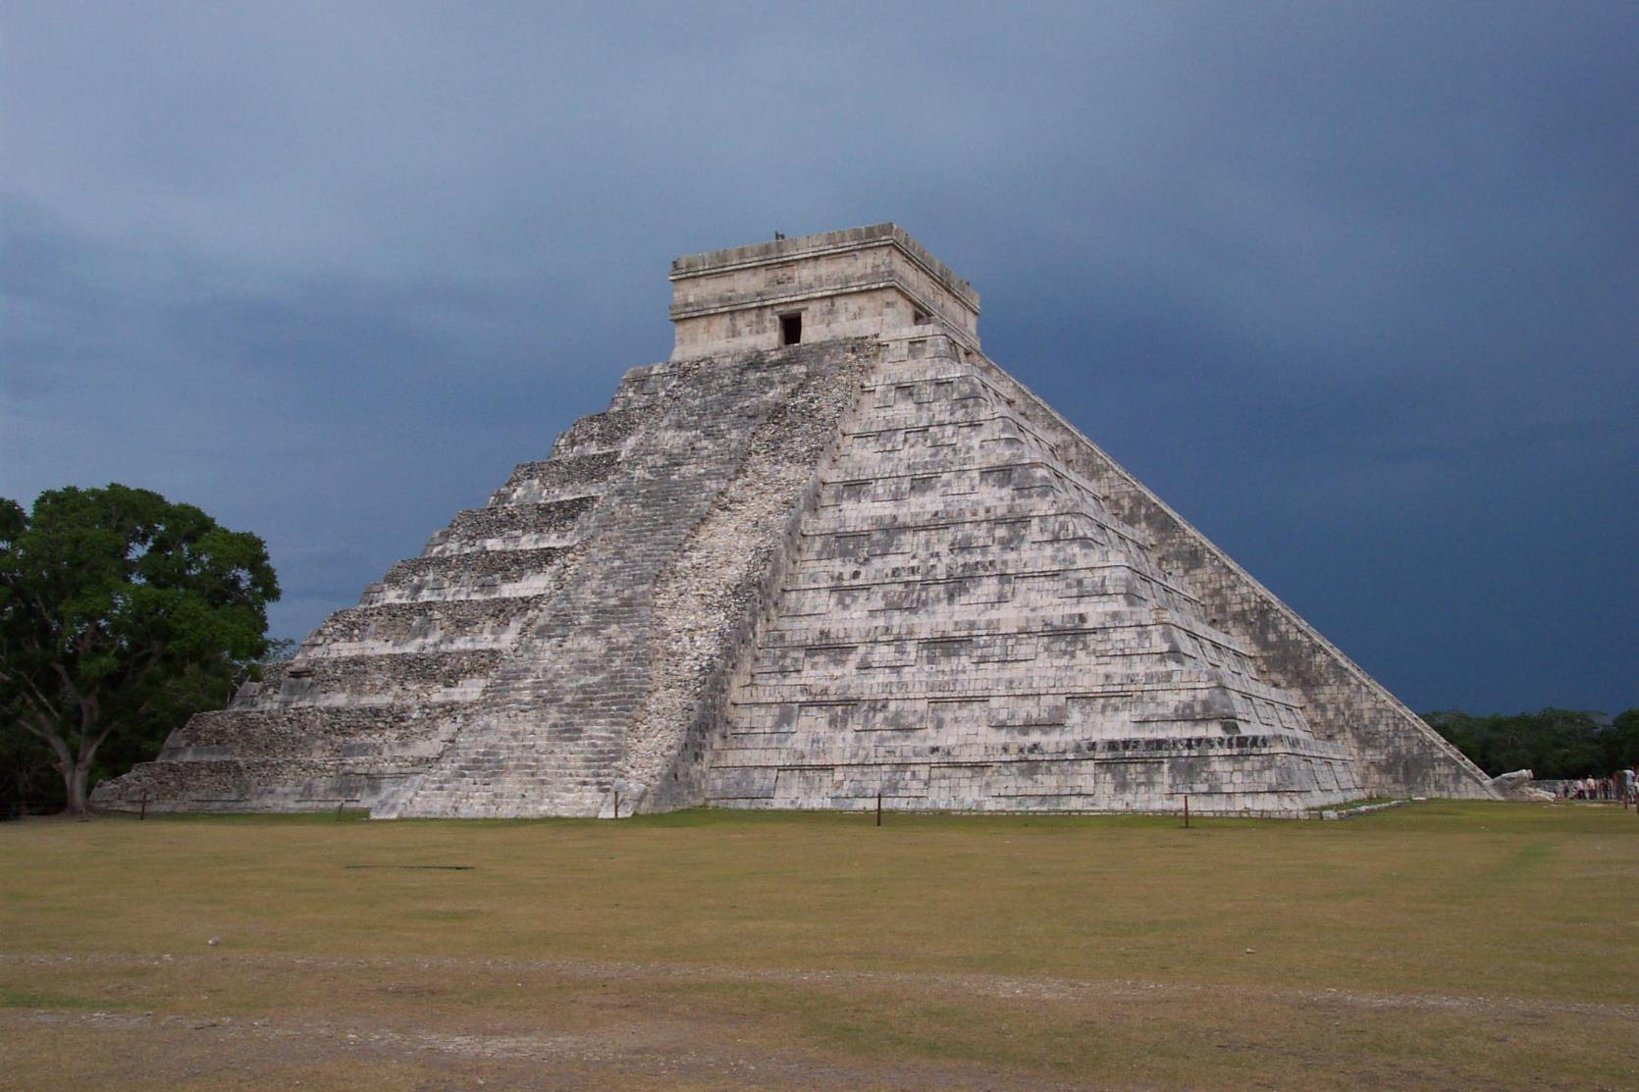
Main pyramid at Chichen Itza

Slide 21
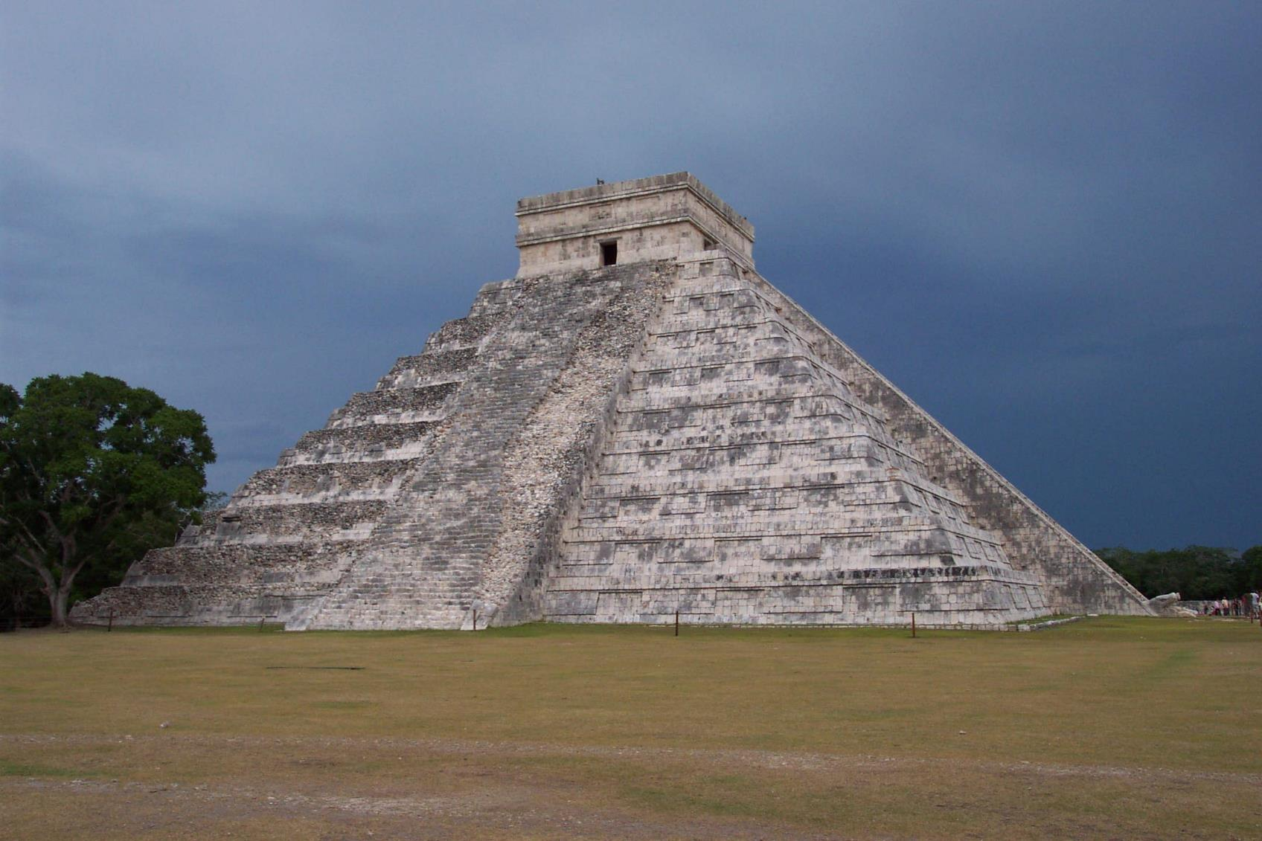

Slide 22
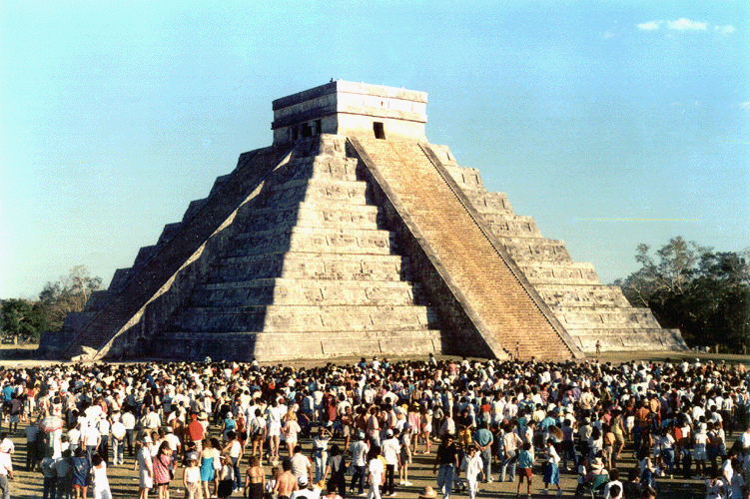
Pyramid at Winter Solstice
Shadow
Snake head

Slide 23
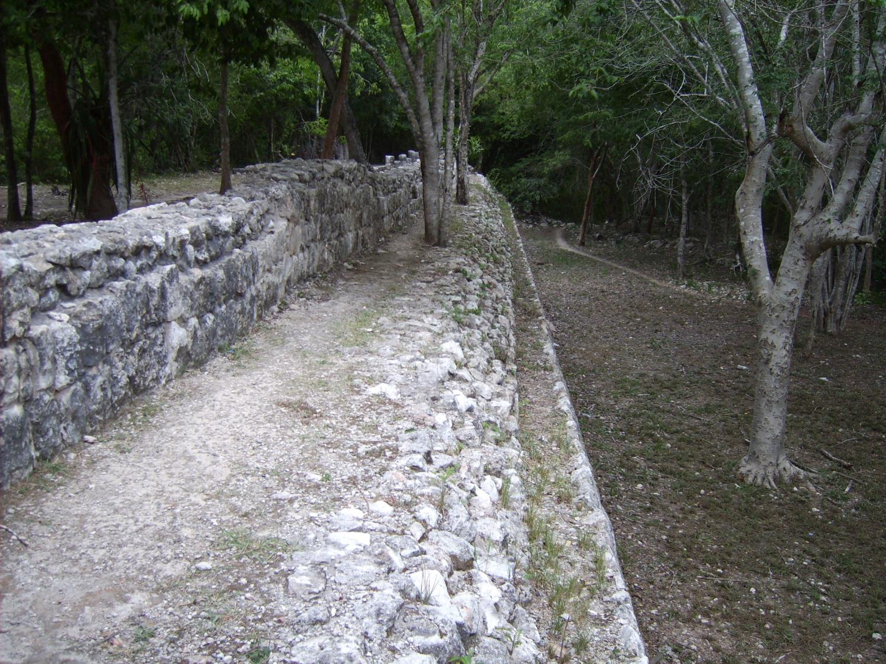

Slide 24
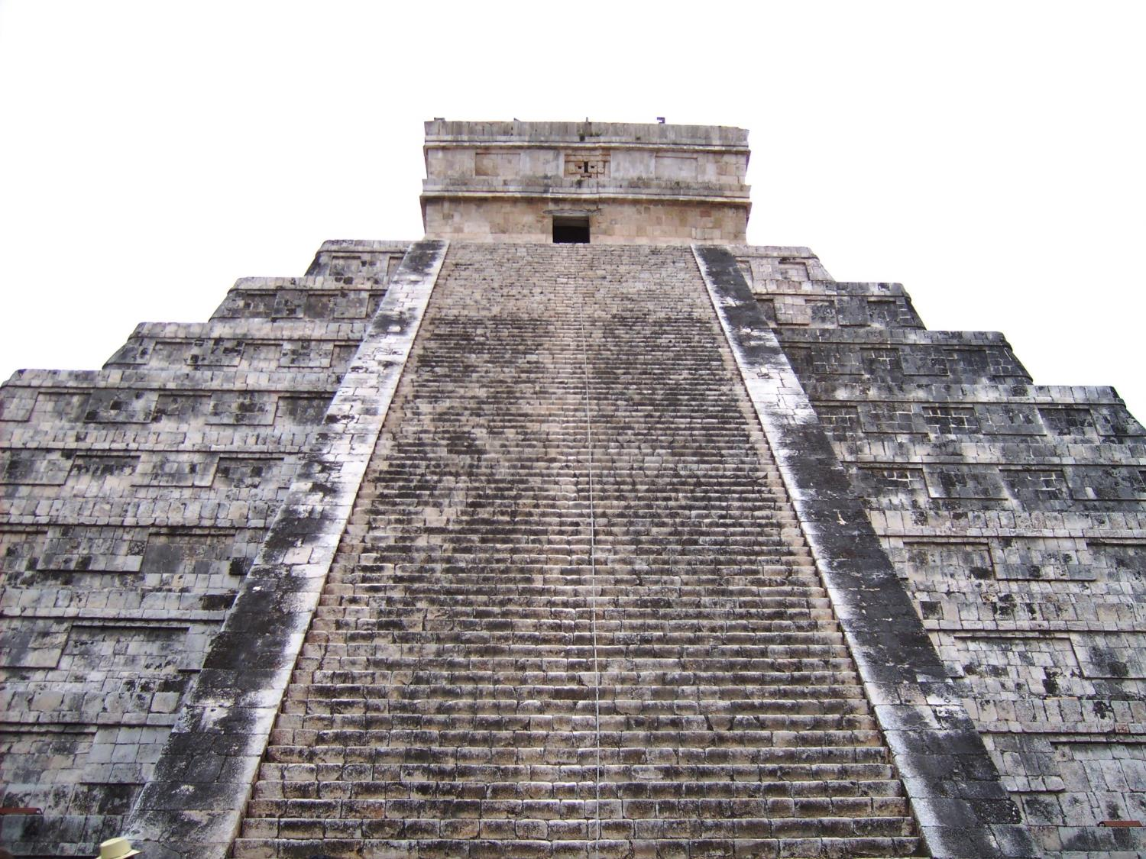

Slide 25
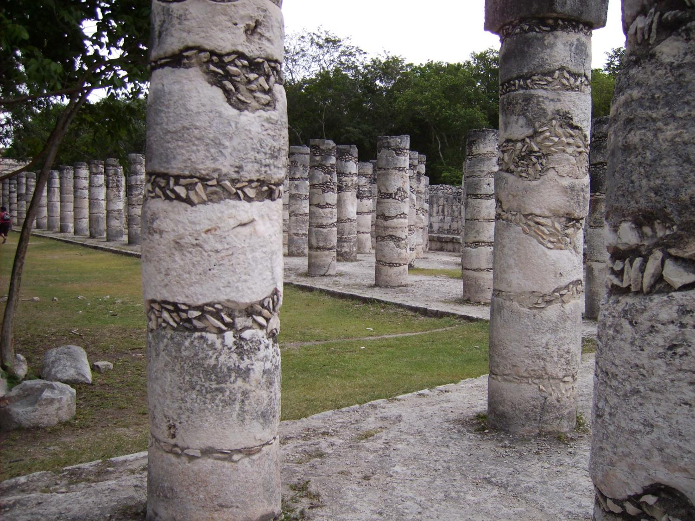

Slide 26
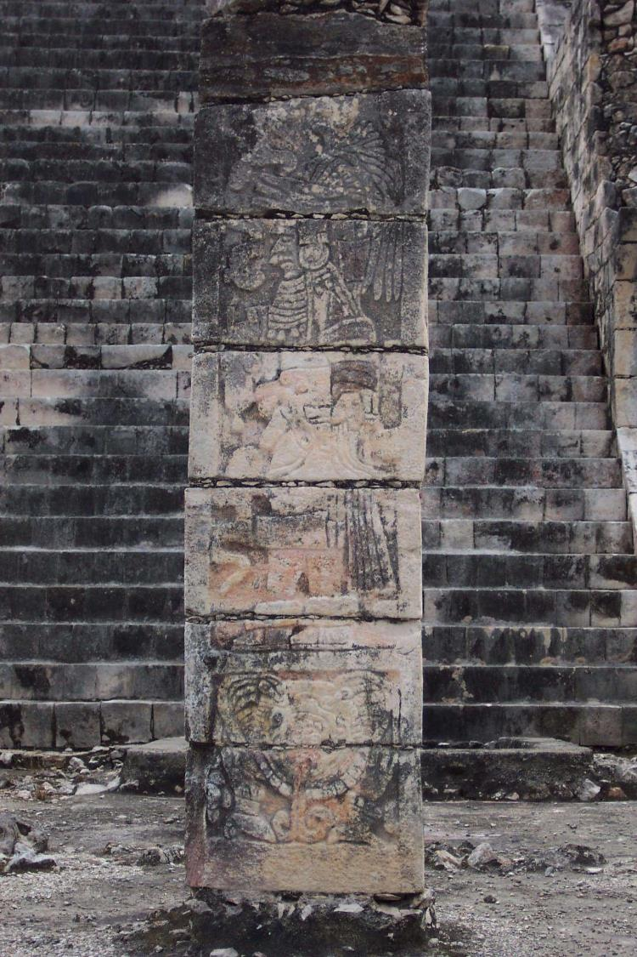

Slide 27
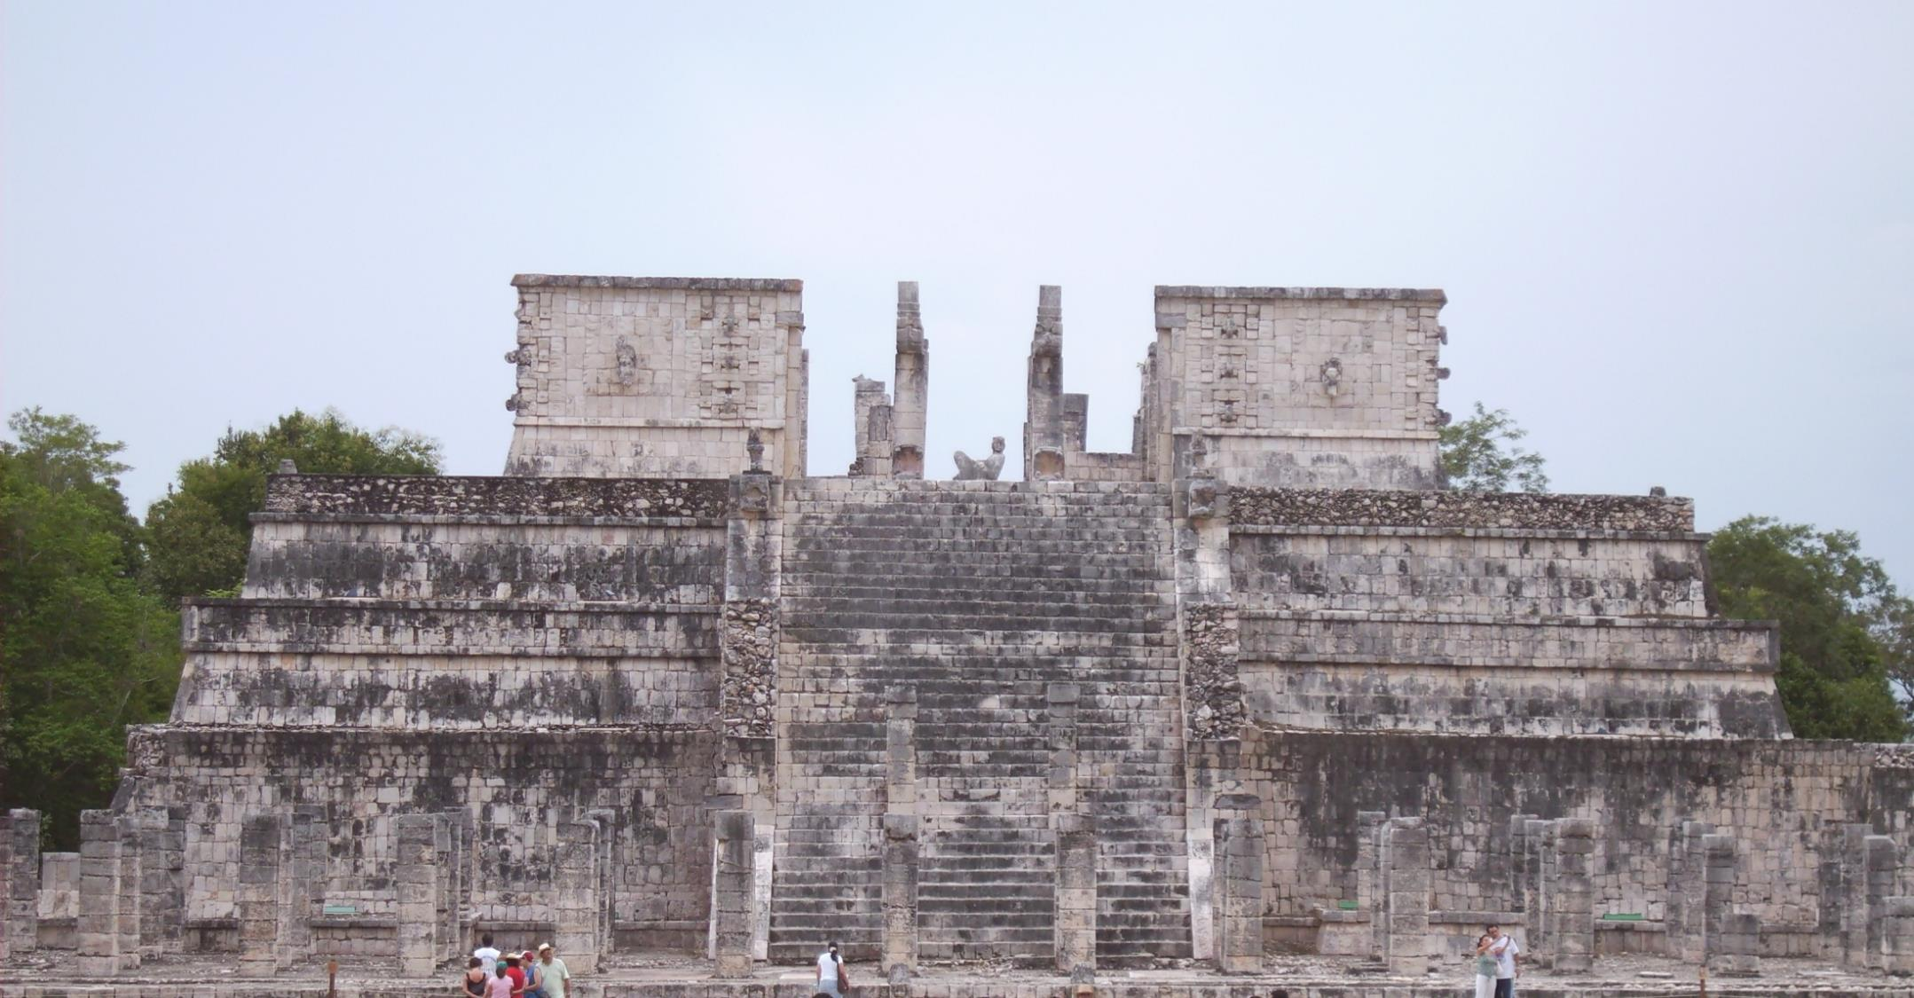

Slide 28
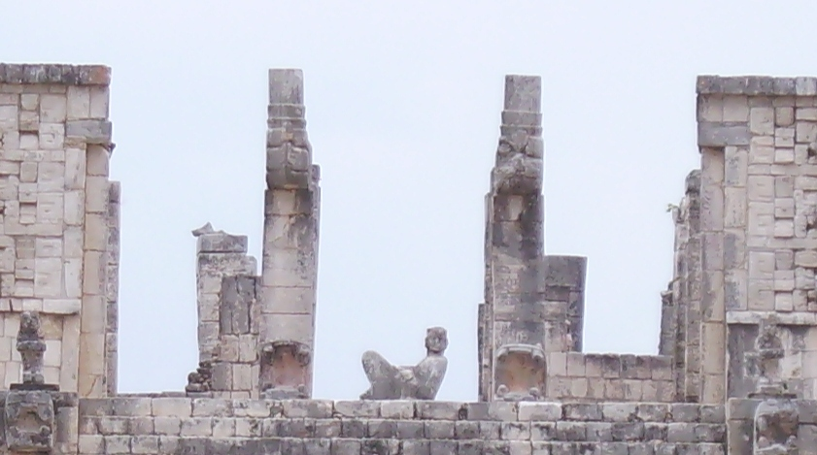

Slide 29
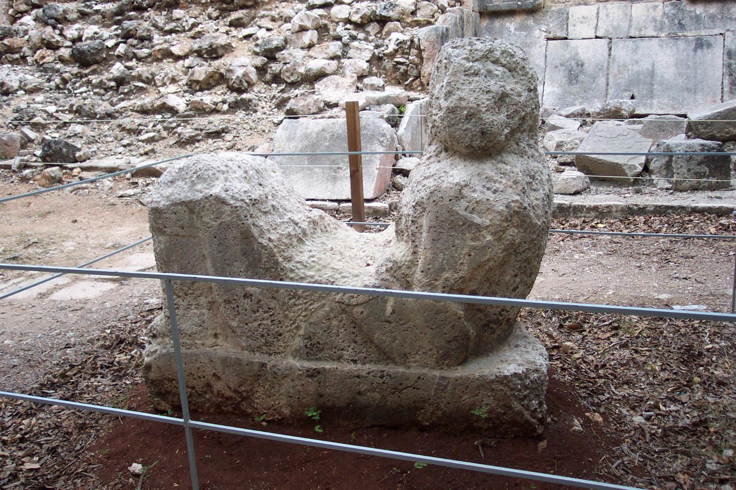

Slide 30
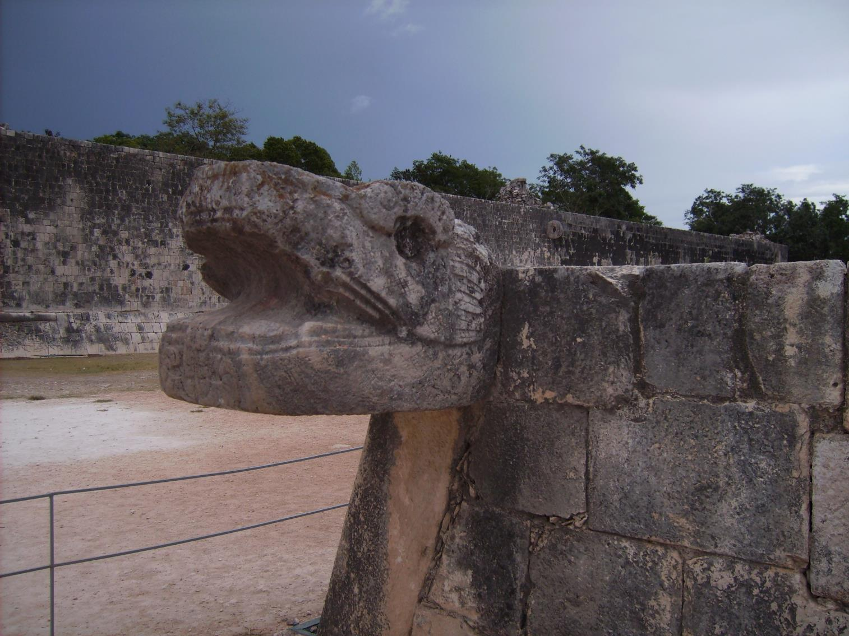

Slide 31
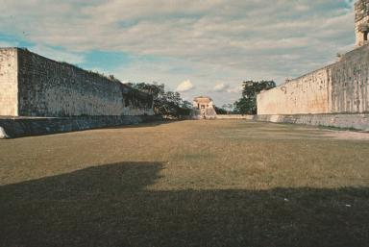

Slide 32
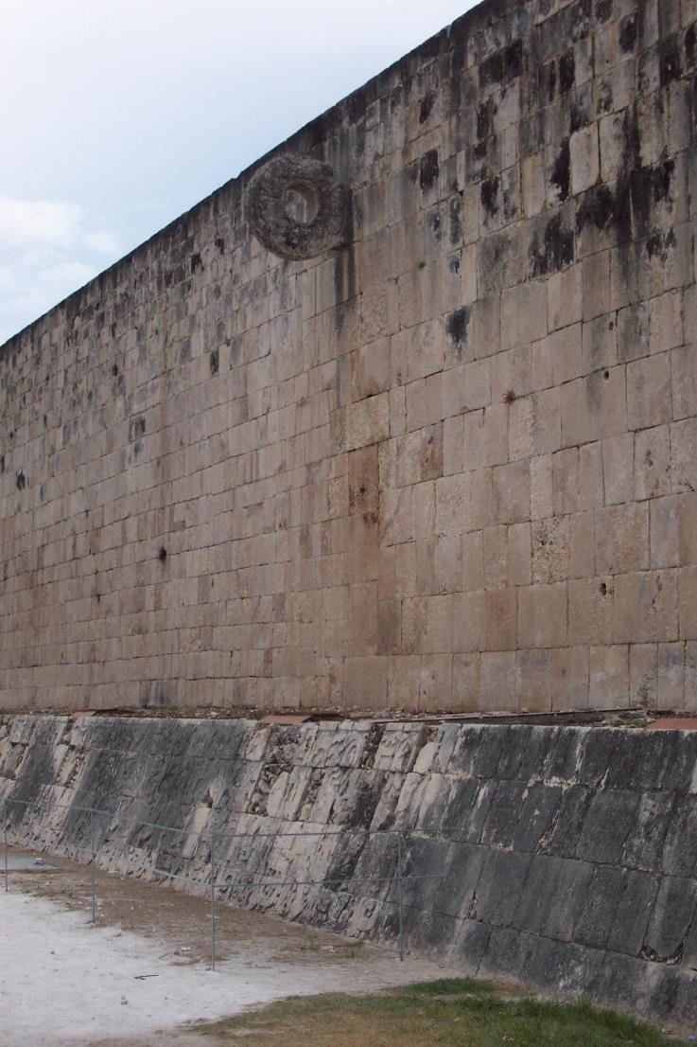

Slide 33
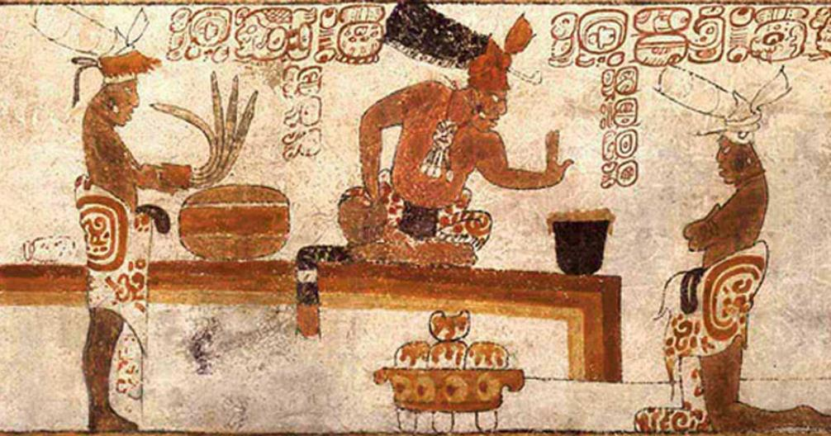
Maintaining Power in the Mayan EMpire
Ritual sacrifice
Regional trade in luxury items for wealthy (cacao as money)
  Exotic feathers, furs, jade distinguished them from common society
Head binding for the powerful
Dentistry

Slide 34
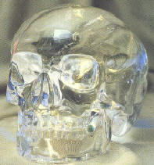
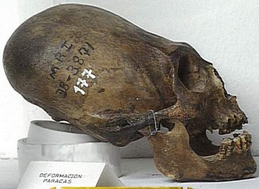
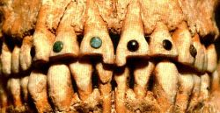
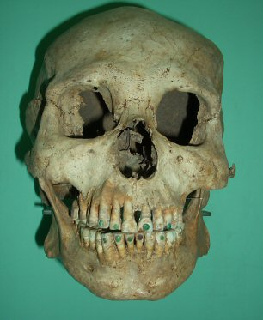
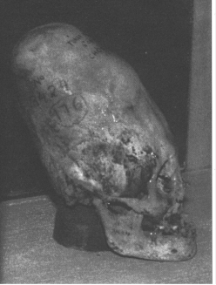


Slide 35
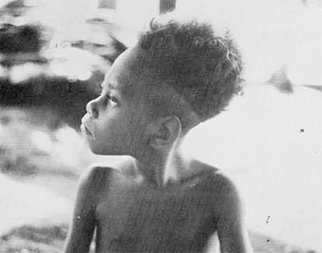
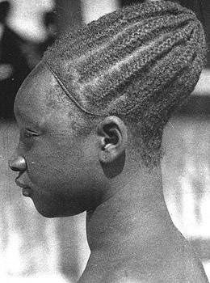
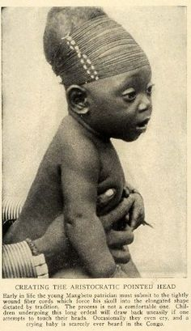
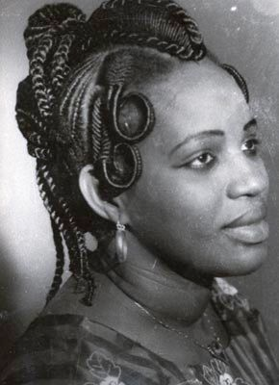
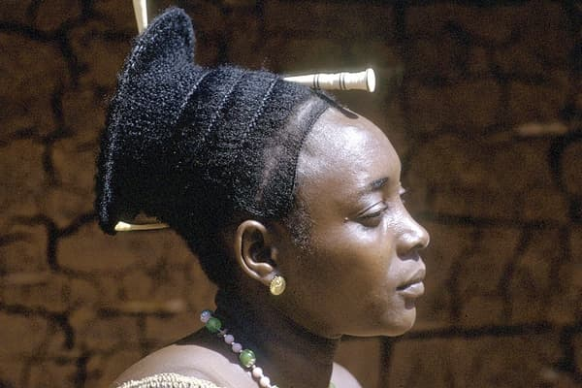

Slide 36
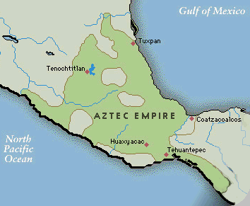
The Mexica
One of several groups of migrants, mid 13th c. CE
Tradition of kidnapping women, seizing cultivated lands; perpetually relocating
Settled c. 1375 CE on Lake Texcoco and established Tenochtitlan (later becomes Mexico City)

Slide 37
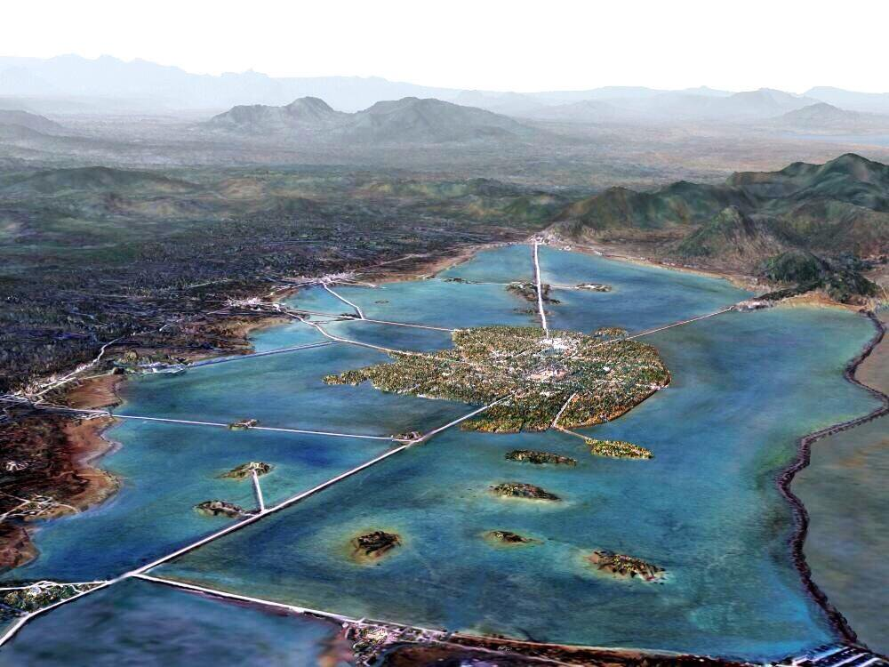
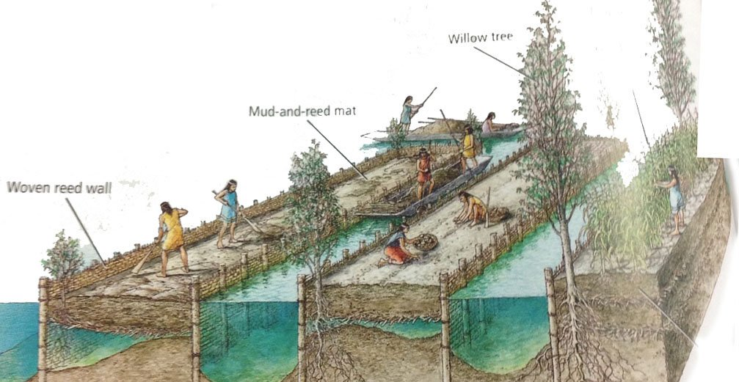
The Mexica
Unusual location leads to advantages: protection, agriculture
Created Chinampas: fertile plots of land created from dredged soil from lake bottom
  Up to 7 crops per year!

Slide 38
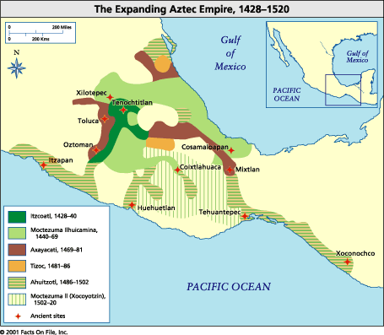
The Aztec Empire
Mexica powerful enough to develop tributary empire by 15th century
  Use of flower wars to gain tributary states
Mexica become known as Aztec Empire

Slide 39

Conquered peoples
Tributes often oppressive
  Cacao, vanilla, animal skins, rubber balls, clothing, jade, jaguar skins
Local governance remained with conquered people
  Fear of Aztecs

Slide 40


Mexica Society
Strict hierarchical social structure
High stature for soldiers
  Mainly drawn from aristocratic class
  Land grants, food privileges
  Sumptuary privileges, personal adornment
All males potential warriors

Slide 41

Mexica Women
Extremely patriarchal society
Emphasis on child-bearing
  Especially future soldiers
  Mothers of warriors especially lauded
  Death in childbirth as honorable as death in warfare

Slide 42


Priests
Theocratic governance
Priests masters of complex agricultural/ritual calendars
Ritual functions
Read omens, advised rulers
Occasionally became rulers as well

Slide 43


Cultivators and Slaves
Peasants lived in communal groups: calpulli
  Management of communal lands
  Work obligation on aristocratic lands
Slave class
  Debtors
  Children sold into slavery

Slide 44

Mexica Religion
Influenced by indigenous traditions from the Olmec period
  Nahuatl language
  Ritual ball game
  Solar calendar (365 days) and ritual calendar (260 days)
    Not as elaborate as Maya calendar

Slide 45

Mexica Gods
Tezcatlipoca (“smoking mirror”)
  Powerful god of life and death
  Patron god of warriors
Quetzalcóatl
  Arts, crafts, agriculture
Huitzilopochtli
  14th century popularity, patron of Mexica
  Emphasis on blood sacrifices

Slide 46

Knowledge CHeck
Outline a response to the following essay prompt:
  Explain how environmental barriers led to specific adaptations in Mesoamerican civilizations.

Slide 47
The Inca

Slide 48



Slide 49


Chavin CultURE (900-300 BCE)
New religion in central Andes
Little known about particulars of religion
Intricate stone carvings; devised techniques of producing cotton textiles and fishing nets
Discovered gold, silver, and copper metallurgy
Cult may have developed when maize became an important crop
During the era Andean society became increasingly complex

Slide 50

The Inca Empire
From valley of Cuzco
Refers to people who spoke Quechua language
Settlement around Lake Titicaca mid 13th century
Ruler Pachacuti expands territory, conquering local tribes
  Population 11.5 million

Slide 51

Food Sources
Potato and sweet potato cultivation, herding of llamas, alpacas
Guinea pigs
Waru waru irrigation

Slide 52

Quipu and Inca Administration
Inca ruled as a military and administrative elite
  Used hostages, colonization
Capital at Cuzco, which had as many as 300,000 people in the late 15th century
Extensive Carpe Nan road system linked north and south
No writing, used system of cords and knots called quipu
  Mnemonic aid
Official runners carried messages; spread of Quecha language

Slide 53




Inca roads
Massive road building system
Two north-south roads, approximately 10,000 miles
  Mountain route
  Coastal route
Paved, shaded, wide roads
Limited long-distance trade, held by government monopoly (aka. “state-sponsored trade”)

Slide 54




Slide 55


Slide 56

Machu Picchu

Slide 57

Inca Religion and POwer
Inca society was also a hereditary aristocracy
Chief ruler considered - descended from the sun god, Inti - owned everything on earth
After death, mummified rulers became intermediaries with gods
Aristocrats enjoyed fine food, embroidered clothes, and wore ear spools
Temples as pilgrimage sites

Slide 58


Slide 59

Peasants
Peasants organized into community groups called ayllu
  Land, tools held communally
  Mandatory work details on land of aristocrats
  Gave over a portion of their own produce to the state
  Public works
Mit’a system – mandatory public service (conscripted labor), usually for roads and infrastructure projects.

Slide 60



Incan Society and Religion
Ancestor veneration
  Remains preserved in mummified form
  Regularly consulted
  Sacrifices offered
  Paraded on festive occasions

Slide 61


Llullaillaco Volcano

Slide 62



Slide 63



Slide 64



Slide 65


Slide 66
Wrap Up
Outline a response to the following (hypothetical) essay:
  How did the Inca respond to environmental barriers?

