Slide 1
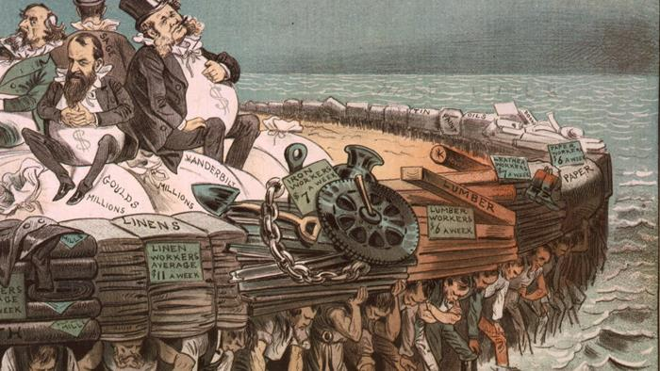
Industrialization
(Capital, capital, capital!)

Slide 2
Industrial Revolution Begins
5.3 A variety of factors contributed to the growth of industrial production and eventually resulted in the Industrial Revolution, including:
Proximity to waterways; access to rivers and canals
Geographical distribution of coal, iron, and timber
Urbanization
Improved agricultural productivity
Legal protection of private property
Access to foreign resources
Accumulation of capital
The development of the factory system concentrated production in a single location and led to an increasing degree of specialization of labor.

Slide 3
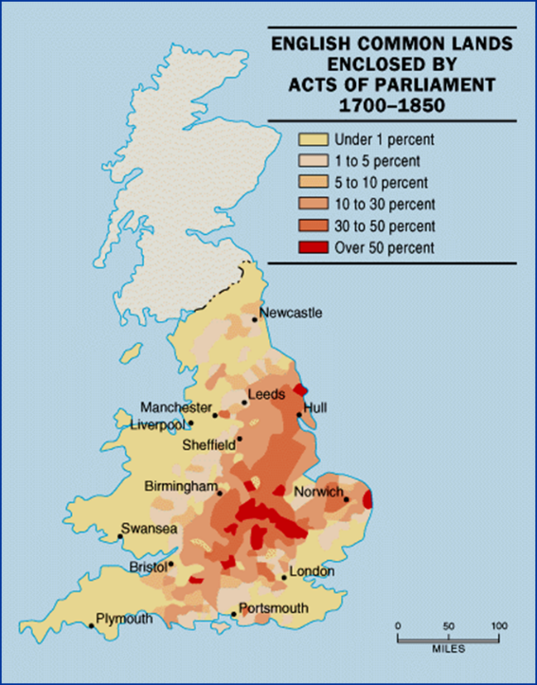
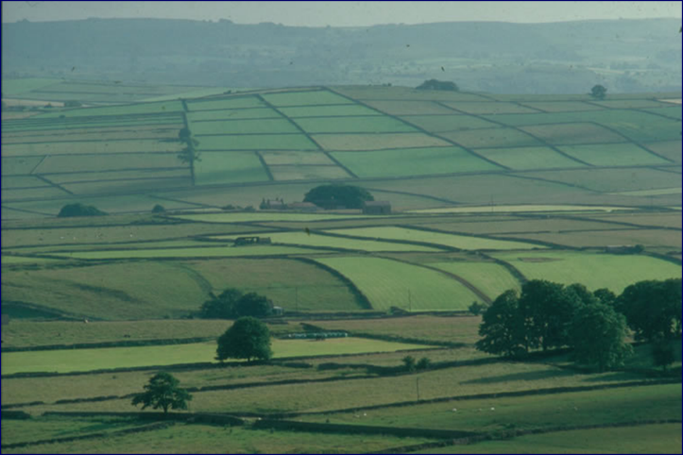

Slide 4
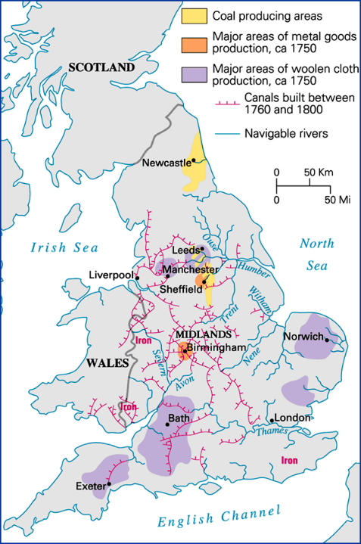
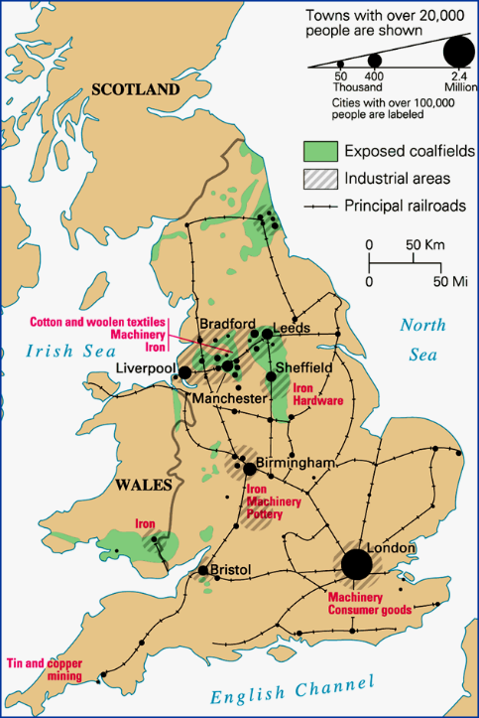
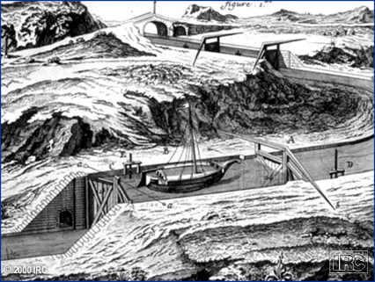
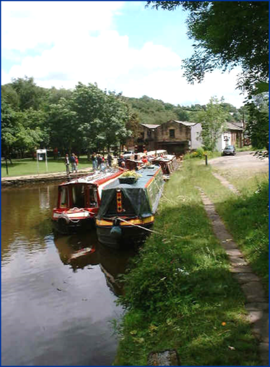

Slide 5
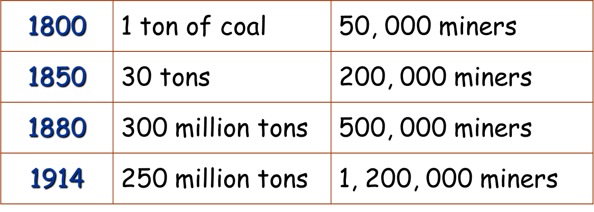

Slide 6
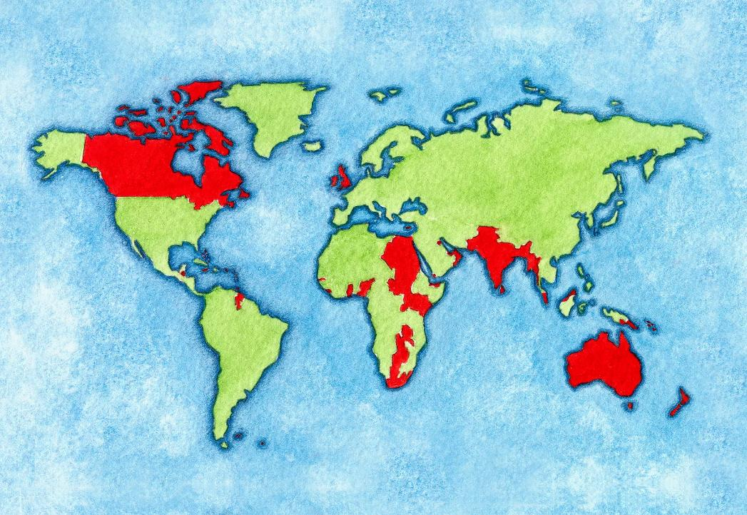
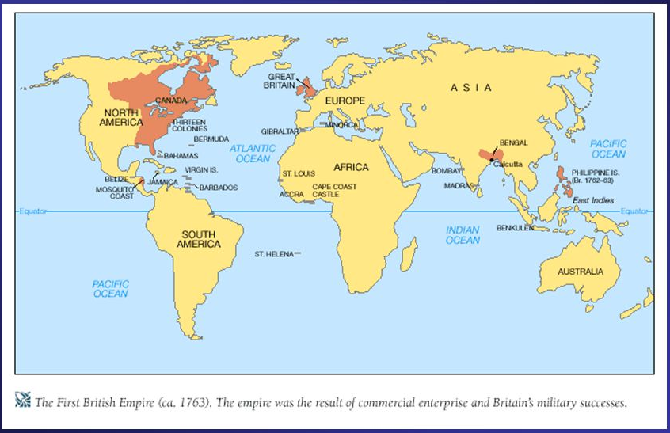

Slide 7
From Cottage Industry to factory

Slide 8
Rigid schedule.
12-14 hour day.
Dangerous conditions.
Mind-numbing monotony.

Slide 9
5.4 Industrialization Spreads in the Period from 1750 to 1900
The rapid development of steam-powered industrial production in European countries and the U.S. contributed to the increase in these regions’ share of global manufacturing during the first Industrial Revolution. While Middle Eastern and Asian countries continued to produce manufactured goods, these regions’ share in global manufacturing declined.

Slide 10
Industrialization and Transportation spread

Slide 11
Share in World Manufacturing Output: 1750-1900

Slide 12
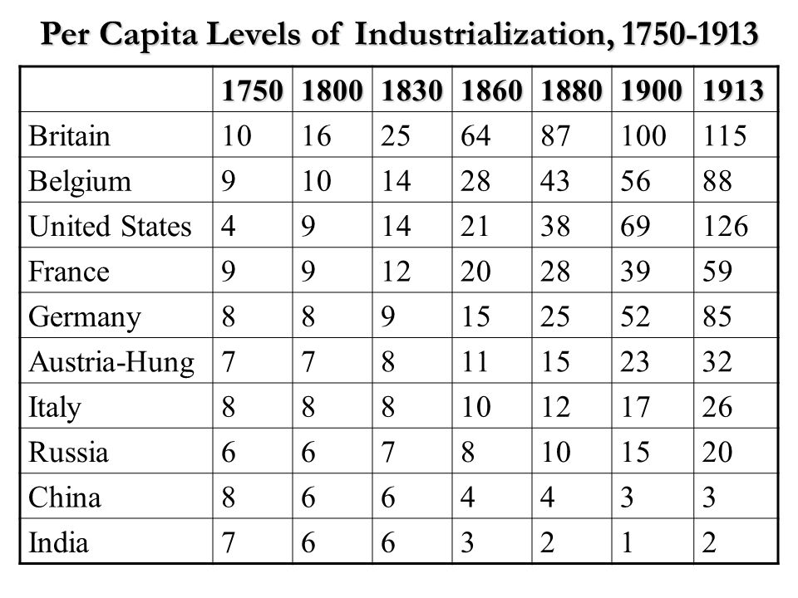
Human capital!

Slide 13
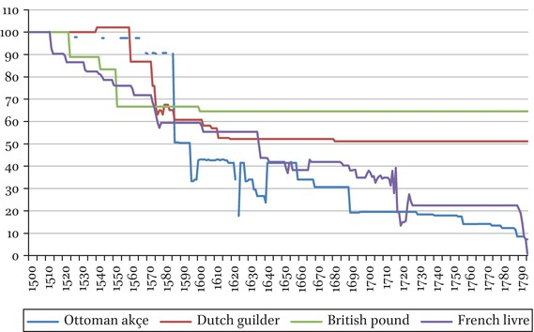

Slide 14
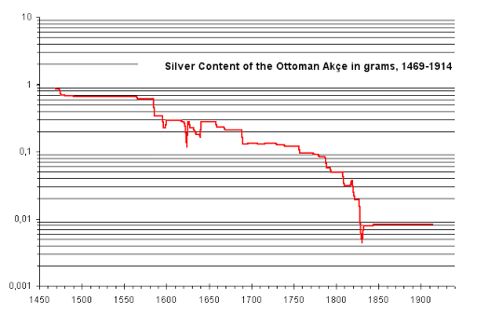

Slide 15
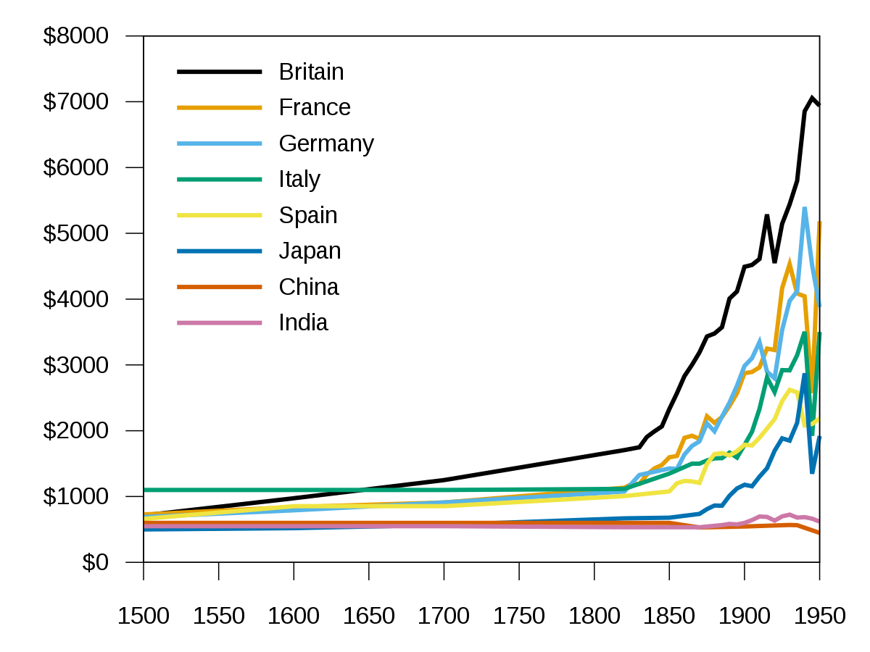

Slide 16
British interference in India from 1753-1853
Company Rule vs. Raj

Slide 17
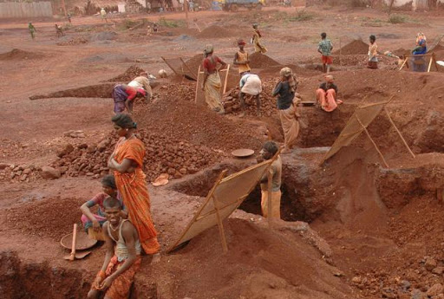
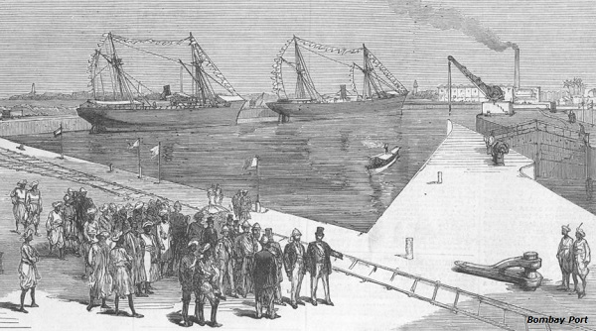
India

Slide 18
5.4 Industrialization Spreads in the Period from 1750 to 1900
The rapid development of steam-powered industrial production in European countries and the U.S. contributed to the increase in these regions’ share of global manufacturing during the first Industrial Revolution. While Middle Eastern and Asian countries continued to produce manufactured goods, these regions’ share in global manufacturing declined.
EXPLAIN IT!

Slide 19
5.4 Industrialization Spreads in the Period from 1750 to 1900
As new methods of industrial production became more common in parts of northwestern Europe, they spread to other parts of Europe and the United States, Russia, and Japan.
What spread where and what were the consequences?

Slide 20
5.5: Technology of the Industrial Age
The development of machines, including steam engines and the internal combustion engine, made it possible to take advantage of both existing and vast newly discovered resources of energy stored in fossil fuels, specifically coal and oil. The fossil fuels revolution greatly increased the energy available to human societies.

Slide 21
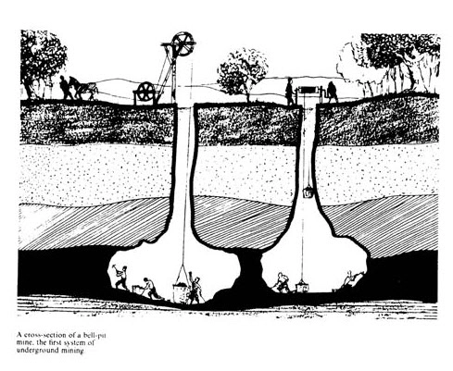
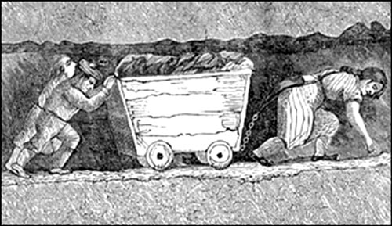

Slide 22
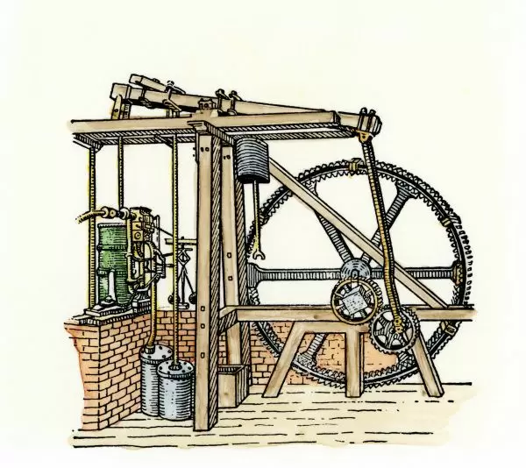
Watt’s Steam Engine

Slide 23
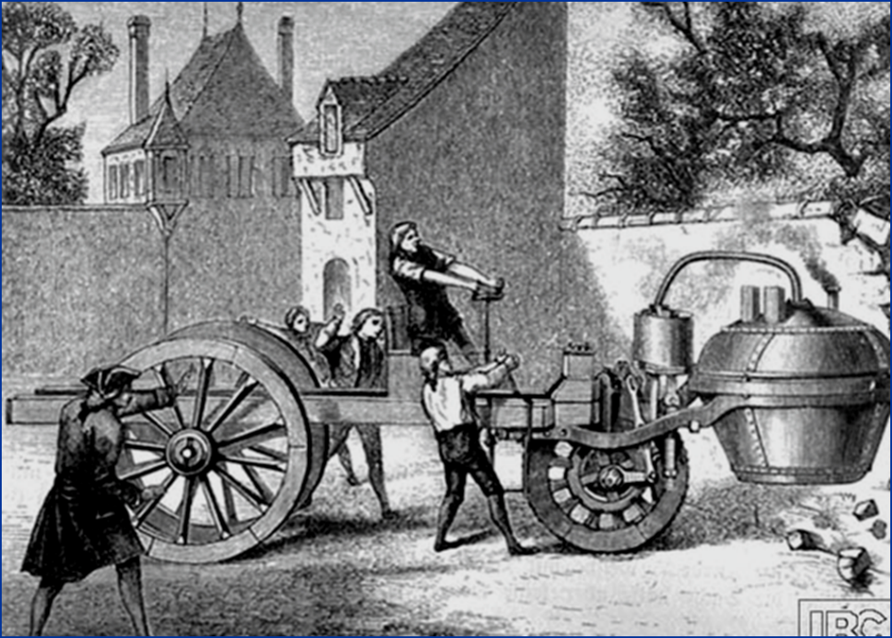
Steam Tractor

Slide 24
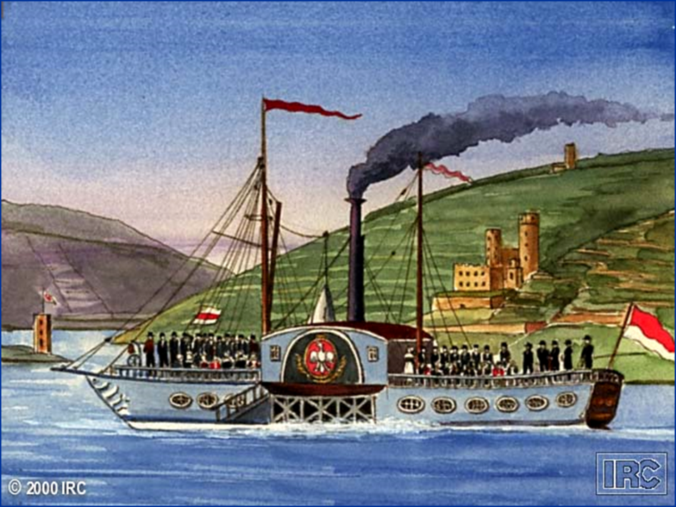

Slide 25
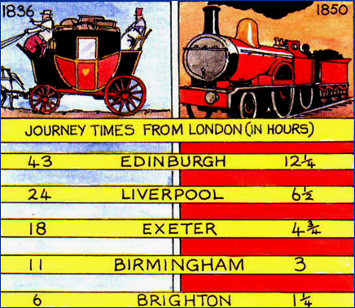
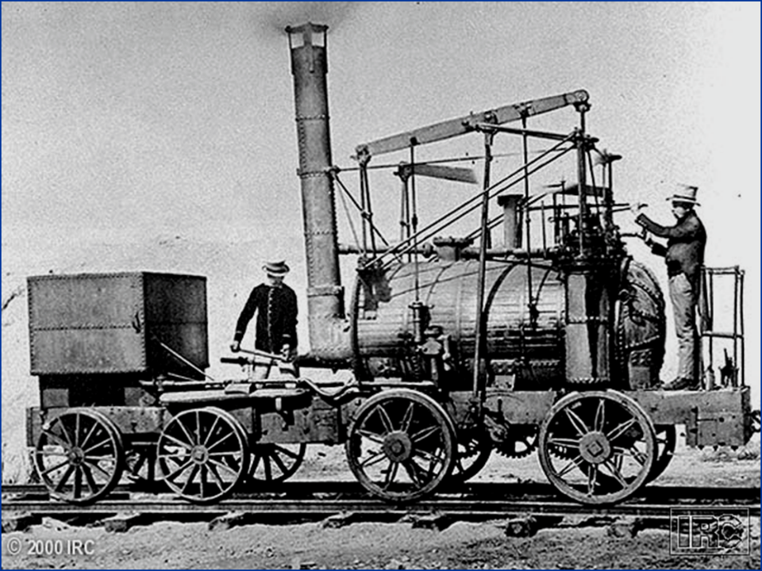
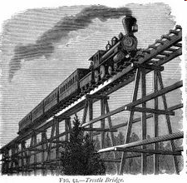

Slide 26
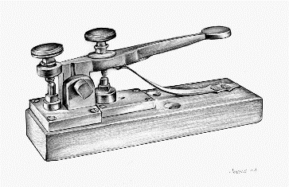
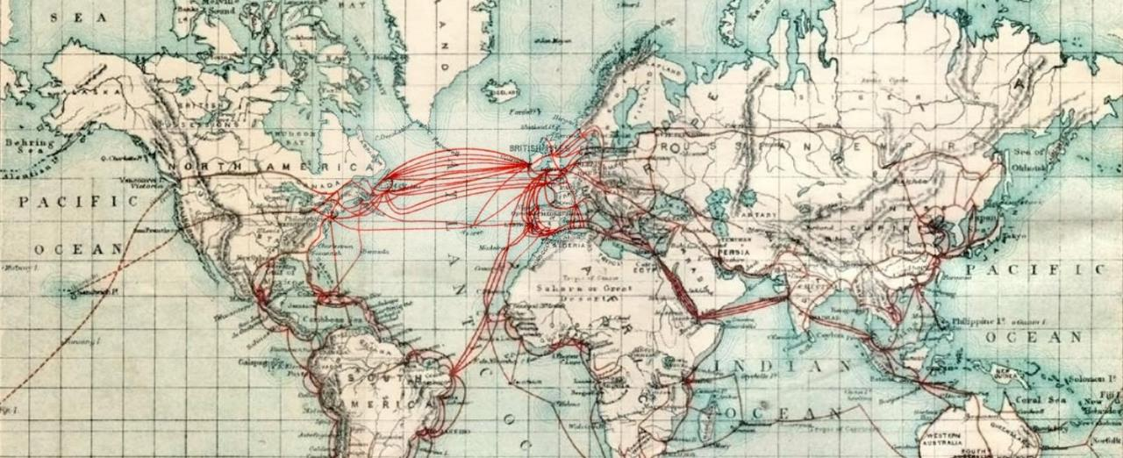

Slide 27
5.5: Technology of the Industrial Age
The “second industrial revolution” led to new methods in the production of steel, chemicals, electricity, and precision machinery during the second half of the 19th century. Railroads, steamships, and the telegraph made exploration, development, and communication possible in interior regions globally, which led to increased trade and migration.
1870-1914

Slide 28
Industrialized area | Developments
steel | Bessemer process
chemicals | Production of nitrate fertilizers (guano imported from around the world), artificial dyes, quinine, dynamite, sulfuric acid, vulcanized rubber, celluloid plastics, aspirin.
electricity | Internal combustion engine: telegraphs, arc light,
Precision machinery | Interchangeable parts, mechanized mass-production, clocks, typewriters, sewing machines

Slide 29
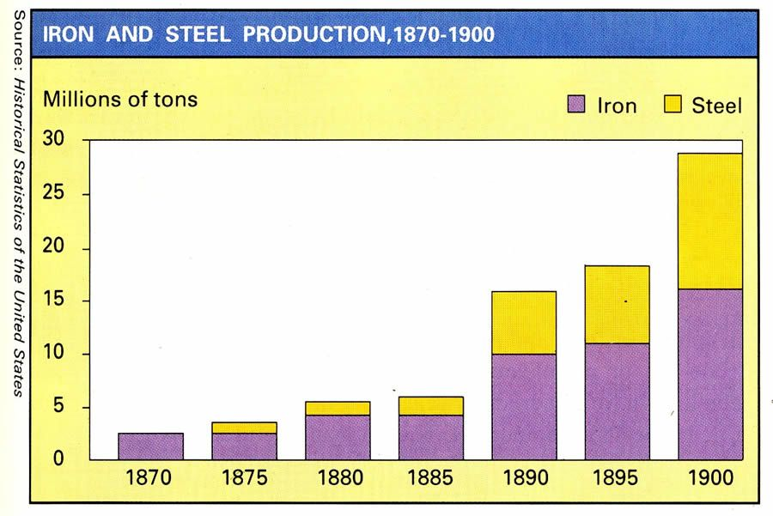

Slide 30
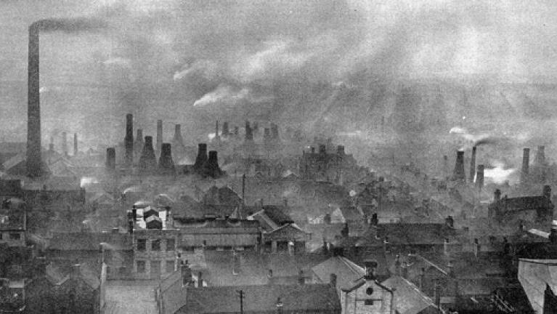

Slide 31
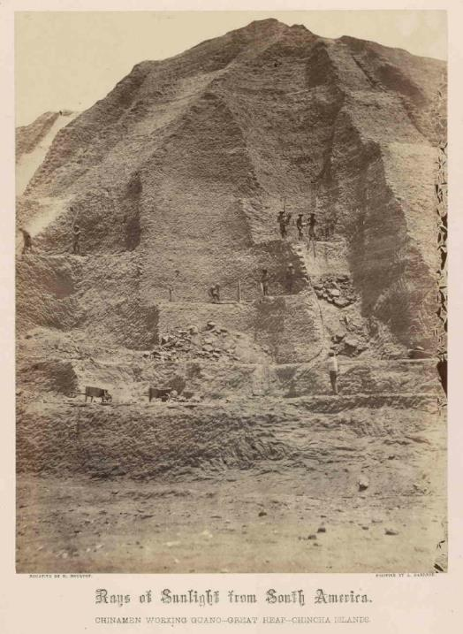
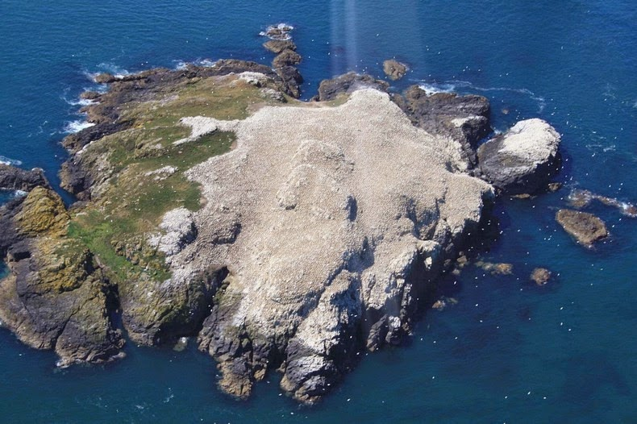

Slide 32
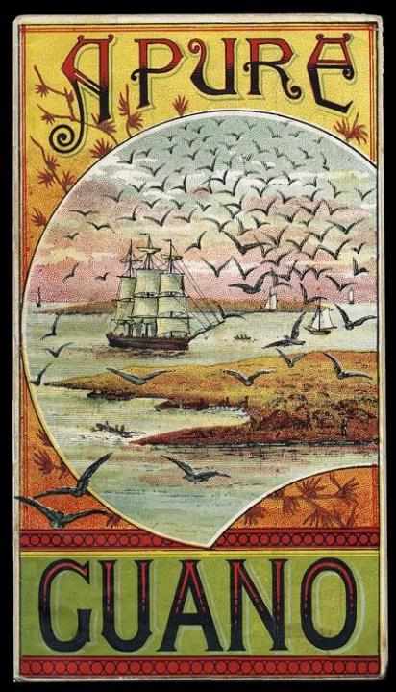
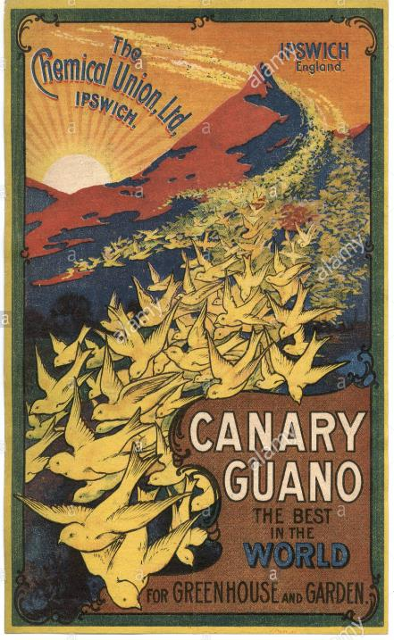
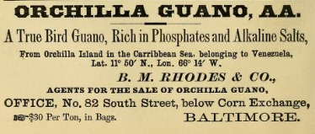
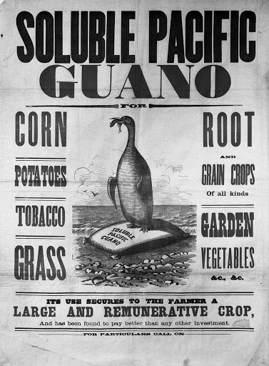
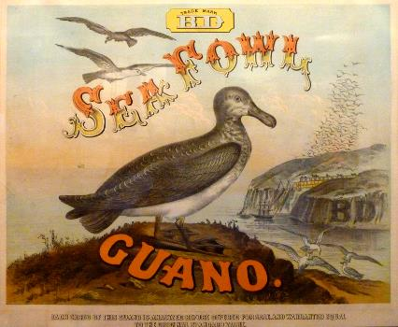
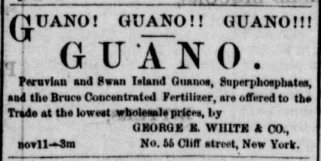

Slide 33
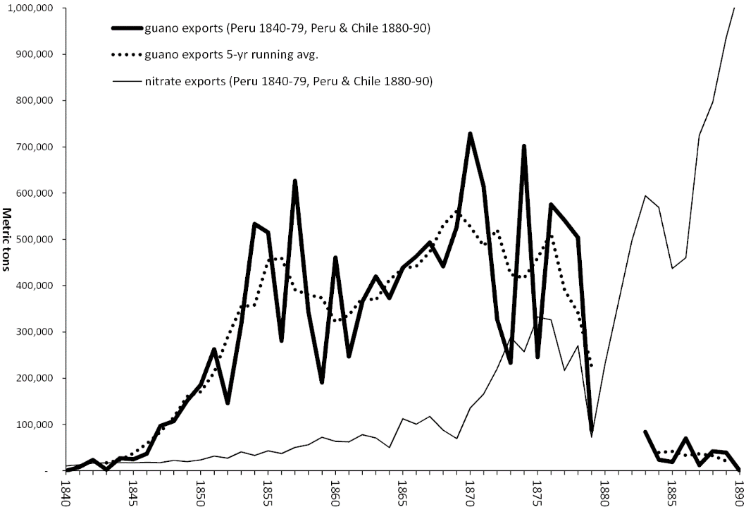
The Great Peruvian Guano Bonanza: Rise, Fall, and Legacy

Slide 34
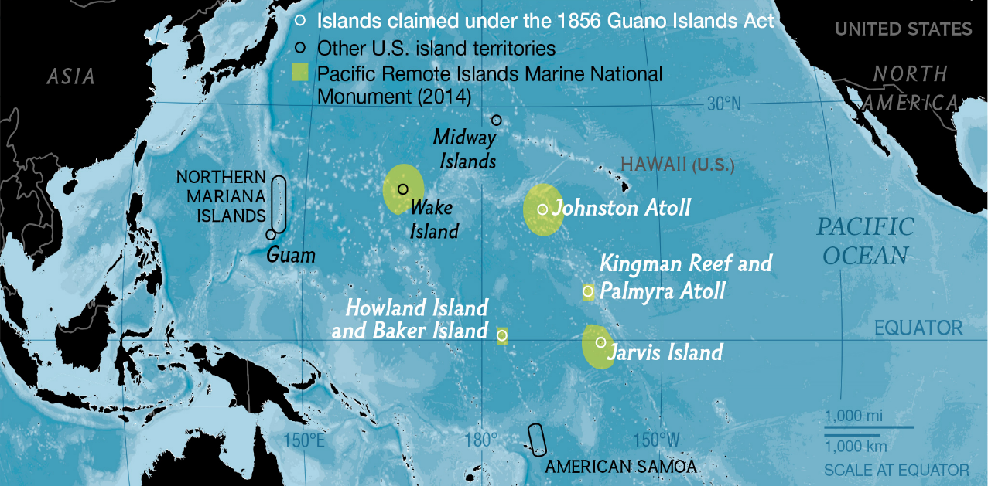
The Guano Islands Act US federal law passed in 1856 that enables citizens of the United States to take possession, in the name of the United States, of unclaimed islands containing guano deposits.

Slide 35
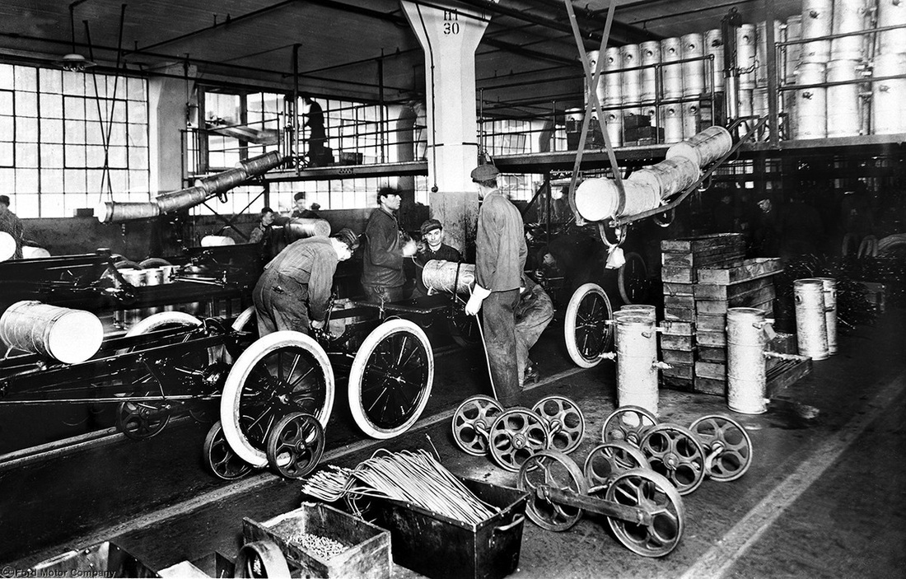

Slide 36
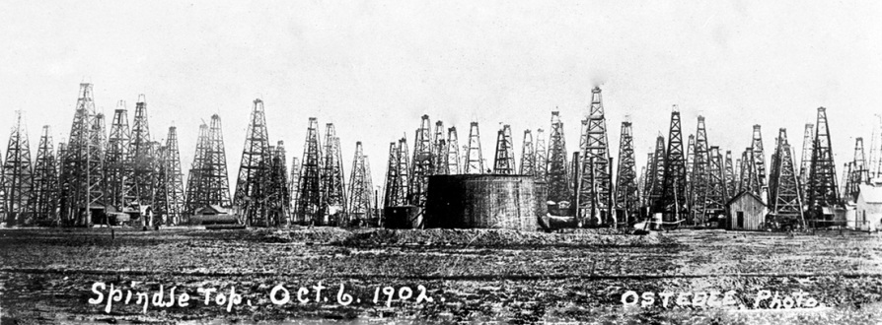

Slide 37
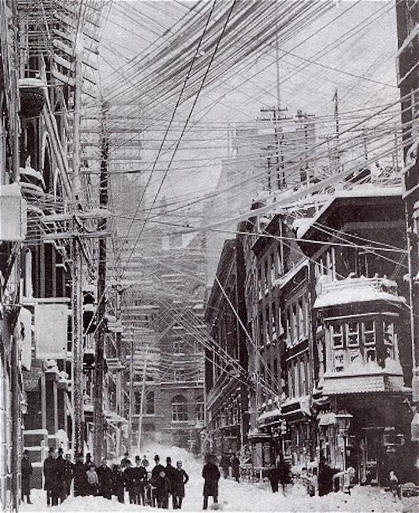
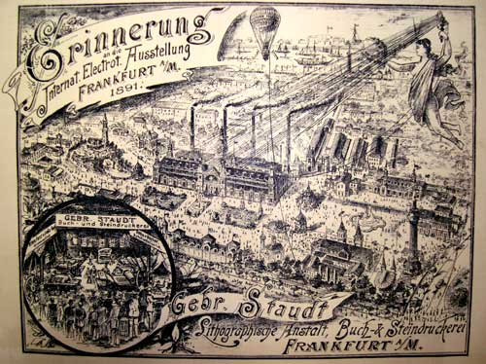

Slide 38
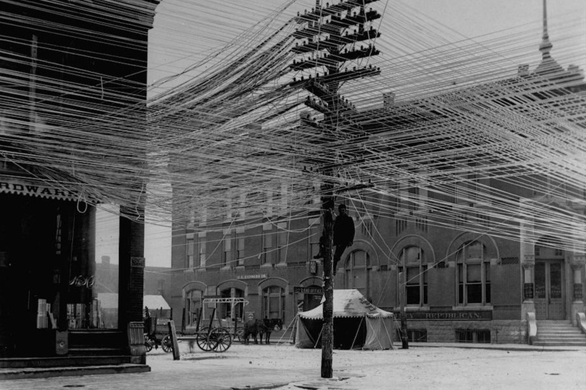
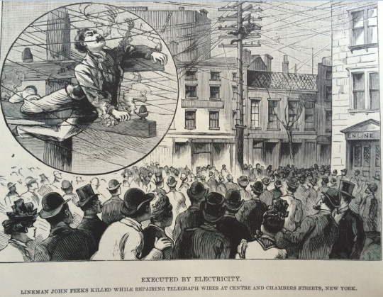

Slide 39
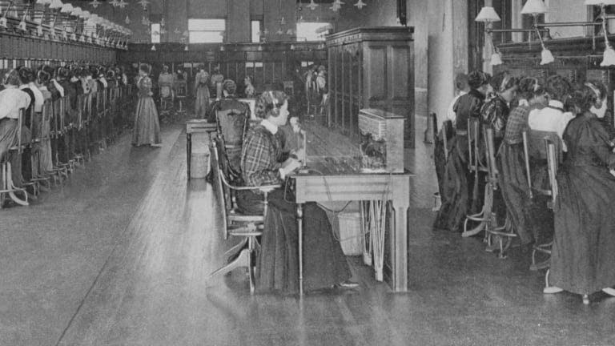

Slide 40
