Slide 1
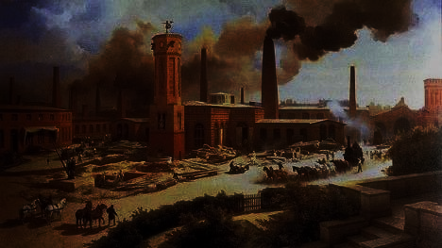
What do you mean, “We should have industrialized!?” (and other reactions to the modern economy)

Slide 2
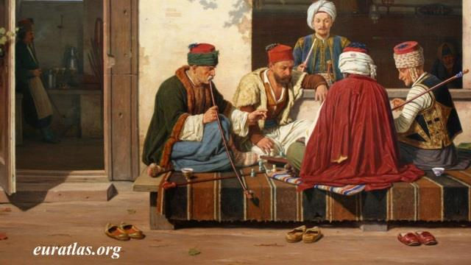
Ottoman Empire
Identify and discuss features of Ottoman decline and subsequent reform programs.

Slide 3
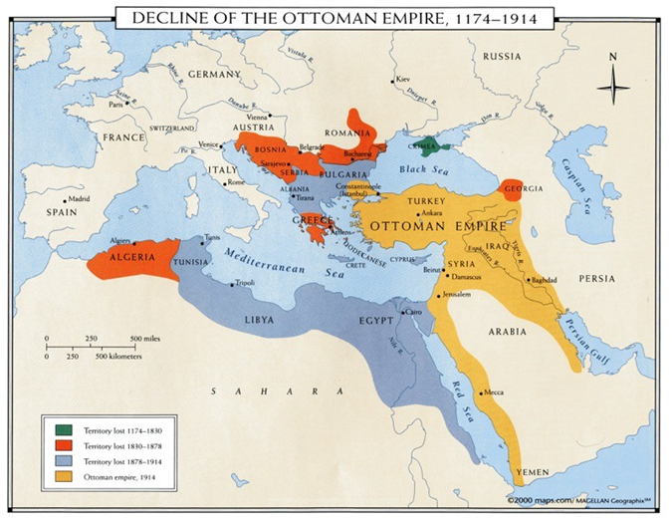
Ottoman Decline
Military decline since the late seventeenth century
Ottoman forces behind European armies in strategy, tactics, weaponry, training
Janissary corps politically corrupt, undisciplined
Provincial governors gained power, private armies

Slide 4
Ottoman Territory loss
Lost Caucasus and central Asia to Russia; western frontiers to Austria; Balkan provinces to Greece and Serbia
Egypt gained autonomy after Napoleon's failed campaign in 1798
Egyptian general Muhammad Ali built a powerful, modern army
Ali's army threatened Ottomans, made Egypt an autonomous province

Slide 5
Ottoman Economy
Less trade throughout empire as Europeans shifted to the Atlantic Ocean basin
Exported raw materials, imported European manufactured goods
Heavily depended on foreign loans; HALF of revenues paid to loan interest!
Foreigners began to administer the debts of the Ottoman state by 1882

Slide 6
Capitulate
To cease to resist an opponent or an unwelcome demand; surrender.

Slide 7
Nations with Ottoman capitulation treaties
Venice (1454)
France (1535, 1673, 1740)
England / Britain (1579, 1675, 1809)
Netherlands (1612, 1634, 1680)
Austria (1615)
Russia (1711, 1783)
Sweden (1737)
Sardinia (1740, 1825)
Denmark (1746 or 1756)
Prussia (1761)
Spain (1782)
United States (1830)
Belgium (1838)
Hanseatic League (1839)
Portugal (1843)
Greece (1854 or 1855)
Brazil (1858)
Bavaria (1870)

Slide 8
"capitulations": European domination of Ottoman economy
Extraterritoriality: Europeans exempt from Ottoman law within the empire
Could operate tax-free, levy their own duties in Ottoman ports
Deprived empire of desperately needed income

Slide 9
Early Reforms
Attempts to reform taxation, increase agricultural output, and reduce corruption
Sultan Selim III (r. 1789-1807) remodeled army on European lines
Janissaries revolt, kill new troops, imprison Sultan
Sultan Mahmud II (r. 1808-1839) attempts same, has Janissaries massacred
Also reforms schools, taxation, builds telegraph, postal service; introduces fez to military

Slide 10
Tanzimat (“Reorganization”) Era, 1839-1876
Ruling class sought sweeping restructuring to strengthen state
Broad legal reforms, modeled after Napoleon's civic code
Millets no longer independent from Ottoman courts
State reform of education for men (1846), free and compulsory primary education for all (1869)
Undermined authority of the ulama, enhanced the state authority

Slide 11
Opposition to Tanzimat reforms
Religious conservatives critical of attack on Islamic law and tradition
Legal equality for minorities resented by some, even a few minority leaders
Young Ottomans wanted more reform: freedom, autonomy, decentralization
High-level bureaucrats wanted more power and checks on the sultan's power

Slide 12
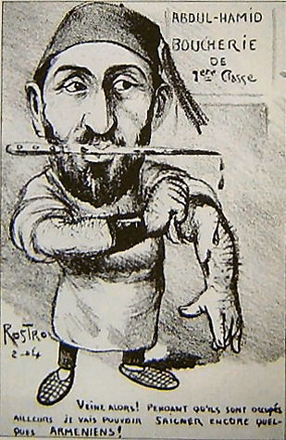
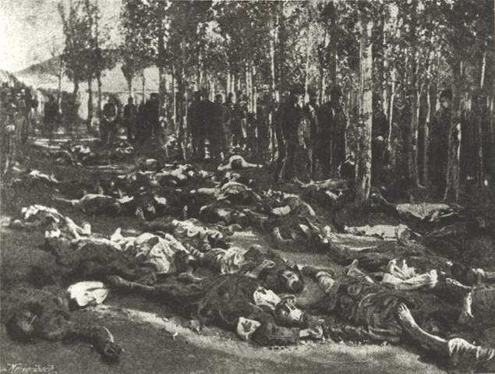
REFORM: From Liberal to repressive
1876, coup staged by bureaucrats who demanded a constitutional government
New sultan Abd al-Hamid II (1876-1909) proved an autocrat: suspended constitution, dissolved parliament, and punished liberals
Reformed army and administration: became source of the new opposition
Hamidian Massacre – Armenians and other Christian groups

Slide 13
The Young Turk Era: after 1889, an active body of opposition
Founded by Ottomans in exile in Paris
Called for rapid, secular reforms
universal suffrage, equality, freedom, secularization, women's rights
Forced Abd al-Hamid to restore constitution, dethroned him (1909)

Slide 14
Young Turk Rule
Nationalistic: favored Turkish dominance within empire, led to Arab resistance
Turkish made official language, despite large numbers of Arabic and Slavic language speakers
Yet could not contain forces of decline
The empire survived only because of distrust among European powers

Slide 15
Wrap up:
Identify and discuss features of Ottoman decline and subsequent reform programs.

Slide 16
The Decline and Reform of the Qing
Explain the significance of the Opium War and the unequal treaties for imperial China.
Compare the origins, course, and impact of Chinese rebellions and reform movements.

Slide 17
Chinese restrictions on British trade
Since 1759, European commercial presence limited to port of Guangzhou
Foreign merchants forced to deal solely with licensed Chinese firms called cohongs; currency of trade, silver bullion
British East India Company heavily involved in opium trade
Opium grown in India, sold in China for silver, silver used to buy other Chinese products. 40,000 chests by 1838!

Slide 18
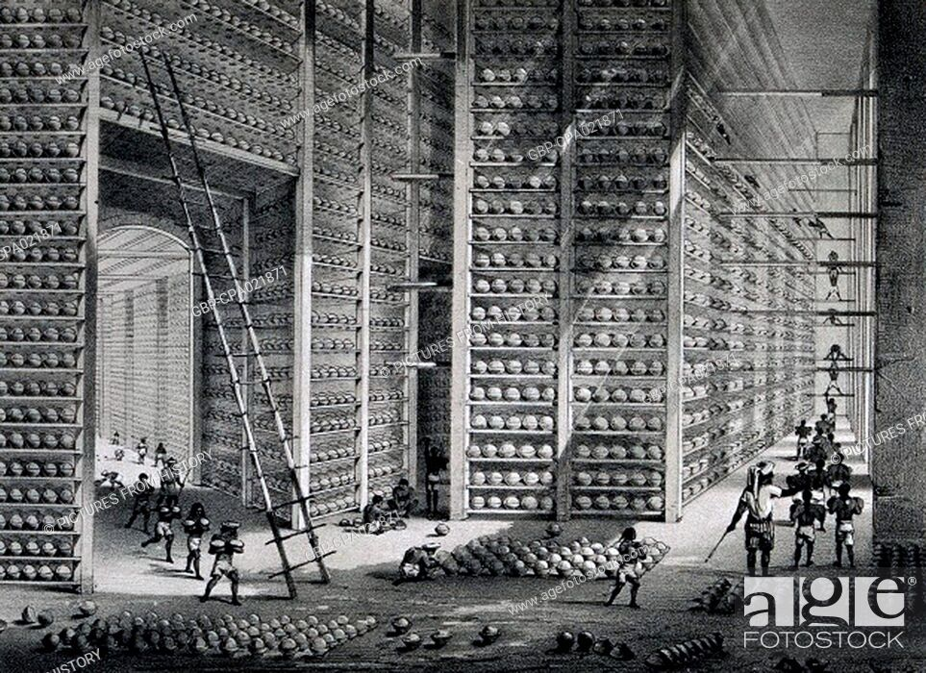
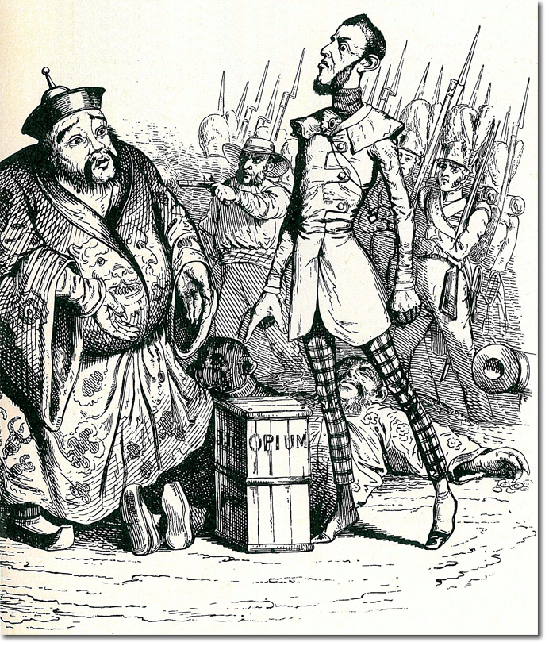
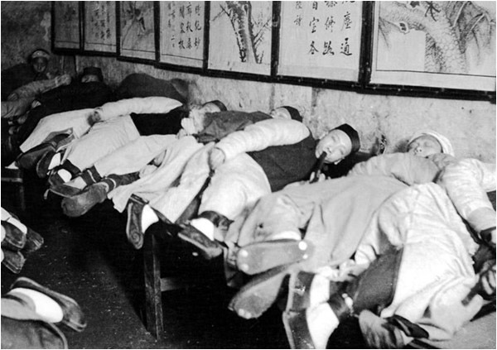
Opium Factory

Slide 19
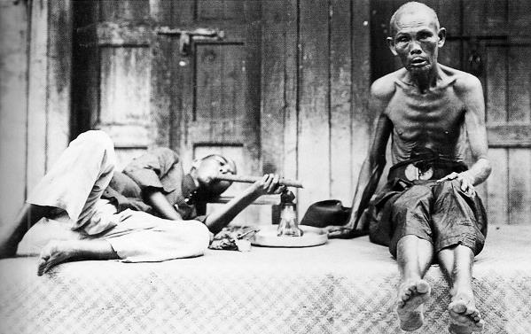
The Opium War (1839-1842)
Illegal, but poor enforcement
Increasing trade and social ills evident by late 1830s
Chinese move to enforce ban
British refused; twenty thousand chests of opium confiscated and destroyed
British retaliated, easily crushed Chinese forces, destroyed Grand Canal

Slide 20
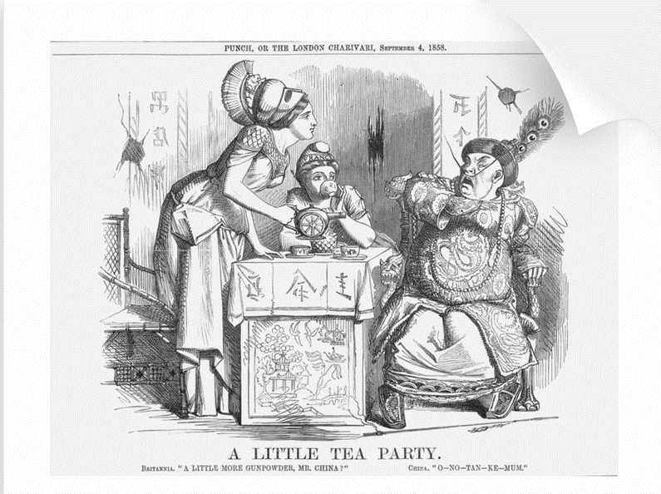
Unequal Treaties
First of several disadvantageous treaties China forced to sign.
Hong Kong ceded to British in Treaty of Nanjing (1842), ports opened to British traders
Extraterritorial status to British subjects
Later, other countries conclude similar treaties

Slide 21
The Taiping Rebellion (1850-1864)
Large-scale rebellions in later nineteenth century reflect poverty, discontent of Chinese peasantry
Population grew by 50 percent; land and food more slowly; poverty strained resources
Other problems: official corruption, drug addiction
Four major rebellions in 1850s and 1860s; the most dangerous was the Taiping
Taiping Rebellion led by Hong Xiuquan, schoolteacher who claimed to be Jesus’ brother, called for destruction of Qing dynasty

Slide 22
Taiping (“Great Peace”) Platform
End Qing Dynasty
Abolition of private property
Creation of communal wealth
Prohibition of foot-binding and concubines
Free public education, simplification of written Chinese, mass literacy

Slide 23
Taiping Defeat
Nanjing captured in 1858, made into capital
Attack on Beijing with force of 1 million, but turned back
Gentry sided with government
Imperial army unable to contain Taipings, so regional armies created with Manchu soldiers and outfitted with European weaponry
Hong commits suicide in 1864, Nanjing recaptured
100,000 Taipings massacred

Slide 24
The Self-Strengthening Movement (1860-1895)
High point in 1860s-1870s after rebellion
Slogan “Chinese learning at the base, Western learning for use”
Blend of Chinese cultural traditions with European industrial technology
Built shipyards, railroads, weapon industries, steel foundries, academies
Not enough industry to make a significant change
Empress Dowager Cixi (1835-1908) diverted funds for her own aesthetic purposes

Slide 25
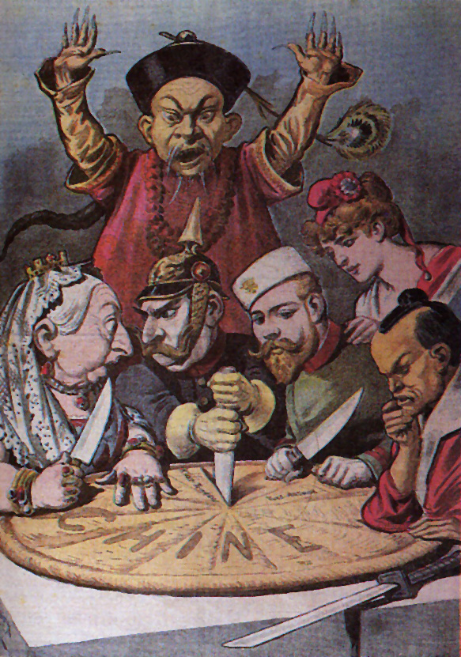
Spheres of Influence
Qing dynasty loses influence in south-east Asia, losing tributary states to Europeans and Japanese
Vietnam: France, 1886
Burma: Great Britain, 1885
Korea, Taiwan, Liaodong Peninsula: Japan, 1895
China itself divided into spheres of influence, 1895

Slide 26
Hundred Days Reforms (1898)
Two Confucian scholars advised radical changes in imperial system
Interpreted Confucianism to allow for radical changes to system
Young emperor Guangxu inspired to launch wide-range reforms
Pro-industrialization
Movement crushed by Cixi and supporters; emperor imprisoned; reformers killed

Slide 27
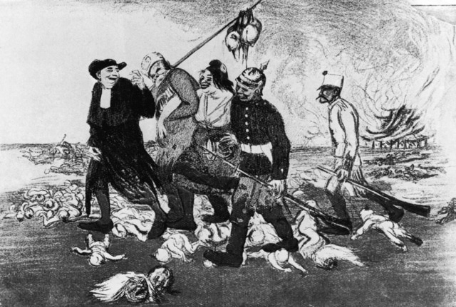
The Boxer Rebellion
Cixi supports Society of Righteous and Harmonious Fists (“Boxers”), anti-foreign militia units
1899 fight to rid China of “foreign devils”
Misled to believe European weapons would not harm them, 140,000 Boxers besiege European embassies in 1900
Crushed by coalition of European forces
China forced to accept stationing of foreign troops

Slide 28
Boxers

Slide 29
Death of the Dowager Empress
Emperor dies a mysterious, sudden death (likely arsenic…)
Cixi dies one day later, November 1908
2-year old Puyi placed on the throne
Revolution in 1911
Puyi abdicates, 1912

Slide 30
The Decline and Reform of the Qing
Explain the significance of the Opium War and the unequal treaties for imperial China.
Compare the origins, course, and impact of Chinese rebellions and reform movements.

Slide 31
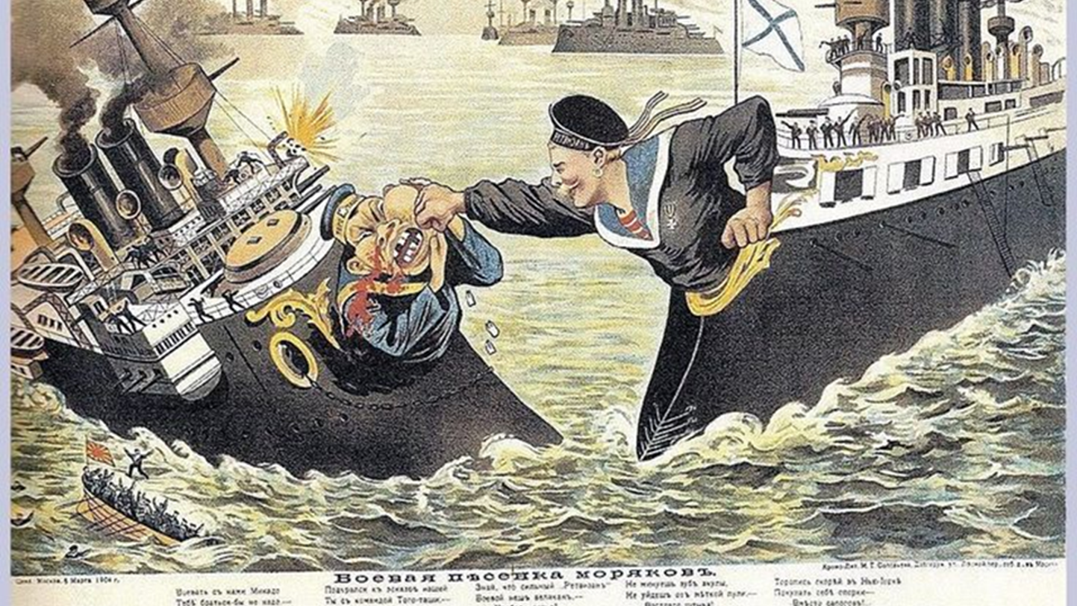
Decline and Reform in Russia

Slide 32
The Russian Empire in Decline
Russia a massive, multi-cultural empire
Only half speak Russian, observe Russian Orthodox Christianity
Romanov Tsars rule autocratic empire
Powerful class of nobles exempt from taxation, military duty
Exploitative serfdom

Slide 33
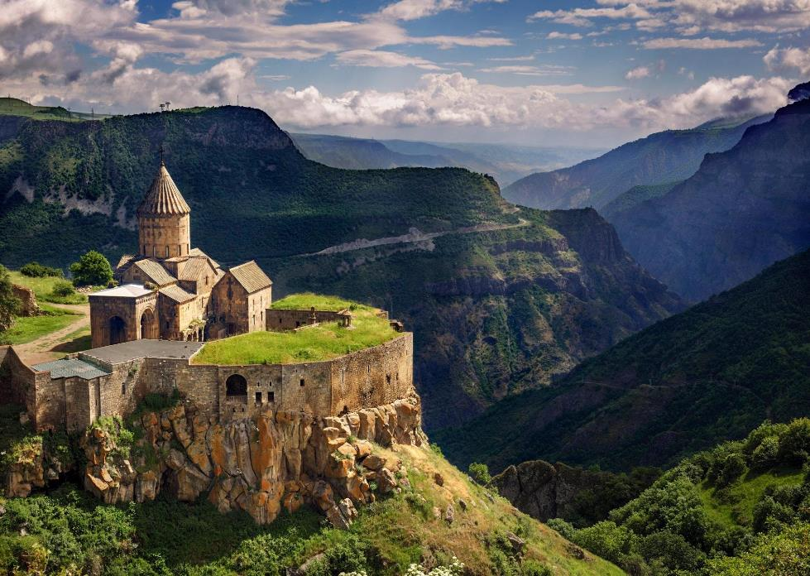
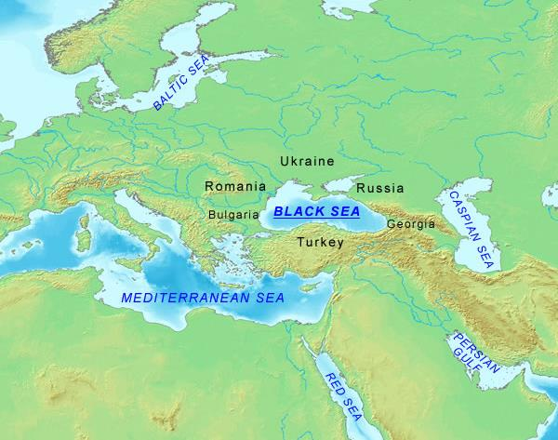
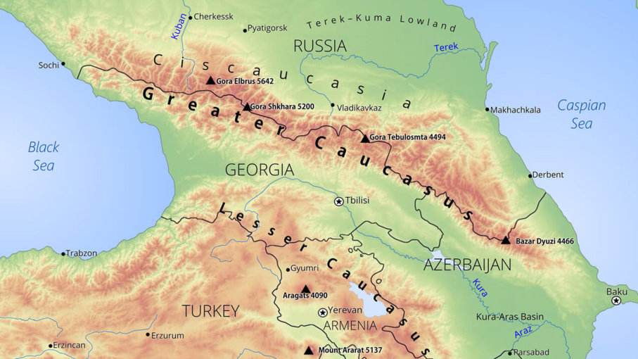
The Crimean War, 1853-1856
Russian expansion into Caucasus in larger attempt to establish control over weakening Ottoman empire
Threatens to upset balance of power, Europeans become involved
Russia driven back from Crimea in humiliating defeat
Demonstration of Russian weakness in the face of western technology and strategy; tsars to take radical steps to modernize army, industry

Slide 34
Reform: Emancipation of the Serfs (1861)
Serfdom supported landed nobility, a major obstacle to economic development
Serfs gained right to land, but no political rights; had to pay a redemption tax
Emancipation did not increase agricultural production, as was expected
Limited attempts to reform government
1864, creation of zemstvos, local assemblies with representatives from all classes – WEAK!

Slide 35
Industrialization in Russia
Count Sergei Witte, minister of finance 1892-1903
Massive railroad construction
Trans-Siberian railroad
Remodeled the state bank, protected infant industries, secured foreign loans
Top-down industrialization effective; steel, coal, and oil industries grew
But massive industrial discontent
Peasants uprooted from rural lifestyle to work for low wages, long hours

Slide 36
Russian Repression
Intelligentsia class spreads radical ideas for social change
Socialists and anarchists
Terror tactics, assassinations
Witte attempts to connect with the distrustful peasantry in 1870s; denounced and sent into Siberian exile
Tsarist authorities turn to censorship, secret police
“Russification” sparked ethnic nationalism, pogroms against Jews tolerated

Slide 37
Radicalization
Alexander II, the reforming tsar, assassinated by a terrorist bomb in 1881
Prompted widespread pogroms against Jews (blamed)
Son, Nicholas II (1894-1917), more oppressive, conservative ruler
enters into war with Japan (1904-1905)
Humiliating defeat exposes government weaknesses

Slide 38
Revolution of 1905
Triggered by costly Russian defeat by Japan
Bloody Sunday massacre: unarmed workers shot down by government troops
Peasants seized landlords' property; workers formed soviets
Tsar forced to accept elected legislature, the Duma; did not end conflict

Slide 39
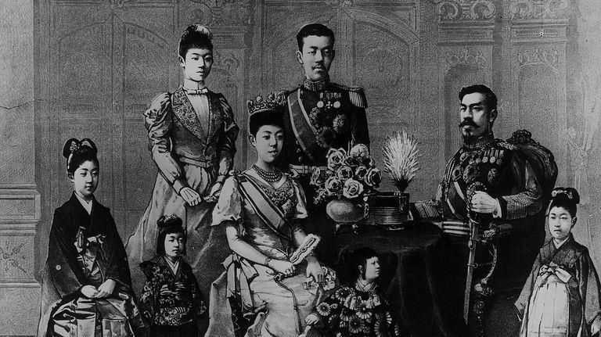
Opening and Reform of Japan
How did Japan’s transformation in the late nineteenth century compare to that of Russia and the Ottoman Empire?

Slide 40
Transformation of Japan
Japanese society in turmoil in early 19th century
Crop failures, famines, high taxes, inflation
Daimyo, samurai classes decline; peasants starve
Tokugawa government attempts reforms, 1841-1843
Cancelled daimyo and samurai debts
Abolished merchant guilds
Compelled peasants to return to cultivating rice
Reforms ineffective

Slide 41
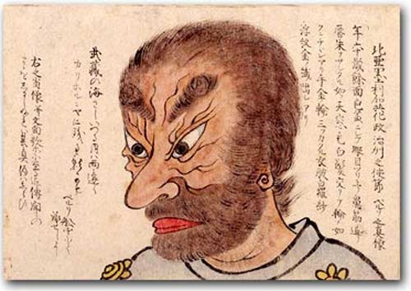
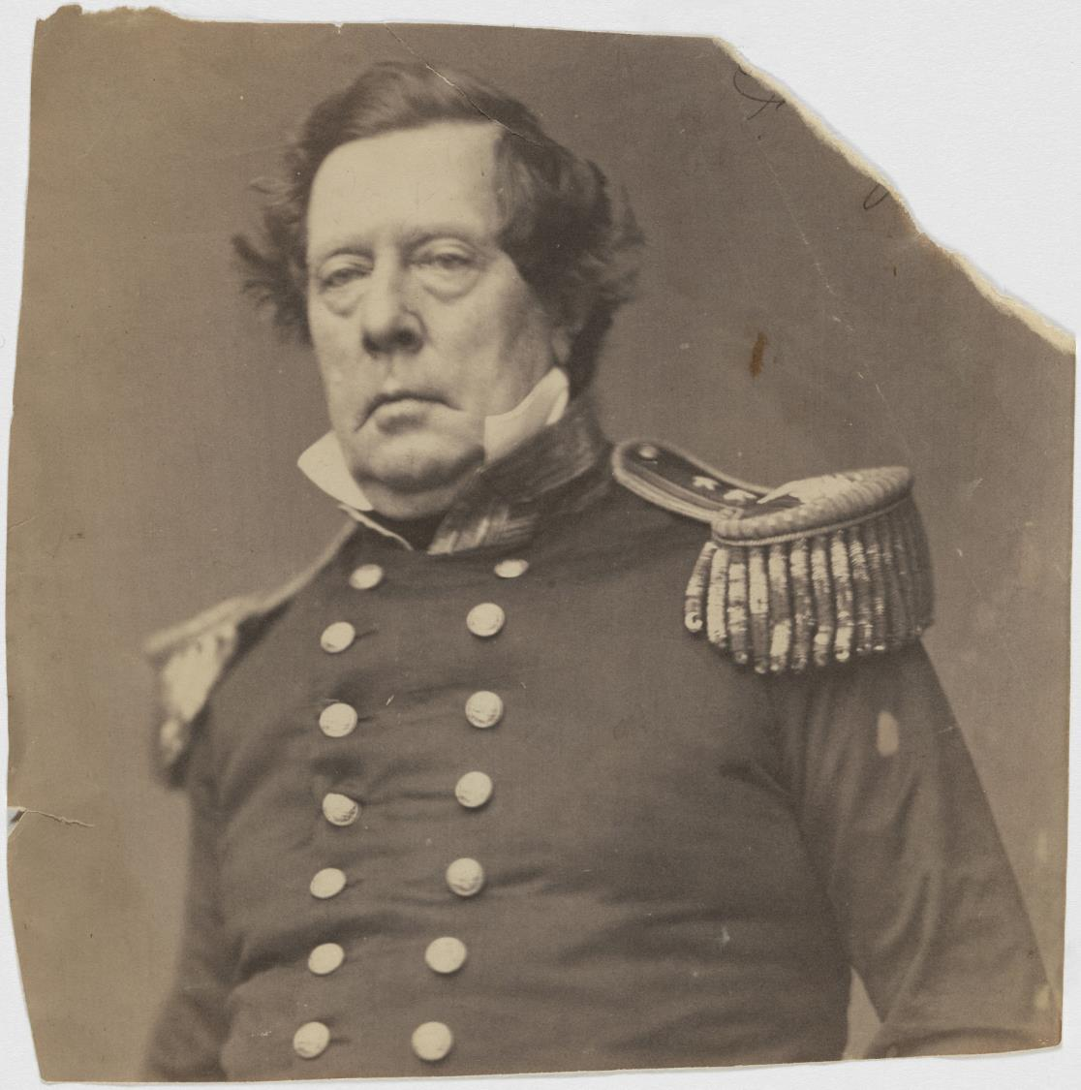
Matthew Perry…

Slide 42
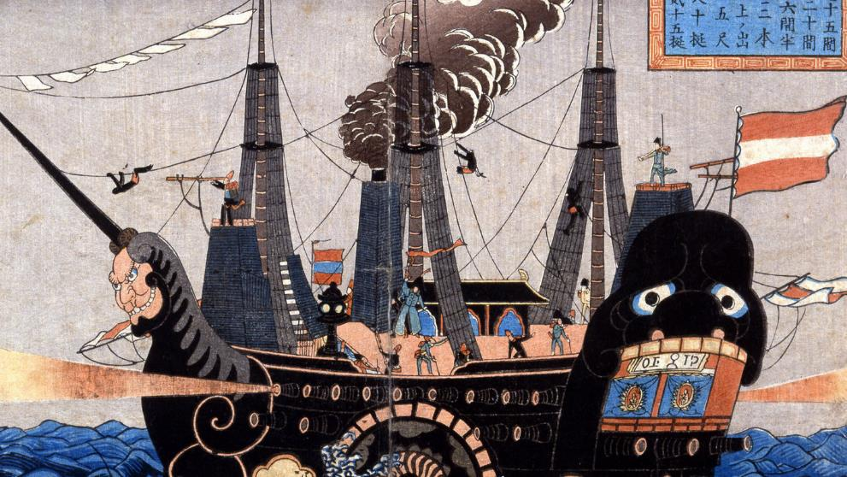
Foreign Pressure
Foreign pressure for Japan to reverse long-standing closed door policy
U.S. in particular look for Pacific ports for whalers, merchants
Japan only allowed Dutch presence in Nagasaki
1853 Matthew Perry sails gunship up to Edo (Tokyo), forces Japanese to open port
Japan forced to accept unequal treaties with United States and other western countries
Sparks conservative Japanese reaction against Shogun, rally around Emperor in Kyoto

Slide 43
The Meiji Restoration (1868)
After brief civil war, Tokugawa armies defeated by dissident militia
The boy emperor Mutsuhito, or Meiji, regained authority
End of almost seven centuries of military rule in Japan
Goals of prosperity and strength: “rich country, strong army”
Resolved to learn western technology

Slide 44
Meiji Reforms
Travelers venture to U.S., Europe (especially Germany)
Argue for adoption of western legal proceedings, technology

Slide 45
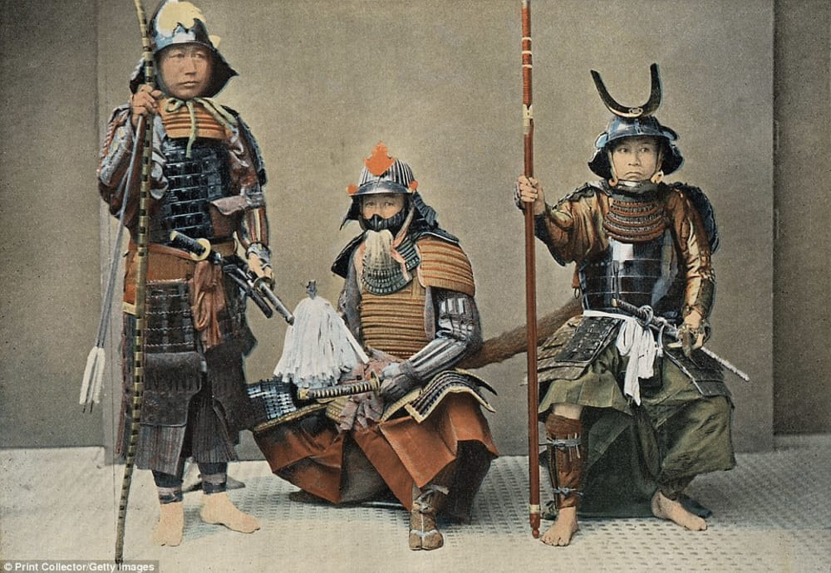
Abolition of the feudal order
Meiji government reorganized districts to break up old feudal domains
Removes privileges for daimyo, samurai
Conscript army replaces samurai mercenaries
Samurai rebellion crushed by new national army (1877)

Slide 46
Revamping tax system
Converted grain taxes to a fixed money tax: more reliable income for state
Assessed taxes on potential productivity of arable land

Slide 47
Constitutional Government
Constitutional government, the emperor's "gift" to the people in 1889
Emperor remained supreme, limited the rights of the people
Conservative: only 5 % of male population allowed to vote in 1890 election
Legislature, the Diet, was an opportunity for debate and dissent

Slide 48
Economic reforms
Rapid industrialization
Transportation: railroads, telegraph, steamships
Education: universal primary and secondary; competitive universities
Dramatic improvement in literacy rates
Industry: privately owned
zaibatsu, powerful financial cliques develop
government controlled arms industry

Slide 49
Consequences of economic development
NEGATIVE
Costs borne by Japanese people
Land tax cost peasants 40-50% of crop yield - provided 90 percent of state revenue!
Peasant uprisings crushed; little done to alleviate suffering
Labor movement also crushed; Meiji law treated unions and strikes as criminal
POSITIVE
Japan became an industrial power in a single generation
Ended unequal treaties in 1899
Defeated China in 1895 and Russia in 1904

Slide 50
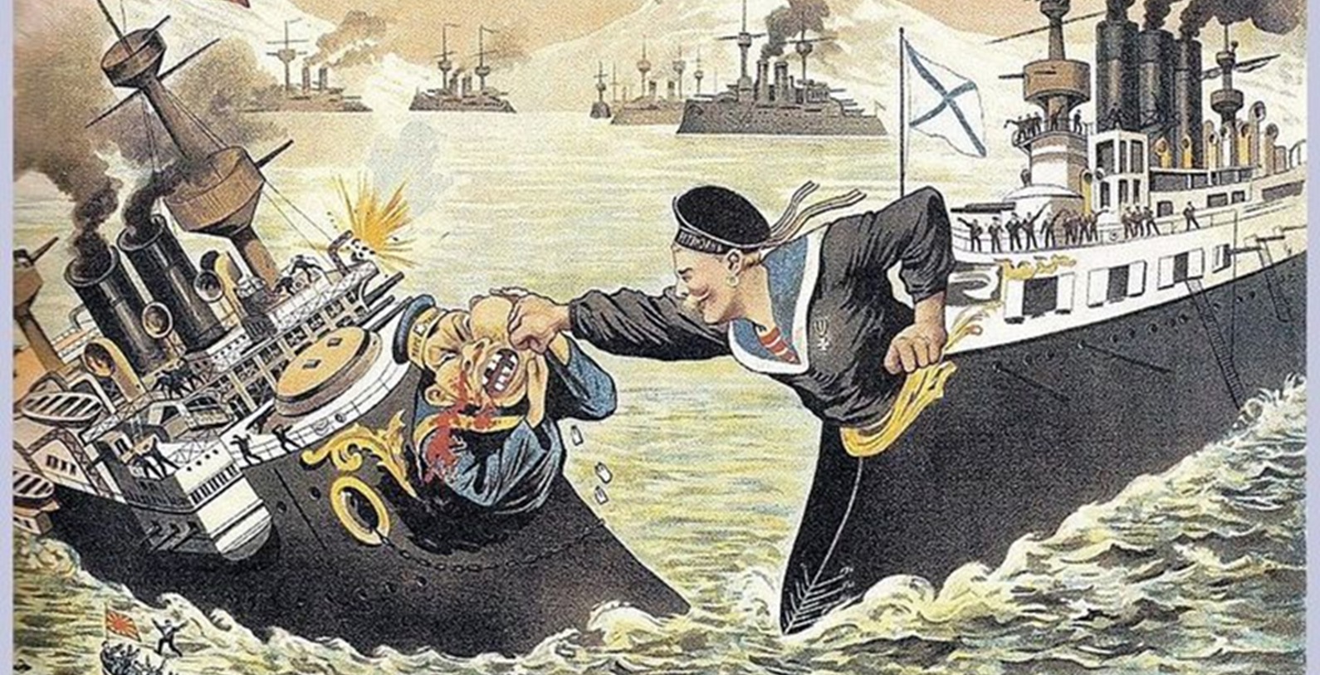

Slide 51
Opening and Reform of Japan
How did Japan’s transformation in the late nineteenth century compare to that of Russia and the Ottoman Empire?

Slide 52
Ottoman empire, Russia, China, and Japan
Common Problems | Reform Efforts | Different Results of Reforms
Military weakness, vulnerability to foreign threats Internal weakness due to economic problems, financial difficulties, and corruption | Attempts at political and educational reform and at industrialization Utilization of Western models Clash of conservative and liberal ideologies | Ottoman empire, Russia, and China unsuccessful; societies on the verge of collapse Reform in Japan was more thorough; Japan emerged as an industrial power

