Slide 1
Africa and the Atlantic World

Slide 2
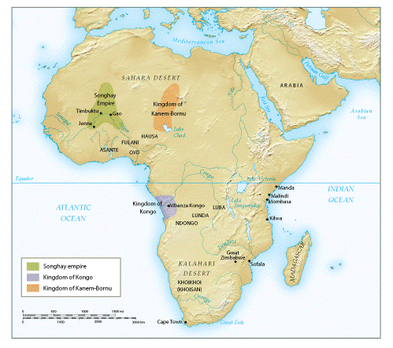
African states 1500-1650

Slide 3
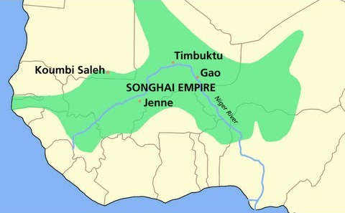
The States of West Africa and East Africa
Developed over 8th-16th centuries
Kingdom of Ghana
  Major gold trader
Mali Empire, 13th century
  Rise of Timbuktu as cultural center
Songhay Empire, 15th century
  Sunni Ali (r. 1464-1493) created effective army, navy
  Timbuktu at height under nephew
  Musket-bearing Moroccan army destroys Songhay forces; regional city-states exert local control

Slide 4
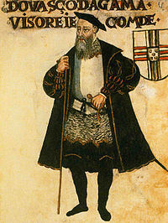
Swahili Decline in East Africa
Portuguese Vasco da Gama skirmishes with Swahili states (1497-1498)
  1502 returns, forces Kilwa to pay tribute
1505 Portuguese gun ships dominate Swahili ports

Slide 5
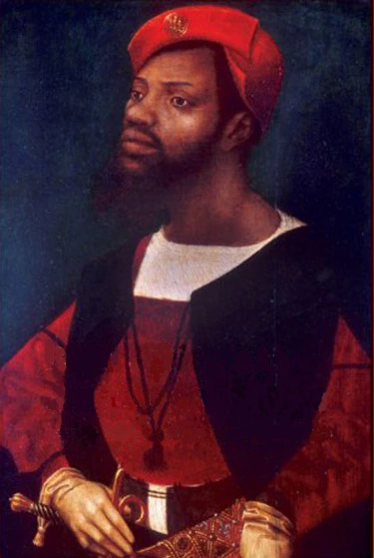
The Kingdom of Kongo
Relations with Portuguese beginning 1483
King Nzinga Mbemba (Alfonso I, r. 1506-1542) converts to Christianity
  Useful connection with Portuguese interests
  But zealous convert, attempts to convert population at large

Slide 6
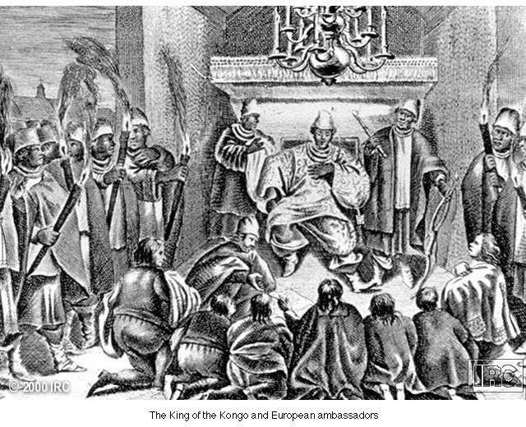
The King of Kongo and European Ambassadors

Slide 7
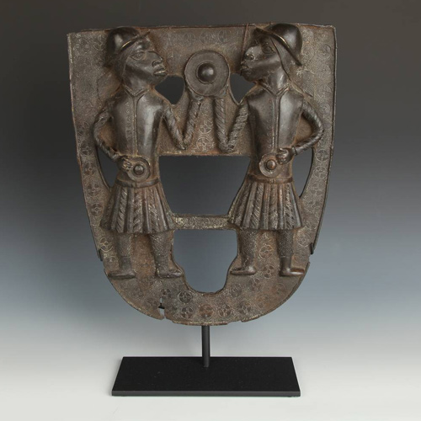
Slave Raiding in Kongo
Initially, Portuguese attempt slave raiding
Easier to trade weapons for slaves provided by African traders
  Dealt with several authorities besides Kongo
Kongo kings appeal without success to slow, but not eliminate, slave trade
Relations deteriorate, Portuguese attack Kongo and decapitate king in 1665
More effective slave market develops in the south

Slide 8
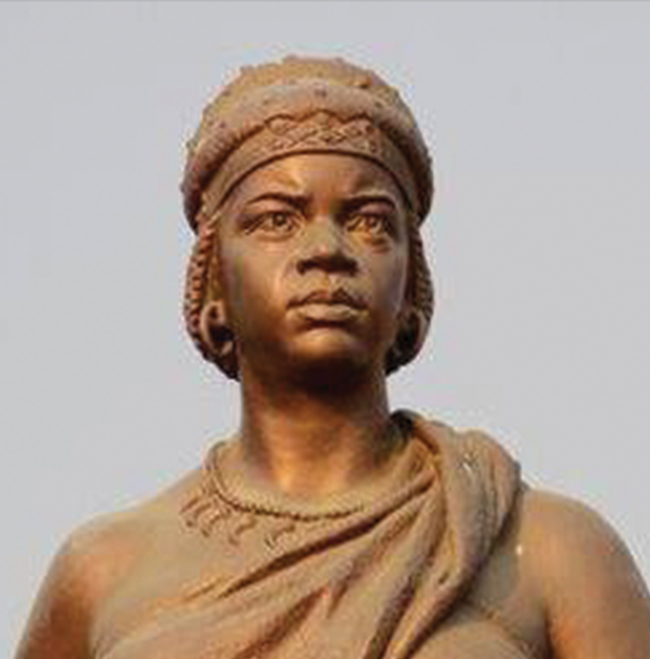
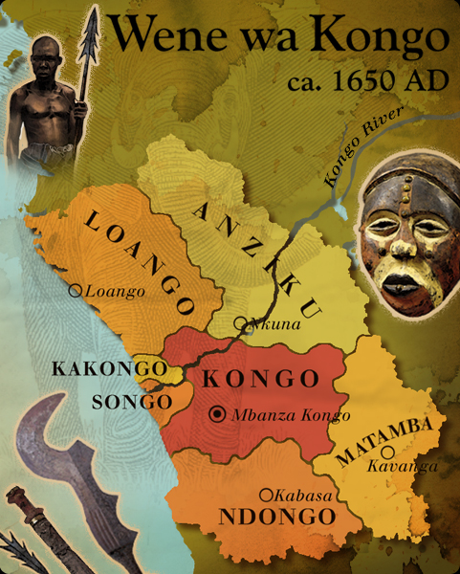
The Kingdom of Ndongo (Angola)
Ndongo gains wealth and independence from Kongo by means of Portuguese slave trade
But Portuguese influence resisted by Queen Nzinga (r. 1623-1663)
  Posed as male King, with male concubines in female dress attending her
Nzinga establishes temporary alliance with Dutch in unsuccessful attempt to expel Portuguese
  Decline of Ndongo power after her death

Slide 9
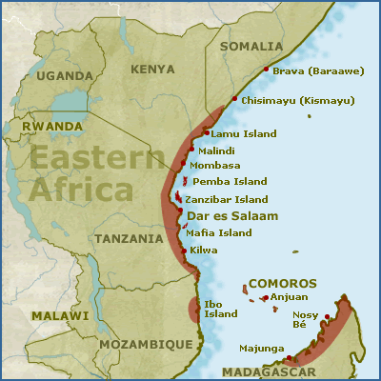
Regional Kingdoms in South Africa
1300: Great Zimbabwe
Dutch build Cape Town in 1652, increased involvement with southern African politics
  Encounter Khoikhoi people (called “Hottentots” by Dutch)
British colonies also develop

Slide 10
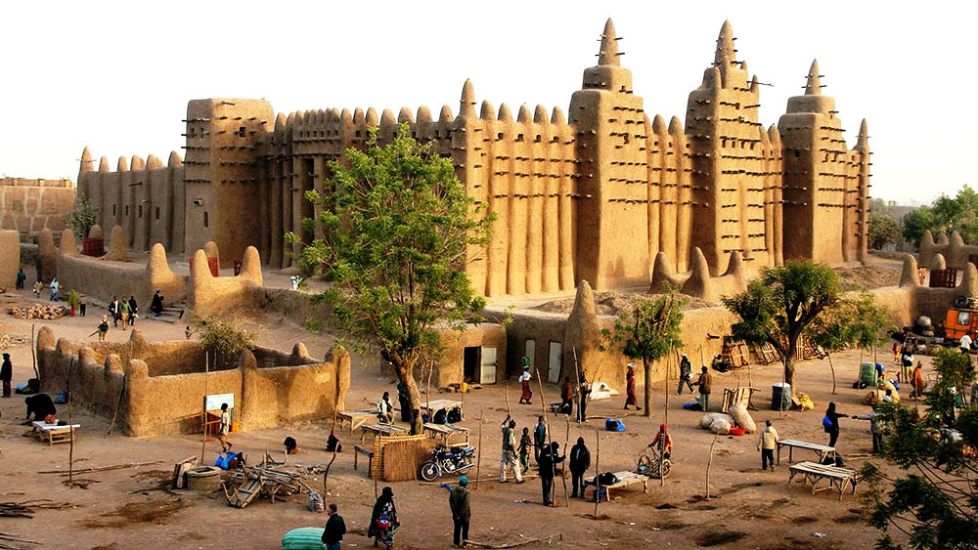
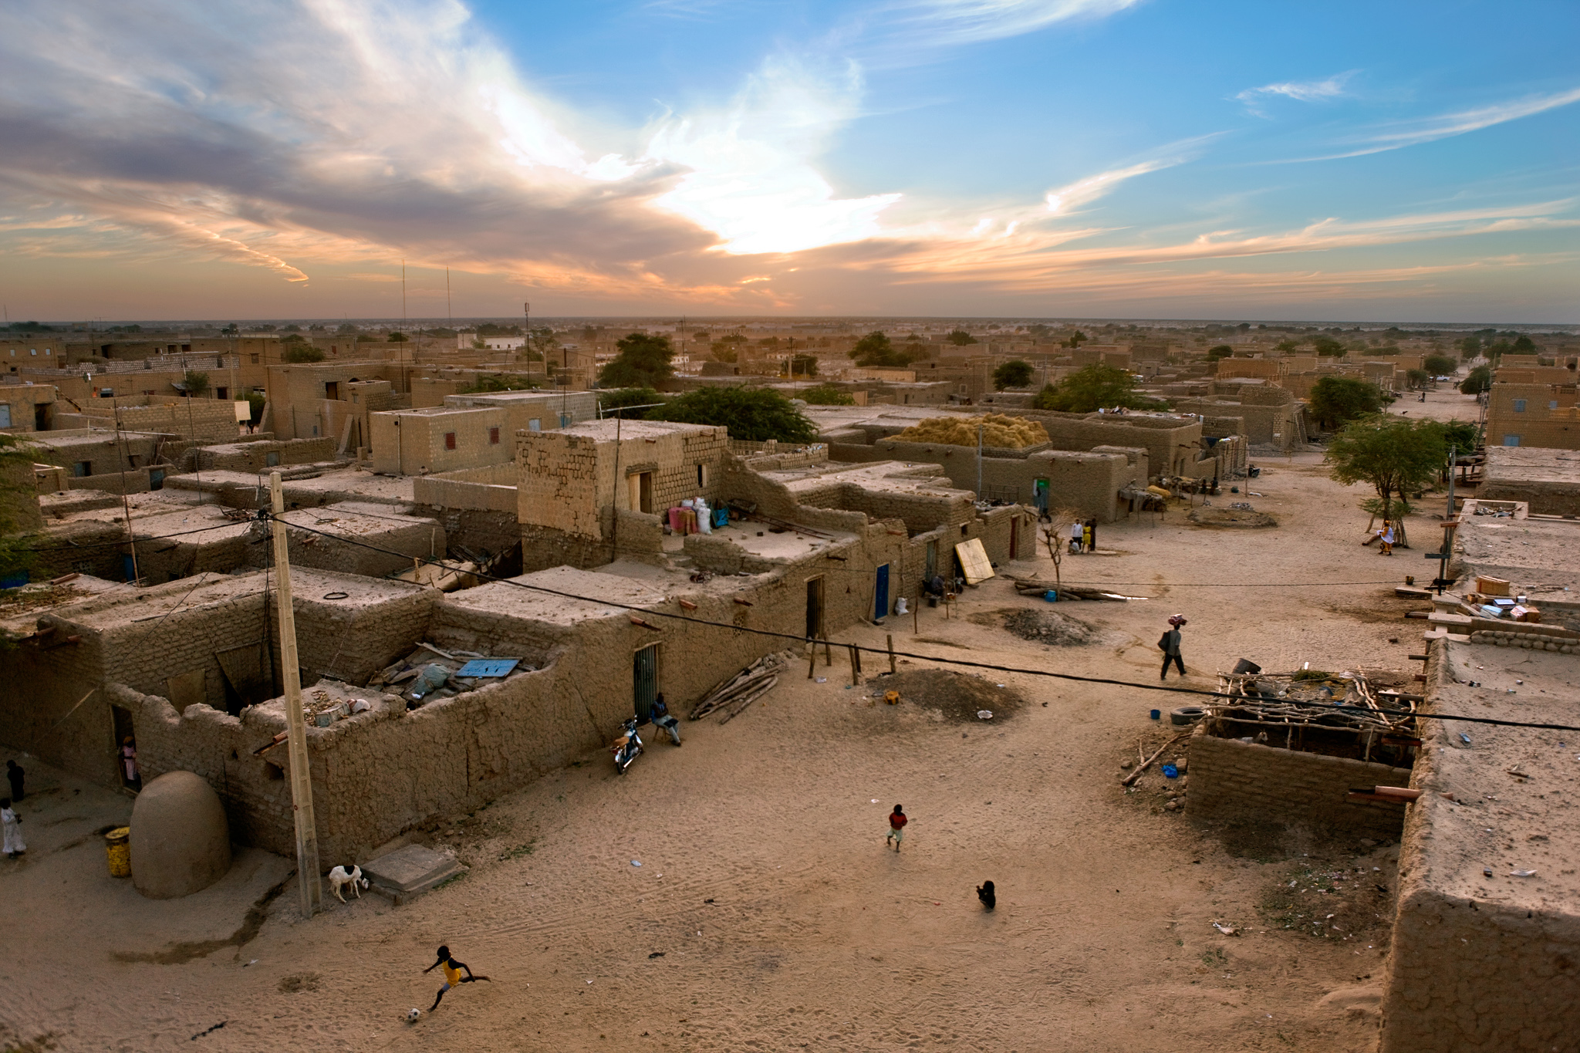
Islam in Sub-Saharan Africa
Pre-Islamic paganism, ancestor worship
Islam develops in commercial centers
  African traditions and beliefs blended into Islam
  Gender relations, standards of female modesty
Timbuktu becomes major center of Islamic scholarship by 16th century

Slide 11
Social Change in Early Modern Africa
Trade with Europeans brings new goods to Africa
New crops from Americas
  Manioc becomes staple bread flour
Increased food supply boosts population growth despite slave trade

Slide 12
Foundations of the Slave Trade
Distinct from Asian, European slavery
  No private property, therefore wealth defined by human labor potential, not land
  Slaves often assimilated into owner’s clan
African slavery dates to antiquity
  War captives, criminals, people expelled from clans

Slide 13
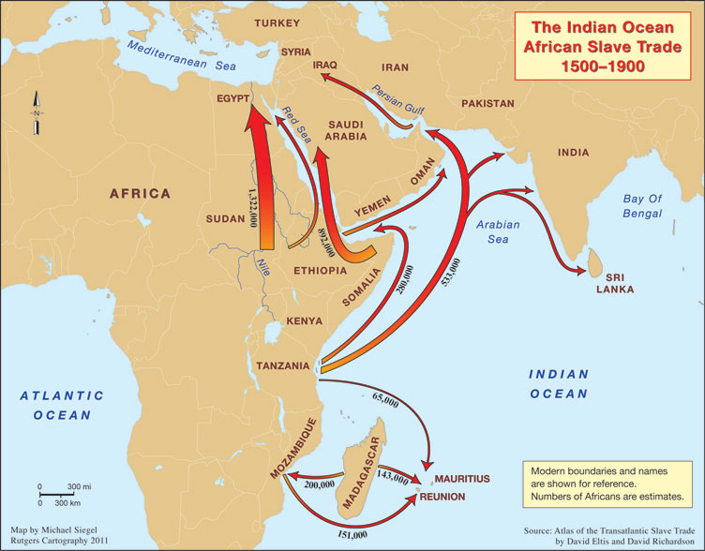
The Islamic Slave Trade
Dramatic expansion of slave trade with Arab traders
New slaves acquired by raiding villages, selling on Swahili coast
Arab traders depend on African infrastructure to maintain supply
European demand on west coast causes demand to rise again

Slide 14
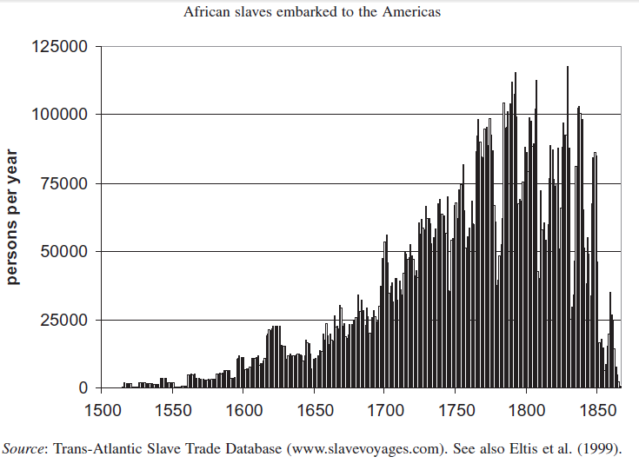
The Early Slave Trade
Portuguese raid west African coast in 1441, take 12 men
  Met with stiff resistance
African dealers ready to provide slaves
1460: 500 slaves per year sold to work as miners, porters, domestic servants in Spain and Portugal
1520: 2,000 per year to work in sugarcane plantations in the Americas
Slave trade: https://ed.ted.com/on/IZqszXUD

Slide 15
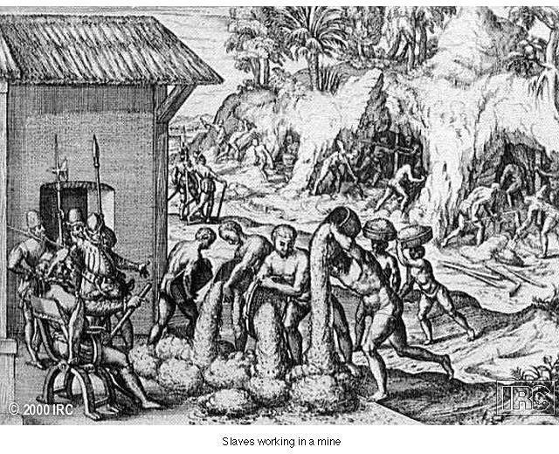
Slaves at Work in a Mine

Slide 16
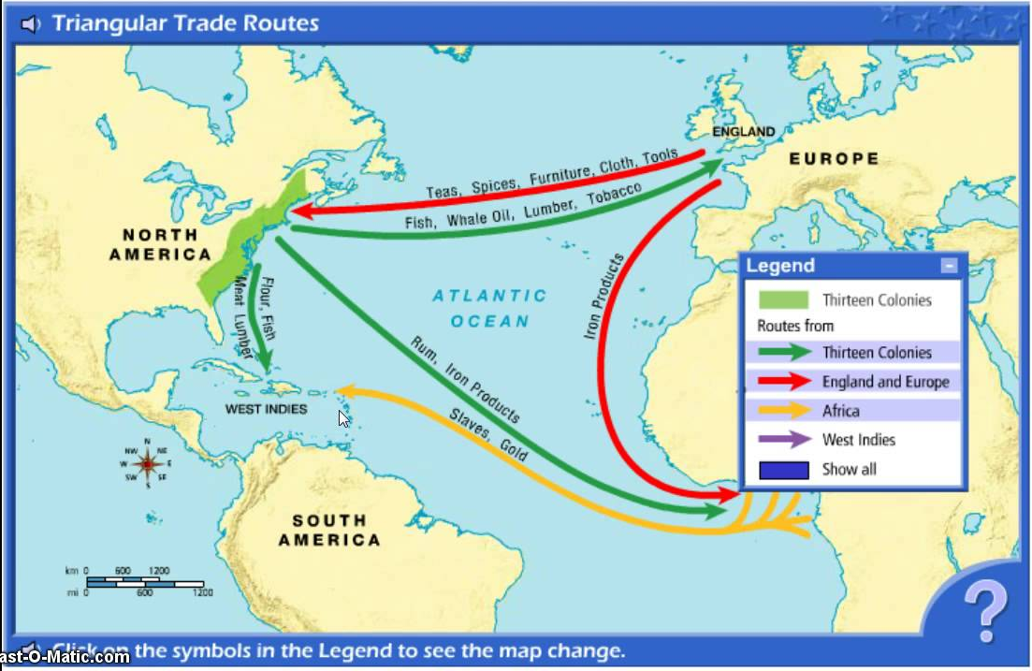
The Triangular Trade
1. European manufactured goods (especially firearms) sent to Africa
2. African slaves purchased and sent to Americas (“Middle Passage”)
3. Cash crops purchased in Americas and returned to Europe

Slide 17
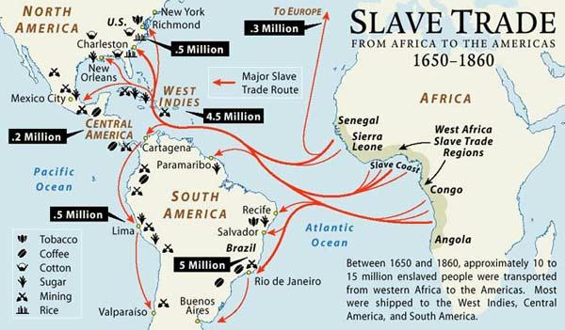

Slide 18
Destinations of African Slaves

Slide 19
African Slave Export per Year

Slide 20
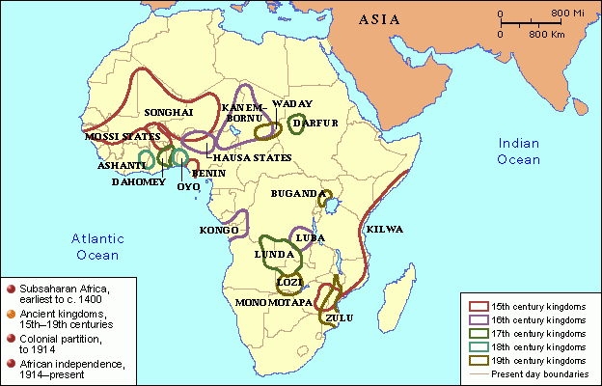
Impact on African Regions
Rwanda, Bugunda, Masai, Turkana resist slave trade
  Benefit from distance from slave ports on western coast
Other societies benefit from slave trade profit
  Asante, Dahomey, Oyo peoples

Slide 21

Social Effects of Slave trade
Total African population expands due to importation of American crops
Yet millions of captured Africans removed from society, deplete regional populations
Distorted sex ratios result
  2/3 of slaves male, 14-35 years of age
  Encouraged polygyny
  women acting in traditionally male roles

Slide 22
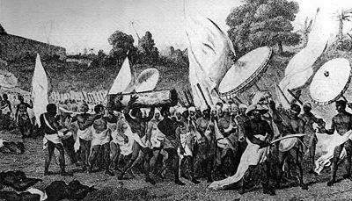
Political Effects of Slave Trade
Introduction of firearms increases violence of pre-existing conflicts
  More weapons = more slaves; more slaves = more weapons
Dahomey people create army dedicated to slave trade

Slide 23





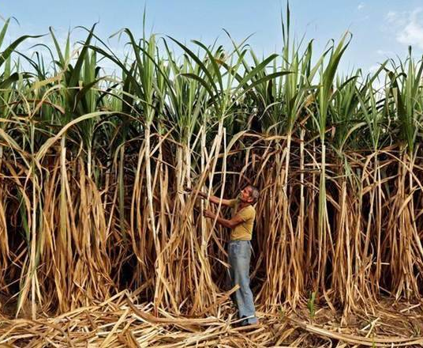
African Slaves in Plantation Societies
Most slaves in tropical and subtropical regions
First plantation established in Hispaniola (Haiti, Dominican) 1516
  Later Mexico, Brazil, Caribbean and Americas
Sugar major cash crop
  Later: tobacco, rice, indigo, cotton, coffee
Plantations heavily dependent on slave labor

Slide 24
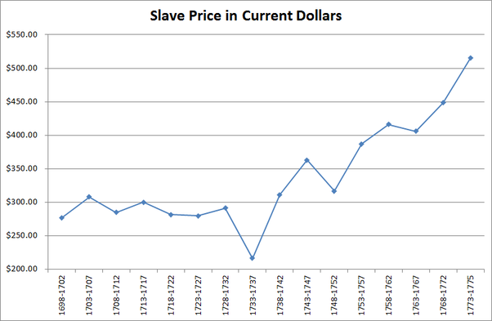
Regional Differences
Caribbean, South America: African population unable to maintain numbers through natural means
  Malaria, yellow fever
  Brutal working conditions, sanitation, nutrition
  Gender imbalance
Constant importation of slaves
North America: less disease, more equal sex ratio
  Slave families encouraged as prices rise in 18th century

Slide 25
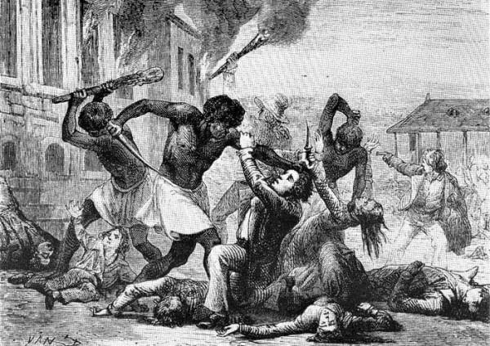
Resistance to Slavery
Half-hearted work effort
Sabotage
Flight (Maroon populations)
Revolts
  Only one successful revolt – Haitian Revolution
    French-controlled St.-Domingue (1793)
    Renamed Haiti
  Elsewhere, revolts outgunned by Euro-American firepower

Slide 26
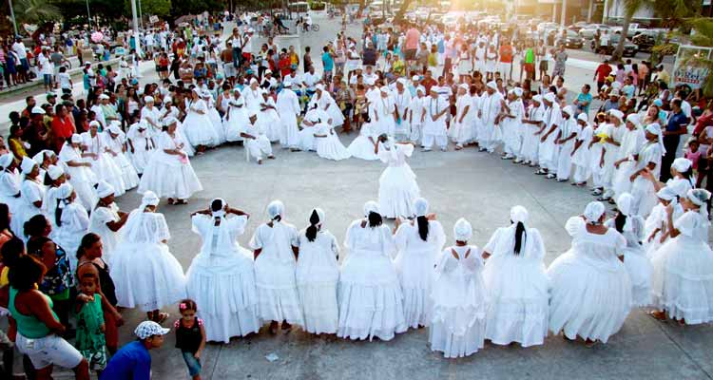
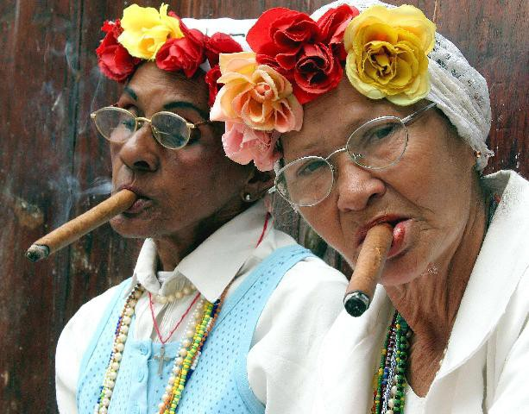
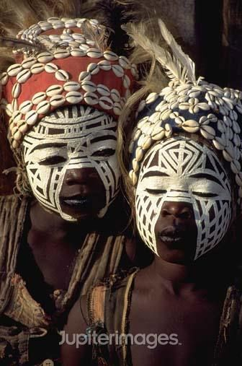
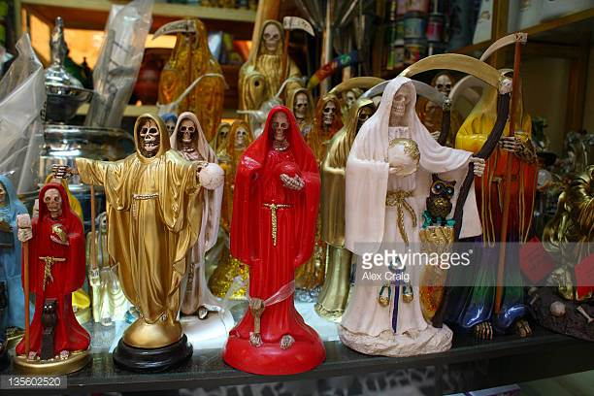
African-American Culture
Diversity of African cultures concentrated in slave population
    Massive blend of cultures!
European language adapted with African influences
  Creole languages
Christianity incorporated into African traditions
  Vodun, Santeria, Candomble

Slide 27
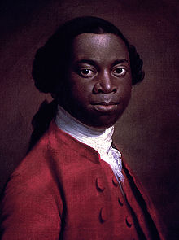
The Abolition of Slavery
Olaudah Equiano (1745-1797), former slave authors best-selling autobiography
  Eloquent attacks on institution of slavery
Economic costs of slavery increase
  Military expenses to prevent rebellions
  18th century: price of sugar falls, price of slaves rises
  Wage labor becomes more efficient
    Wage-earners can spend income on manufactured goods

Slide 28
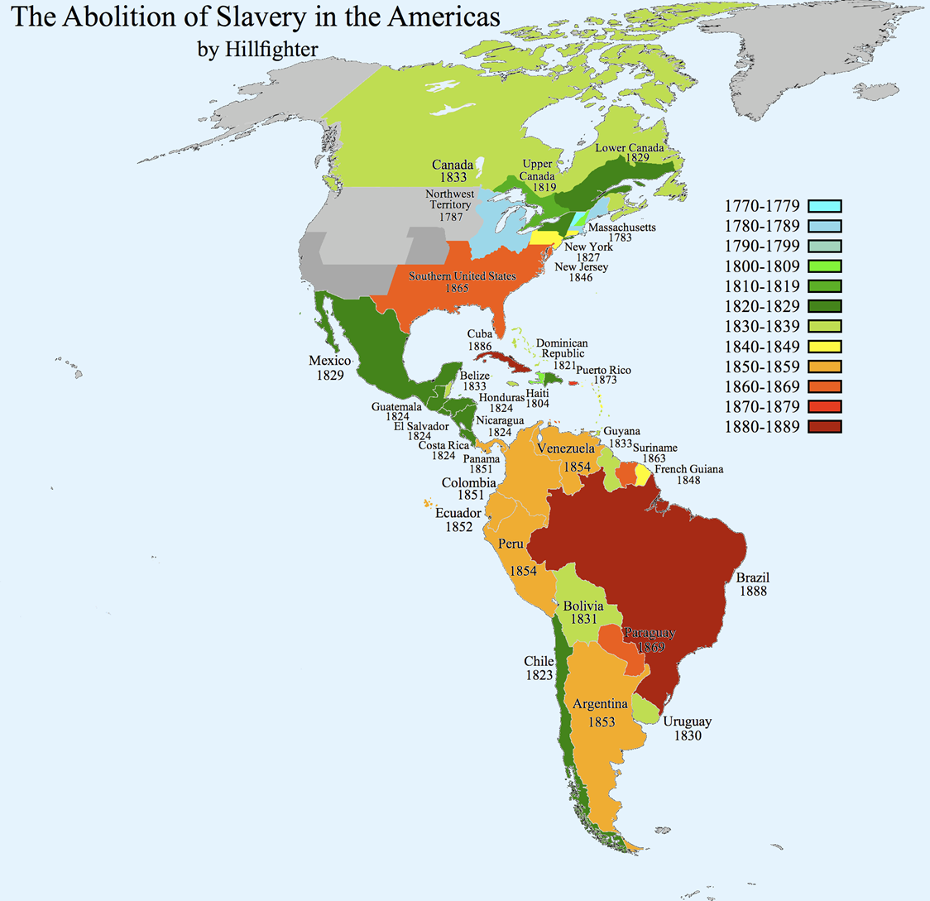
End of the Slave Trade
Denmark abolishes slave trade in 1803, followed by Great Britain (1807), United States (1808), France (1814), Netherlands (1817), Spain (1845)
Possession of slaves remains legal
Clandestine trade continues to 1867
Emancipation of slaves begins with British colonies (1833), then French (1848), U.S. (1865), Brazil (1888)
Saudi Arabia and Angola continue to the 1960s

