Slide 1
New Worlds: The Americas and Oceania
While I check your notes, OUTLINE responses to the following questions:
Compare and contrast the Iberian empires in the Americas and the settler colonies in North America.
Explain the formation and features of multicultural societies in the Americas.
Explain the roles of mining, sugar, and slavery in the economy of the Spanish empire.
Explain the roles played by agriculture traders and settlers in early colonial North America compared to the economic developments in the Spanish empire and Portuguese Brazil.

Slide 2
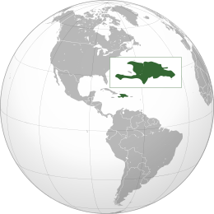
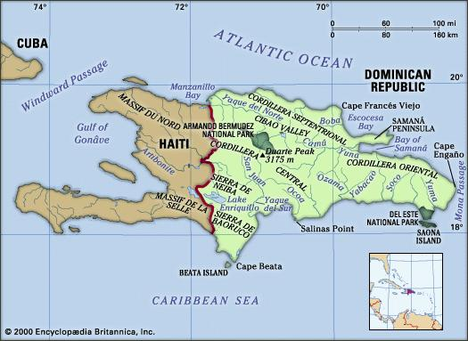
Know Hispaniola!
Modern Haiti/Dominican Republic

Slide 3
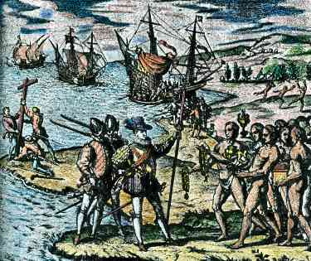
The Spanish Caribbean
Spanish mariners meet indigenous Tainos (Arawaks)
  settled in Caribbean from S.A. in late centuries BCE - 900 CE
Columbus uses Hispaniola as base for trading with Tainos
  Disappointed that Tainos had no spices, silks
“Recruits” locals to mine gold instead
  Encomienda: Forced labor

Slide 4
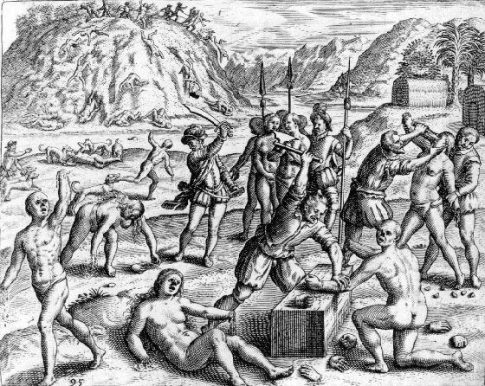
From Mining to Plantation Agriculture
Tainos occasionally rebel, but outgunned by Spanish
Smallpox epidemics begin 1518 – Taino gone by mid 16th cent
  Spanish raids to kidnap and replace workers spread disease quickly
Limited gold production causes new interest in exploiting Caribbean for sugarcane production
  Requires massive importation of slaves!

Slide 5
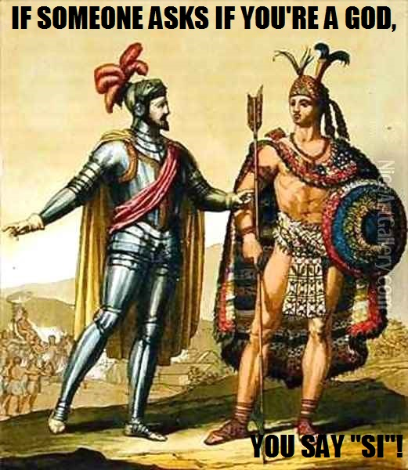
Conquest of Mexico and Peru
Spanish conquerors (conquistadores) explore other territories
Hernán Cortés and 450 men bring down Aztec empire in Mexico (1519-1521)
  Smallpox destroys besieged Tenochtitlan
Francisco Pizarro and 600 men bring down Inca empire in Peru (1532-1533)
  Calls conference of warring Inca rulers, massacres them all

Slide 6
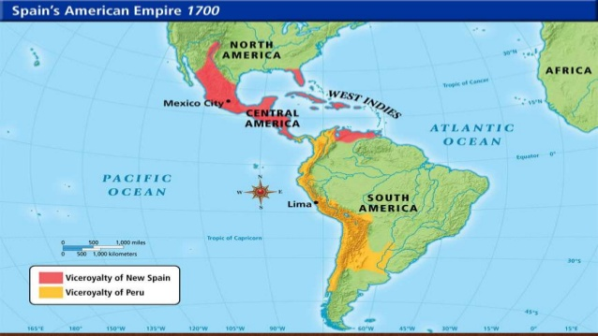
Spanish Colonial Administration
Spanish administration based in New Spain (Mexico) and New Castile (Peru), extended to Florida and Buenos Aires
  Mexico city built atop Tenochtitlan, founded Lima in Peru
  Viceroys rule, but supervised by local courts called audiencias designed to prevent buildup of local power bases
  Considerable dispute with Spanish homeland

Slide 7
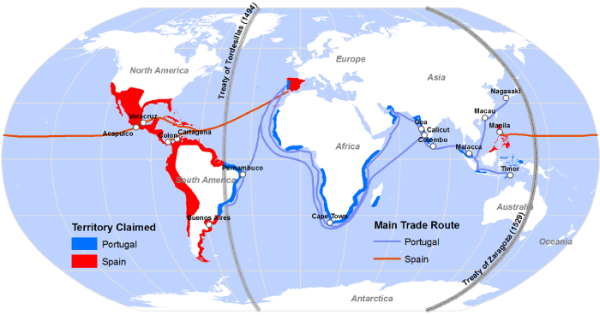
Portuguese Brazil
1494 Treaty of Tordesillas divides entire (non-Christian) world between Spain and Portugal
Portugal claims Brazil - exploited for sugarcane production

Slide 8
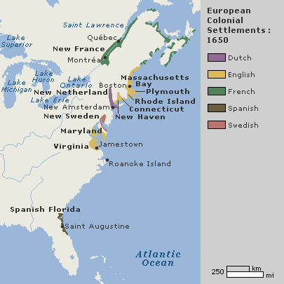
Settler Colonies in North America
Spanish towns, forts, missions on E. coast of North America; a few on W. coast
  Dislodged in 17th century by French, English, Dutch mariners
Permanent colonies in North America
  France: Nova Scotia (1604), Quebec (1608)
  England: Jamestown (1607), Massachusetts Bay Colony (1630)
  Netherlands: New Amsterdam (1623)
    English take it in 1664, rename it New York

Slide 9
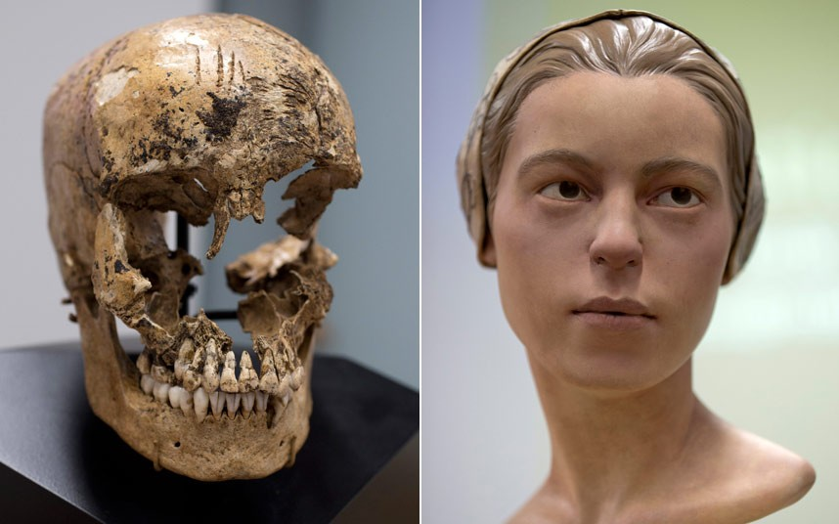
Colonial Government
Exceptionally difficult conditions
  Starvation rampant, cannibalism occasionally practiced (Jamestown)
French, English private merchants invest heavily in expansion of colonies
Greater levels of self-government than Spanish and Portuguese colonies

Slide 10
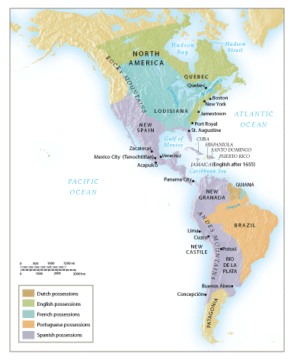
European Empires and colonies in the Americas about 1700

Slide 11
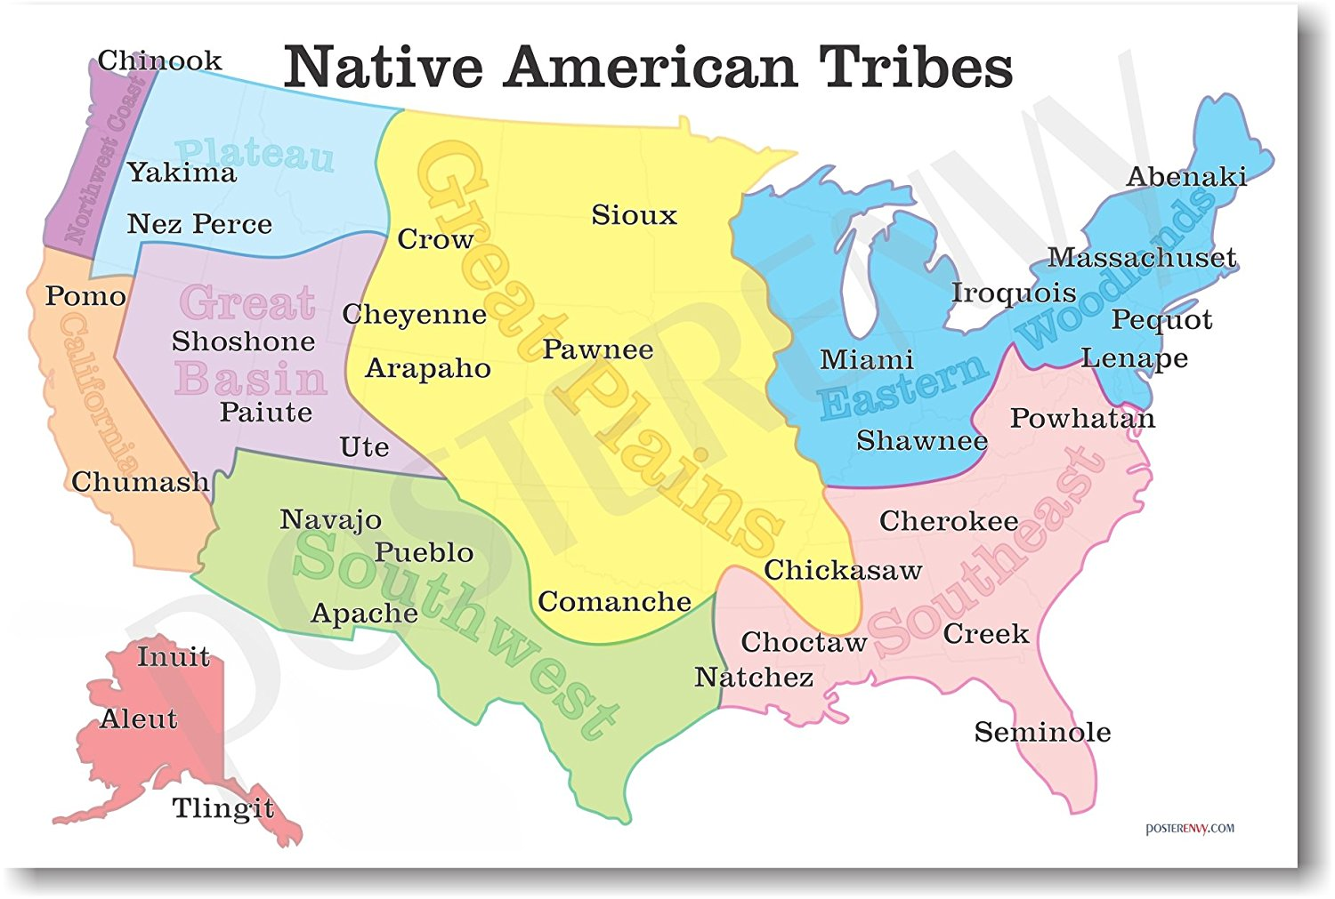
Conflict with Indigenous Peoples
North American peoples loosely organized, migratory
  Unlike Aztec, Inca empires
European colonists stake out forested land, clear it for agriculture
  Colonists displace indigenous peoples, trespass on hunting grounds
  English settlers negotiate treaties, poorly understood by natives
Military conflicts frequent
  Natives also devastated by epidemic disease
Increasing number of Europeans arrive seeking ample land

Slide 12
North American Populations

Slide 13
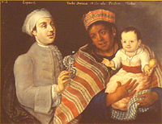
Multicultural Societies In Spanish colonies
European, African migrants primarily men
Relationships with native women formed
Mestizo (mixed) societies formed
  People of Spanish and native parentage
  Descendants of Spaniards and African slaves (“mulattoes”)
  Descendants of African slaves and natives (“zambos”)
Less pronounced in Peru

Slide 14
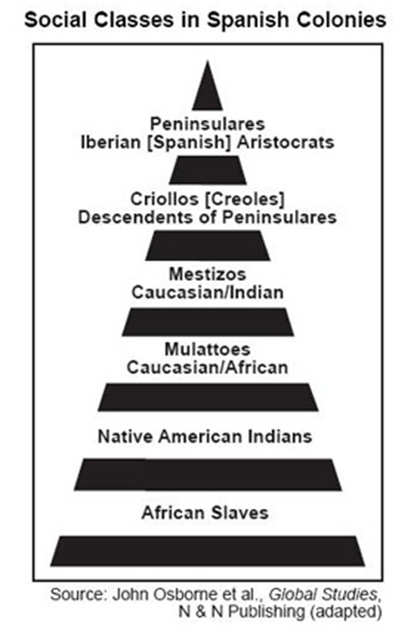
The Social Hierarchy
Race-based hierarchy
Top: peninsulares, i.e. migrants from Iberian peninsula
Criollos (creoles), i.e. children of migrants, born in colonies
Mestizos, mulattoes, zambos, other combinations of parentage
Bottom: slaves, conquered peoples

Slide 15
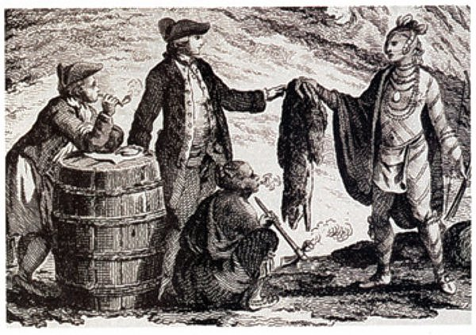
North American Societies
Higher ratio of French, English female migrants than in South America
Higher social stigma attached to relationships with natives, African slaves
Fur traders have relationships with North American native women
  Children: métis

Slide 16
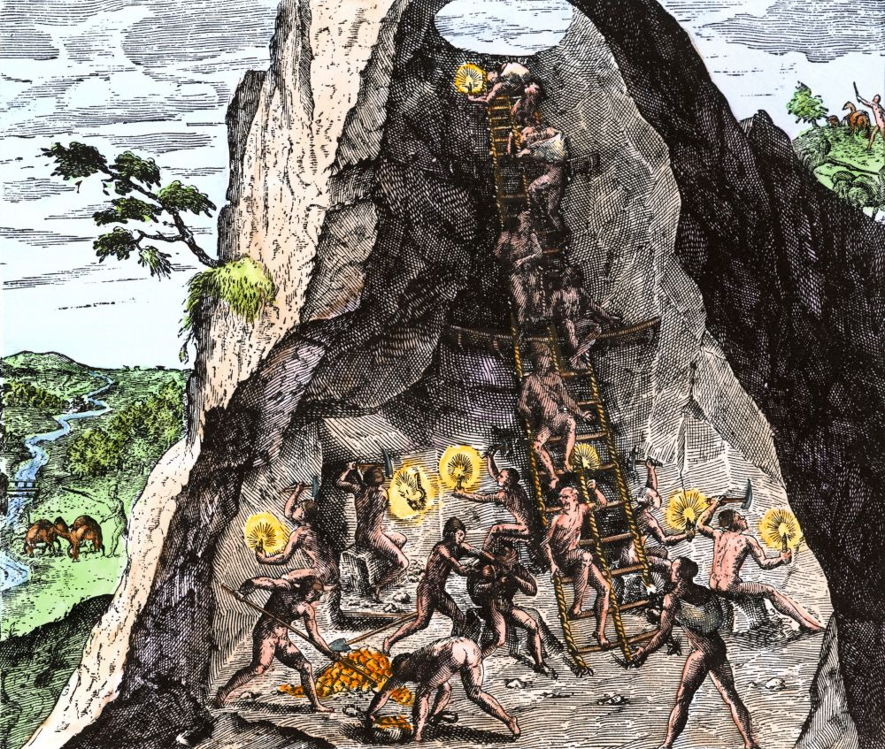
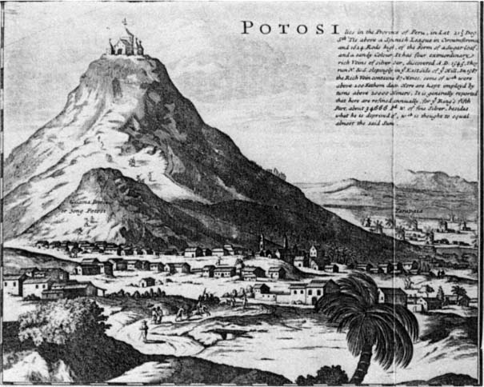
Mining in the Spanish Empire
Hunt for gold and silver
  Conquistadores loot Aztec, Inca treasures and melt them down
  Gold not extensive in Spanish holdings, but silver relatively plentiful
  Extensive employment of natives
    Incan mita system of conscripted labor
    Dangerous working conditions
  Eventually assimilate into Spanish culture
1/5 reserved for crown (quinta), hugely profitable

Slide 17
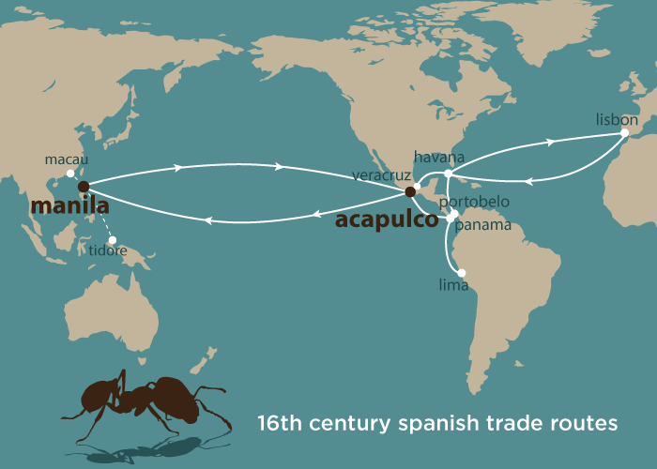
Global Significance of Silver
Major resource of income for Spanish crown
Manila Galleons take it to the Pacific rim for trading
Very popular with Chinese markets
  Also trade in the Atlantic basin

Slide 18
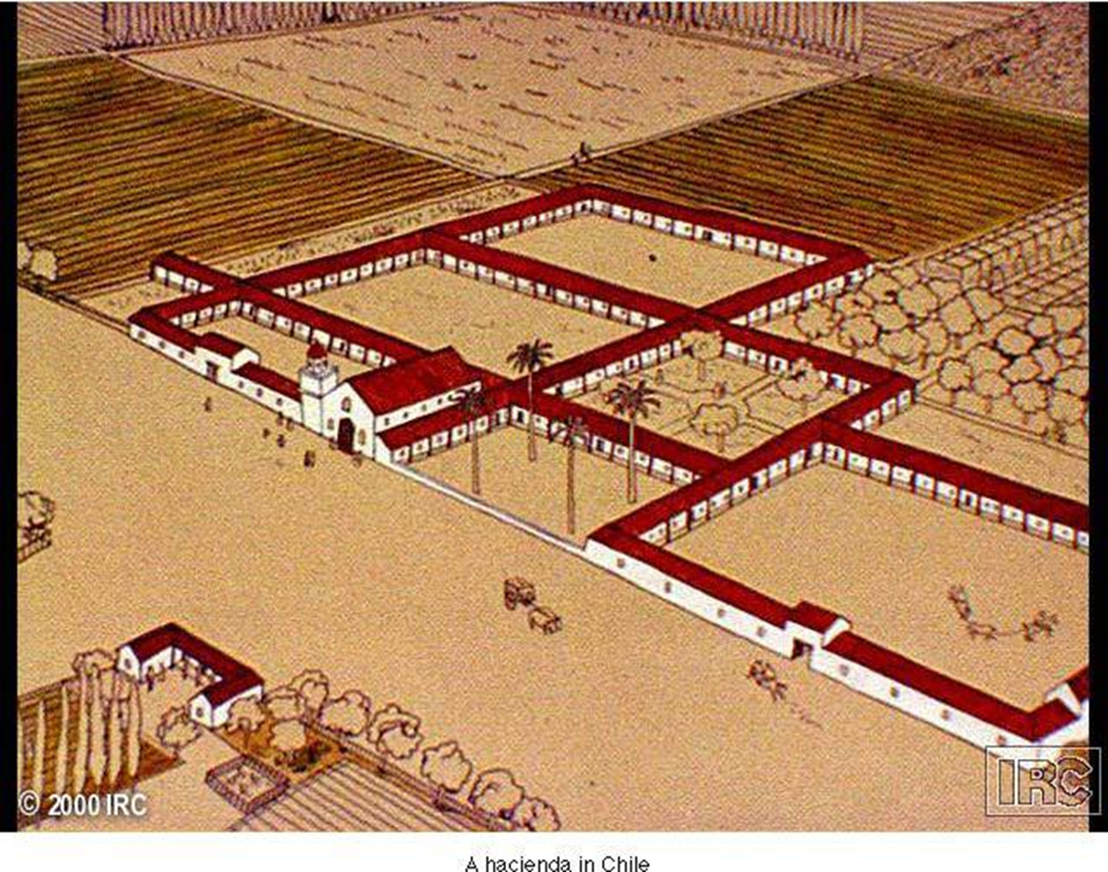
The Hacienda
Large estates produce products of European origin
  Wheat, grapes, meat
Encomienda system of utilizing native labor force
Rampant abuses 1520-1540
Gradually replaced by debt patronage
  Peasants repay loans with cheap labor

Slide 19
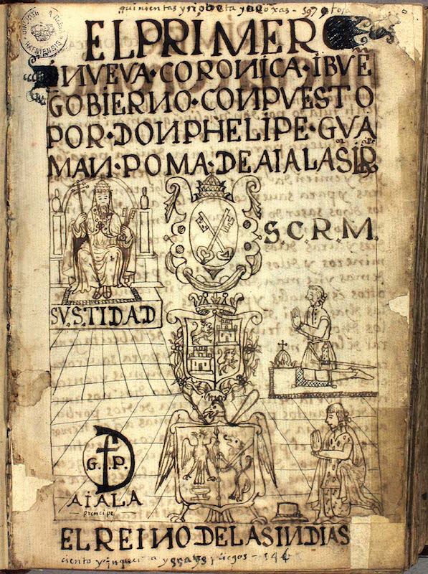
Resistance to Spanish Rule
Rebellion
  1680 Pueblo Revolt
  1780 Túpac Amaru rebellion
Half-hearted work
Retreat into mountains and forests
Appeal to Spanish crown
  1,200 page letter of Guaman Poma de Ayala, 1615

Slide 20
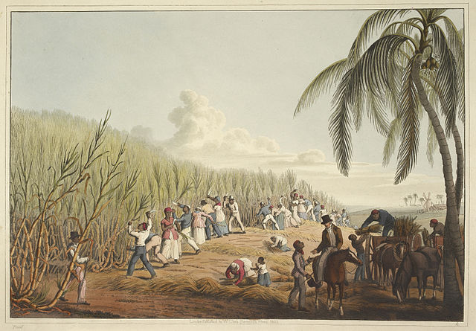
Sugar and Slavery in Portuguese Brazil
Unlike Spanish system of forced native labor, Portuguese rely on imported African slaves
  Natives continually evaded Portuguese forces
Large-scale importing of slaves begins 1580s
  Working conditions poor: 5-10% die annually
  Approximately one human life per ton of sugar

Slide 21
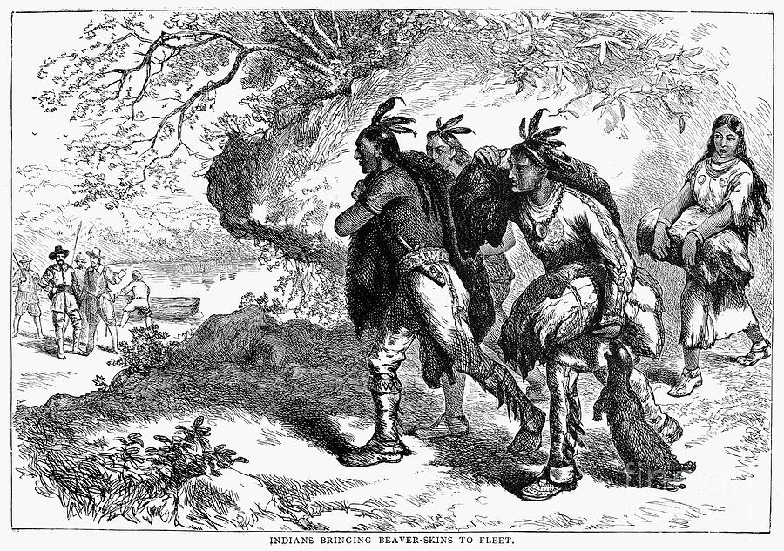
Fur Trading in North America
Indigenous peoples trade pelts for wool blankets, iron pots, firearms, alcohol
Beaver hunts cause frequent incursions into neighboring territories, conflicts
European settler-cultivators also displacing natives from traditional lands
  Albeit initially dependent on native assistance, as European grains did not grow well in many areas

Slide 22
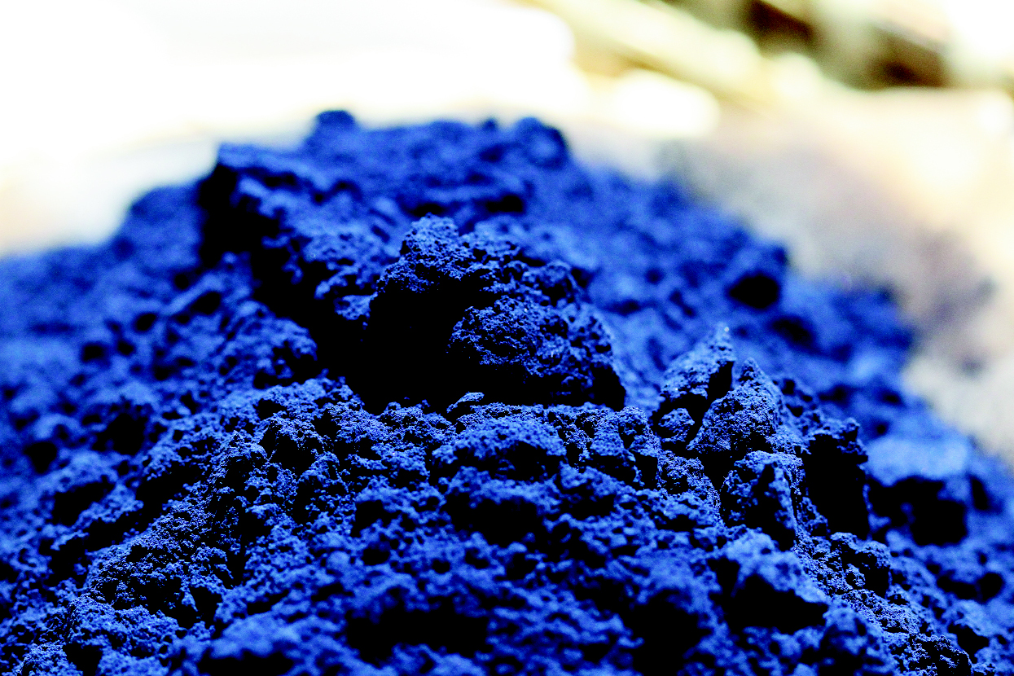

Development of Cash Crops
Products developed for European markets
  Tobacco
  Rice
  Indigo
  Cotton
Increases demand for imported slave labor
  European indentured servants, 4-7 year terms
    Chronically unemployed, orphans, political prisoners and criminals

Slide 23
Export of Tobacco from Virginia

Slide 24
Slavery in North America
African slaves in Virginia from 1610
Increasingly replace European indentured laborers, late 17th-early 18th centuries
Less prominent in north/northeast due to weak nature of cash-crop industry
  Slave trading still important part of economy
  Also, products made through slave labor
    Rum, based on sugar from plantations

Slide 25
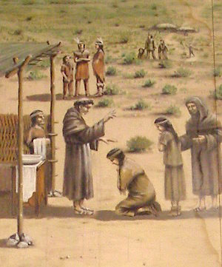
Missionary Activity in the Americas
Franciscan, Dominican, Jesuit missionaries from 16th century
Taught Christian doctrine, literacy
Often accumulated cultural knowledge to better communicate their message
  Bernardino de Sahagún
Due to conquest and plague, many natives in Spanish America concluded that their gods had abandoned them, converted to Catholicism
  Yet often retained elements of pagan religion in Christian worship

Slide 26
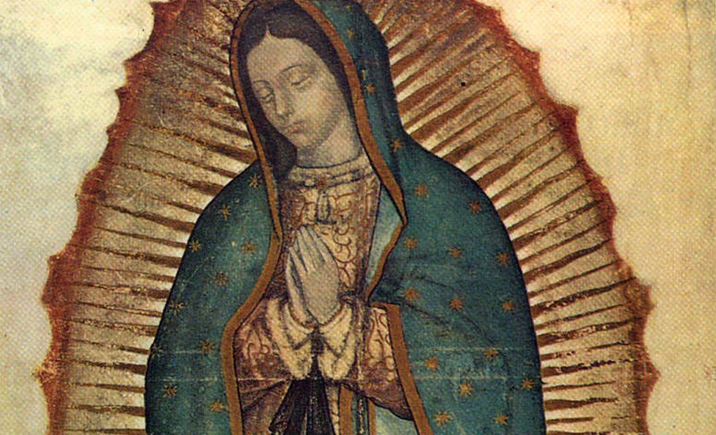
The Virgin of Guadalupe

Slide 27
French and English Missions VS. Spanish
Less effective than Spanish missions
  Spaniards ruled native populations more directly
  Migration patterns of North American natives made it more difficult to conduct missions
  English colonists little interest in converting natives

Slide 28
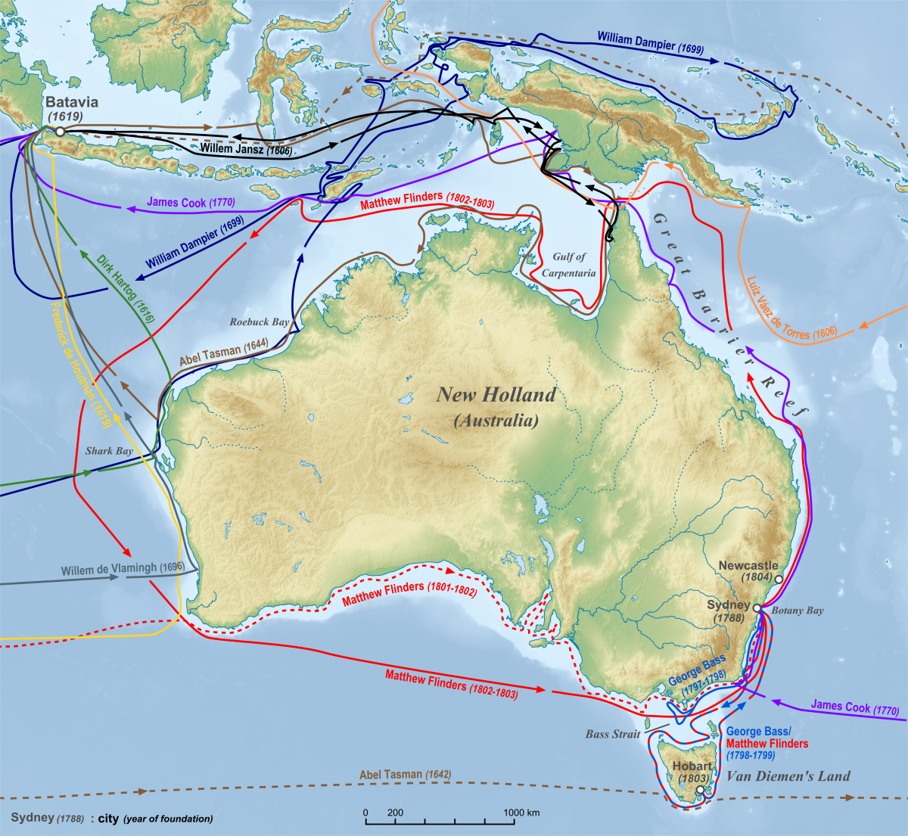
Australia
Broadly similar experiences to American natives
Portuguese mariners long in the region, but Dutch sailors make first recorded sighting of Australia in 1606
VOC surveys territory, conclude it is of little value
  Limited contact with indigenous peoples
  Nomadic, fishing and foraging societies
British Captain James Cook lands at Botany Bay, 1770
  Convicts shipped to Australia, outnumber free settlers until 1830

Slide 29
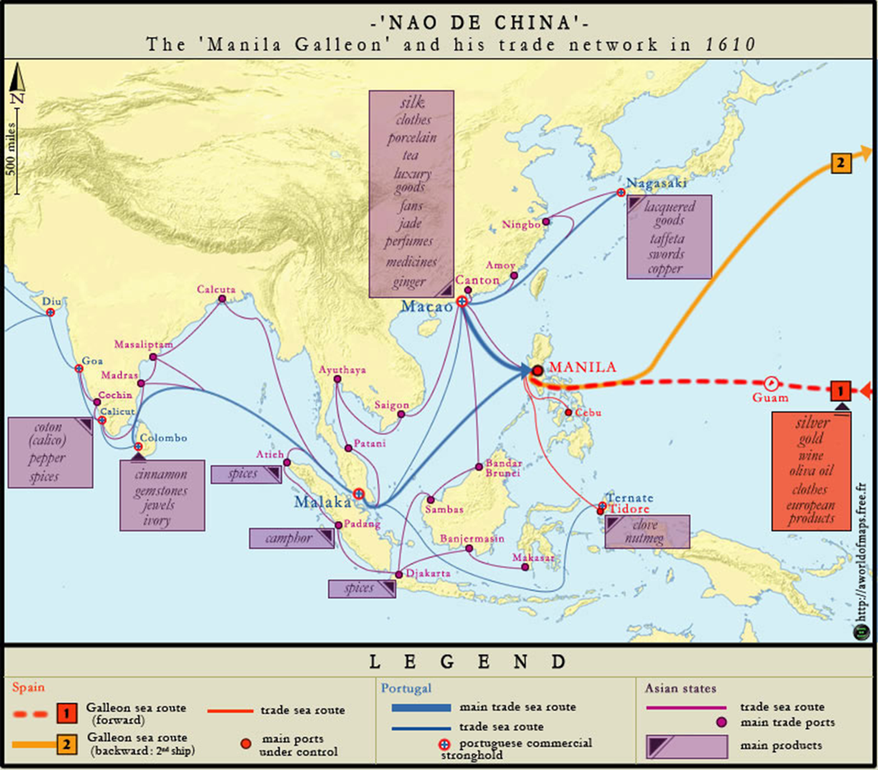
Pacific Islands and the Larger World
Manila Galleons interested in quick trade routes, little exploration of Pacific
  Islands of Guam and the Marianas significant, lay on trade routes
  1670s-1680s took control of islands, smallpox destroys local population
James Cook visits Hawai’i in 1778
  Good relationship with Hawaiians
  Sailors spread venereal disease
  Cook not welcomed in 1779, killed in dispute over petty thefts

